Slide 1
Object Proposal Estimation in Depth Images using Compact 3D Shape Manifolds
Shuai Zheng, Victor Prisacariu, Melinos Averkiou, Ming-Ming Cheng, Niloy Mitra, Jamie Shotton, Philip Torr, Carsten Rother

Slide 2
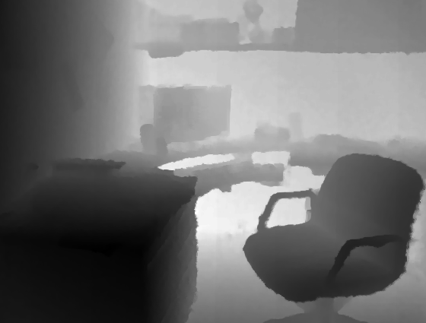
Goal
Depth image
100 proposal windows for chairs (few shown)
Four Classes: Chair, Sofa, Toilet, Monitor

Slide 3
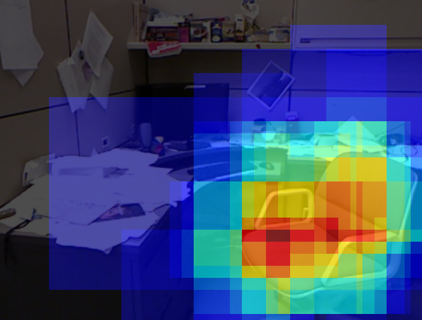
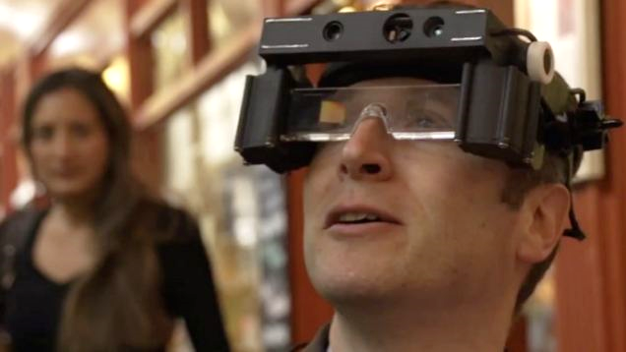
Motivation
Heat map
Dr. Hicks, Oxford University (Aid for partially sighted)
100 Chair Proposals (few shown)
Chair detection

Slide 4
Challenges
Chairs (Sofas, etc.) have very different shape and appearance
Collecting and annotating enough real data is expensive

Slide 5
Related Work
Proposal Generation
Not class-specific e.g. Objectness [Alexe, Deselaers, Ferrari PAMI 12], Selective Search [Uijlings, van de Sande, Gevers, Smeulders IJCV 13],
Class specific e.g. Cascade SVM [Zhang, Warell, Torr CVPR 13], [Cheng, Zhang, Lin, Torr, CVPR 14]
Utilizing 3D Database for Training
Seeing 3D chairs [Aubry, Maturana, Efros, Russel, Sivic, CVPR 14]
Sliding Shapes [Song, Xiao, ECCV 2014]
Google 3D Warehouse

Slide 6
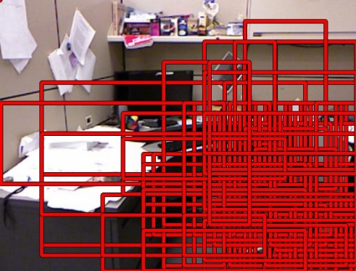
Our approach
Positive examples (> 50% IoU)
Negative examples (< 50% IoU)
BING (0,0009sec)
CNN (0.88sec)
1000 proposals (few shown)
100 proposals (few shown)
Contribution 1: This two-stage pipeline
Contribution 2: Training Data generation

Slide 7
Our approach
Positive examples (> 50% IoU)
Negative examples (< 50% IoU)
BING (0,0009sec)
CNN (0.88sec)
1000 proposals (few shown)
100 proposals (few shown)
Contribution 1: This two-stage pipeline
Contribution 2: Training Data generation

Slide 8
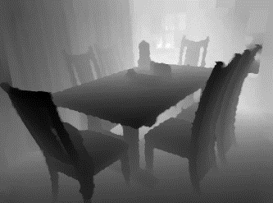
First Stage: BING [Cheng, Zhang, Lin, Torr, CVPR 14]
Binarized Normalized Gradients for Objectness Estimation at 300fps:
Extract $\sim 7M$rectangles from $0.3M$ Pixel Image (quantized position$×$scale$×$aspect ratio)
Resize to $8×8$ pixel and compute normalized gradient
Classify with 2-Stage Linear SVM
Test-time: 1000 proposals using SVM score
Normalized Gradient ($8×8$ window)
Chair SVM weights

Slide 9
Second Stage: CNN
{dog, frog,ship, bird,truck,…}
CNN (Network in Network) [Lin, Chen, Yan ICLR 2013]
{chair, no chair}
Re-train for Chair Proposals
Linear SVM
{chair, no chair}
Train new Linear SVM
Test Time: Use SVM score to take best 100 out of 1000 proposals

Slide 10
Our approach
Positive examples (> 50% IoU)
Negative examples (< 50% IoU)
BING (0,0009sec)
CNN (0.88sec)
1000 proposals (few shown)
100 proposals (few shown)
Contribution 1: This two-stage pipeline
Contribution 2: Training Data generation

Slide 11
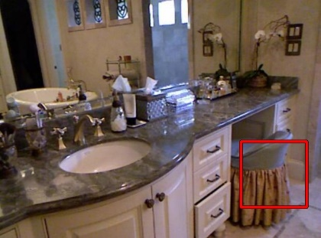
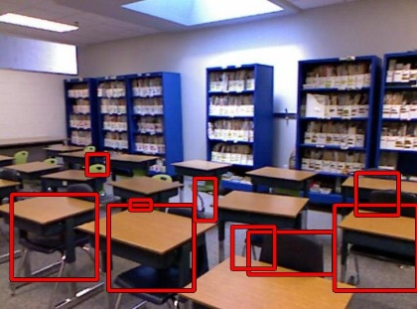
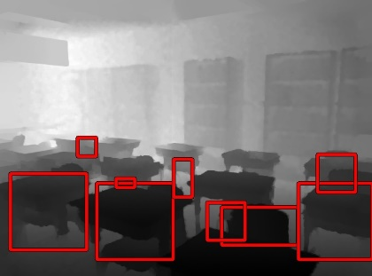
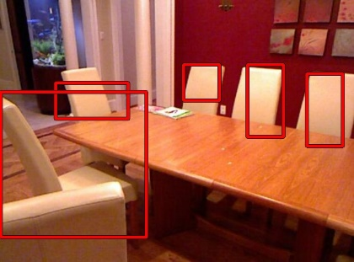
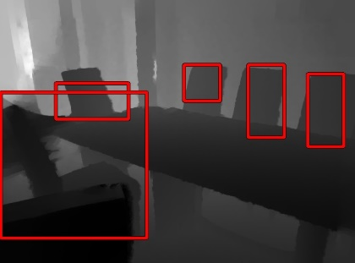
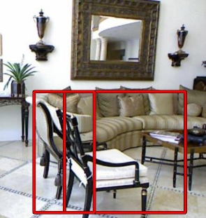
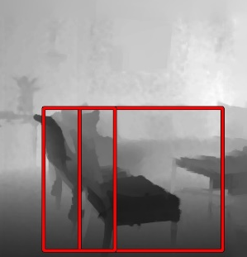
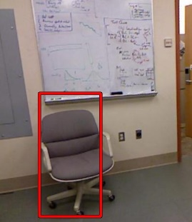
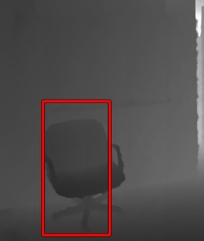
Real Training Data
Dataset | Detection Rate (1000 proposals)
NYU | 85.6 %
Bathroom
Detection Rate (Recall): How many true rectangles are covered by a proposal? (Inlier: IoU > 50%)
Classroom
Dining room
Livingroom
Office
495 NYU V2 Training Images (404 NYU V2 Test images)

Slide 12
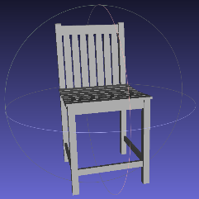
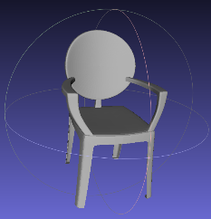
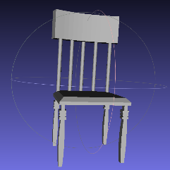
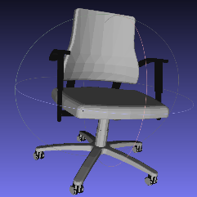
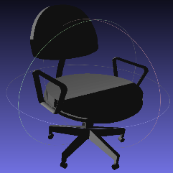
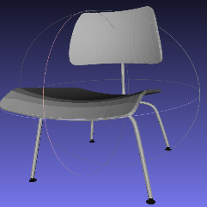
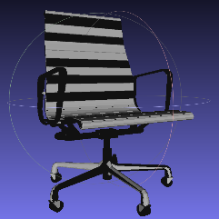
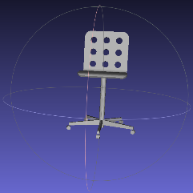
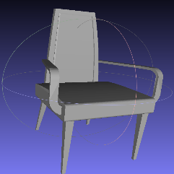
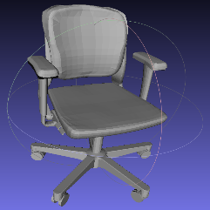
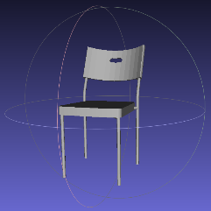
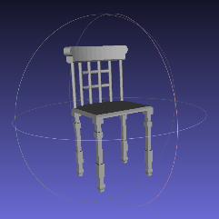
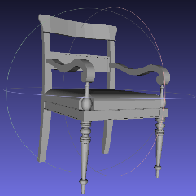
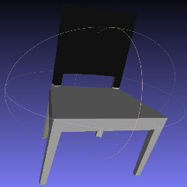
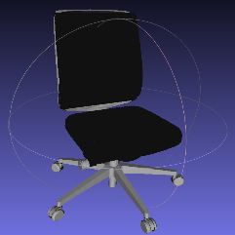
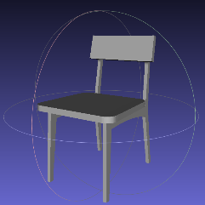
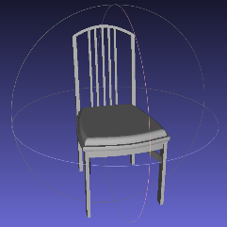
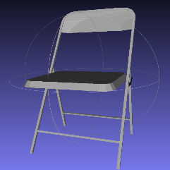
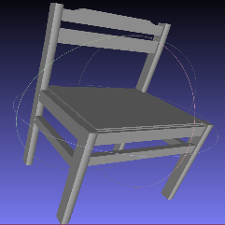
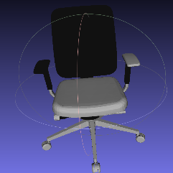
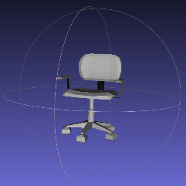
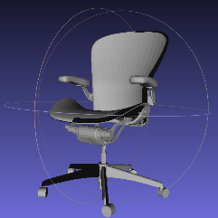
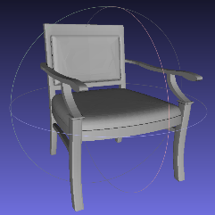
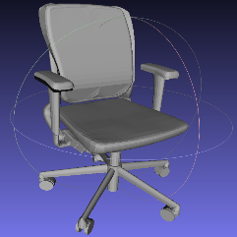
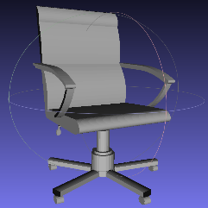
Google 3D Warehouse
Dataset | Detection Rate (1000 proposals)
NYU | 85.6 %
Warehouse | Low number
NYU+Warehouse | 87.8 %
Detection Rate (Recall): How many true rectangles are covered by a proposal? (Inlier: IoU > 50%)
Conclusions:
Data distribution of NYU and Warehouse do not coincide
Can we massage the Warehouse data to make it work better?
37,400 Synthetic Images (374 Warehouse Chairs)

Slide 13
Idea 1: Shapesynth [Averkiou, Kim, Zheng, Mitra, Computer Graphics Forum 2014]
Dataset | Detection Rate (1000 proposals)
NYU | 85.6 %
Warehouse | Low number
NYU+Warehouse | 87.8 %
NYU+ShapeSynth | 88.5 %
Detection Rate (Recall): How many true rectangles are covered by a proposal? (Inlier: IoU > 50%)
Filter
manual
2D Embedding (MDS)
~150 synthetic chairs
(37,400 images)
374 Warehouse Chairs
3D Bbox Templates

Slide 14
Idea 2: Gaussian Process Latent Variable Model [Lawrence JLMR 2005]
Dataset | Detection Rate (1000 proposals)
NYU | 85.6 %
Warehouse | Low number
NYU+Warehouse | 87.8 %
NYU+ShapeSynth | 88.5 %
NYU+GPLVM | 89.7 %
Detection Rate (Recall): How many true rectangles are covered by a proposal? (Inlier: IoU > 50%)
374 Warehouse Chairs
~150 Synthetic chairs (37,400 images)
Low Dimensional Latent Space

Slide 15
How does it work?
IDCT
ICP
DCT
Aligned Chairs
${256}^{3} Volume$ (Signed Distance Function for each chair)
$$64,000D$$ vector
$N = 374$Warehouse Chairs
$$x_{i}$$
$$M=64,000D$$
$$L=5D$$
$$1$$
$$2$$
$$N$$
GPLVM Embedding
$$X$$
Latent Space
2D Projection of 5D $X$
For $x_{i}^{∗} derive y_{i}^{∗}, σ_{i}^{2}$
Sample low variance shapes
$$1$$
$$2$$
$$Y$$
$$N$$
$$M$$
$$y_{n}=Wx_{n}+μ_{n}$$
$$P\left(Y | X\right)=\prod_{m=1}{ (y_{(m)}^{T}|0,K\left(X\right))}$$

Slide 16
GPLVM – Fine Tuning
GPLVM Dimensions $L$ | Detection Rate (1000 proposals)
3 | 88.0 %
4 | 89.6 %
5 | 89.7 %
6 | 89.3 %
7 | 89.2 %
Number sampled 3D Models | Detection Rate (1000 proposals)
100 | 87.8 %
150 | 89.7 %
200 | 89.2 %
374 | 88.4 %
GPLVM Dimension $L=5$
150 3D Models

Slide 17
GPLVM Manifolds: Chairs
New Chairs (low variance)
New Chairs (high variance)
Reconstruct Training Shapes
Warehouse
GPLVM

Slide 18
GPLVM Manifolds: Toilets
New Toilets (low variance)
New Toilets (high variance)
Reconstruct Training Shapes
Warehouse
GPLVM

Slide 19
Comparison
Method | Detection Rate (1000 proposals) | seconds
Ours | 89.7 % | 0.0009
Selective Search (no training) [Uijlings, van de Sande, Gevers, Smeulders IJCV 2013] | 85.9 % | 2.6
Cascade SVM (trained on NYU) [Zhang, Warell, Torr IJCV 2013] | 84.5 % | 1.2
Objectness (trained on NYU RGB) [Alexe, Deselaers, Ferrari PAMI 2012] | 83.0 % | 2.1
Random | 42.0 % | N/A
Notes:
Objectness use RGB

Slide 20
Our approach
BING (0,0009sec)
CNN (0.88sec)
1000 proposals (few shown)
100 proposals (few shown)

Slide 21
Comparison – Full Pipeline
82.9%
Ours
26.6 % Improvement
Ours w/o CNN
59.2 %
56.3 %
Detection Rate
Selective Search [Uijlings et al. IJCV 2013]
Number of Proposals

Slide 22
Results: Chair

Slide 23
Results: Toilet

Slide 24
Result: Sofa

Slide 25
Result Monitor

Slide 26
Take-Home Messages
Our 2-Stage pipeline (BING, CNN) gives state-of-the-art results for object proposal generation
GPLVM is useful for training with 3D shape collections

Slide 27
Advertisement
Learning Analysis-by-Synthesis (Nectar Track Thursday 15-17)
Join our 6D Object Pose Estimation Challenge at ICCV 2015
[Krull et al. ICCV 2015]
CNN
Energy

