Slide 1
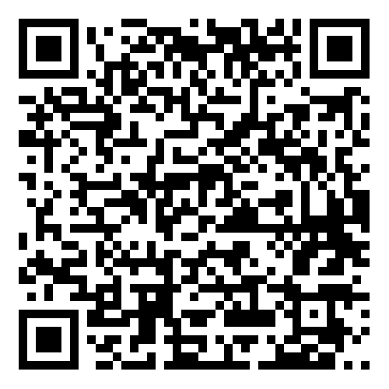





Diffusion Models for
Visual Computing
Niloy J. Mitra, Or Patashnik, Daniel Cohen-Or,
Paul Guerrero, Juil Koo, Minhyuk Sung
Part 2: Guidance and Controlled Generation
https://geometry.cs.ucl.ac.uk/courses/diffusion_ImageVideo_sigg25/
Notes:
Welcome to the second part

Slide 2
Presentation Schedule
Introduction to Diffusion Models
Guidance and Controlled Generation
Attention and Personalization
Break (15 min)
Advanced Techniques
Video Diffusion Models
Advanced Generative Models

Slide 3
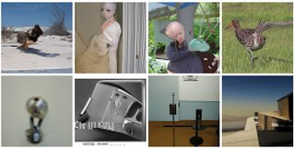
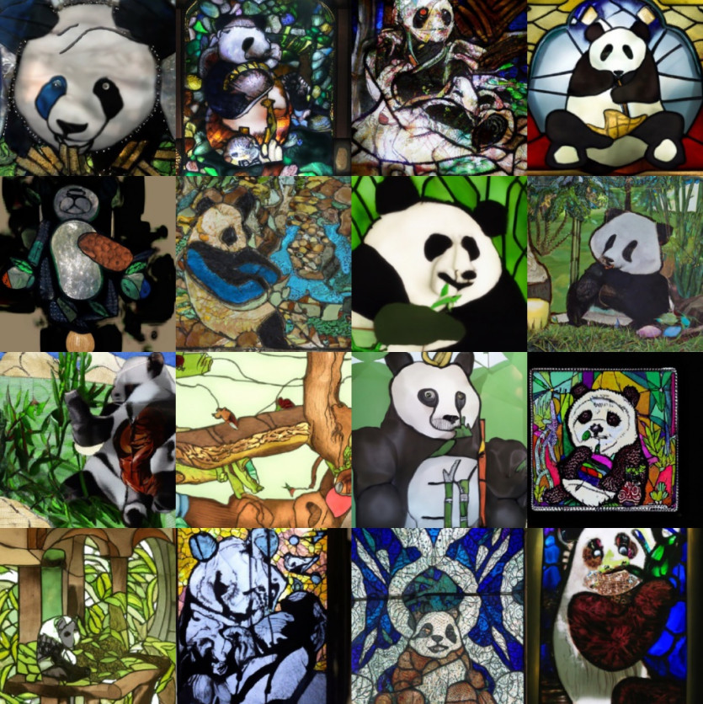


Guided and Controllable Generation: Text Conditioning
Unconditional Denoiser
$$ε_{θ}(x_{T}, T)$$
Text-conditioned Denoiser
$$ε_{θ}(x_{T}, T, c)$$
$c$ = “A stained glass window of a panda eating bamboo.”
Images from: Variational Diffusion Models, Kingma et al., NeurIPS 2021
Images from: GLIDE: Towards Photorealistic Image Generation and Editing with Text-Guided Diffusion Models, Nichol et al., ICML 2022

Slide 4
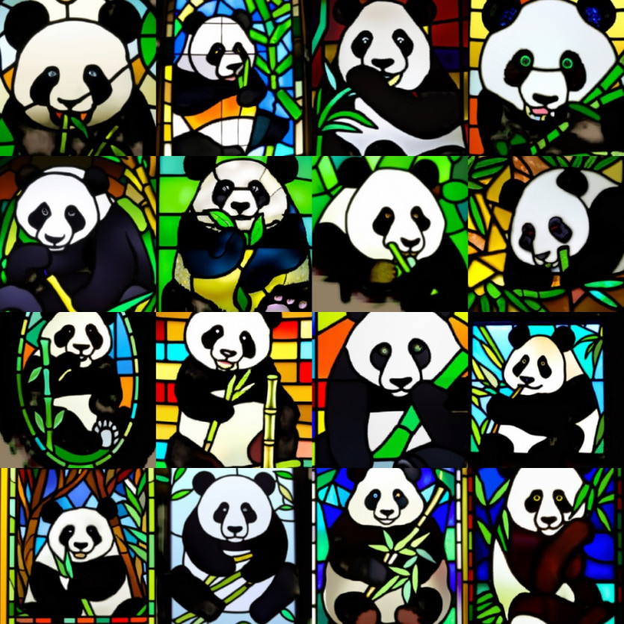
Guided and Controllable Generation
“A stained glass window of a panda eating bamboo.”
“A stained glass window of a panda eating bamboo.”
More Text
Adherence
Images from: GLIDE: Towards Photorealistic Image Generation and Editing with Text-Guided Diffusion Models, Nichol et al., ICML 2022
Notes:
So far, we have seen the basic ideas behind a diffusion model, how the basic architecture works, and how it is trained and evaluated.
The type of control we have over the generated output is a text prompt. A text prompt can be quite general, but it only determines the generated output very loosely.
More control over the output enables many useful types of applications.
You have probably seen many very nice applications online or here at Siggraph that require more control over the output.
For example, a simple type of additional control is increasing or decreasing the amount of text adherence

Slide 5
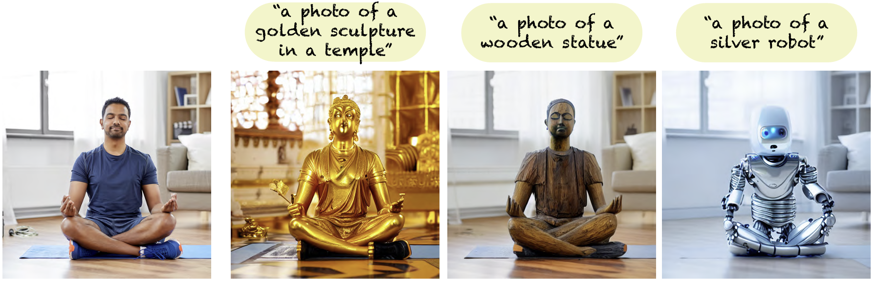
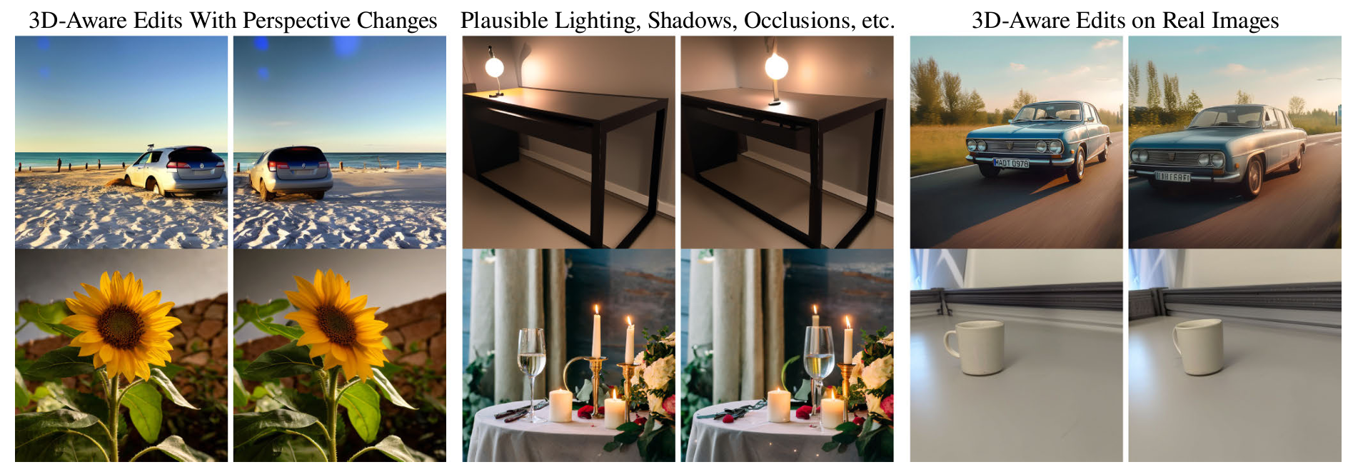
Guided and Controllable Generation
Stylization /
I2I Translation
Generative
Move
Plug-and-Play Diffusion Features for Text-Driven Image-to-Image Translation, Tumanyan et al., CVPR 2023
Diffusion Handles: Enabling 3D Edits for Diffusion Models by Lifting Activations to 3D, Pandey et al., CVPR 2024
Notes:
Generating an image with a given style, or even stylizing a given photograph
Moving objects around in images

Slide 6
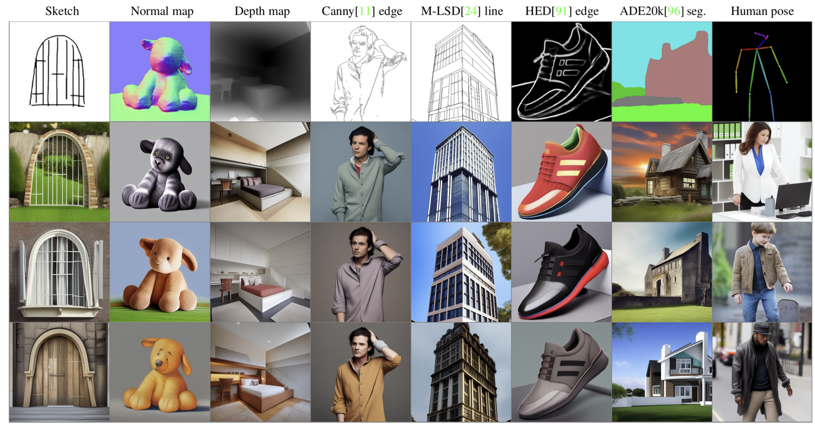
Guided and Controllable Generation
Varied Control Signals
Adding Conditional Control to Text-to-Image Diffusion Models, Zhang et al., ICCV 2023
Notes:
Making the generation process follow various types of control signals, such as normals, sketches, skeletons, etc.

Slide 7
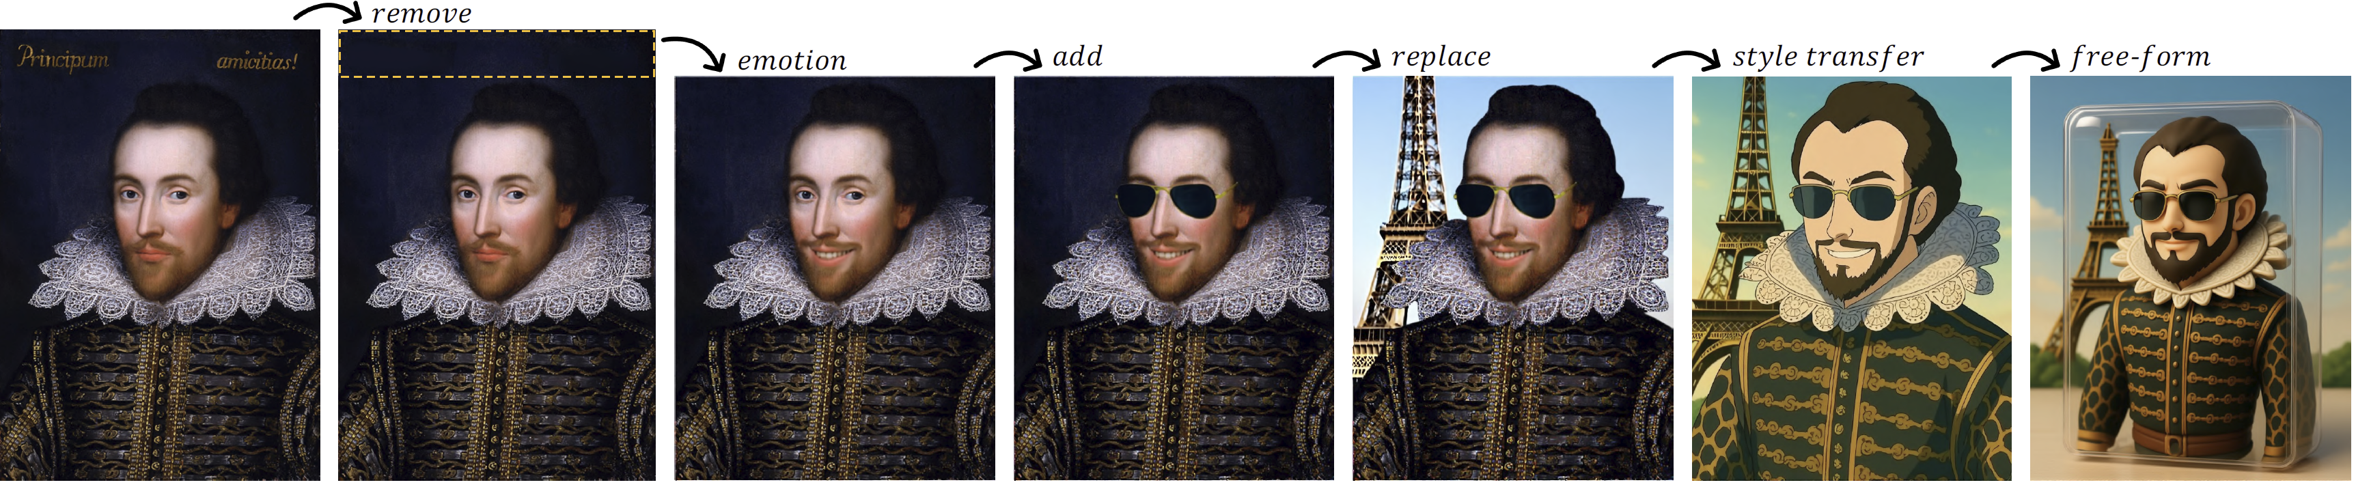
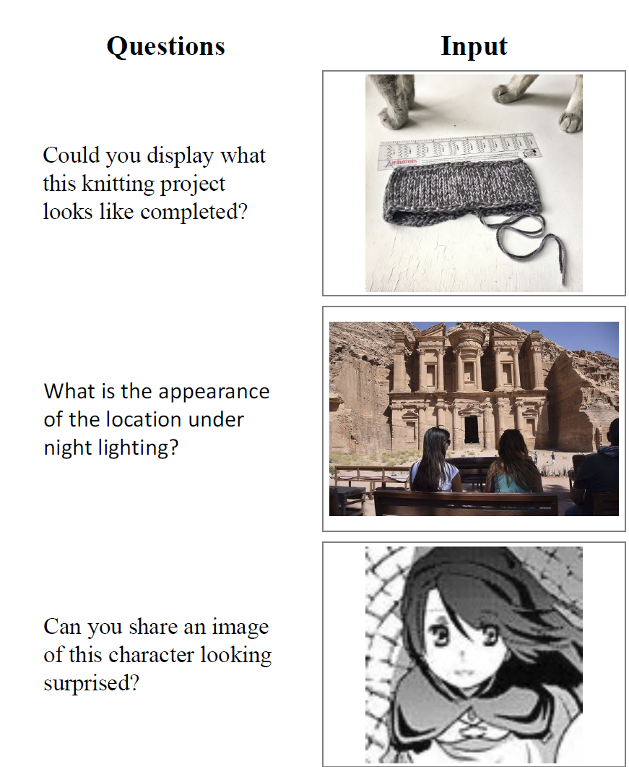
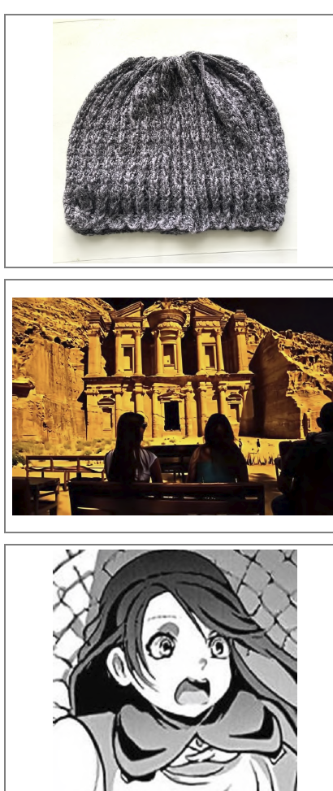
Guided and Controllable Generation
Multi-round
Complex
Instructions
Emerging Properties in Unified Multimodal Pretraining (aka. Bagel), Deng et al., ArXiv May 2025
Notes:
Or even multi-round editing sessions
That may have complex instructions requiring good prior knowledge

Slide 8
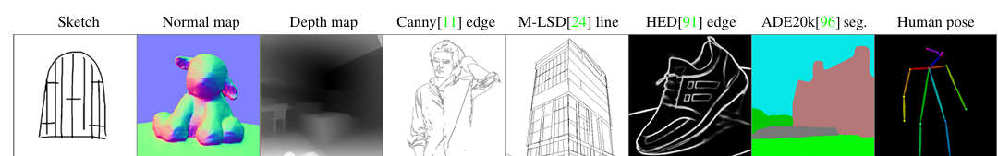
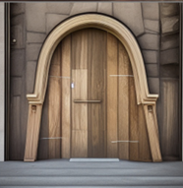
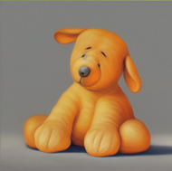
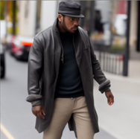
Guided and Controllable Generation: Overview
Training-free
methods
Training-based
methods
Integrating Diffusion
into MLLMs
GLIDE: Towards Photorealistic Image Generation and Editing with Text-Guided Diffusion Models, Nichol et al., ICML 2022
Adding Conditional Control to Text-to-Image Diffusion Models, Zhang et al., ICCV 2023
Emerging Properties in Unified Multimodal Pretraining (aka Bagel), Deng et al., ArXiv May 2025
Diffusion Handles: Enabling 3D Edits for Diffusion Models by Lifting Activations to 3D, Pandey et al., CVPR 2024
Notes:
In this part of the course, I will present different techniques to guide a diffusion model and achieve more control over its output, in order to enable some of these applications.

Slide 9

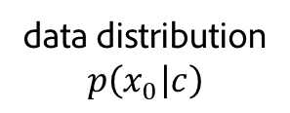

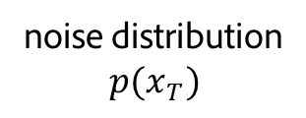



Trajectory Guidance
$c =$“A stained glass window of a panda eating bamboo.”
$$x_{T}$$
$$x_{T−1}$$
$$ε_{θ}(x_{T}, T, c)$$
$$x_{0}^{′}$$
noise distribution
$$p(x_{T})$$
data distribution
$$p\left(x_{0} | c\right)$$
Panda Images from: GLIDE: Towards Photorealistic Image Generation and Editing with Text-Guided Diffusion Models, Nichol et al., ICML 2022
Notes:
This diagram is a bit of a simplification, since the interpolation between x_T and x_0 to get x_T-1 shown here does not need to be linear.
Also DDIM, for DDPM we would additionally add some random perturbation to each sampled x_t

Slide 10


Trajectory Guidance
$c =$“A stained glass window of a panda eating bamboo.”
$$x_{T}$$
$$x_{T−1}$$
$$σ_{t}N(0,1)$$
$$ε_{θ}(x_{T}, T, c)$$
$$x_{0}^{′}$$
noise distribution
$$p(x_{T})$$
data distribution
$$p\left(x_{0} | c\right)$$
Panda Images from: GLIDE: Towards Photorealistic Image Generation and Editing with Text-Guided Diffusion Models, Nichol et al., ICML 2022
Notes:
For DDPM we would additionally add some random perturbation to each sampled x_t
But lets focus on DDIM here for simplicity. The same guidance techniques I will discuss here can be used for DDPM as well.

Slide 11
Trajectory Guidance
$c =$“A stained glass window of a panda eating bamboo.”
$$x_{T}$$
$$x_{T−1}$$
$$ε_{θ}(x_{T}, T, c)$$
$$x_{0}^{′}$$
noise distribution
$$p(x_{T})$$
data distribution
$$p\left(x_{0} | c\right)$$
Panda Images from: GLIDE: Towards Photorealistic Image Generation and Editing with Text-Guided Diffusion Models, Nichol et al., ICML 2022
Notes:
This diagram is a bit of a simplification, since the interpolation between x_T and x_0 to get x_T-1 shown here does not need to be linear.
Also DDIM, for DDPM we would additionally add some random perturbation to each sampled x_t

Slide 12



Trajectory Guidance
$c =$“A stained glass window of a panda eating bamboo.”
$$x_{T}$$
$$x_{T−1}$$
$$x_{T−2}$$
$$ε_{θ}(x_{T−1}, T−1,c)$$
$$x_{0}^{′}$$
noise distribution
$$p(x_{T})$$
data distribution
$$p\left(x_{0} | c\right)$$
Panda Images from: GLIDE: Towards Photorealistic Image Generation and Editing with Text-Guided Diffusion Models, Nichol et al., ICML 2022

Slide 13

Trajectory Guidance
$c =$“A stained glass window of a panda eating bamboo.”
$$x_{0}$$
$$x_{T}$$
$$x_{T−1}$$
$$x_{T−2}$$
noise distribution
$$p(x_{T})$$
data distribution
$$p\left(x_{0} | c\right)$$
Panda Images from: GLIDE: Towards Photorealistic Image Generation and Editing with Text-Guided Diffusion Models, Nichol et al., ICML 2022

Slide 14
Trajectory Guidance
$c =$“A stained glass window of a panda eating bamboo.”
noise distribution
$$p(x_{T})$$
data distribution
$$p\left(x_{0} | c\right)$$
Panda Images from: GLIDE: Towards Photorealistic Image Generation and Editing with Text-Guided Diffusion Models, Nichol et al., ICML 2022

Slide 15


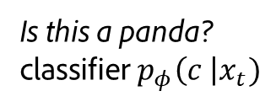
Trajectory Guidance: Classifier Guidance
$c =$“A stained glass window of a panda eating bamboo.”
Is this a panda?
classifier$p_{φ}\left(c \right|x_{t})$
$$x_{0}$$
$$x_{T}$$
$$x_{t}$$
$$s_{t} ∇_{x_{t}}\log{p_{φ}\left(c \right|x_{t}) }$$
noise distribution
$$p(x_{T})$$
data distribution
$$p\left(x_{0} | c\right)$$
Diffusion Models Beat GANs on Image Synthesis, Dhariwal and Nichol, NeurIPS 2021
Panda Images from: GLIDE: Towards Photorealistic Image Generation and Editing with Text-Guided Diffusion Models, Nichol et al., ICML 2022
Notes:
Nudge the trajectory in a direction that improves the classifier’s assessment of the image

Slide 16

Trajectory Guidance: Classifier Guidance
$c =$“A stained glass window of a panda eating bamboo.”
Is this a panda?
classifier$p_{φ}\left(c \right|x_{t})$
$$x_{T}$$
$$x_{t}$$
$$x_{0}$$
Downsides:
Classifier needs to be trained
Limited number of classes
noise distribution
$$p(x_{T})$$
data distribution
$$p\left(x_{0} | c\right)$$
Diffusion Models Beat GANs on Image Synthesis, Dhariwal and Nichol, NeurIPS 2021
Panda Images from: GLIDE: Towards Photorealistic Image Generation and Editing with Text-Guided Diffusion Models, Nichol et al., ICML 2022
Notes:
Nudge the trajectory in a direction that improves the classifier’s assessment of the image

Slide 17
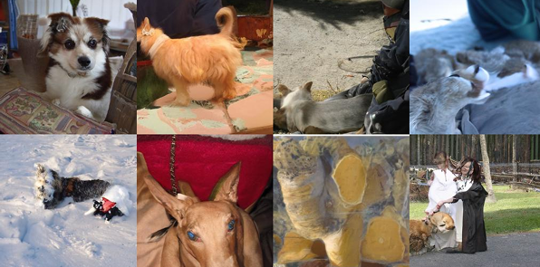
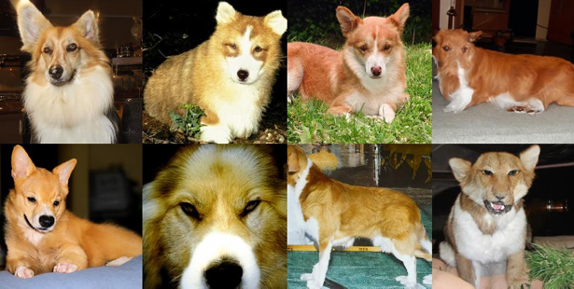
Comparison: Unguided vs. Classifier Guidance
Unconditional Model
Unconditional Model
with Classifier Guidance
(class: “Pembroke Welsh corgi”)
Diffusion Models Beat GANs on Image Synthesis, Dhariwal and Nichol, NeurIPS 2021

Slide 18

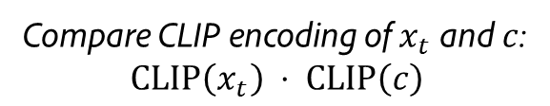
Trajectory Guidance: CLIP Guidance
$c =$“A stained glass window of a panda eating bamboo.”
Compare CLIP encoding of $x_{t}$ and $c$:
$$\text{CLIP}\left(x_{t}\right) ⋅ \text{CLIP}\left(c\right)$$
$$x_{0}$$
$$x_{T}$$
$$x_{t}$$
$$s_{t} ∇_{x_{t}}\left(\text{CLIP}\left(x_{t}\right) ⋅ \text{CLIP}\left(c\right)\right)$$
Downsides:
CLIP needs to be re-trained/fine-tuned
noise distribution
$$p(x_{T})$$
data distribution
$$p\left(x_{0} | c\right)$$
GLIDE: Towards Photorealistic Image Generation and Editing with Text-Guided Diffusion Models, Nichol et al., ICML 2022
Panda Images from: GLIDE: Towards Photorealistic Image Generation and Editing with Text-Guided Diffusion Models, Nichol et al., ICML 2022
Notes:
Nudge the trajectory in a direction that improves the classifier’s assessment of the image

Slide 19
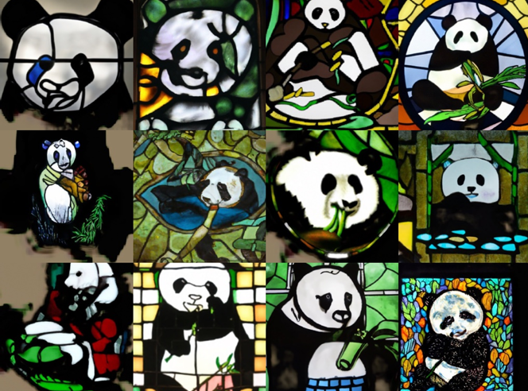
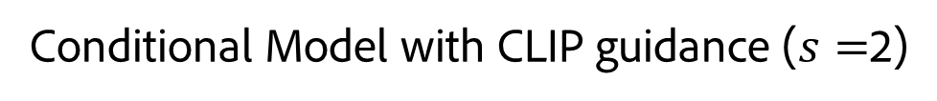
Comparison: Unguided vs. CLIP Guidance
$c =$“A stained glass window of a panda eating bamboo.”
Conditional Model without Guidance
Conditional Model with CLIP guidance ($s=$2)
GLIDE: Towards Photorealistic Image Generation and Editing with Text-Guided Diffusion Models, Nichol et al., ICML 2022
Notes:
Biasing:
- Saturation
- Lower variety

Slide 20
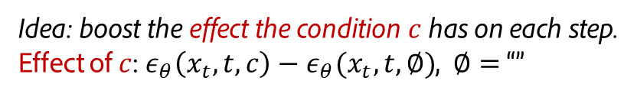
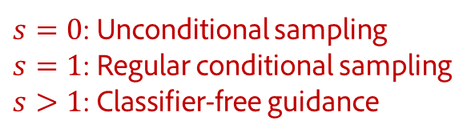
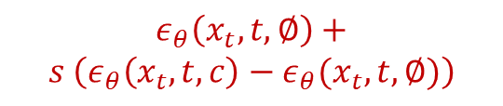


Trajectory Guidance: Classifier-Free Guidance (CFG)
$c =$“A stained glass window of a panda eating bamboo.”
Idea: boost the effect the condition $c$ has on each step.
Effect of $c$:$ε_{θ}\left(x_{t}, t, c\right)−ε_{θ}(x_{t}, t, ∅)$, $∅=$“”
$$x_{T}$$
$$ε_{θ}\left(x_{t}, t,∅\right)$$
Downsides:
2x inference cost
Biases the distribution
$$x_{t}$$
$s=0$: Unconditional sampling
$s=1$: Regular conditional sampling
$s>1$: Classifier-free guidance
$$ε_{θ}\left(x_{t}, t, c\right)$$
noise distribution
$$p(x_{T})$$
$$ε_{θ}\left(x_{t}, t,∅\right)+$$
$$s \left(ε_{θ}\left(x_{t}, t, c\right)−ε_{θ}(x_{t}, t, ∅)\right)$$
data distribution
$$p\left(x_{0} | c\right)$$
Classifier-free Diffusion Guidance, Ho and Salimans, NeurIPS 2021 Workshop on Deep Generative Models
Notes:
Nudge the trajectory in a direction that improves the classifier’s assessment of the image
Classifier was trained with noisy data

Slide 21
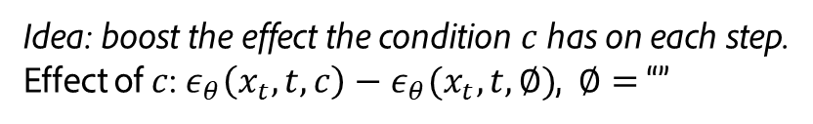
Trajectory Guidance: Classifier-Free Guidance (CFG)
$c =$“A stained glass window of a panda eating bamboo.”
Idea: boost the effect the condition $c$ has on each step.
Effect of $c$:$ε_{θ}\left(x_{t}, t, c\right)−ε_{θ}(x_{t}, t, ∅)$, $∅=$“”
$$x_{T}$$
$$x_{t}$$
$$x_{0}$$
noise distribution
$$p(x_{T})$$
Downsides:
2x inference cost
Biases distribution
data distribution
$$p\left(x_{0} | c\right)$$
Classifier-free Diffusion Guidance, Ho and Salimans, NeurIPS 2021 Workshop on Deep Generative Models
Panda Images from: GLIDE: Towards Photorealistic Image Generation and Editing with Text-Guided Diffusion Models, Nichol et al., ICML 2022
Notes:
Nudge the trajectory in a direction that improves the classifier’s assessment of the image
Classifier was trained with noisy data

Slide 22
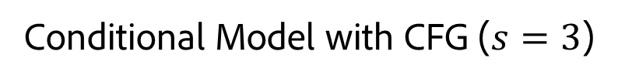
Comparison: Unguided vs. Classifier-free Guidance
$c =$“A stained glass window of a panda eating bamboo.”
Conditional Model without Guidance
Conditional Model with CFG ($s=3$)
Classifier-free Diffusion Guidance, Ho and Salimans, NeurIPS 2021 Workshop on Deep Generative Models
Panda Images from: GLIDE: Towards Photorealistic Image Generation and Editing with Text-Guided Diffusion Models, Nichol et al., ICML 2022
Notes:
Biasing:
- Saturation
- Lower variety

Slide 23
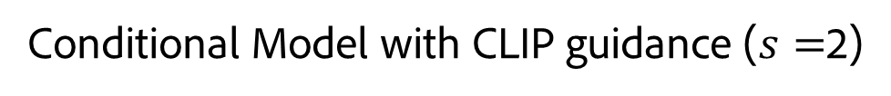
Comparison: CLIP vs. Classifier-free Guidance
$c =$“A stained glass window of a panda eating bamboo.”
Conditional Model with CLIP guidance ($s=$2)
Conditional Model with CFG ($s=3$)
Classifier-free Diffusion Guidance, Ho and Salimans, NeurIPS 2021 Workshop on Deep Generative Models
Panda Images from: GLIDE: Towards Photorealistic Image Generation and Editing with Text-Guided Diffusion Models, Nichol et al., ICML 2022
Notes:
CFG Tends to be more realistic
and experiments from the GLIDE authors also show that CFG generalizes to a larger range of prompts.
CFG is standard in current models.

Slide 24
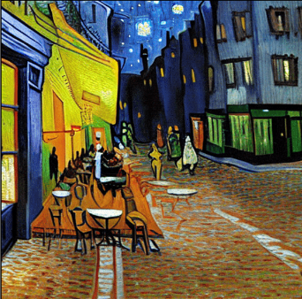
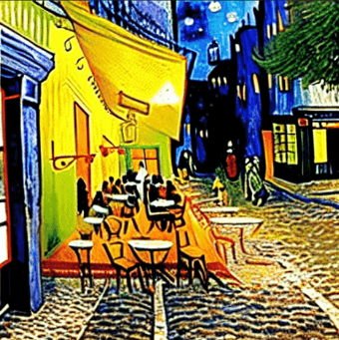

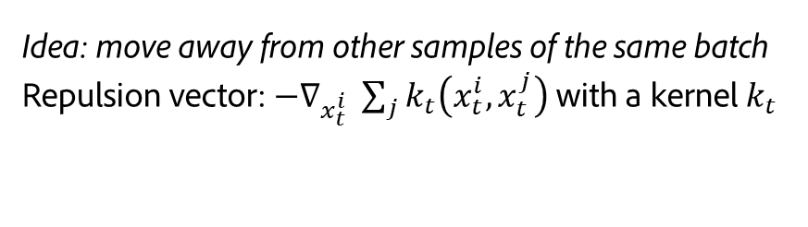




Trajectory Guidance: Particle Guidance
$c =$“Van Gogh Café Terasse”
Idea: move away from other samples of the same batch
Repulsion vector: $−∇_{x_{t}^{i} }\sum_{j}{k_{t}\left(x_{t}^{i},x_{t}^{j}\right)}$ with a kernel $k_{t}$
$$x_{T}^{2}$$
$$x_{T}^{1}$$
$$x_{0}^{2}$$
$$x_{0}^{1}$$
noise distribution
$$p(x_{T})$$
data distribution
$$p\left(x_{0} | c\right)$$
Particle Guidance: non-I.I.D. Diverse Sampling with Diffusion Models, Corso et al., ICLR 2024
Notes:
Nudge the trajectory in a direction that improves the classifier’s assessment of the image
Classifier was trained with noisy data

Slide 25
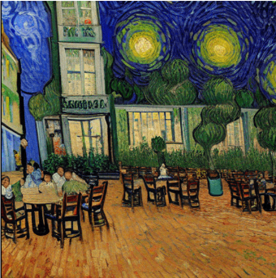


Trajectory Guidance: Particle Guidance
$c =$“Van Gogh Café Terasse”
Idea: move away from other samples of the same batch
Repulsion vector: $−∇_{x_{t}^{i} }\sum_{j}{k_{t}\left(x_{t}^{i},x_{t}^{j}\right)}$ with a kernel $k_{t}$
$$x_{0}^{2b}$$
$$x_{T}^{2}$$
$$x_{T}^{1}$$
$$x_{0}^{2}$$
$$x_{0}^{1}$$
noise distribution
$$p(x_{T})$$
data distribution
$$p\left(x_{0} | c\right)$$
Particle Guidance: non-I.I.D. Diverse Sampling with Diffusion Models, Corso et al., ICLR 2024
Notes:
Nudge the trajectory in a direction that improves the classifier’s assessment of the image
Classifier was trained with noisy data

Slide 26
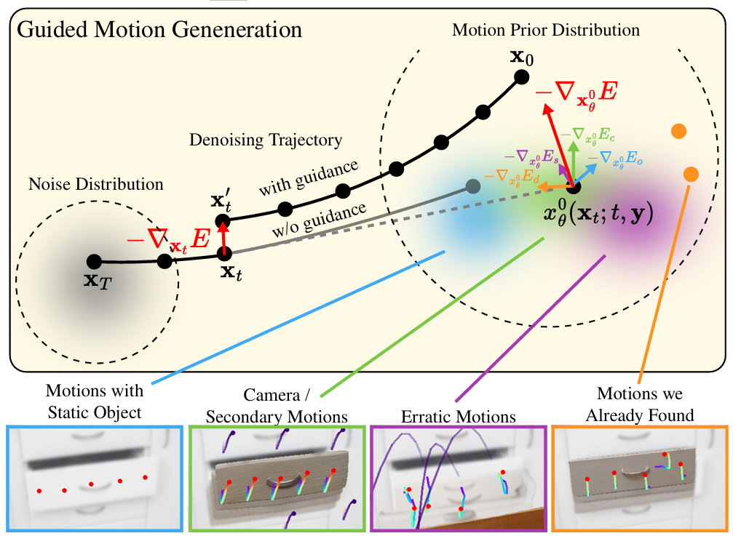
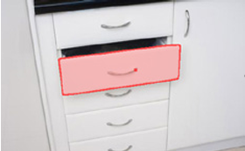
Trajectory Guidance: Multiple Guidance Terms
Task: Find diverse motions
for the selected object.
Motion Modes: What Could Happen Next?, Pandey et al., CVPR 2025

Slide 27
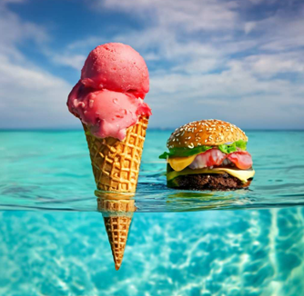



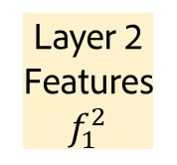
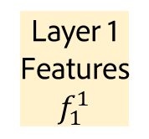

Latent Feature Manipulation
$$x_{T}$$
$$x_{0}$$
Denoiser
Layer 1
Layer 1
Features
$$f_{1}^{1}$$
Layer 2
Layer 2
Features
$$f_{1}^{2}$$
…
…
Denoiser
$$x_{T}$$
$$x_{0}$$
Denoising Timestep 1
Timestep 2
Image from: Diffusion Self-Guidance for Controllable Image Generation, Epstein et al., NeurIPS 2023

Slide 28
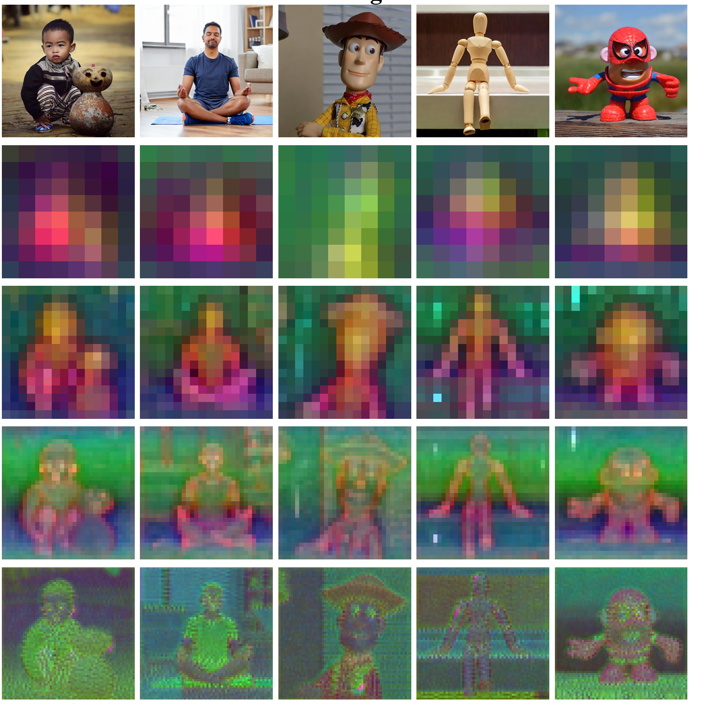
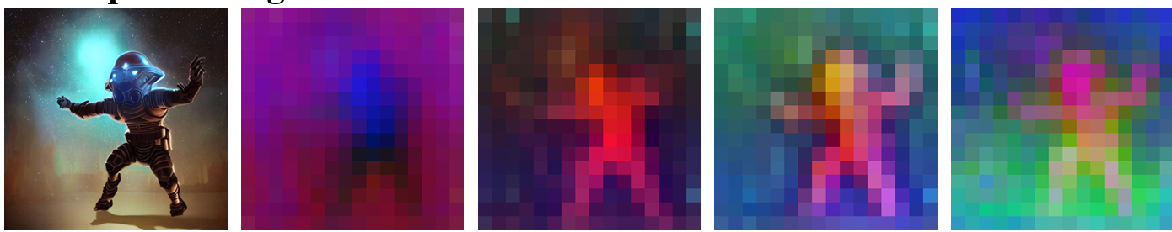




Latent Feature Manipulation
Earlier layers & timesteps typically contain more semantic concepts, later layers & timesteps also describe details
Timestep 540/1000
Timestep
Layer 1 $(f_{540}^{1}$)
Layer 4 $(f_{540}^{4}$)
Layer 7 $(f_{540}^{7}$)
Layer 11 $(f_{540}^{11}$)
Generated image
Plug-and-Play Diffusion Features for Text-Driven Image-to-Image Translation, Tumanyan et al., CVPR 2023

Slide 29
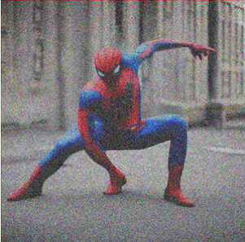
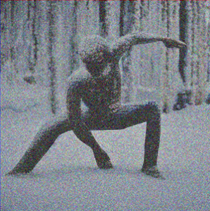




Latent Feature Manipulation: Override Features
“A photo of spiderman”
…
Denoiser
…
Features $f$
same noise
Override some features
𝒇’ with 𝒇
$$x_{t}$$
$$x_{t−1}$$
…
Denoiser
…
Features $f′$
“A photo of a statue in the snow”
Plug-and-Play Diffusion Features for Text-Driven Image-to-Image Translation, Tumanyan et al., CVPR 2023
Notes:
We’ll hear more about this, especially for attention features, in the next part of the course.

Slide 30
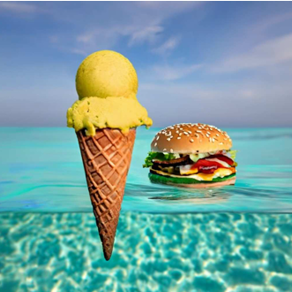



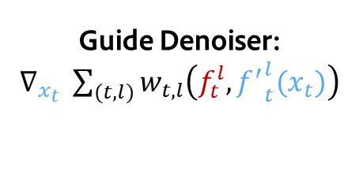

Latent Feature Manipulation: Guide Features
“a photo of a burger and an ice cream cone floating in the ocean”
…
Denoiser
…
Features $f$
Guide Denoiser: $∇_{x_{t} }\sum_{(t,l)}{w_{t,l}\left(f_{t}^{l}, {f^{′}}_{t}^{l}(x_{t})\right)}$
same noise
$$x_{t}$$
$$x_{t−1}$$
…
Denoiser
…
Features $f′$
“a photo of a burger and a yellow ice cream cone floating in the ocean”
Diffusion Self-Guidance for Controllable Image Generation, Epstein et al., NeurIPS 2023

Slide 31
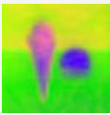


Latent Feature Manipulation: Guide Features
“a photo of a burger and an ice cream cone floating in the ocean”
…
Denoiser
…
Features $f$
Guide Denoiser: $∇_{x_{t} }\sum_{(t,l)}{w_{t,l}\left(f_{t}^{l}, {f^{′}}_{t}^{l}(x_{t})\right)}$
same noise
Features $f$
Edited Features $g$
$$x_{t}$$
$$x_{t−1}$$
…
Denoiser
…
Features $f′$
“a photo of a burger and an ice cream cone floating in the ocean”
Diffusion Self-Guidance for Controllable Image Generation, Epstein et al., NeurIPS 2023

Slide 32
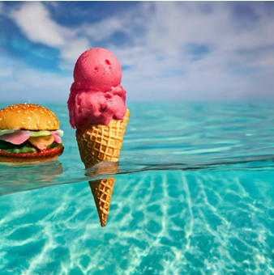

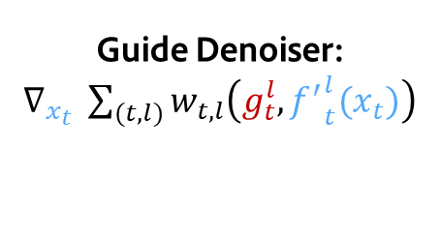

Latent Feature Manipulation: Guide Features
“a photo of a burger and an ice cream cone floating in the ocean”
…
Denoiser
…
Features $f$
Guide Denoiser: $∇_{x_{t} }\sum_{(t,l)}{w_{t,l}\left(g_{t}^{l}, {f^{′}}_{t}^{l}(x_{t})\right)}$
same noise
Features $f$
Edited Features $g$
$$x_{t}$$
$$x_{t−1}$$
…
Denoiser
…
Features $f′$
“a photo of a burger and an ice cream cone floating in the ocean”
Diffusion Self-Guidance for Controllable Image Generation, Epstein et al., NeurIPS 2023

Slide 33
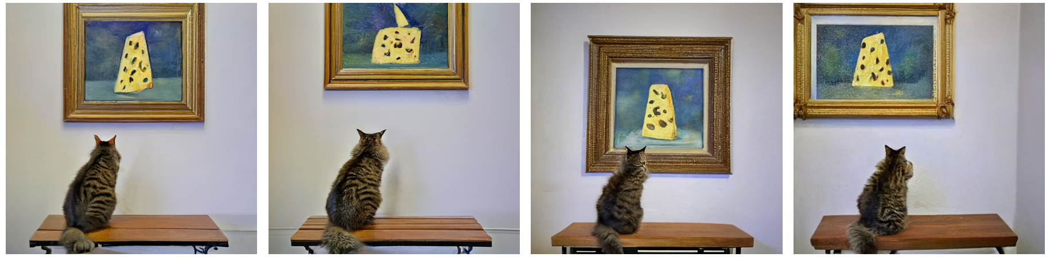
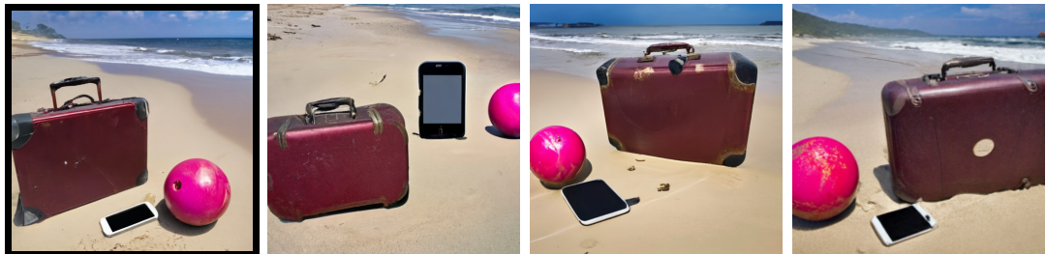
Latent Feature Manipulation: Guide Features
Diffusion Self-Guidance for Controllable Image Generation, Epstein et al., NeurIPS 2023
Notes:
And here are some examples of moving attention maps and intermediate features to change the object layout in the image. The edit control is quite effective in specifying the 2D location of the objects, although their 3D pose can not be accurately specified yet, and identity preservation is reasonable, but does show some differences to the original objects.

Slide 34
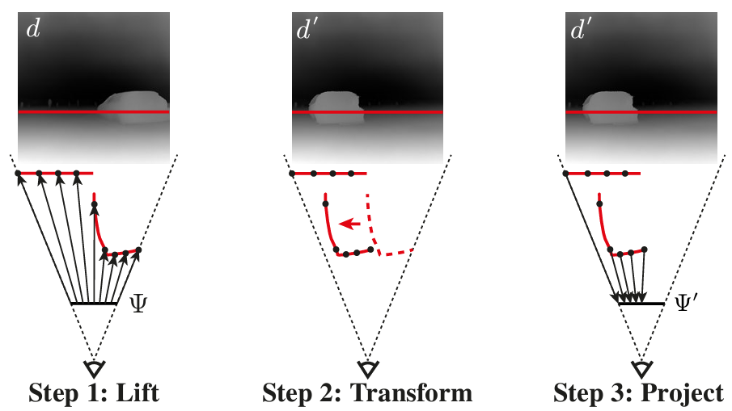


Latent Feature Manipulation: Guide Features
Intermediate features can be 3D-transformed using monocular depth estimates.
Features $f$
Edited Features $g$
Diffusion Handles: Enabling 3D Edits for Diffusion Models by Lifting Activations to 3D, Pandey et al., CVPR 2024
Notes:
A similar approach can also be used to achieve more accurate control over the 3D pose of objects.
Instead of simply moving the content of attention maps and intermediate features, they can be 3D-transformed by projecting them 3D depth surfaces, and transforming these surfaces in 3D, before re-projecting the now 3d-transformed features back to the image.

Slide 35
Latent Feature Manipulation: Guide Features
Attention maps / intermediate features can be 3D-transformed using monocular depth estimates.
Diffusion Handles: Enabling 3D Edits for Diffusion Models by Lifting Activations to 3D, Pandey et al., CVPR 2024

Slide 36
Latent Feature Manipulation: Guide Features
Diffusion Handles: Enabling 3D Edits for Diffusion Models by Lifting Activations to 3D, Pandey et al., CVPR 2024
Notes:
This results in more accurate control over the 3D pose of objects, as you can see here.
Lighting changes

Slide 37
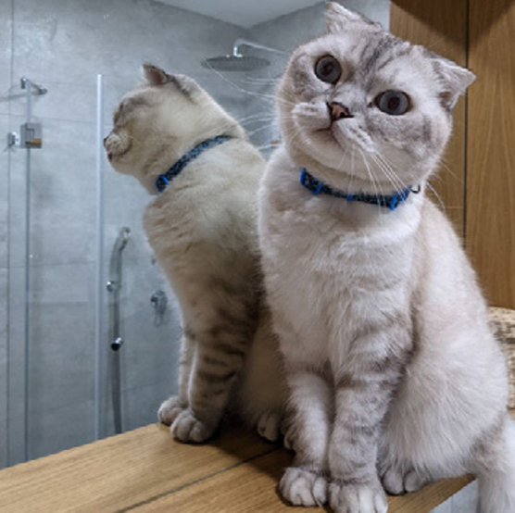

Inversion
Can we re-generate a non-generated image, like a photograph? This would enable editing.
“A cat sitting next to a mirror.”
Left Image From: Null-text Inversion for Editing Real Images using Guided Diffusion Models, Mokady and Hertz et al. CVPR 2023

Slide 38



Inversion
Which noise $x^{T}$ generates a given image?
“A cat sitting next to a mirror.”
$x^{T}$
Inversion
Diffusion
Images from: Null-text Inversion for Editing Real Images using Guided Diffusion Models, Mokady and Hertz et al. CVPR 2023

Slide 39

Inversion
This lets us preserve the input image.
“A sleeping cat sitting next to a mirror.”
$x^{T}$
Inversion
Diffusion
Images from: Null-text Inversion for Editing Real Images using Guided Diffusion Models, Mokady and Hertz et al. CVPR 2023

Slide 40

Inversion: DDIM Inversion
“A cat sitting next to a mirror.”
$$x_{T}$$
?
$$x_{0}$$
noise distribution
$$p(x_{T})$$
data distribution
$$p\left(x_{0} | c\right)$$
Images from: Null-text Inversion for Editing Real Images using Guided Diffusion Models, Mokady and Hertz et al. CVPR 2023
Notes:
Nudge the trajectory in a direction that improves the classifier’s assessment of the image

Slide 41


Inversion: DDIM Inversion
“A cat sitting next to a mirror.”
$$x_{T}$$
$$x_{t−1}$$
?
$$x_{t}$$
$$x_{0}$$
noise distribution
$$p(x_{T})$$
data distribution
$$p\left(x_{0} | c\right)$$
Images from: Null-text Inversion for Editing Real Images using Guided Diffusion Models, Mokady and Hertz et al. CVPR 2023
Notes:
Nudge the trajectory in a direction that improves the classifier’s assessment of the image

Slide 42


Inversion: DDIM Inversion
“A cat sitting next to a mirror.”
$$x_{T}$$
$$x_{t−1}$$
$$ε_{θ}(x_{t}, t, c)$$
$$x_{t−1}$$
?
$$x_{t}$$
$$x_{0}$$
noise distribution
$$p(x_{T})$$
data distribution
$$p\left(x_{0} | c\right)$$
Images from: Null-text Inversion for Editing Real Images using Guided Diffusion Models, Mokady and Hertz et al. CVPR 2023
Notes:
CFG amplifies the accumulated error

Slide 43



Inversion: DDIM Inversion
“A cat sitting next to a mirror.”
$$x_{T}$$
$$x_{0}$$
$$x_{T}$$
$$x_{0}$$
noise distribution
$$p(x_{T})$$
data distribution
$$p\left(x_{0} | c\right)$$
Images from: Null-text Inversion for Editing Real Images using Guided Diffusion Models, Mokady and Hertz et al. CVPR 2023
Notes:
CFG amplifies the accumulated error

Slide 44





Inversion: Null-Text Inversion
Reminder: CFG adds this to each step:
$s \left(ε_{θ}\left(x_{t}, t, c\right)−ε_{θ}(x_{t}, t, ∅)\right)$, $∅=$“”
“A cat sitting next to a mirror.”
Null-Text
Idea: use CFG to correct the drift
Optimize embedding of the Null-Text $∅$ in each step
to minimize $\left\|x_{t}−x_{t}^{′}\right\|$
$$x_{T}$$
$$x_{0}$$
$$x_{T}$$
$$x_{t}^{′}$$
Drift
$$x_{t}$$
$$x_{0}$$
noise distribution
$$p(x_{T})$$
data distribution
$$p\left(x_{0} | c\right)$$
Null-text Inversion for Editing Real Images using Guided Diffusion Models, Mokady and Hertz et al. CVPR 2023
Notes:
CFG amplifies the accumulated error

Slide 45

Inversion: Null-Text Inversion
Reminder: CFG adds this to each step:
$s \left(ε_{θ}\left(x_{t}, t, c\right)−ε_{θ}(x_{t}, t, ∅)\right)$, $∅=$“”
“A cat sitting next to a mirror.”
Null-Text
Idea: use CFG to correct the drift
Optimize embedding of the Null-Text $∅$ in each step
to minimize $\left\|x_{t}−x_{t}^{′}\right\|$
$$x_{T}$$
$$x_{T}$$
$$x_{0}$$
$$x_{0}$$
Downsides:
Requires per-step optimization.
noise distribution
$$p(x_{T})$$
data distribution
$$p\left(x_{0} | c\right)$$
Null-text Inversion for Editing Real Images using Guided Diffusion Models, Mokady and Hertz et al. CVPR 2023
Notes:
CFG amplifies the accumulated error

Slide 46









Comparison: DDIM vs. Null-Text Inversion
Input
DDIM
Null-Text
“Zoom photo of flowers.”
“A cat sitting next to a mirror.”
“A baby wearing a blue shirt
lying on the sofa.”
Null-text Inversion for Editing Real Images using Guided Diffusion Models, Mokady and Hertz et al. CVPR 2023

Slide 47

Editing with Null-Text Inversion
Input
Null-Text Inversion + Prompt-to-Prompt
“Zoom photo of flowers.”
“A cat sitting next to a mirror.”
Null-text Inversion for Editing Real Images using Guided Diffusion Models, Mokady and Hertz et al. CVPR 2023

Slide 48

Noise + Denoise
$$x_{T}$$
$$x_{0}$$
Coarse Layout
Fine Details
noise distribution
$$p(x_{T})$$
data distribution
$$p\left(x_{0} | c\right)$$
Images from: Denoising Diffusion-based Generative Modeling: Foundations and Applications, Kreis et al., CVPR 2022
Notes:
Earlier steps define the coarse layout, while later steps generate fine details

Slide 49




Noise + Denoise
Idea: noise + denoise a given coarse layout to add fine details
Noise
Input Layout
Denoise
$$x_{0}$$
Coarse Layout
Fine Details
How much noise?
noise distribution
$$p(x_{T})$$
data distribution
$$p\left(x_{0} | c\right)$$
Only noise
No noise
Images from: SDEdit: Guided Image Synthesis and Editing with Stochastic Differential Equations, Meng et al., ICLR 2022
Notes:
Nudge the trajectory in a direction that improves the classifier’s assessment of the image

Slide 50

Noise + Denoise: Examples
Images from: SDEdit: Guided Image Synthesis and Editing with Stochastic Differential Equations, Meng et al., ICLR 2022
Notes:
Nudge the trajectory in a direction that improves the classifier’s assessment of the image

Slide 51

Blended Diffusion
Blended Diffusion for Text-driven Editing of Natural Images, Avrahami et al., CVPR 2022

Slide 52

Blended Diffusion: Examples
Blended Diffusion for Text-driven Editing of Natural Images, Avrahami et al., CVPR 2022
Notes:
Nudge the trajectory in a direction that improves the classifier’s assessment of the image

Slide 53
Training-free Methods: Summary
Trajectory Guidance
Inversion
Noise & Denoise
Blended Diffusion

Slide 54
Guided and Controllable Generation: Overview
Training-free
methods
Training-based
methods
Integrating Diffusion
into MLLMs
GLIDE: Towards Photorealistic Image Generation and Editing with Text-Guided Diffusion Models, Nichol et al., ICML 2022
Adding Conditional Control to Text-to-Image Diffusion Models, Zhang et al., ICCV 2023
Emerging Properties in Unified Multimodal Pretraining (aka Bagel), Deng et al., ArXiv May 2025
Diffusion Handles: Enabling 3D Edits for Diffusion Models by Lifting Activations to 3D, Pandey et al., CVPR 2024
Notes:
In this part of the course, I will present different techniques to guide a diffusion model and achieve more control over its output, in order to enable some of these applications.

Slide 55
Adapting Pre-trained Models to New Conditions
Examples of conditions that provide useful control for a diffusion model:
Adding Conditional Control to Text-to-Image Diffusion Models, Zhang et al., ICCV 2023

Slide 56

Fine-Tuning
Paired Data
Fine-Tune Denoiser
Condition A
Denoiser A
…
…
Downsides:
Training cost & time
(SD 3.5: 8.1 billion parameters; Wan 2.2: 14/27 billion)
Small size of paired dataset &
overfitting
Prior drift &
catastrophic forgetting
Condition B
Denoiser B
…
…
Condition C
Denoiser C
…
…
Images from: Adding Conditional Control to Text-to-Image Diffusion Models, Zhang et al., ICCV 2023

Slide 57


Fine-Tuning: Image Editing Examples
Training Tuples
Input
Output
ObjectMover: Generative Object Movement with Video Prior, Yu et al., CVPR 2025

Slide 58















Low-Rank Adaption (LoRA)
Paired Data
Fine-Tune LoRA Params Only
Replace Linear Operations:
LoRA A
Original:
Denoiser
$$x_{o}=Wx_{i}$$
Condition A
…
…
($W∈ℝ^{d×k}$)
LoRA:
$$x_{o}=Wx_{i}+BAx_{i}$$
LoRA B
($B∈ℝ^{d×r}$; $A∈ℝ^{r×k}$ with $r≪min⁡(d,k)$)
Condition B
Denoiser
…
…
$$W$$
$$d$$
LoRA C
$$x_{i}$$
$$k$$
+
$$x_{o}$$
Condition C
Denoiser
…
…
$$B$$
$$d$$
$$r$$
$$A$$
$$k$$
$$r$$
LoRA: Low-Rank Adaptation of Large Language Models, Hu et al., ICLR 2022
Some images from: Adding Conditional Control to Text-to-Image Diffusion Models, Zhang et al., ICCV 2023
Notes:
Loose Control

Slide 59
Adapter
Paired Data
Fine-Tune Adapter Only
Well-Known Adapters Architectures
Adapter A
ControlNet
IP-Adapter
Condition A
Denoiser
…
…
Adapter B
Condition B
Denoiser
…
…
Adapter C
Condition C
Denoiser
…
…
Images from: Adding Conditional Control to Text-to-Image Diffusion Models, Zhang et al., ICCV 2023
Notes:
I will cover two well-known adapter architectures

Slide 60






ControlNet
ControlNet creates a trainable copy of some layers and uses zero-initialized convolutions to make sure that initially, the ControlNet has no effect on the output.
Layer n
Features
$$f_{A}^{n}$$
Layer n+1
Features
$$f_{A}^{n+1}$$
Zero-Conv
+
…
…
ControlNet
Layer 1
Layer 2
Layer n
Layer n+1
Zero-Conv
Zero-Conv
Control
…
…
Layer n
Features
$$f^{n}$$
Layer n+1
Features
$$f^{n+1}$$
…
…
Denoiser
Layer 1
Layer 2
Layer n
+
Layer n+1
+
$$x_{T}$$
$$x_{0}$$
Adding Conditional Control to Text-to-Image Diffusion Models, Zhang et al., ICCV 2023
Notes:
Trainable Copy

Slide 61
ControlNet Examples
input
generated
Adding Conditional Control to Text-to-Image Diffusion Models, Zhang et al., ICCV 2023

Slide 62




ControlNet + LoRA: Example (LooseControl)
Input
ControlNet
LooseControl
LooseControl: Lifting ControlNet for Generalized Depth Conditioning, Bhat et al., Siggraph 2024

Slide 63








IP-Adapter (Image Prompt Adapter)
Image Encoder
MLP
Image Tokens
Image Prompt
…
Cross-Att.
Cross-Att.
Features
$$f_{A}^{n}$$
Cross-Att.
Cross-Att.
Features
$$f_{A}^{n+1}$$
IP-Adapter
…
…
Self-Att.
Cross-Att.
Features
$$f^{n}$$
+
Self-Att.
Cross-Att.
Features
$$f^{n+1}$$
+
…
…
Denoiser
Feed Forw.
Cross-Att.
Feed Forw.
Cross-Att.
$$x_{T}$$
$$x_{0}$$
Text Encoder
Text Tokens
“A sports car”
IP-Adapter: Text Compatible Image Prompt Adapter for Text-to-Image Diffusion Models, Ye et al., ArXiv 2023

Slide 64


IP-Adapter: Examples
IP-Adapter Only
IP-Adapter + ControlNet
IP-Adapter + ControlNet
input
generated
Input (IP-A.)
Input (C.Net)
generated
Input (IP-A.)
Input (C.Net)
generated
IP-Adapter: Text Compatible Image Prompt Adapter for Text-to-Image Diffusion Models, Ye et al., ArXiv 2023

Slide 65
Guided and Controllable Generation: Overview
Training-free
methods
Training-based
methods
Integrating Diffusion
into MLLMs
GLIDE: Towards Photorealistic Image Generation and Editing with Text-Guided Diffusion Models, Nichol et al., ICML 2022
Adding Conditional Control to Text-to-Image Diffusion Models, Zhang et al., ICCV 2023
Emerging Properties in Unified Multimodal Pretraining (aka Bagel), Deng et al., ArXiv May 2025
Diffusion Handles: Enabling 3D Edits for Diffusion Models by Lifting Activations to 3D, Pandey et al., CVPR 2024
Notes:
In this part of the course, I will present different techniques to guide a diffusion model and achieve more control over its output, in order to enable some of these applications.

Slide 66
Integrating Diffusion into MLLMs
Integrate a diffusion process into an MLLM for mixed text/image generation and editing.
Multi-round
Complex
Instructions
Emerging Properties in Unified Multimodal Pretraining (aka. Bagel), Deng et al., ArXiv May 2025
Notes:
MLLMs are another option to edit images or videos.
One example enabled by integrating diffusion into MLLMs is multi-round editing …

Slide 67
Integrating Diffusion into MLLMs
Representation: sequence of mixed text and image/video tokens
“Can you guide me
through making
Avocado and
Apple Juice”
“A woman is
cutting an avocado
on a plate.”
“A person is
cutting an apple”
mixed
tokens
Text token
Image token
Show-O: One Single Transformer to Unify Multimodal Understanding and Generation, Xie et al., ICLR 2025
Notes:
How do we generate these mixed tokens?

Slide 68











Integrating Diffusion into MLLMs
Typical
Autoregressive Generator
Typical
Diffusion Transformer (DiT)
token $i+1$
token $i+3$
token $i+2$
token $i+1$
token $i+3$
token $i$
token $i+2$
token $i$
…
…
…
denoising step $t$
…
…
denoising step $t+1$
…
…
…
Causal information flow
& sequential token generation
Non-causal information flow
& parallel token denoising
Discrete token values
& CE loss
Continuous token values
& MSE loss
Notes:
Images can be generated autoregressively as tokens, but that usually comes with lower quality.
Instead, several methods propose to combine autoregressive token generation with diffusion.

Slide 69

Integrating Diffusion into MLLMs: Discrete vs. Continuous
MSE for Image, CE for text:
Use different losses depending on token type.
Diffusion with Discrete Tokens:
Iteratively mask/unmask tokens.
To create a ‘noisy’ image, progressively mask random tokens in each step, so that step $t$ has $M_{t}$masked tokens.
In each denoising step, predict the value for all masked tokens, then re-mask the $M_{t}$ least confident tokens.
MaskGIT: Masked Generative Image Transformer, Chang et al., CVPR 2022
Show-O: One Single Transformer to Unify Multimodal Understanding and Generation, Xie et al., ICLR 2025

Slide 70

Integrating Diffusion into MLLMs: Generation Strategy
Pure Autoregress.
(does not use diffusion)
Autoregress. Condition
for Diffusion
Hybrid
Autoregressive/Diffusion
…
…
Condition
Projection
…
…
Encoding + Projection
Diffusion Forcing: Next-token Prediction Meets Full-Sequence Diffusion, Chen et al., NeurIPS 2025
Emerging Properties in Unified Multimodal Pretraining (aka. Bagel), Deng et al., ArXiv May 2025
Chameleon: Mixed-Modal Early-Fusion Foundation Models, Chameleon Team (Meta), ArXiv May 2024
SEED-X: Multimodal Models with Unified Multi-granularity Comprehension and Generation, Ge et al., ArXiv April 2024
Show-O: One Single Transformer to Unify Multimodal Understanding and Generation, Xie et al., ICLR 2025

Slide 71


Integrating Diffusion into MLLMs: Examples
Emerging Properties in Unified Multimodal Pretraining (aka. Bagel), Deng et al., ArXiv May 2025

Slide 72

Integrating Diffusion into MLLMs: Examples
Input
Output
Chain of Thought
Emerging Properties in Unified Multimodal Pretraining (aka. Bagel), Deng et al., ArXiv May 2025

Slide 73
End of Part 2
Guided and Controllable Generation

Slide 74
Presentation Schedule
Introduction to Diffusion Models
Guidance and Controlled Generation
Attention and Personalization
Break (15 min)
Advanced Techniques
Video Diffusion Models
Advanced Generative Models

