Slide 1




Diffusion-Based Image and Video Generation
Part 4: Advanced Techniques
Accelerating Generative Process
Juil Koo
Notes:
Welcome back to our presentation.
Hi, I’m Juil Koo from KAIST. I’ll be continuing the presentation with some advanced techniques on diffusion models, specifically focusing on accelerating the generative process.

Slide 2
Presentation Schedule
Introduction to Diffusion Models
Guidance and Controlled Generation
Attention and Personalization
Break
Advanced Techniques
Video Diffusion Models
Advanced Generative Models
Notes:
This is the today’s presentation schedule, and now (click) we’ll discuss some advanced techniques focusing on how to speed up the generative process of diffusion models.

Slide 3
Presentation Schedule
Introduction to Diffusion Models
Guidance and Controlled Generation
Attention and Personalization
Break
Advanced Techniques
Video Diffusion Models
Advanced Generative Models
Notes:
This is the today’s presentation schedule, and now (click) we’ll discuss some advanced techniques focusing on how to speed up the generative process of diffusion models.

Slide 4
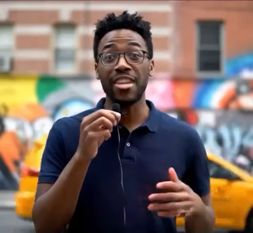

Good Generation Quality. How about Speed?
Notes:
So far, we’ve seen that diffusion models can produce remarkably high-quality results, such as the highly realistic videos on thel left and the 3D output from a single image on the right.

Slide 5
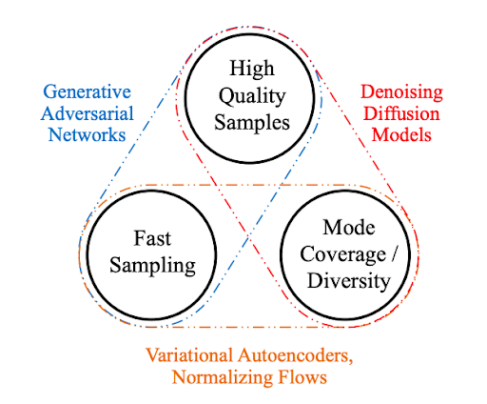
Diffusion Models – Pros and Cons
Can we improve generation speed?
https://developer.nvidia.com/blog/improving-diffusion-models-as-an-alternative-to-gans-part-1/
Notes:
When we think about the goals of generative models, they can largely be categorized into three aspects: high-quality samples, diversity, and generation speed.
Compared to other generative model families, diffusion models excel in generating high-quality and diverse outputs.
However, they tend to be slower than other approaches.
(click)
So, a natural question is: can we also improve the generation speed?

Slide 6
How to Speed up the Sampling Process While Achieving Good Quality?
Notes:
Given this limitation of diffusion models, now we will explore how we can speed up the sampling process without compromising generation quality.

Slide 7
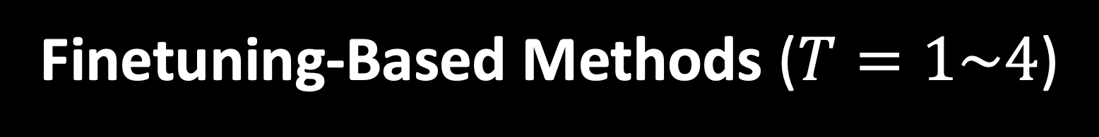
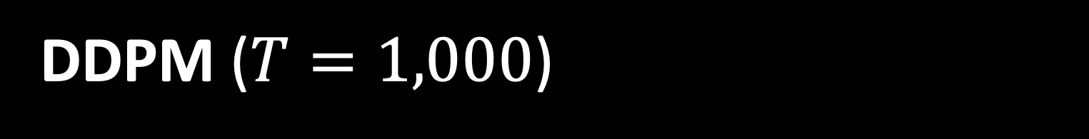
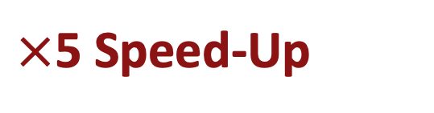
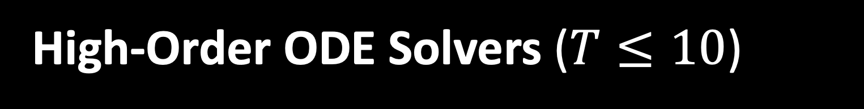
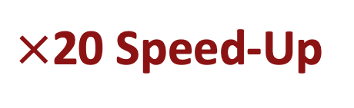
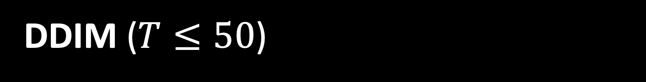
DDPM ($T=1,000$)
$×$20 Speed-Up
DDIM ($T≤50$)
$×$5 Speed-Up
High-Order ODE Solvers ($T≤10$)
Real-Time Generation
Finetuning-Based Methods ($T=1\sim 4$)
Notes:
In the previous presentations, we have discussed basic DDPMs, which typically require 1,000 or more timesteps to generate a single sample.
(click) Now, first of all, we’ll look at DDIM, which achieves about a 20× speed-up over DDPMs without additional training.
(click) Next, we’ll cover high-order ODE solvers, which provide a further 5× acceleration, also without extra training.
(click) Finally, for real-time generation where the required sampling steps are even lower than 10 such as a single or just a few steps, we’ll explore finetuning-based approaches that can produce results in just one or a few steps.

Slide 8
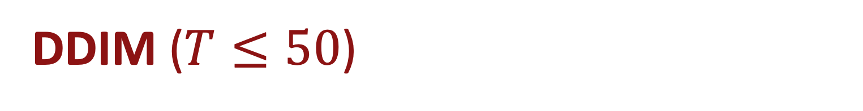
DDPM ($T=1,000$)
DDIM ($T≤50$)
High-Order ODE Solvers ($T≤10$)
Finetuning-Based Methods ($T=1\sim 4$)
Notes:
Then, let’s begin with DDIMs.

Slide 9
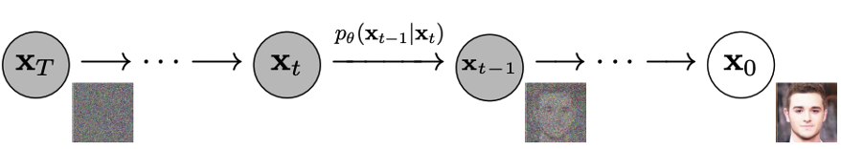

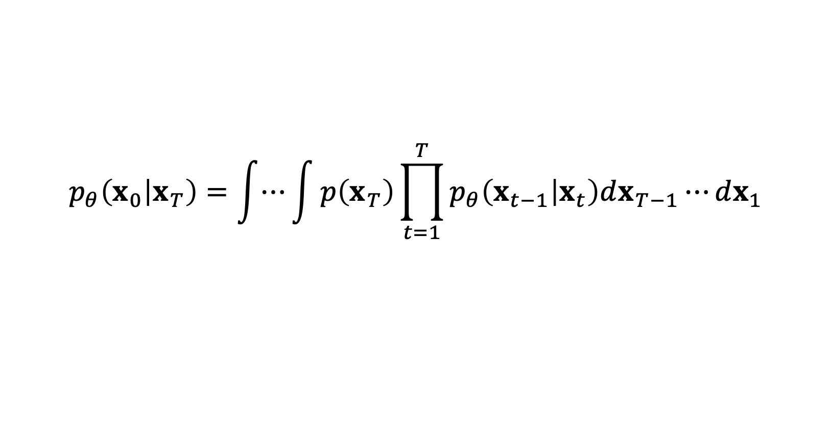
Why DDPMs Are So Slow?
$$p_{θ}\left(x_{0} | x_{T}\right)=\int{⋯}\int{p\left(x_{T}\right)\prod_{t=1}^{T}{p_{θ}\left(x_{t−1} | x_{t}\right)dx_{T−1}⋯dx_{1}}}$$
DDPM sampling is defined as a Markov chain, requiring $T(≥1,000)$ steps:
Notes:
First, this is a brief overview of DDPM’s sampling process. (click) As you can see, in order to compute x_0 from x_T, it must go through all consecutive timesteps.
Specifically, we refer to this type of sequential process as a Markov chain, and it typically requires 1,000 or more steps to produce plausible outputs, which is highly time-consuming.

Slide 10
Denoising Diffusion Implicit Models (DDIMs)
DDIMs reinterpret DDPMs as a non-Markovian process that can:
skip intermediate timesteps and
control the magnitude of stochasticity.
Notes:
In order to address this slow sampling process of DDPMs, DDIM was introduced.
It reinterprets DDPM’s sequential sampling process as a non-Markovian process that brings the following two major benefits:
First, it allows us to skip intermediate timesteps, thus we can achieve faster generation.
And second, it gives us control over the level of stochasticity in the sampling process, which is crucial for maintaining high-quality when generating with fewer sampling steps.

Slide 11

DDPMs
DDPM’s Markovian reverse process:
$$x_{t−1}∼p_{θ}(x_{t−1}|x_{t})$$
Notes:
Then, let’s first take a look at the key difference between the sampling processes of DDPM and DDIM.
Unlike the Markov chain of DDPMs, (click) which must go through all timesteps sequentially,

Slide 12
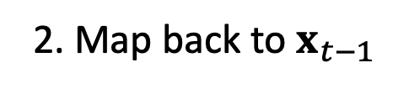
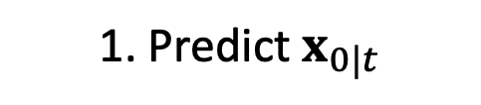

Denoising Diffusion Implicit Models (DDIMs)
DDIM’s non-Markovian reverse process:
$$x_{t−1}∼q_{σ}(x_{t−1}|x_{t},x_{0})$$
1. Predict $x_{0|t}$
2. Map back to $x_{t−1}$
Notes:
In the case of DDIM, given the x_t, (click) we first forecast x_0, and then, (click) we map the predicted x_0 back to the x_{t-1} state.

Slide 13

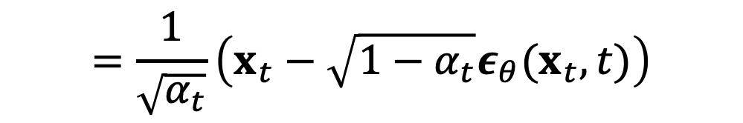
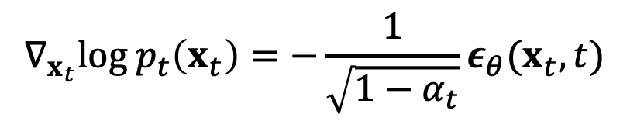
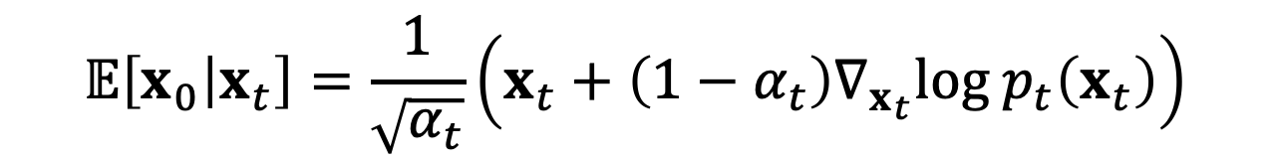
DDIM’s Non-Markovian Sampling Process
$$\text{Forward} \text{Pass}\text{: }x_{t}=\sqrt{α_{t}}x_{0}+\sqrt{1−α_{t}}ε$$
Predict $x_{0|t}$ using Tweedie’s formula:
$$𝔼\left[x_{0} | x_{t}\right]=\frac{1}{\sqrt{α_{t}}}\left(x_{t}+\left(1−α_{t}\right)∇_{x_{t}}log p_{t}\left(x_{t}\right)\right)$$
$$=\frac{1}{\sqrt{α_{t}}}\left(x_{t}−\sqrt{1−α_{t}}ε_{θ}(x_{t},t)\right)$$
$$∇_{x_{t}}log p_{t}\left(x_{t}\right)=−\frac{1}{\sqrt{1−α_{t}}}ε_{θ}(x_{t},t)$$
Notes:
Now, let’s walk through this process step by step in more detail.
As shown at the top, the forward pass of diffusion models is represented as a combination of the clean data x_0 and random noise epsilon, which are weighted by noise schedule parameter \alpha_t.
Given this forward pass equation, we can compute x_0 from x_t using Tweedie’s formula.
As shown at the bottom, according to Tweedies’ formula, the posterior mean equlas to the noisy observation x_t plus a correction term on the right-, which is a variance-scaled score function.
Here the score function means the gradient of the log-likelihood.
Since we are using diffusion models that predict noise rather than score function itself, using the relation between the score function and noise prediction term as shown in the yellow box, we can finally compute x_0 using pre-trained diffusion models

Slide 14

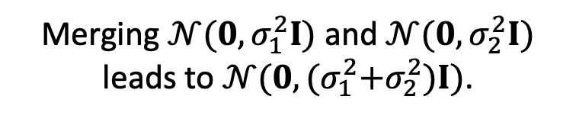
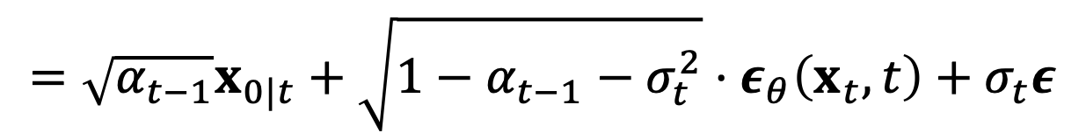
DDIM’s Non-Markovian Sampling Process
$$\text{Forward} \text{Pass}\text{: }x_{t}=\sqrt{α_{t}}x_{0}+\sqrt{1−α_{t}}ε$$
Map $x_{0|t}$ back to $x_{t−1}$ through the forward pass:
$$x_{t−1}=\sqrt{α_{t−1}}x_{0|t}+\sqrt{1−α_{t−1}}ε_{t−1}, ε_{t−1}∼𝒩\left(0,I\right)$$
$$=\sqrt{α_{t−1}}x_{0|t}+\sqrt{1−α_{t−1}−σ_{t}^{2}}⋅ε_{θ}\left(x_{t},t\right)+σ_{t}ε$$
Merging $𝒩(0,σ_{1}^{2}I)$ and $𝒩(0,σ_{2}^{2}I)$ leads to $𝒩(0,{(σ}_{1}^{2}+σ_{2}^{2})I)$.
Notes:
After estimating x_0 from x_t, we map it back to the x_{t-1} state using the same forward pass equation. As shown at the bottom, x_{t-1} is computed following the forward pass.
(click) Here, we apply one trick. Given the random noise \epsilon_{t-1}, we split it into two components — one from the noise-prediction output and another from an independent random noise. This is done by a property of Gaussians: where merging two Gaussian variables leads to another Gaussin whose variance is the sum of the two variances.

Slide 15
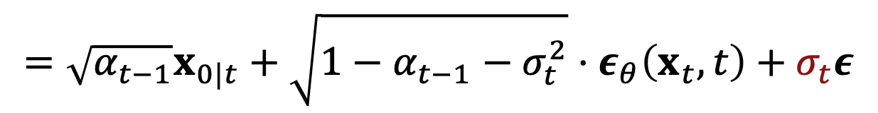
DDIM’s Non-Markovian Sampling Process
$$\text{Forward} \text{Pass}\text{: }x_{t}=\sqrt{α_{t}}x_{0}+\sqrt{1−α_{t}}ε$$
Map $x_{0|t}$ back to $x_{t−1}$ through the forward pass:
$$x_{t−1}=\sqrt{α_{t−1}}x_{0|t}+\sqrt{1−α_{t−1}}ε_{t−1}, ε_{t−1}∼𝒩\left(0,I\right)$$
$$=\sqrt{α_{t−1}}x_{0|t}+\sqrt{1−α_{t−1}−σ_{t}^{2}}⋅ε_{θ}\left(x_{t},t\right)+σ_{t}ε$$
Hyperparameter to control the level of stochasticity
Notes:
You don’t need to follow every detail in this step, but just keep this in mind.
The reason why we split a single random noise term into two components is that by doing so, we can introduce a user-defined hyperparameter sigma_t, which allows controlling the level of stochasticity during inference. For instance, as one of the special cases, when \sigma_t goes to 0, the sampling process becomes fully deterministic.
We will discuss this in more detail later.
---
Animiation showing sequential process of DDPM and DDIM.
Explanation of how to compute x_0|t. Details are missing.
Sampling 방식만 DDPM/DDIM (같은 step개수일 때) 결과 먼저 보여주기
학습 없이도 inference 때 sampling process 바꿀 수 있단 얘긴 계속 강조

Slide 16

DDIM’s Non-Markovian Sampling Process
Predict $x_{0|t}$:
$$x_{0|t}=\frac{1}{\sqrt{α_{t}}}\left(x_{t}−\sqrt{1−α_{t}}ε_{θ}(x_{t},t)\right)$$
Compute $x_{t−1}$ using $x_{t}$ and $x_{0|t}$:
$$x_{t−1}=\sqrt{α_{t−1}}x_{0|t}+\sqrt{1−α_{t−1}−σ_{t}^{2}}⋅ε_{θ}\left(x_{t},t\right)+σ_{t}ε_{t}$$
$$q_{σ}\left(x_{t−1} | x_{t},x_{0}\right)=𝒩\left(μ_{σ_{t}}\left(x_{t},x_{0}\right), σ_{t}^{2}I\right)$$
$$μ_{σ_{t}}\left(x_{t},x_{0}\right)$$
Notes:
In summary, DDIM’s non-Markovian sampling process consists of two steps: first, forecasting x_0 from x_t; and
(click) second, we compute x_{t-1} from the current noisy observation x_t and the predicted x_0.
Consequently, as shown in the equation at the top, the reverse transition from x_t to x_{t-1} can be expressed as a Gaussian distribution with variance \sigma_t squared.

Slide 17
Denoising Diffusion Implicit Models (DDIMs)
Key Features of DDIMs:
skipping intermediate timesteps and
controlling the magnitude of stochasticity.
Notes:
This is a recap of two key features of DDIM enabled by its non-Markvoain sampling process: first, it can skip intermediate timesteps, and it enables to control the magnitude of stochasticity.

Slide 18
Denoising Diffusion Implicit Models (DDIMs)
Key Features of DDIMs:
skipping intermediate timesteps and
controlling the magnitude of stochasticity.
Notes:
Then, let’s take a closer look at how we can skip intermediate timesteps.

Slide 19

Accelerated Sampling Process
Consider $τ=[τ_{1},τ_{2},…,τ_{s}]$ as a sub-sequence of the full timesteps $\left[1,T\right].$
Notes:
Consider we have a sub-sequence of the full timesteps from 1 to T.

Slide 20
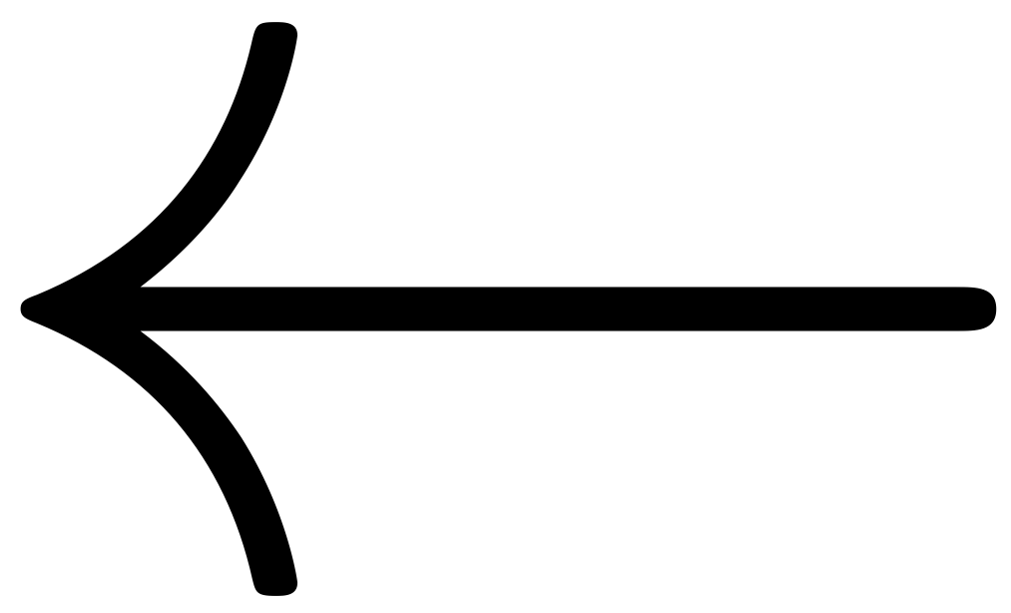

Accelerated Sampling Process
Consider $τ=[τ_{1},τ_{2},…,τ_{s}]$ as a sub-sequence of the full timesteps $\left[1,T\right].$
Redefine the DDIM’s non-Markovian reverse process under this sub-sequence.
$$q_{σ}\left(x_{t−1} | x_{t},x_{0}\right)=𝒩\left(μ_{σ_{t}}\left(x_{t},x_{0}\right), σ_{t}^{2}I\right)$$
$$q_{σ}\left(x_{τ_{i−1}} | x_{τ_{i}},x_{0}\right)=𝒩\left(μ_{σ_{τ_{i}}}\left(x_{τ_{i}},x_{0}\right), σ_{τ_{i}}^{2}I\right)$$
Notes:
Then, we redefine the DDIM’s non-Markovian sampling process under this sub-sequence.

Slide 21

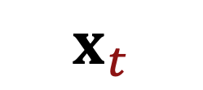
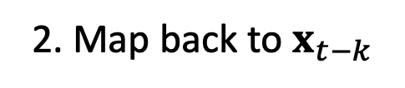
Accelerated Sampling Process
$$q_{σ}\left(x_{τ_{i−1}} | x_{τ_{i}},x_{0}\right)=𝒩\left(μ_{σ_{τ_{i}}}\left(x_{τ_{i}},x_{0}\right), σ_{τ_{i}}^{2}I\right)$$
1. Predict $x_{0|t}$
2. Map back to $x_{t−k}$
$$x_{t}$$
$$x_{t−k}$$
Notes:
Which means that, after we compute x_0 from x_t, (click) instead of mapping it back to x_{t-1}, we can jump directly to x_{t-k}, which enables to skip intermediate timesteps effectively.

Slide 22
Accelerated Sampling Process
With fewer sampling steps, the generation quality can worsen.
However, the quality degradation can be mitigated by controlling the stochasticity.
Notes:
So far, we’ve seen that how we can skip intermediate timesteps at inference without any additional training. While this can speed up the sampling process, at the same time, generating with fewer sampling steps can also lead to quality degradation.
(click) However, this degradation can be mitigated by controlling the stochasticity during sampling. Then, now let’s discuss how we can control this stochasticity during generation.

Slide 23
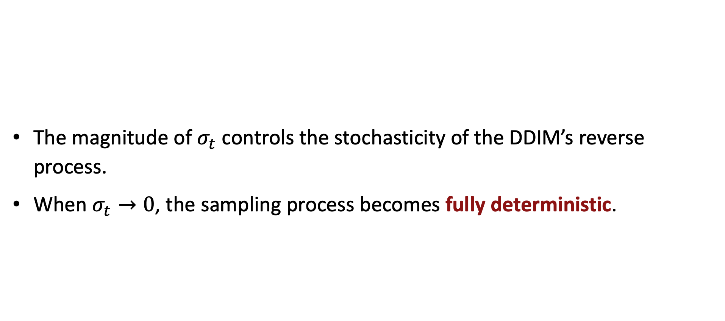
Stochasticity Control in DDIMs
The magnitude of $σ_{t}$ controls the stochasticity of the DDIM’s reverse process.
When $σ_{t}→0$, the sampling process becomes fully deterministic.
$$q_{σ}\left(x_{t−1} | x_{t},x_{0}\right)=𝒩\left(μ_{σ_{t}}\left(x_{t},x_{0}\right), σ_{t}^{2}I\right)$$
Notes:
We’ve discussed that, in the reverse step of DDIMs, sigma_t is a hypermarater that users can control at inference time.
So when it is set to 0, the variance of the reverse transition, which is expressed at the top, becomes 0. Thus, when computing x_{t-1} from x_t with eta equals 0, there is no random noise injected. So, as a result, the sampling process becomes fully deterministic.

Slide 24
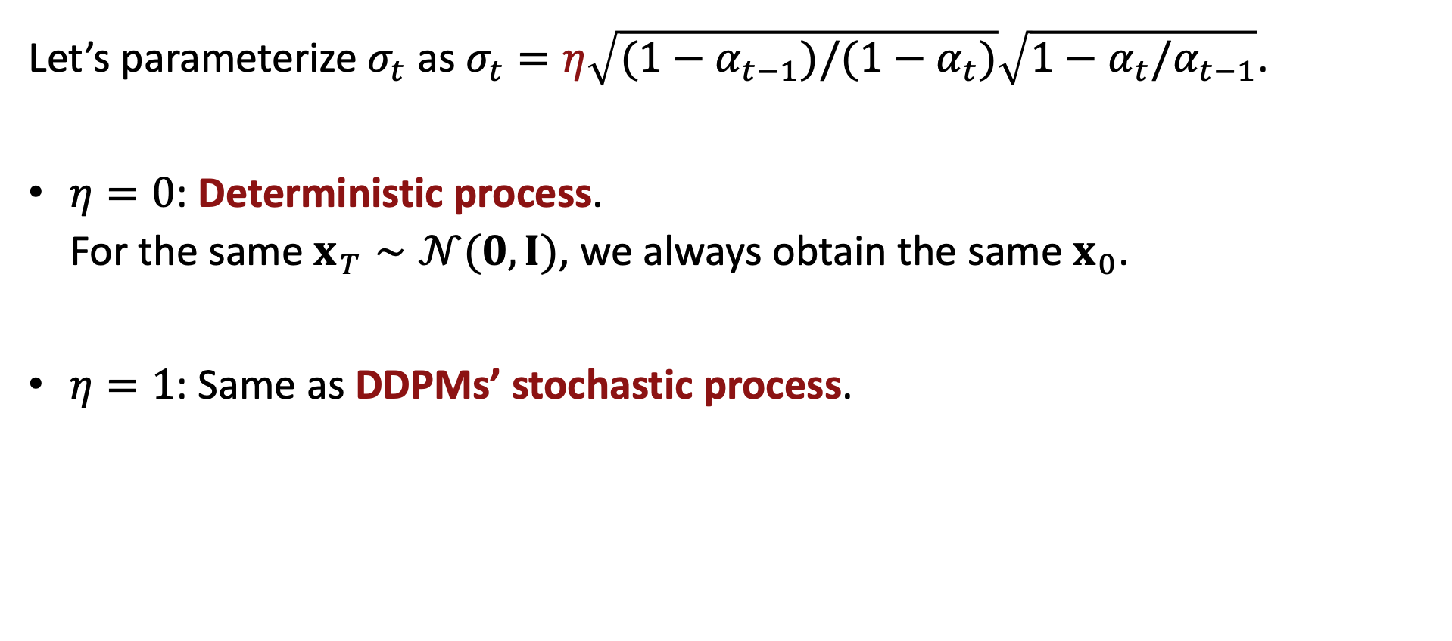
Stochasticity Control in DDIMs
Let’s parameterize $σ_{t}$ as $σ_{t}=η\sqrt{(1−α_{t−1})/(1−α_{t})}\sqrt{1−α_{t}/α_{t−1}}$.
$η=0$: Deterministic process.
For the same $x_{T}∼𝒩(0,I)$, we always obtain the same $x_{0}$.
$η=1$: Same as DDPMs’ stochastic process.
Notes:
For convenience, if we parameterize sigma_t with another hyperparameter eta, there are two special cases:
First, if eta is 0, this corresponds to the deterministic process we saw earlier on the previous slide.
Second, when eta is 1, it recovers the DDPM’s original stochastic sampling process.

Slide 25
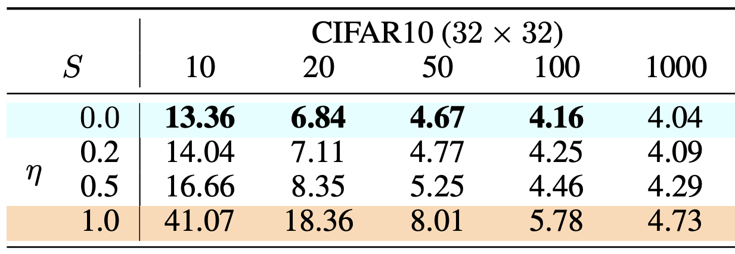

Faster, Without Compromise
FID scores (lower is better) while varying
$η$: Stochasticity
$S$: The number of sampling steps
Notes:
Now, let’s see how this stochasticity control affects generation quality through experiment results. The table below shows FID scores to measure generated images quality, with each row corresponding to a different \eta value and each column corresponding to a different number of sampling steps.

Slide 26
Faster, Without Compromise
FID scores (lower is better) while varying
$η$: Stochasticity
$S$: The number of sampling steps
Stochasticity increases.
Notes:
As we go down the rows, stochasticity increases, and (click) as we move from right to left across the columns, the number of sampling steps decreases

Slide 27
Faster, Without Compromise
FID scores (lower is better) while varying
$η$: Stochasticity
$S$: The number of sampling steps
# of sampling steps decreases.
Notes:
As we go down the rows, stochasticity increases, and (click) as we move from right to left across the columns, the number of sampling steps decreases

Slide 28

Faster, Without Compromise
When $η=1$ (DDPM), the quality quickly drops as $S$ decreases from 1000 to 10.
Notes:
First, let’s look at the special case of \eta = 1, which corresponds to the basic DDPM sampling process.
As you can see in the table, as the number of sampling steps decreases from 1000 on the rightmost column to smaller values, the generation quality drops dramatically.

Slide 29

Faster, Without Compromise
When $η=0$ (Fully-deterministic),
the quality degradation is relaxed.
Notes:
On the other hand, when we make the sampling process fully deterministic by setting eta equals 0, the generation quality remains relatively high even with a small number of sampling steps.
This suggests that removing stochasticity helps stabilize the process when operating under fast, few-step sampling process.

Slide 30

Faster, Without Compromise
When $η=0$ (Fully-deterministic),
the quality degradation is relaxed.
it achieves 20x faster generation with similar results.
20x faster
Notes:
Even, in this table, we can see that DDIM’s deterministic process provides 20x speed-up with comparable FID scores from DDPM’s stochastic process.

Slide 31
Takeaways of DDIM
Generalization of DDPM
Replaces a stochastic, Markovian process with a non-Markovian process.
No Training Required
Uses the same DDPM model directly at inference.
Faster Sampling
Generates high-quality outputs in just 10-50 steps.
Stochasticity Control
Speeds up generation without quality compromise.
Notes:
To sum up, here is takeaway messages about DDIMs.
First, DDIM is a generalization of DDPM, which replaces a stochastic markovian process with a non-markvoian process.
As it’s a generalized version of DDPM, the same model trained for DDPM can be used for DDIM at inference, without any additional training.
And the non-markovian process of DDIM provides much faster sampling process, generating high-quality outputs in just 10-50 steps compared to DDPM that typically requires 1000 or more steps.
And finally, a crucial factor for maintaining quality with fwer steps is the ability to control stochasticty during inference.
By reducing the level of stochasticity, DDIM achieves a more stable and higher-quality generation process with fewer steps.

Slide 32

Relevance to ODEs
When the number of sampling steps is small, the deterministic sampling process ($η=0$) achieves better performance.

Slide 33
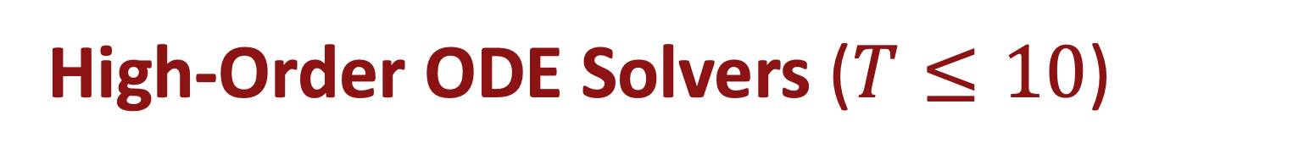
DDPM ($T=1,000$)
DDIM ($T≤50$)
High-Order ODE Solvers ($T≤10$)
Finetuning-Based Methods ($T=1\sim 4$)
Notes:
So far we’ve seen how DDIM can achieve about a 20× speed-up without training and without significant quality loss. Now, let’s move on to high-order ODE solvers and see how they can further reduce the number of steps to around 10 while maintaining similar performance.

Slide 34
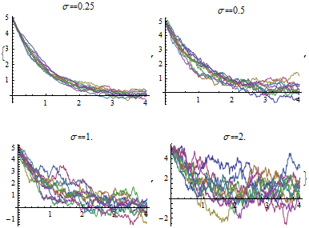
Stochastic Differential Equations
A stochastic differential equation (SDE) is a differential equation with a stochastic process (a.k.a. Brownian motion).
Notes:
Before we discuss high-order ODE solvers, let’s briefly review what a stochastic differential equation is. An SDE is a differential equation that incorporates a stochastic process, which is also known as Brownian motion. As shown in the plots below, even though they share the same SDE, the evolution can vary depending on the level of stochasticity, here denoted by sigma.

Slide 35
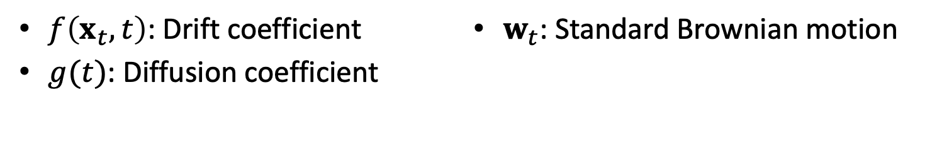
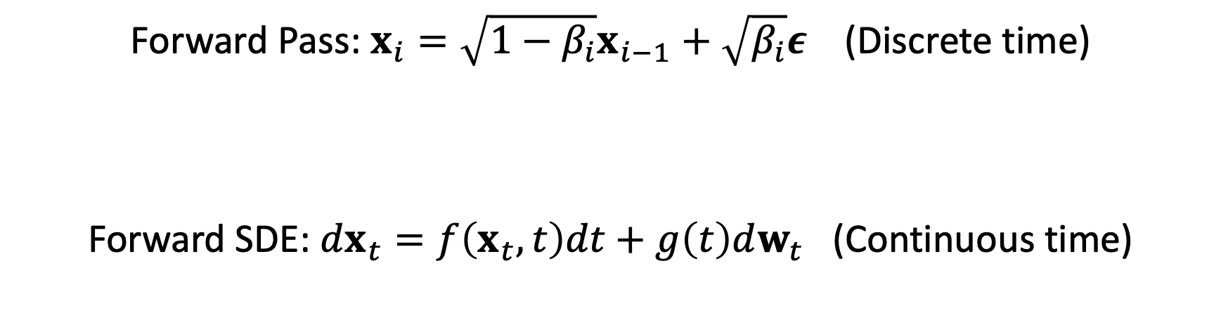
Diffusion Models and SDEs
In a continuous time domain, the forward process is described by an SDE.
Forward Pass: $x_{i}={\sqrt{1−β_{i}}x}_{i−1}+\sqrt{β_{i}}ε$ (Discrete time)
Forward SDE: $dx_{t}=f\left(x_{t},t\right)dt+g\left(t\right)dw_{t}$ (Continuous time)
$f\left(x_{t},t\right)$: Drift coefficient
$g(t)$: Diffusion coefficient
$w_{t}$: Standard Brownian motion
Notes:
The reason why we introduce SDE is that there is an interesting connection between diffusion models and SDEs.
When the time domain of diffusion models becomes continuous from the discrete domain, the forward pass is now described in the form of an SDE.

Slide 36
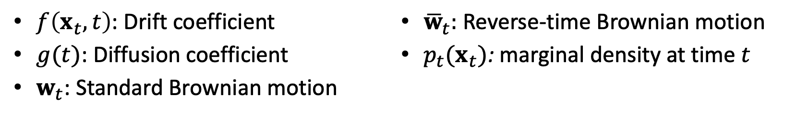
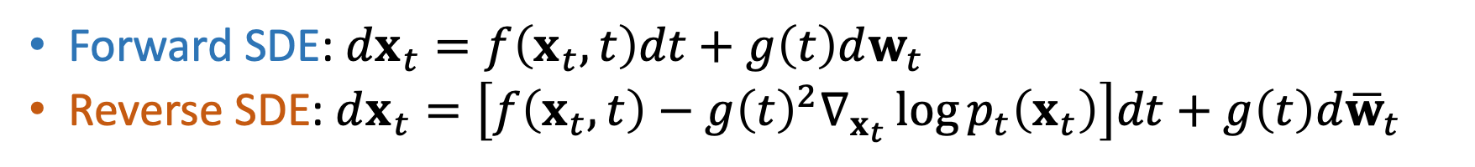
Diffusion Models and SDEs
The reverse process of diffusion models also has its corresponding SDE form.
Forward SDE: $dx_{t}=f\left(x_{t},t\right)dt+g\left(t\right)dw_{t}$
Reverse SDE: $dx_{t}=\left[f\left(x_{t},t\right)−g{\left(t\right)}^{2}∇_{x_{t}}\log{p_{t}\left(x_{t}\right)}\right]dt+g\left(t\right)d{\overline{w}}_{t}$
$f\left(x_{t},t\right)$: Drift coefficient
$g(t)$: Diffusion coefficient
$w_{t}$: Standard Brownian motion
${\overline{w}}_{t}$: Reverse-time Brownian motion
$p_{t}(x_{t})$: marginal density at time $t$
Notes:
Interestingly, not only the forward pass of diffusion models, but also the reverse process has its corresponding SDE form.

Slide 37
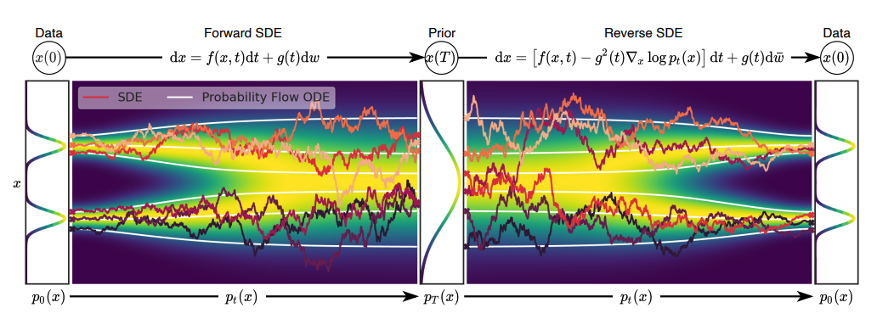
Probability Flow ODE
A SDE has a corresponding ODE (no stochasticity) that has the same marginal distribution at every time step.
Red curves: SDE
White curves: ODE
Notes:
Furthermore, every SDE has its corresponding ODE form that has the same marginal distribution,
and we refer to the ODE that describes the sampling process of diffusion models as a probability flow ODE or in short PF-ODE.

Slide 38

Probability Flow ODE
Forward SDE: $dx_{t}=f\left(x_{t},t\right)dt+g\left(t\right)dw_{t}$
Reverse SDE: $dx_{t}=\left[f\left(x_{t},t\right)−g{\left(t\right)}^{2}∇_{x_{t}}\log{p_{t}\left(x_{t}\right)}\right]dt+g\left(t\right)d{\overline{w}}_{t}$
Reverse PF-ODE: $dx_{t}=\left[f\left(x_{t},t\right)−\frac{1}{2}g{\left(t\right)}^{2}∇_{x_{t}}\log{p_{t}\left(x_{t}\right)}\right]dt$
Notes:
In summary, the forward process and the reverse process of diffusion models can be described by differential equations in the continuous time domain.

Slide 39
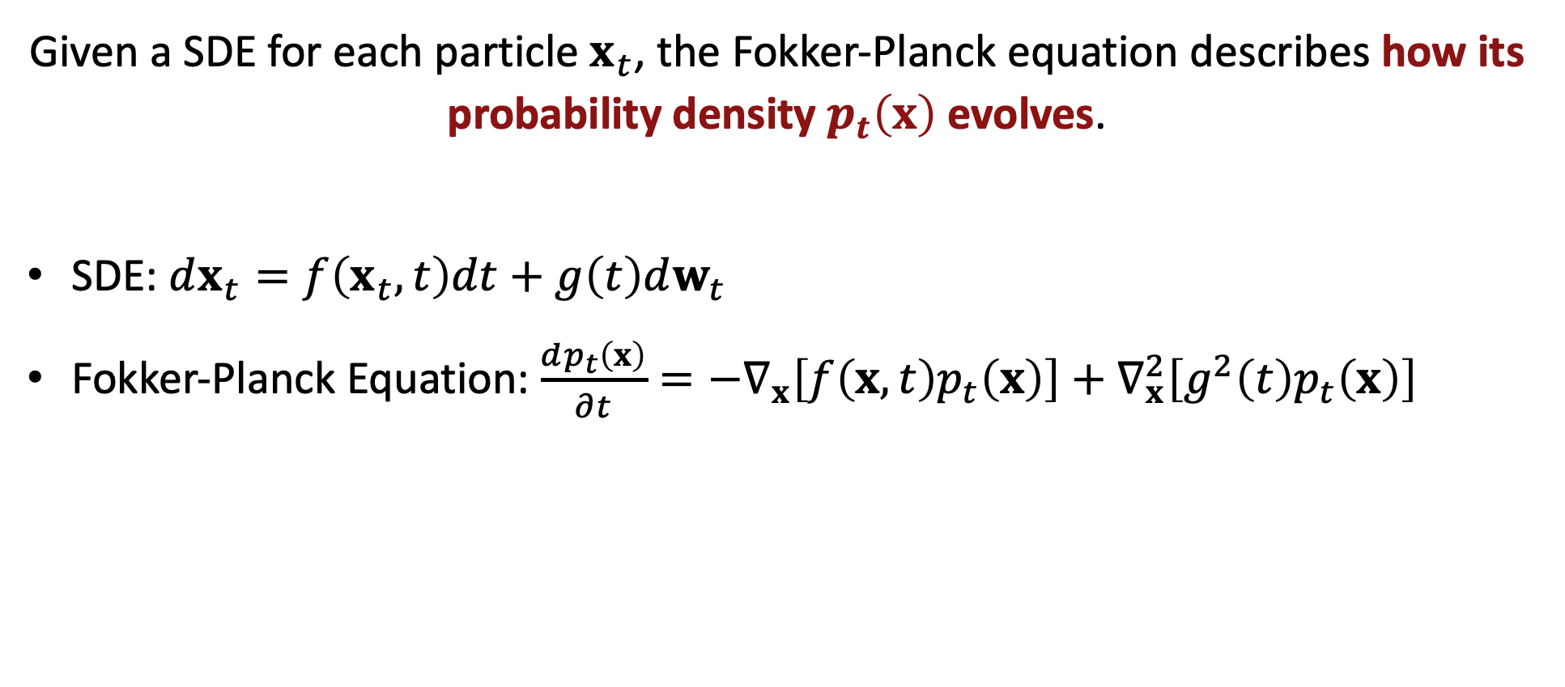
Fokker-Planck Equation
Given a SDE for each particle $x_{t}$, the Fokker-Planck equation describes how its probability density $p_{t}\left(x\right)$ evolves.
SDE: $dx_{t}=f\left(x_{t},t\right)dt+g\left(t\right)dw_{t}$
Fokker-Planck Equation: $\frac{dp_{t}\left(x\right)}{∂t}=−∇_{x}\left[f\left(x,t\right)p_{t}\left(x\right)\right]+∇_{x}^{2}\left[g^{2}\left(t\right)p_{t}\left(x\right)\right]$
Notes:
While so far we have discussed only SDE for each particle x_t,, there is an interesting connection between this SDE and the evolution of their probability density itself.
Given an SDE for each particle x_t, we can also ask: how does the probability density itself evolve over time? This is exactly what the Fokker–Planck equation describes — it connects the SDE of individual trajectories to the time evolution of the overall probability density, as shown here.

Slide 40

Fokker-Planck Equation
The Fokker-Planck equation describes how the $p_{t}$ evolves from a Gaussian distribution to the data distribution.
Notes:
You don’t need to follow all those details, but keep in mind that learning denoising process through diffusion models is equivalent to solving its corresponding SDE/ODE, and learning this SDE for each sample x_t essentially means learning the mapping between two probability distributions: one is the data distribution which is unknown, and the other one is a reference distribution, which is typically modeled as a Gaussian to be tractable. That’s what diffusion models learn under the hood.
We will further discuss this in the next presentation today.

Slide 41

Probability Flow ODE
The sampling process of diffusion models can be framed as solving ODEs.
$\frac{dx_{t}}{dt}=h_{θ}\left(x_{t},t\right)$ $≔f\left(x_{t},t\right)+\frac{g{\left(t\right)}^{2}}{2σ_{t}}ε_{θ}\left(x_{t},t\right)$
Notes:
From this perspective, the sampling process of diffusion models can be seen as solving their corresponding PF-ODEs, where the time derivative of x_t is determined by the output of the noise prediction network.

Slide 42
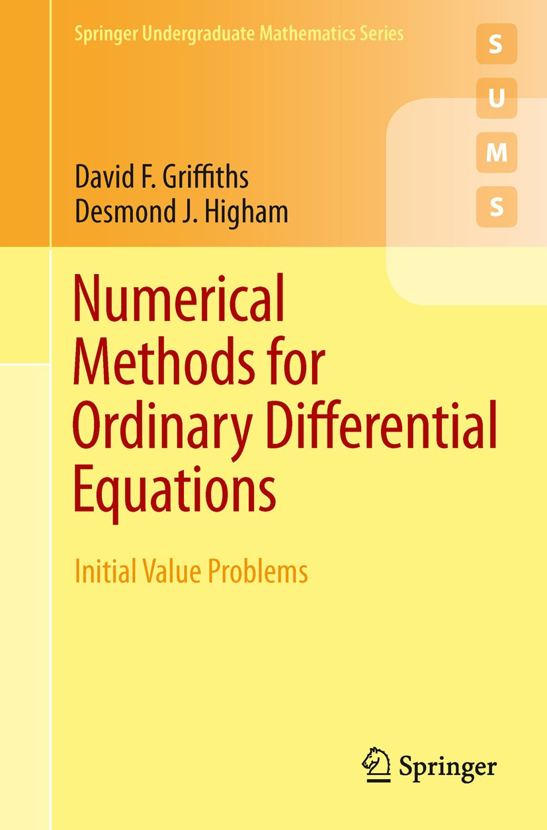

Numerical Methods for ODE
Name | Order | Update Formula
Euler | 1st | $$x_{n+1}=x_{n}+Δt⋅h_{θ}(x_{n},t_{n})$$
Heun | 2nd | Predictor: $k_{1}=h_{θ}\left(x_{n},t_{n}\right)$ ${\tilde{x}}_{n+1}=x_{n}+Δt⋅k_{1}$ Corrector: $k_{2}=h_{θ}\left({\tilde{x}}_{n+1},t_{n+1}\right)$ $x_{n+1}=x_{n}+\frac{Δt}{2}(k_{1}+k_{2})$
Runge-Kutta | 4th | $$k_{1}=h_{θ}\left(x_{n},t_{n}\right) k_{2}=h_{θ}\left(x_{n}+\frac{Δt}{2}k_{1},t_{n}+\frac{Δt}{2}\right)$$ $${k_{3}=h}_{θ}\left(x_{n}+\frac{Δt}{2}k_{2},t_{n}+\frac{Δt}{2}\right)$$ $${k_{4}=h}_{θ}\left(x_{n}+Δtk_{3},t_{n+1}\right)$$ $$x_{n+1}=x_{n}+\frac{Δt}{6}(k_{1}+{2k}_{2}+2k_{3}+k_{4})$$
Notes:
Solving ODEs is a very long-standing problem with numerous numerical methods developed over the centuries, starting from simple Euler method to more advanced higher-order techniques.

Slide 43

DPM-Solver
Can we design a more specialized solver for PF-ODEs?
$\frac{dx_{t}}{dt}=h_{θ}\left(x_{t},t\right)$ $≔f\left(x_{t},t\right)+\frac{g{\left(t\right)}^{2}}{2σ_{t}}ε_{θ}\left(x_{t},t\right)$
Notes:
However, these numerical methods are general-purpose solvers. They’re not specifically designed for PF-ODEs.
This naturally raises the question that “Can we design a dedicated solver for PF-ODEs that computes more accurate solutions with fewer sampling steps.

Slide 44
Semi-Linear Structure of PF-ODEs
PF-ODEs are first-order semi-linear ODEs, split into a linear term and a non-linear term.
$\frac{dx_{t}}{dt}=h_{θ}\left(x_{t},t\right)$ $≔f\left(x_{t},t\right)+\frac{g{\left(t\right)}^{2}}{2σ_{t}}ε_{θ}\left(x_{t},t\right)$
linear term
nonlinear term
Notes:
To answer this question, it’s important to recognize that PF-ODEs follow a specific structure.
They are first-order semi-linear ODEs, meaning that they can be decomposed into a linear term and a nonlinear term.
This structure allows us to consider solvers that are specifically designed for this class of equations

Slide 45

DPM-Solver
DPM-Solver leverages this semi-linear structure for more accurate solutions.
$$x_{s→t}=\frac{α_{t}}{α_{s}}x_{s}−α_{t}\int_{λ_{s}}^{λ_{t}}{e^{−λ}}{\hat{ε}}_{θ}\left({\hat{x}}_{λ},λ\right)dλ$$
$\frac{dx_{t}}{dt}=h_{θ}\left(x_{t},t\right)$ $≔f\left(x_{t},t\right)+\frac{g{\left(t\right)}^{2}}{2σ_{t}}ε_{θ}\left(x_{t},t\right)$
linear term
nonlinear term
Only the nonlinear term is approximate by a Taylor expansion.
Notes:
DPM-Solver leverages this semi-linear structure to compute more accurate solutions.
The equation shown at the bottom represents the exact solution from timestep s to t.
Here, the linear term is highlighted in green, and the nonlinear term is highlighted in red.
As you can see, the linear part is simply a linear function of x.
However, the nonlinear term takes a form of an integral involving an exponential.
Because of this structure, we only need to approximate the nonlinear part of the solution — and this is done by using a Taylor expansion.
In short, the key idea is that DPM-Solver is a dedicated solver for PF-ODEs, leveraging their semi-linear structure.
This allows it to obtain a more accurate solution compared to DDIM for the same number of sampling steps.

Slide 46

DPM-Solver
DDIM
DPM-Solver
Notes:
Then, let’s compare DPM-Solver and DDIM through qualitative results.
On the left side of the figure are results sampled with DDIM with sampling steps from 10 to 100, while on the right are results generated with DPM-Solver in just 10 steps.
In the case of DDIM, we can see that it tends to generate blurry outputs with less than 100 steps.
On the other hand, DPM-Solver produces much cleaner and sharper outputs with only 10 steps,
Indicating that simply changing the sampling strategy from DDIM to DPM-Solver can signficantly improve sample quality with a small number of steps.

Slide 47

DPM-Solver
Notes:
And, here, this is a quantitative comparison of different sampling strategies, including DPM-Solver highlighted in blue, DDPM in orange, and DDIM in red.
In the figure, the x-axis represents the number of sampling steps, and the y-axis is FID-score, where a lower FID score indicates better quality.
Thus, the optimal result lies in the left-bottom corner, achieving high-quality generation within fewer sampling steps.
Compared to DDPM and DDIM, we can see that DPM-Solver consistently achieves lower FID scores for the same number of steps

Slide 48
Takeaways of High-Order ODE Solvers
Diffusion Models as SDEs
In continuous time, forward and reverse processes become SDEs.
SDEs and PF-ODEs
Each SDE has a deterministic counterpart, the PF-ODE.
High-Order ODE Solvers
More accurate solvers yield better results with fewer steps.
No Training
These methods require no extra training.
Notes:
In summary, diffusion models can be expressed as SDEs in continuous time,
(click) and each SDE has a deterministic counterpart, and and the ODE representing the sampling process is called the PF-ODE .
(click) And by using more accurate high-order ODE solvers, we can achieve better results with fewer sampling steps,
(click) Lastly, and importantly, this acceleration is achieved without any extra training..

Slide 49

DDPM ($T=1,000$)
$×100$ Speed-Up Without Training
DDIM ($T≤50$)
High-Order ODE Solvers ($T≤10$)
Finetuning-Based Methods ($T=1\sim 4$)
Notes:
So far, through DDIM and high-order ODE solvers, we’ve seen that it’s possible to achieve nearly a 100× speed-up over the original DDPM without any additional training.
But what if we want to generate samples in just a single step or a few steps?

Slide 50

DDPM ($T=1,000$)
DDIM ($T≤50$)
High-Order ODE Solvers ($T≤10$)
Finetuning-Based Methods ($T=1\sim 4$)
Notes:
For that, we now need further training. So next, let’s look at various finetuning strategies for achieving even greater speed-ups and enabling single- or few-step generation.

Slide 51


Consistency Models
Given a solution trajectory ${\left\{x_{t}\right\}}_{t∈[0,T]}$, consistency models $f_{θ}$ learn to map any $x_{t}$ directly to its final clean sample $x_{0}$.
[Consistency Models, Song et al., ICML 2023]
Notes:
Consistency models are one of the most popular approaches for single- or few-step generation. Unlike diffusion models, which are trained to predict x_{t-1} from x_t, consistency models are trained to directly predict the final clean output x_0 across all timesteps.
In the diagram, this means that all states at different timesteps along the trajectory should be mapped to the same x_0 by the consistency model.

Slide 52


Consistency Loss
In order to map any $x_{t}$ along the trajectory to the same $x_{0}$, it’s trained with the following consistency loss:
$$ℒ_{Consistency}=‖f_{θ}\left(x_{t},t\right)−f_{θ}\left(x_{t+1},t+1\right)‖$$
[Consistency Models, Song et al., ICML 2023]
Notes:
In order to learn this one-step mapping from any x_t to the same x_0, the model is trained with the consistency loss shown here.
This loss measures the difference between the model’s prediction of x_0 from two nearby points along the same trajectory — for example, x_t and x_{t+1}. By minimizing this loss, we ensure that regardless of where we start along the ODE trajectory, the model consistently maps back to the same x_0. The figure below illustrates this: the red arrows show the model mapping different x_ts along the trajectory to the same x_0.

Slide 53



Comparison with Diffusion Models
Diffusion Models
($S≥30$)
Consistency Models
($S=1$)
Notes:
This is a qualitative comparison of standard diffusion models and consistency models.
Compared to diffusion models, consistency models can generate plausible outputs in just a single step — achieving quality that’s nearly comparable to diffusion models sampled with more than 30 steps.

Slide 54

Consistency Trajectory Models
Consistency Models:$x_{0}≈f_{θ}\left(x_{t},t\right)$
Consistency Trajectory Models: $x_{s}≈f_{θ}\left(x_{t},t,s\right)=\int_{t}^{s}{\frac{dx_{τ}}{dτ}}dτ$
Target time
Notes:
There have been several follow-up works aiming to improve consistency models.
One key limitation of standard consistency models is that they always map any x_t directly to the fully denoised output x_0,
which makes it difficult to perform multi-step generation in a natural way.
To address this, Consistency Trajectory Models introduce an additional condition — a target timestep s.
Instead of always predicting x_0, the model now maps x_t to the state at the target timestep s.
Thus, this model allows users to control the trade-off between quality and sampling speed.

Slide 55


Shortcut Models
Model Output:$x_{t+d}=x_{t}+s_{θ}\left(x_{t},t,d\right)d$
When $d→0$, the model output is identical to velocity$(=\frac{{dx}_{t}}{dt})$.
[Shortcut Models, Frans et al., ICLR 2025]
Notes:
Similarly, Shortcut Models introduce an auxiliary condition, which is denoted by d here. It represents a desired step size in solving ODEs. Thus, in Shortcut Models, x_{t+d} can be computed as x_t + the neural net output multiplied by the step size d.
One interesting property of Shortcut Models is that, as the step size d goes to 0, the model’s output converges to the velocity, which is the time derivative of x_t.
So in effect, from the perspective of solving ODEs, Shortcut models unify both the integral output (like consistency models) and the infinitesimal step (like diffusion models’ output).

Slide 56

Distillation-Based Approach
[Progressive Distillation, Salimans and Ho, ICLR 2022]
Notes:
There are also several distillation-based approaches, which involve two different models: a slow teacher model and a faster student model. The goal is to distill a slow teacher diffusion model into a fast student diffusion model. In the figure, we see two iterations of progressive distillation. In each distillation stage, the teacher model takes more sampling steps to compute an accurate solution to the ODE, while the student model is trained to predict these teacher model’s outputs within fewer steps all at once.

Slide 57

GAN-Based Finetuning
[Adversarial Distillation Diffusion, Sauer et al., arXiv preprint 2023]
Notes:
There also have been various attempts to leverage GAN for diffusion model acceleration. Similar to distillation-based approaches, these methods follow a teacher–student framework. However, in addition, they incorporate a GAN adversarial loss, where the student model is trained to produce outputs such that it fools a discriminator into classifying them as real data.
This adversarial loss has been widely demonstrated to be effective in producing sharp outputs and achieving diversity in single/few-step generation.

Slide 58




Acceleration – Summary
By changing the sampling strategy without training, one can accelerate sampling process from 1,000 steps to around 20 steps.
For further acceleration like one/few-step generation, there are several training schemes like consistency models.
$$[T=1,000]$$
$$[T≤50]$$
$$[T≤10]$$
$$[T=1\sim 4]$$
High-Order
ODE Solvers
Finetuning-Based
Approaches
DDPM
DDIM
No Training
Notes:
This is a summary of the entire presentation on acceleration. Using DDIM or high-order ODE solvers, we can achieve about a 100× speed-up over basic DDPMs without any additional training. For further acceleration, there are several training schemes like consistency models.

Slide 59
End of Part 4 – Accelerating Generative Process
Notes:
This is the end of my presentation on accelerating generation. Our next presenter will continue the presentation with a focus on video diffusion models.

