Slide 1
Adaptive multi-scale analysis for point based surface editing
G. Nader¹ and G. Guennebaud² and N. Mellado³
¹ Université de Lyon - LIRIS UMR 5205 CNRS, France
² Inria - Univ. Bordeaux - IOGS - CNRS, France
³ University College London, United Kingdom

Slide 2
Adaptive multi-scale analysis for point based surface editing
Georges Nader
Master thesis (INRIA Bordeaux - France)
Now:
PhD student (LIRIS - France)
Advisor: Florent Dupont
Perceptual Quality Evaluation of Dynamic Meshes and its Applications.

Slide 3
Independent feature editing
Easy to use

Slide 4
Popular tools
3D sculpting software:
Feature selection via manual adjustment of brush size.
Difficult
Time Consuming

Slide 5
Related work
Spectral Processing [Lev06, SOG09, ZVKD10]
Feature editing via re-composition of a set of eigenfunctions [VL08]
Manual selection of the eigenfunctions
Time and memory consuming

Slide 6
Related work
Multi-scale surface decomposition [Pauly2006]
Smoothing
Decomposition
Displacements
(x3)
Manual selection of the scales
Input
Fast to compute and low memory requirement
t

Slide 7
Our Approach
Novel multi-scale decomposition.
Contribution
Automatic clustering of frequencies matching the same feature
Benefits
One-to-one mapping between scale frequency groups and features
Independent manipulation of geometric features by applying a single weight per feature.
Automatic selection of the scales
Fast to compute and low memory requirement

Slide 8
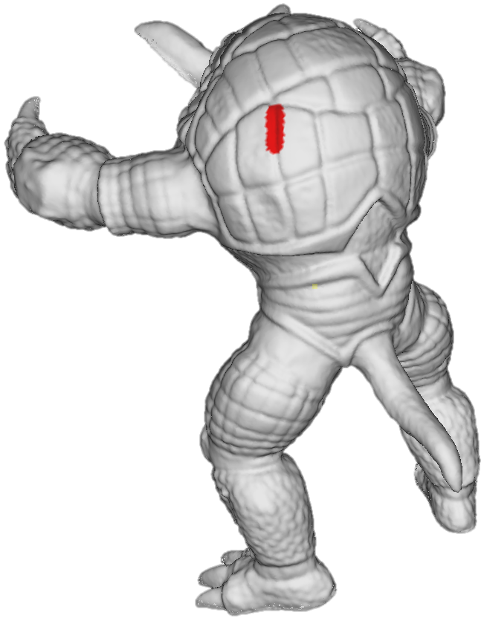
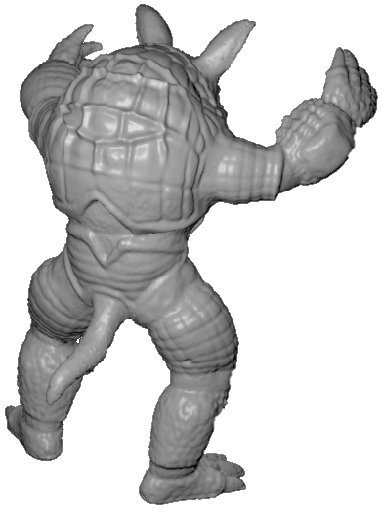
Pipeline
Detection of pertinent feature scales
Feature editing
A - ROI selection
B - Point-wise analysis
C - ROI analysis
1
1
1
0
1
0
-1
-1
-1
-1
t
t
E - GUI generation and mapping
F- Surface editing

Slide 9
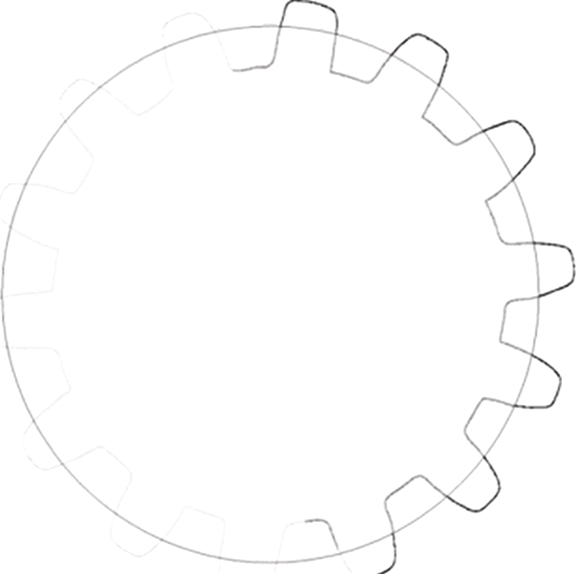
Point-wise Analysis
Pertinent features
No prior knowledge on any feature shape
Analyze variations of the multi-scale decomposition along scale
Geometric Variation ν
GLS Framework [MGB12]
Smoothing
Decomposition
Displacements
(x3)
ν
||d||
Input
t
d
t
t

Slide 10
Point-wise Analysis
Pertinent scale extraction
Find a subset of local minima
Compute the likelihood of scale is pertinent scale
Penalized homological persistence
Noisy
Output:
set of weighted scales per points
s

Slide 11
Pipeline
Detection of pertinent feature scales
Feature editing
A - ROI selection
B - Point-wise analysis
C - ROI analysis
1
1
0
0
0
0
-1
-1
-1
-1
t
t
E - GUI generation and mapping
F- Surface editing

Slide 12
ROI analysis
Accumulate point-wise weights
Extraction of pertinent scales via a clustering algorithm.
Robust clustering: $k$-means++ [AV07] (better initialization)
Number of clusters $k$. [PDN05] (test different values of $k$)
t
t

Slide 13
Feature Editing
1
0
-1
t
t
Generate adaptive equalizer.
1 slider / cluster
Each slider controls a set of scales representing a certain feature.

Slide 14
Results
Synthetic model
1
1
1
1
0
0
0
0
-1
-1
-1
-1

Slide 15
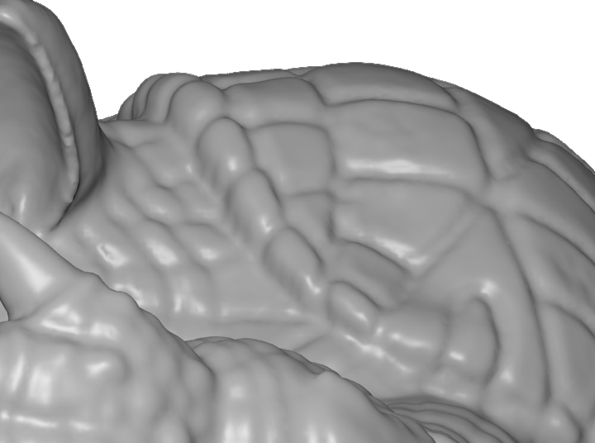
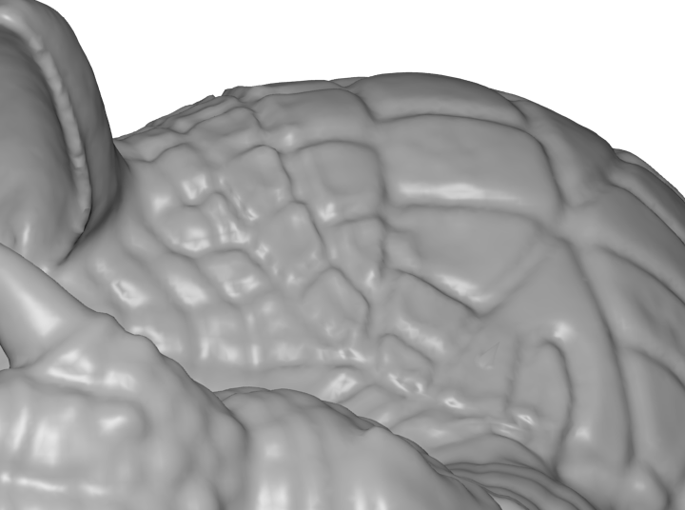
Results
before
after
Manipulation of mid-scale features: removal of the armadillo's carapace’s edge while leaving the finer details intact.

Slide 16
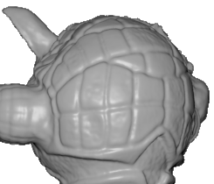
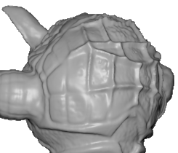
Results
Feature inversion : hollow features on the armadillo’s carapace are inverted.

Slide 17
Results
Large scale editing while preserving small details

Slide 18
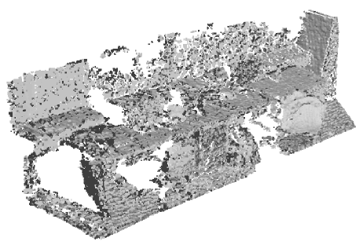
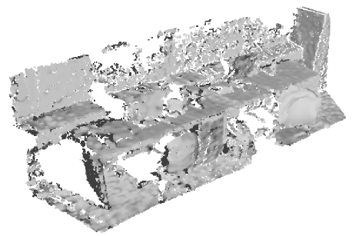
Results
Automatic noise removal on raw Kinect data

Slide 19
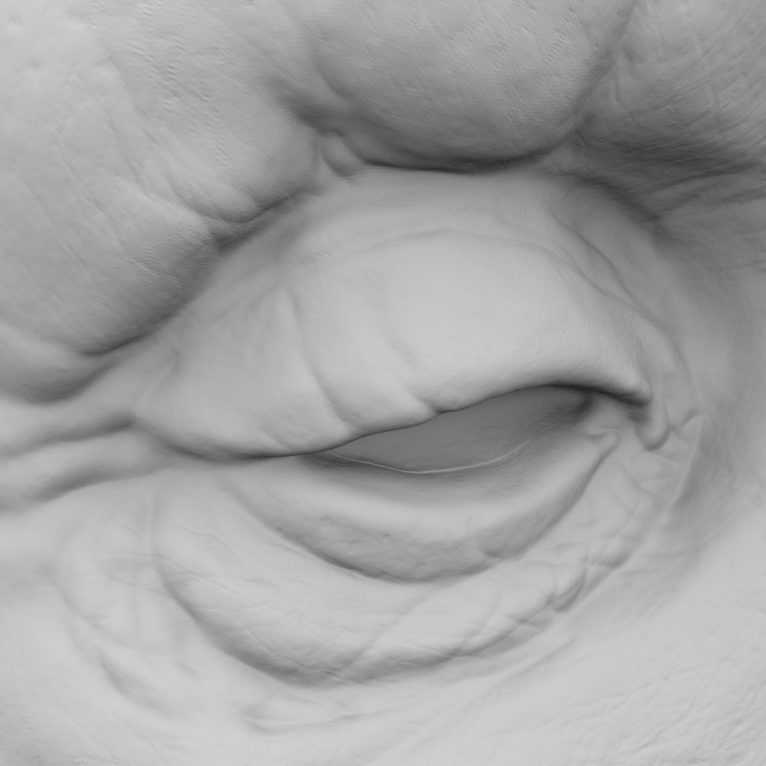
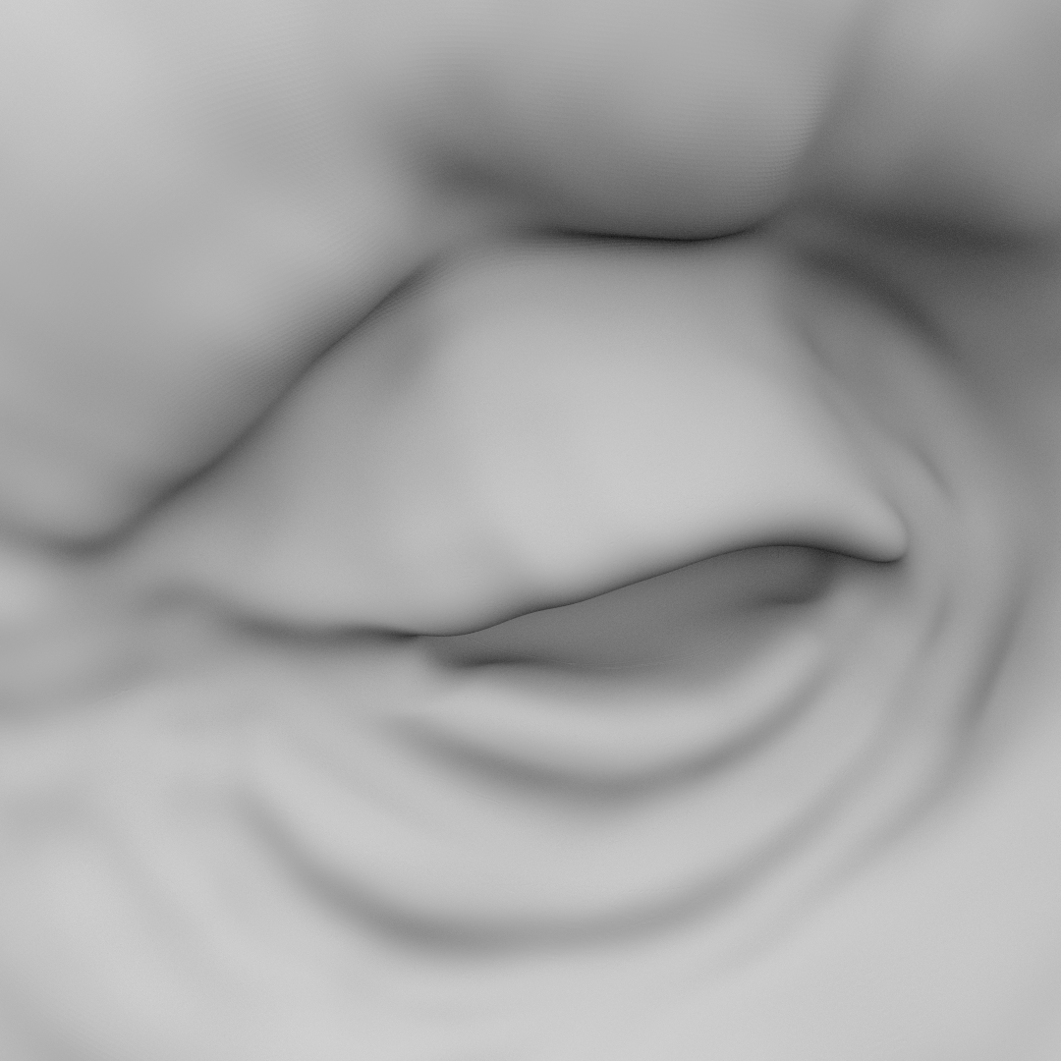
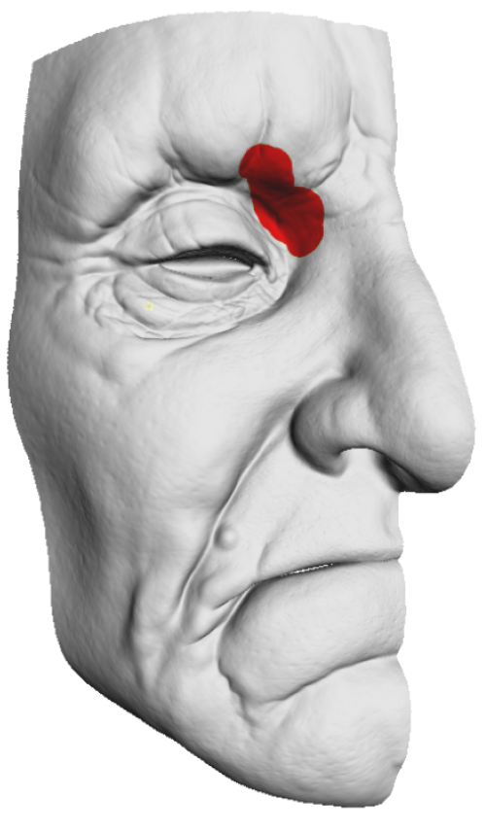
Performances
Performances
Interactive time for small ROI (up to env. 10k vertices)
1
1
1
0
0
0
-1
-1
-1

Slide 20
Discussion
Scalability (implementation)
Multi-resolution for large scale computations
ROI-adaptive sampling
Requires relatively dense scale sampling
Local adjustment of the pertinent scales

Slide 21
Conclusion
Automatic scale extraction of pertinent features.
No connectivity information is required.
Real-time ROI analysis and feature manipulations.

Slide 22
Thank you for your attention

Slide 24
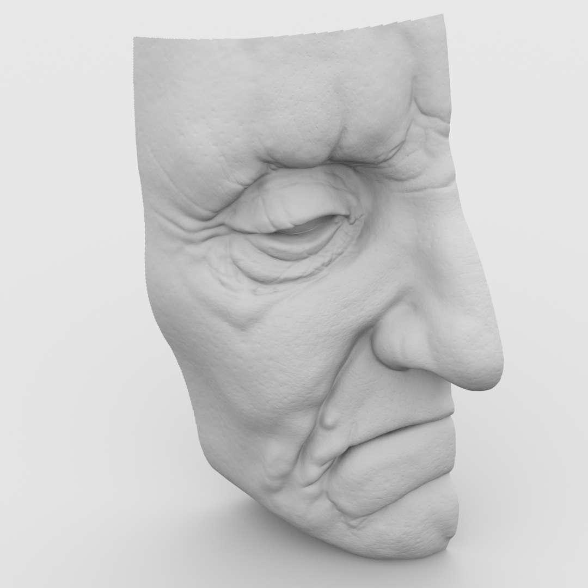
Goal
Input
# Faces: 2.446.671
# Vertices: 1.225.295

Slide 25
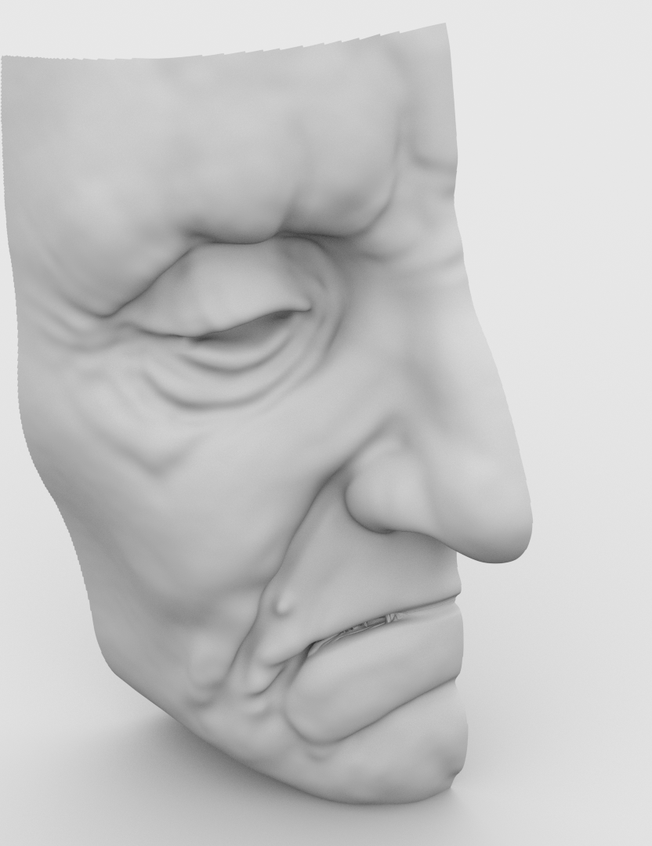
Goal
Smoothing
# Faces: 2.446.671
# Vertices: 1.225.295

Slide 26
Goal
Multi-scale editing
# Faces: 2.446.671
# Vertices: 1.225.295

Slide 27
Goal
original
smoothing
multiscale-editing

