Slide 1
Autocorrelation Descriptor for Efficient Co-Alignment of
3D Shape Collections
Melinos Averkiou¹, Vladimir G. Kim², Niloy J. Mitra³
¹University College London, now at University of Cyprus
²Stanford University, now at Adobe Research
³University College London
Notes:
Hi and thanks for coming to our talk.
I will be presenting the work of Melinos Averkiou and colleagues since Melinos could unfortunately not make it here.
Today we’ll be talking about efficient co-alignment of 3d shape collections.
What do we mean by that?

Slide 2
The Problem

Slide 3
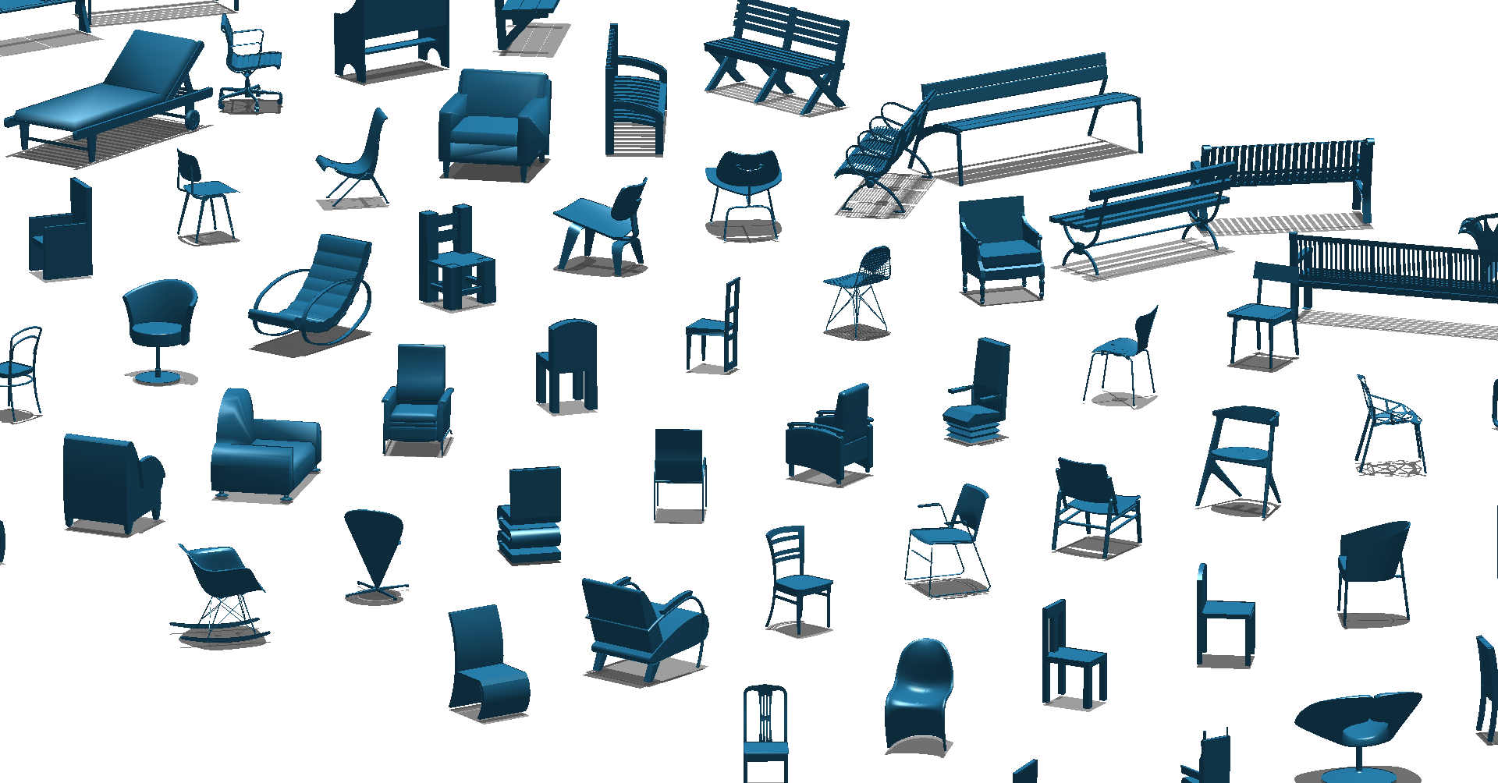
The Problem
Notes:
Raw collections of 3D shapes rarely come consistently aligned.
Consider this collection of chairs. They have a consistent up vector, but they all point in different directions.
This kind of input is typical for an online shape repository.
So given a collection of shapes such as the one shown here, we want to go from this …
(Our problem setting is very clear. )

Slide 4
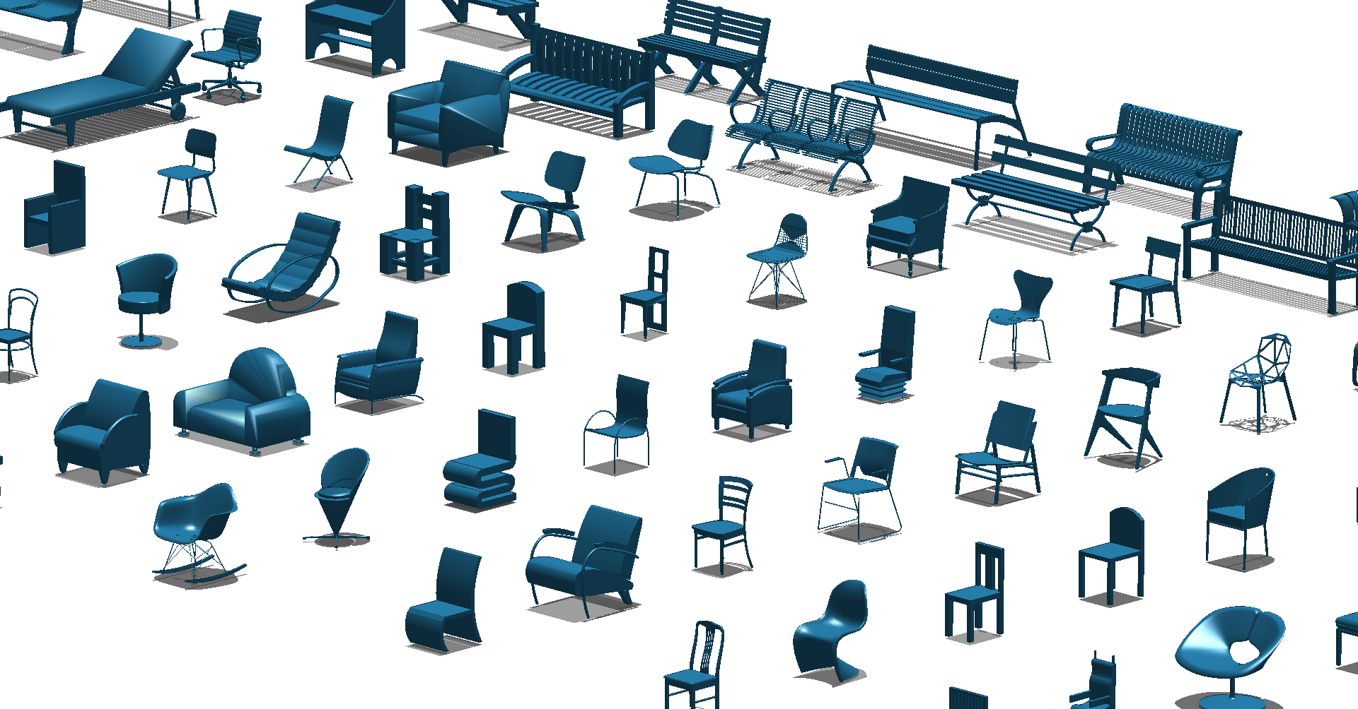
The Problem
Consistently Align shape collections
Notes:
… to this, where every shape points in the same direction.
So, we want to solve for a transformation per shape, that orients all shapes in the collection in a consistent way.

Slide 5
The Problem
Consistently Align shape collections
EFFICIENTLY
Notes:
And most importantly, we want to do this EFFICIENTLY.

Slide 6
Why co-align shape collections?
Shape matching
Model retrieval
Shape analysis
Model consolidation
Assume co-aligned models
Notes:
Why is alignment important?
Because a great deal of geometric modelling relies on vast amounts of 3D data to be consistently aligned.
Matching, retrieval, analysis and consolidation are only a few examples of methods that assume input models to be consistently aligned.

Slide 7
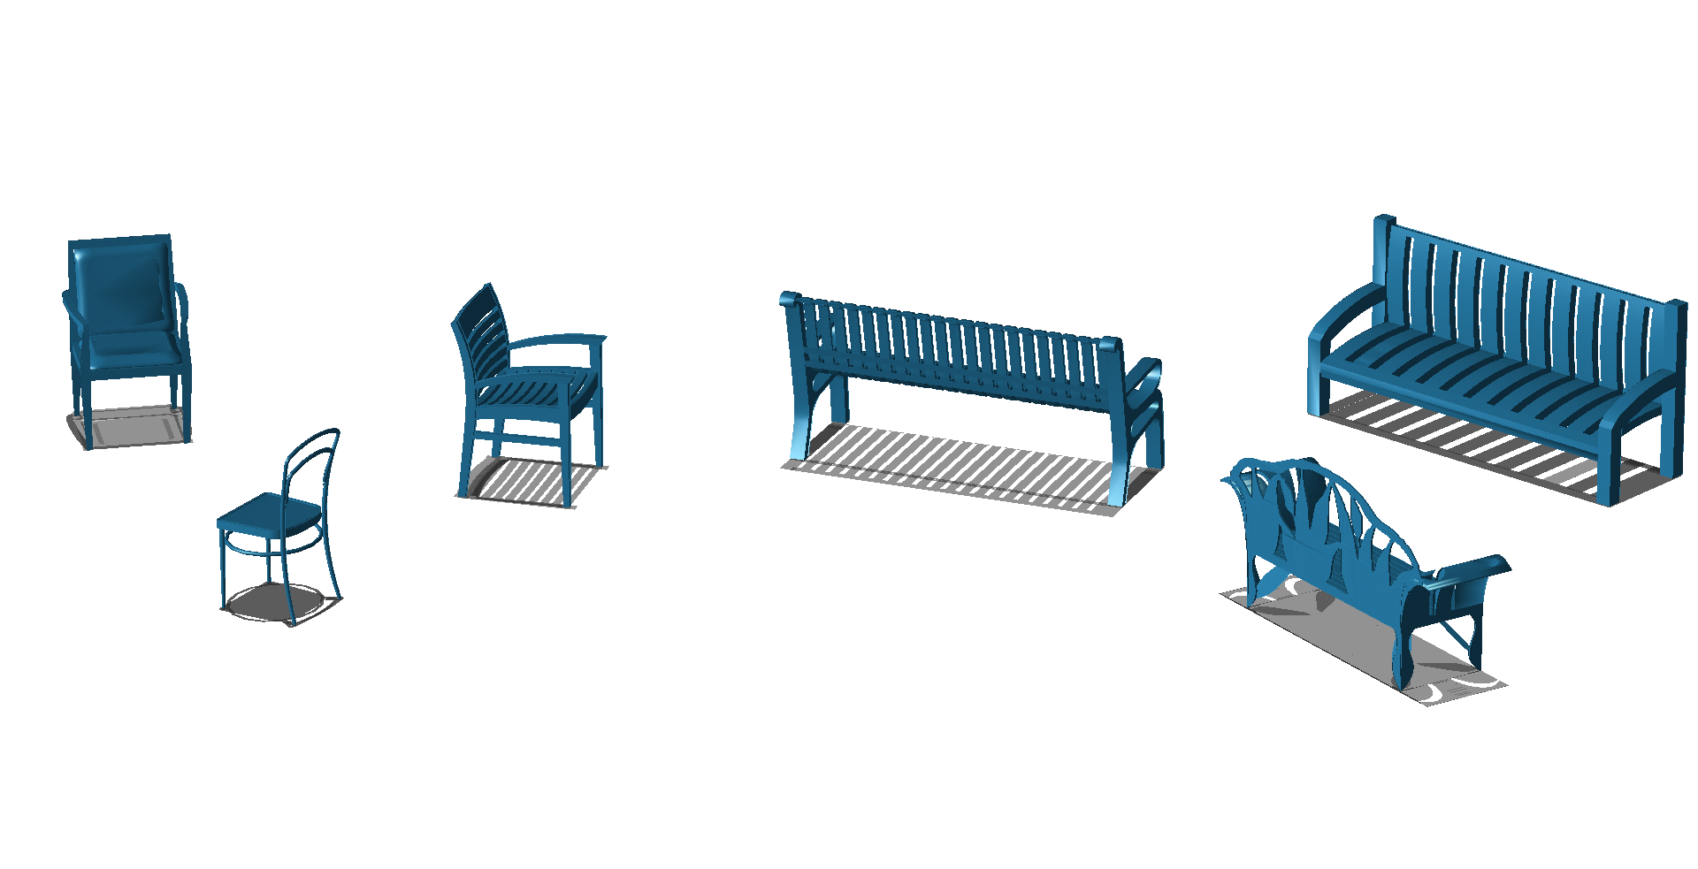
Why efficiently?
Notes:
Why do we want it to be efficient? After all, in most cases it is run as a preprocessing step for other methods.
The rapidly increasing size of online shape collections is the key point here.
While for small collections such as this one, alignment is not so much of a problem, and in fact models can be manually pre-aligned in this case, consider the complexity for larger collections …

Slide 8
Why efficiently?
Notes:
.. such as this one

Slide 9
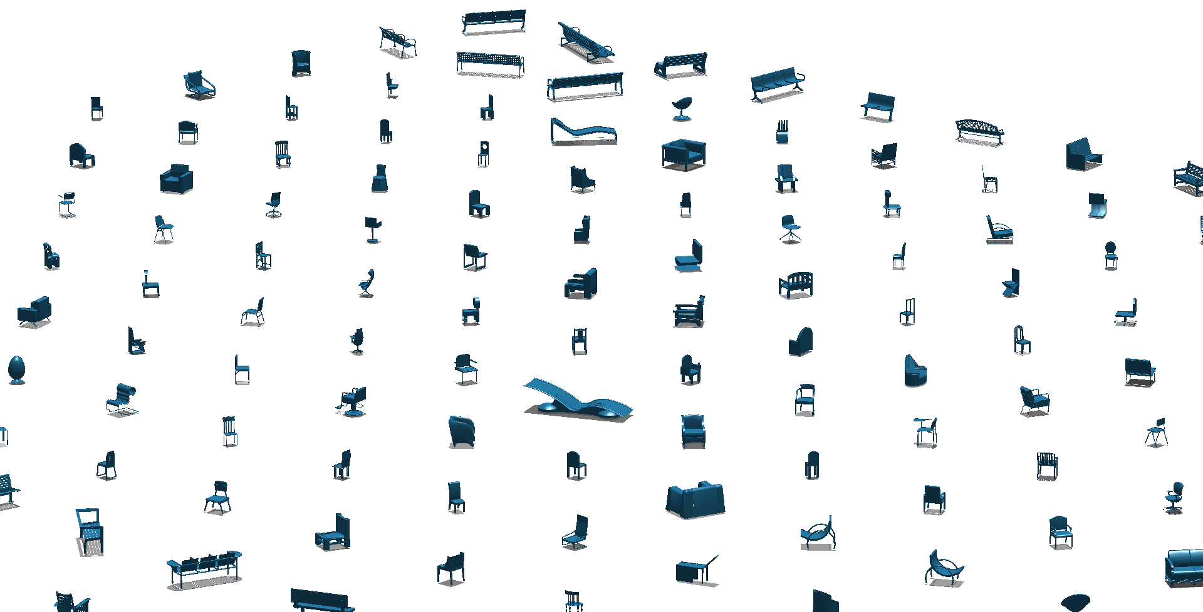
Why efficiently?
Notes:
Or this one, with thousands or millions of shapes.
Manual alignment is clearly not ideal, and we definitely want something that does not take days or weeks to run.

Slide 10
How can we solve this?
A small example
-Consistent up-vector
-Solve for one angle per shape
Notes:
So how can we solve this problem with an automatic method?
We’ll use a toy example from a small chair / bench dataset to demonstrate our solution.
Say that our input is these 6 chairs.
As in the bigger collections shown before, they have a consistent upvector, but each points in an arbitrary direction.
Remember this is typical of online shape collections, so the goal is effectively to solve for an angle per shape (around the up vector) that points all shapes in the same direction.
(Extending our method to deal with arbitrary initial orientations involves solving for two angles per shape, but we restrict ourselves to this case.)
In order to understand our solution, we’ll briefly mention some related work, starting from very simple methods and building our way into our solution.

Slide 11
Related work

Slide 12
Align principal axes to global axes
Notes:
A simple solution is to map each shape’s principal axes to x y z axes.

Slide 13
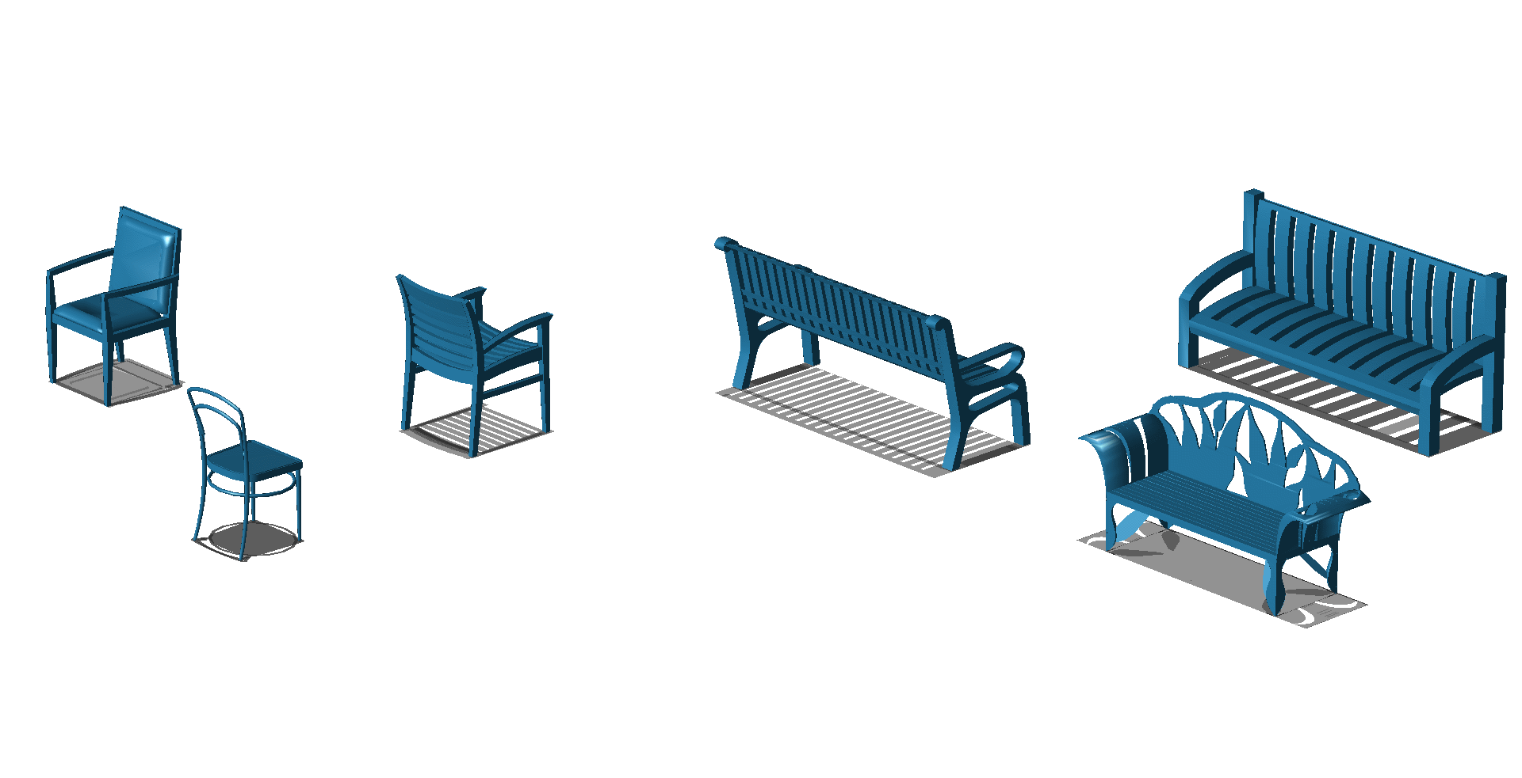
Align principal axes to global axes
Fast
Unstable
Notes:
Although linear in complexity, it is unstable as the principal axes do not necessarily map to the right orientation, and suffers from flips of the axes (eigenvectors).

Slide 14
Align to reference shape
Notes:
Another solution is ..

Slide 15
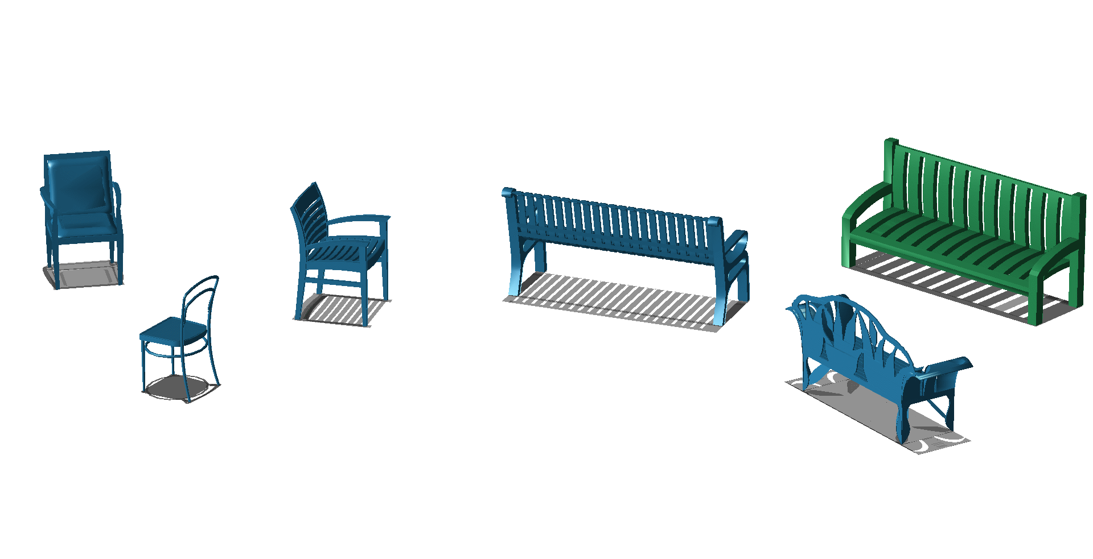
Align to reference shape
Notes:
.. to fix a shape and..

Slide 16
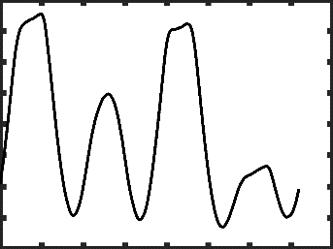
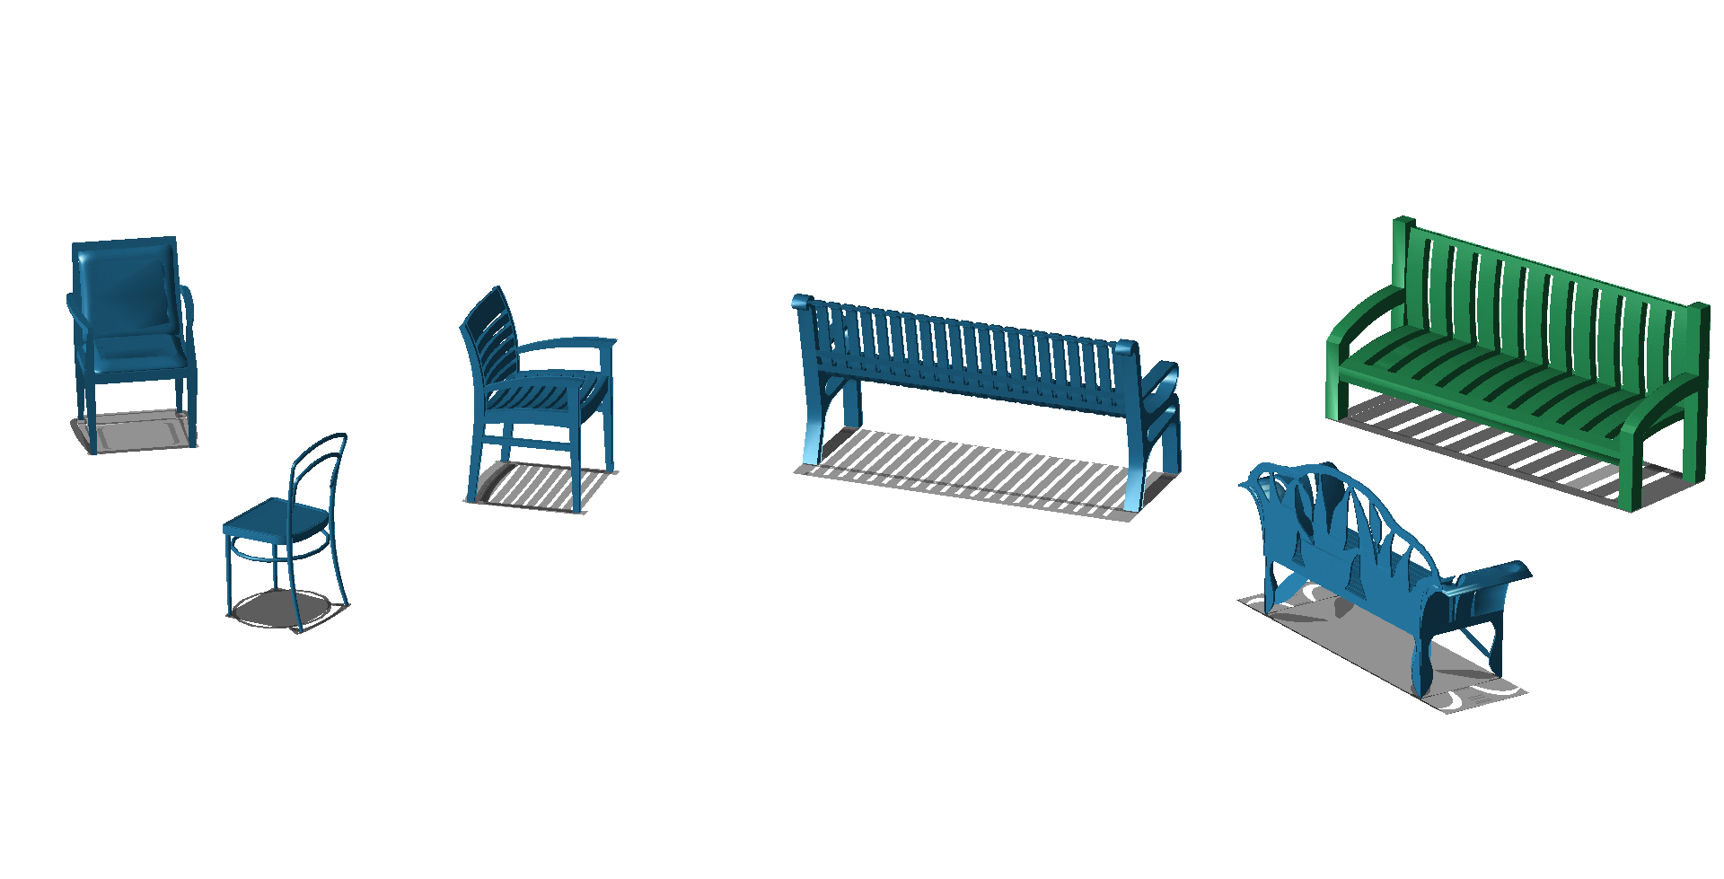
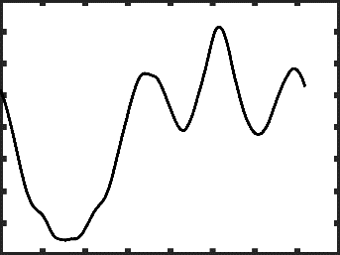
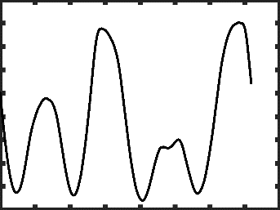
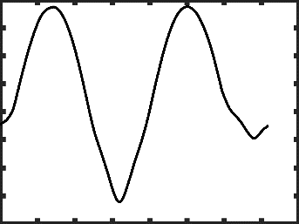
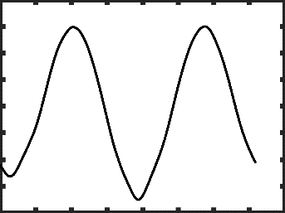
Align to reference shape
Notes:
… align all other shapes to it by exhaustively searching for the alignment with minimum distance between surfaces.

Slide 17
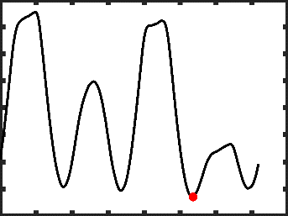
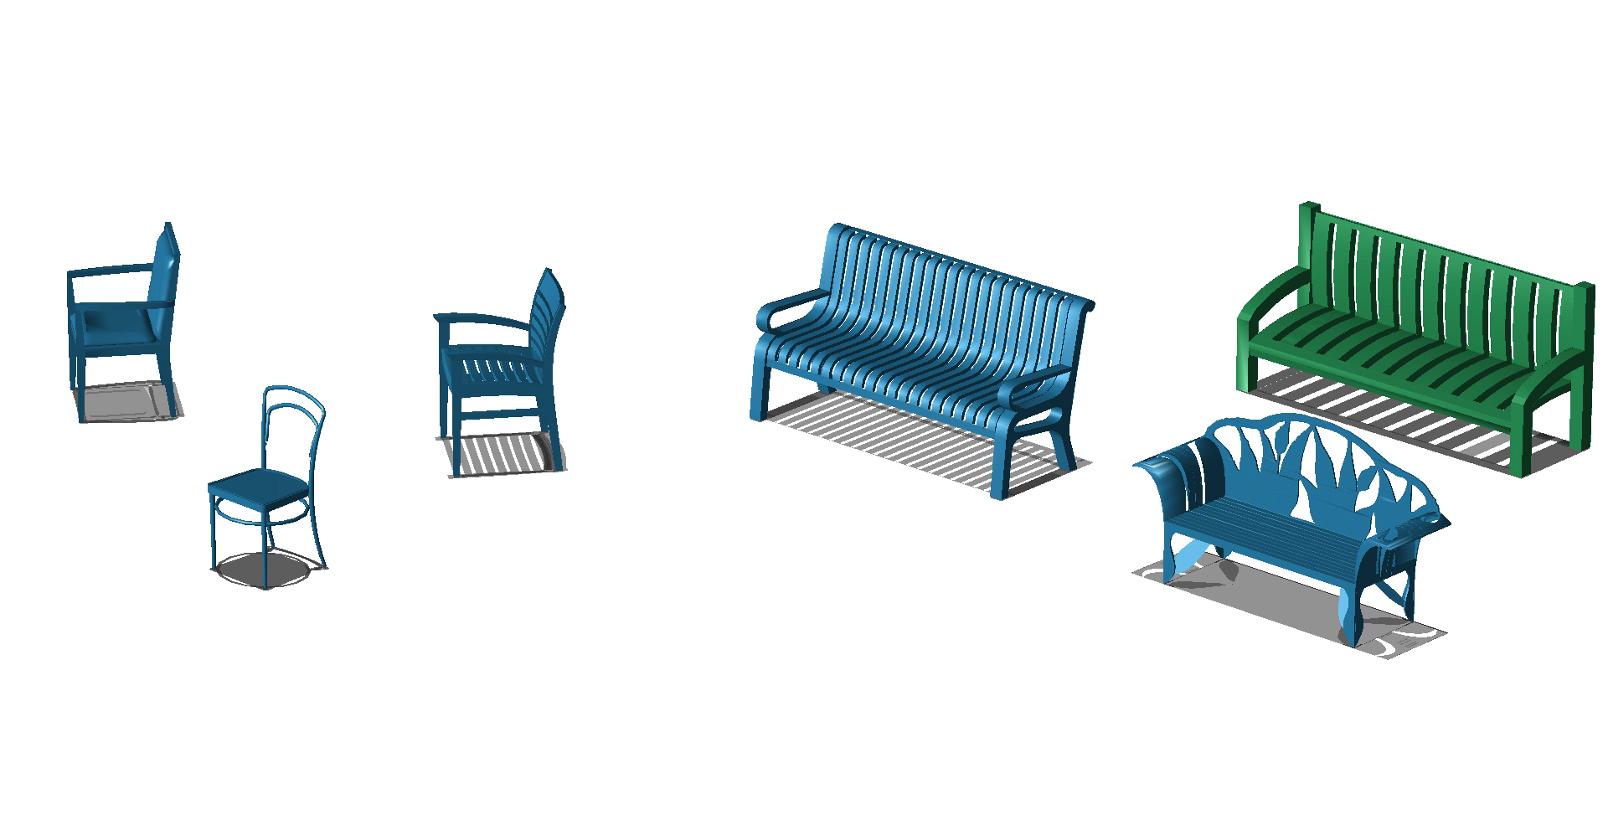
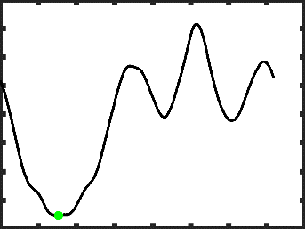
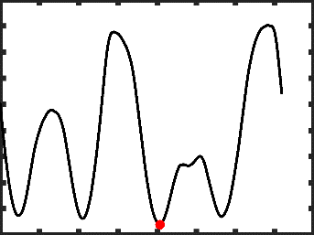
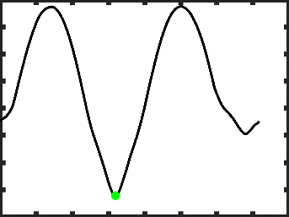
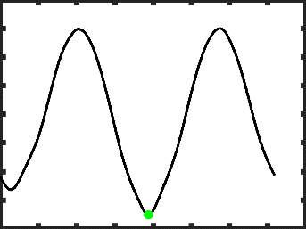
Align to reference shape
Linear complexity
More expensive than PCA
Fails for large variations
Notes:
While more expensive than PCA, it is still unstable and biased to the choice of reference shape.
In the example, benches would align well to the reference shape, but for chairs it is not so easy to find a good match.
This is because any distance function between the surfaces of shapes and the reference shape would have a clear minima for the benches but many local minima for the chairs.
How can we measure surface distance?
Surface Distance can be measured in a number of ways: haussdorff distance, average nearest point distance or some weighted average.
We use average nearest point distance but our method is not tied to any specific distance measure.
It’s important to note here that sampling this surface distance function is the most expensive part of any coalignment method, so our solution tries to avoid sampling it too many times.

Slide 18
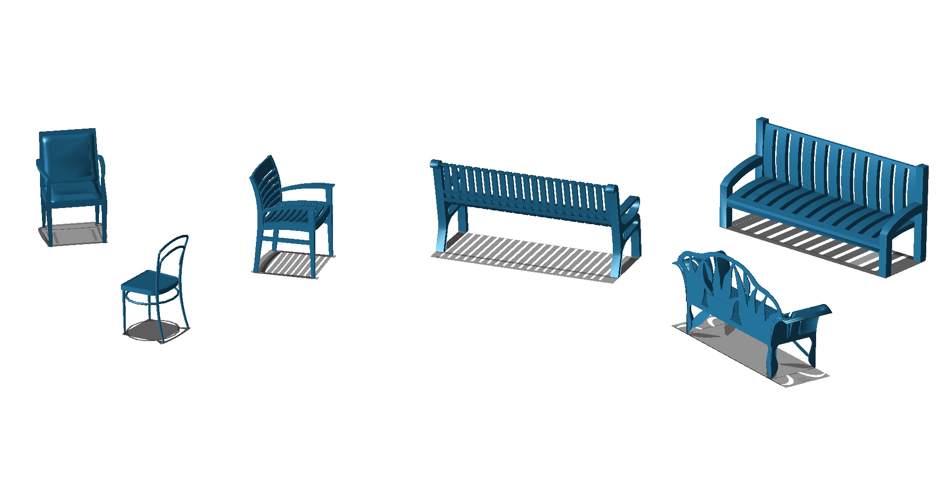
Co-align together
Notes:
A better solution is to compare all pairs of shapes…

Slide 19

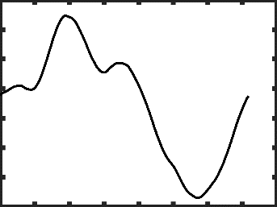
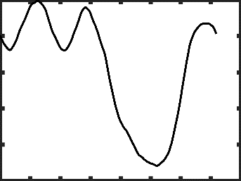
Co-align together
…
…
…
…
…
Notes:
..without committing to a reference shape, ..

Slide 20
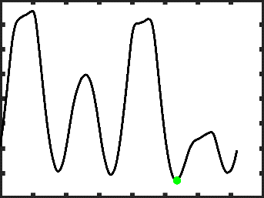
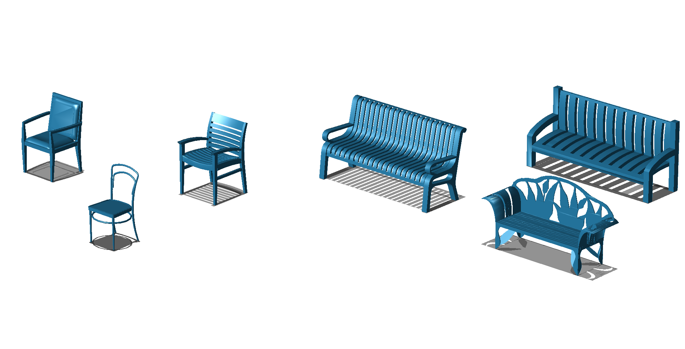
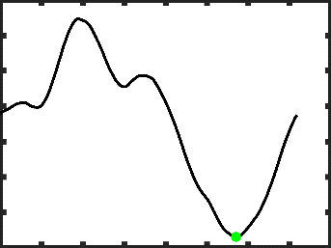
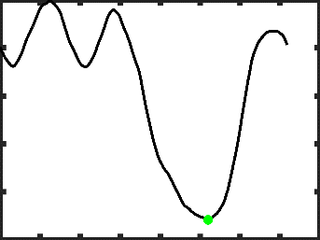
Co-align together
Best results
Very expensive
…
…
…
…
…
Notes:
.. and solve for the angle per shape that minimize the sum of pairwise distances for all pairs of shapes.
Obviously this is very expensive, but it provides the best results.
So some more recent work has relied on two things to speed this up.

Slide 21
Co-align together
Avoid comparing all pairs
Build sparse shape graph
[KLM*12, HSG13, ZCOM13]
Notes:
First, build a shape graph to avoid comparing all possible shape pairs, diffuse the information and rely on consistency.

Slide 22
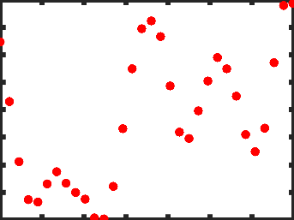
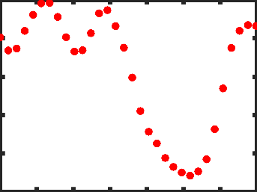
Co-align together
Uniformly sample rotation space
Solve MRF labeling
We can do better!
[KLM*12, HSG13, ZCOM13]
Notes:
And second, since computing the surface distance for a relative angle is the most expensive step,
uniformly sample the rotation space per shape, for example taking 32 samples rather than 360.
Then, these methods solve an MRF labelling problem where the uniform samples are the labels, and we try to pick one angle per shape so that the sum of distances is minimized.
However, we believe that there is still room for improvement.

Slide 23
Our solution

Slide 24
Our solution
Autocorrelation-based sampling
Notes:
This brings us to our solution, which is based on two key observations.
First, we don’t have to sample the entire rotation space if we can predict a sparse set of candidates for rotation space minima.
It turns out, the distance of a shape to itself under different rotation, the autocorrelation, can give us a clue where these minima are.
(First, why sample the rotation space for each shape uniformly, when all we need to know is where the minima occur in each pairwise distance function?)
(How can we know where the minima occur without computing the pairwise distances?)

Slide 25
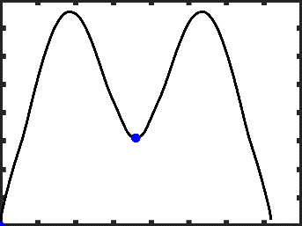
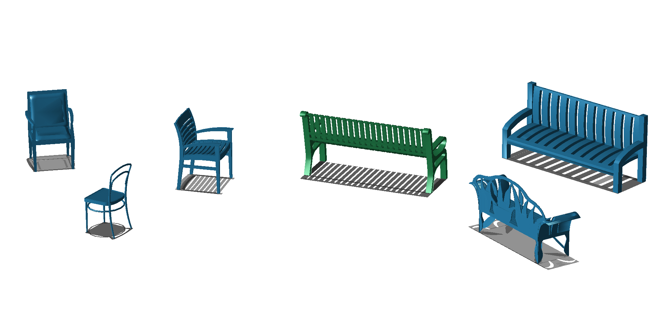
Our solution
Notes:
Consider our input shapes again.
Take the bench in the middle and rotate it around itself, computing distance each time.
We can see there’s two minima, at 0 and 180 degrees, corresponding to the near-symmetries of the shape
In fact all benches share similar minima in this autocorrelation space.

Slide 26
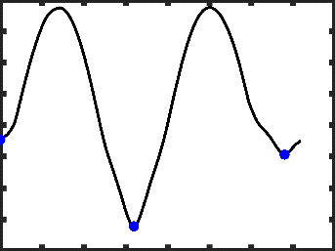
Our solution
Notes:
Now check the pairwise distance of this bench and the bench on the right for varying rotations.
The minima are at 160 and 340 degrees. This is because the relative alignment between the two benches is actually 160 degrees.
This tells us that the minima of the pairwise distance are the minima of the autocorrelation shifted by the relative angle between the two benches
So we would expect to find the correct alignment of the two benches if we rotate the bench in the middle by 160 or 340 degrees.
Checking other angles is not necessary.
(Checking any other angles is just extra effort since even the simplest algorithm would not pick 90 degrees for example.)
(This tells us that the minima of the bench autocorrelation are shifted by the angle that we need to rotate the bench in the middle so that it aligns with the bench on the right.)

Slide 27
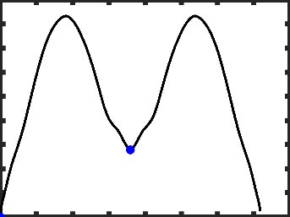
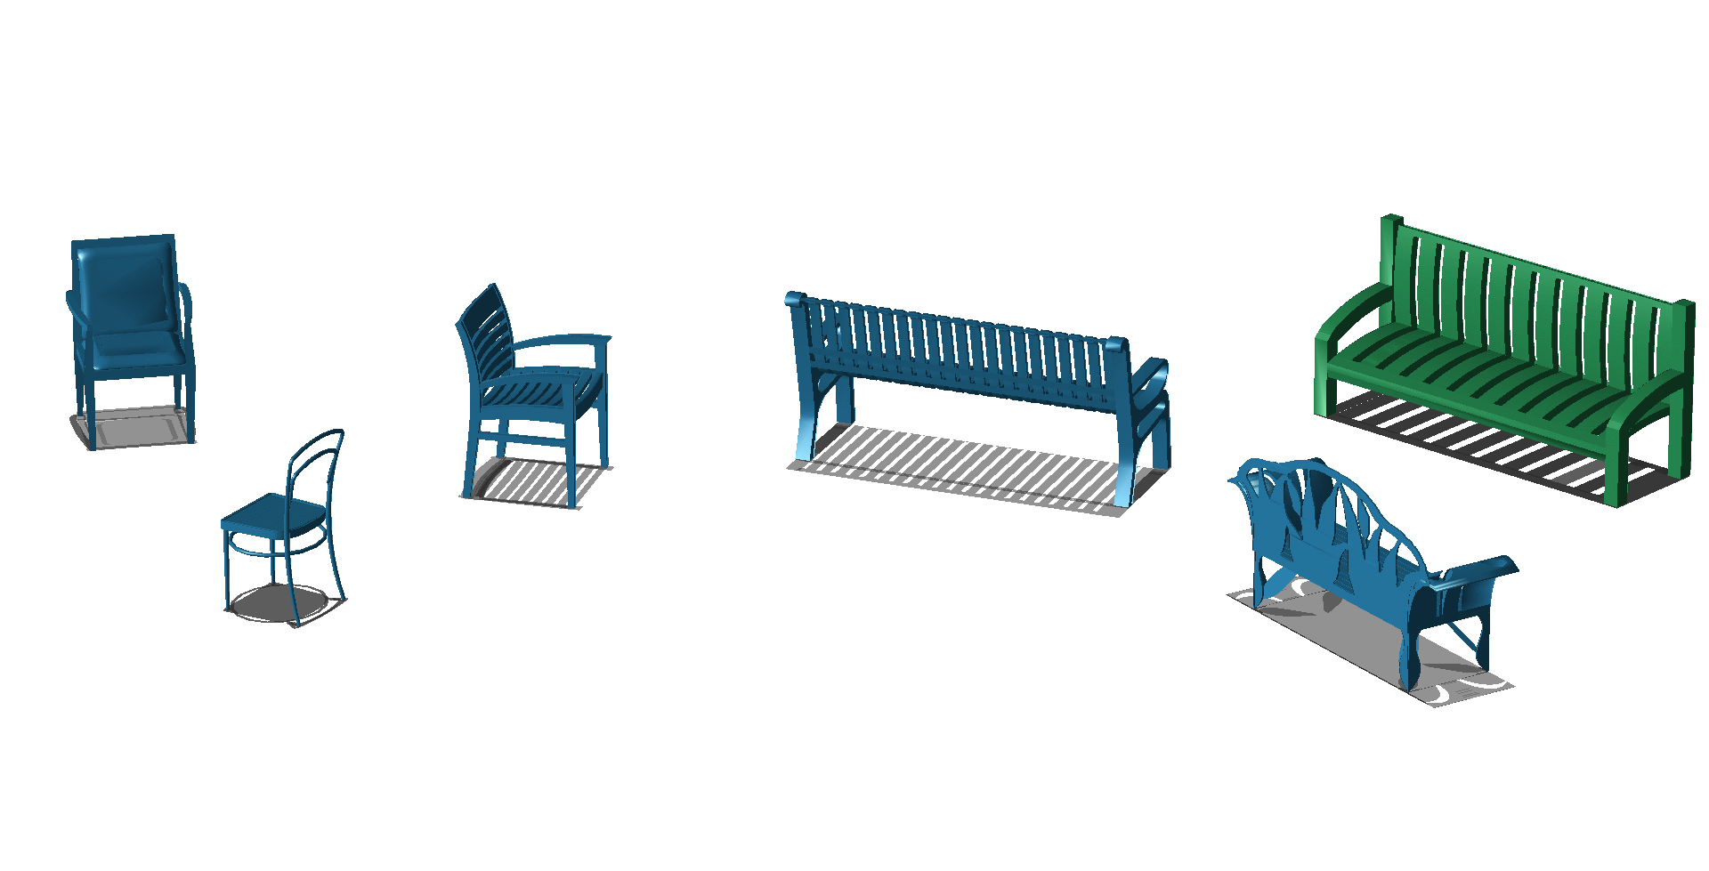
Our solution
Autocorrelation-based shape graph
Notes:
Our second observation is that similar shapes tend to be easier to align.
For example, benches align well with benches, and chairs align well with chairs.
Take the bench on the right and rotate it around itself, computing distance each time.
We can see there’s two minima, at 0 and 180 degrees, exactly the same as for the bench in the middle.
We can use such autocorrelation descriptors to decide which pairs of shapes to connect with an edge in our sparse shape graph, so that alignment is more robust.

Slide 28
Algorithm
Notes:
Now lets describe the algorithm in detail.

Slide 29

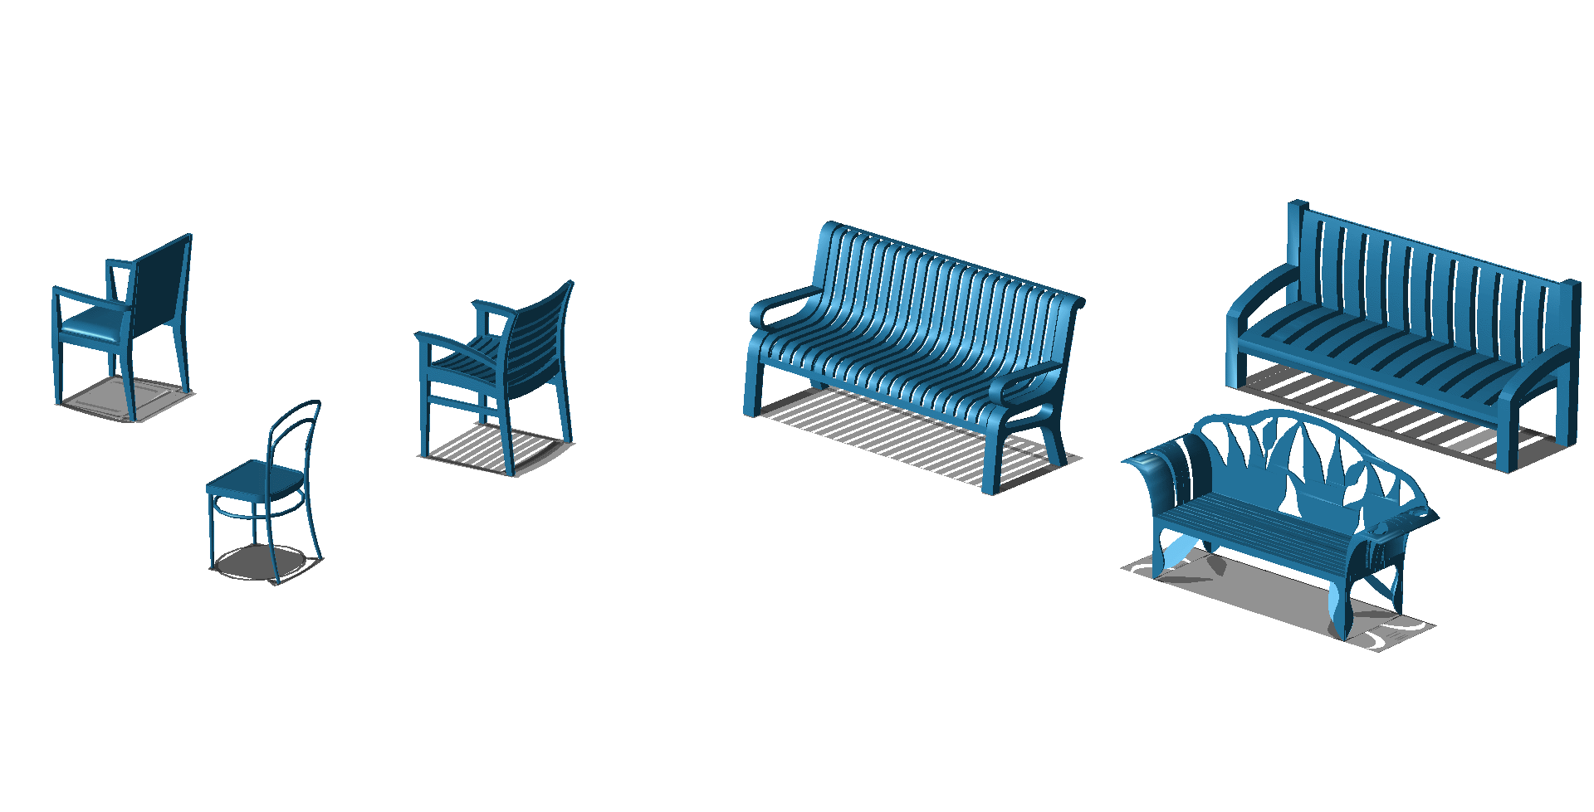
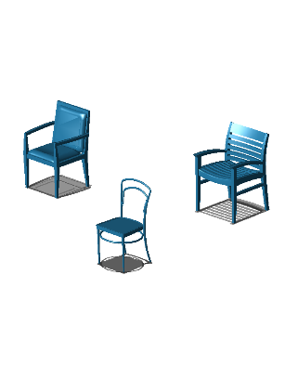
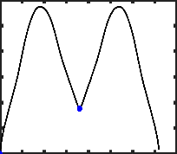

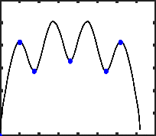

Algorithm
Input Autocorrelation descriptors Clusters Results within clusters Co-aligned models
Compute
Autocorrelations
Clustering
Intracluster
alignment
Intercluster
alignment
Notes:
Starting from an input collection of shapes in arbitrary poses, we have four main steps to produce a set of co-aligned models as output.

Slide 30
Algorithm
Input Autocorrelation descriptors Clusters Results within clusters Co-aligned models
Compute
Autocorrelations
Clustering
Intracluster
alignment
Intercluster
alignment
Notes:
We take as input a set of shapes with similar semantics, e.g. a set of chairs.

Slide 31
Input

Slide 32
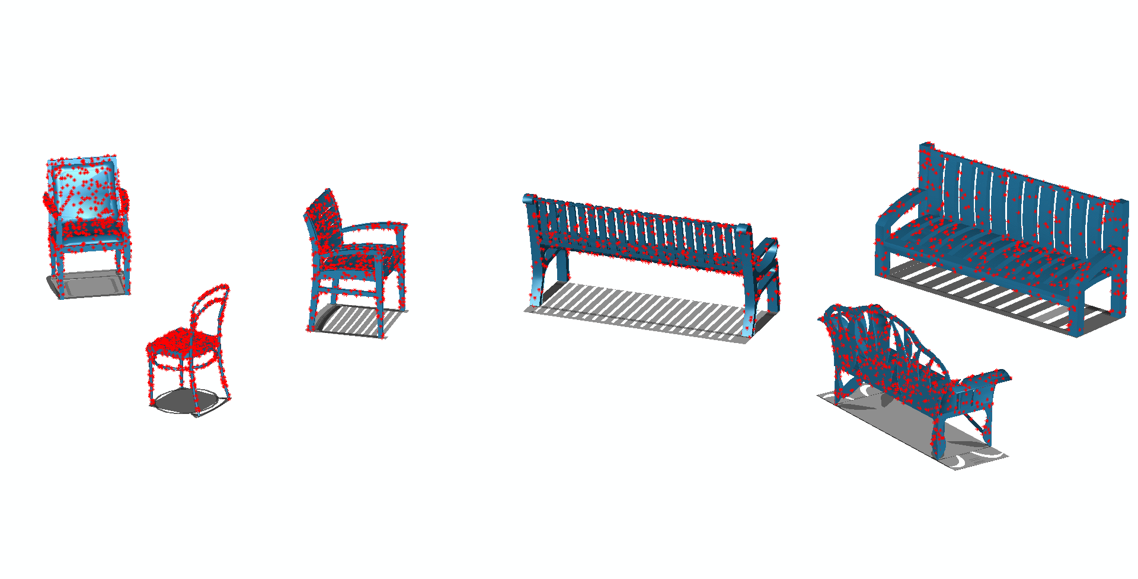
Input
Notes:
We assume all shapes have an aligned up vector, scale them to uniform height and place them at the origin.
(We assume the up vector is given and points in the positive z, so we align the shapes up vector to the positive z in case it is pointing in another direction.)
(We scale shapes to unit height and translate them so the center of mass is at 0,0, 0.5.)
Finally we uniformly sample 1000 points on each shape.

Slide 33
Algorithm
Input Autocorrelation descriptors Clusters Results within clusters Co-aligned models
Compute
Autocorrelations
Clustering
Intracluster
alignment
Intercluster
alignment

Slide 34
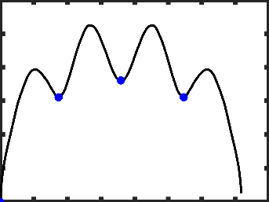
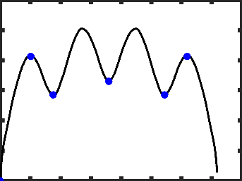
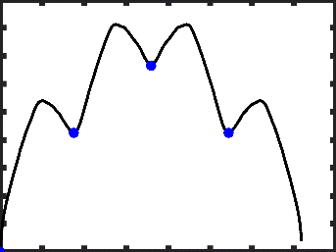
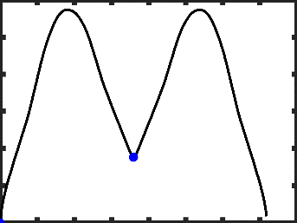
Autocorrelation descriptor
Notes:
We compute the autocorrelation descriptor for each input shape by rotating each shape and measuring surface distance to itself under each rotation.
(We measure surface distance by computing the mean shortest distance from shape I to shape j and likewise for shape j to shape I and taking their maximum.)

Slide 35
Algorithm
Input Autocorrelation descriptors Clusters Results within clusters Co-aligned models
Compute
Autocorrelations
Clustering
Intracluster
alignment
Intercluster
alignment

Slide 36
Clustering
Notes:
We cluster shapes based on their symmetries to ensure that shapes inside each cluster can be co-aligned robustly.
We base the clustering on the L1 distance of the autocorrelation descriptors to approximate the earth-movers distance.
Shape pairs with distance below a threshold determined by the kth largest pairwise distance in the whole collection are connected with an edge.
(we can effectively sample pairwise alignment energy function and to find)
(We take the kth largest pairwise distance in autocorrelation descriptor space and use it as threshold. )
(We use L1 distance in autocorrelation space to measure approximate earth movers distance.)
(Then we connect shapes closer than this distance with an edge and take connected components of the resulting graph as clusters.)

Slide 37
Algorithm
Input Autocorrelation descriptors Clusters Results within clusters Co-aligned models
Compute
Autocorrelations
Clustering
Intracluster
alignment
Intercluster
alignment

Slide 38
Intracluster alignment
Notes:
We smooth the autocorrelation descriptor and compute the local minima for each shape, which form the group of near-symmetries of the shape.

Slide 39
Intracluster alignment
Notes:
These near-symmetries are the potential ambiguities we need to resolve with joint optimization.

Slide 40
Intracluster alignment
offset
Notes:
However, we cannot directly use the minima of the autocorrelation function for alignment, since they are defined in each shape’s coordinate system.
To bring the candidate alignments into a common frame, we pick a reference shape inside each cluster and estimate an offset angle for each shape by finding the rotation with minimum distance to the reference shape.
(The problem is we cannot use these group of potential alignments as is in a joint optimization, since they are defined in each shape’s coordinate system.)
(We pick the shape nearest to the cluster center, and estimate an offset angle for each other shape in the cluster by finding the minimum distance of that shape to the picked shape.)
(This way we can bring each shape’s candidate alignments in a common frame. )
(We then optimize )

Slide 41
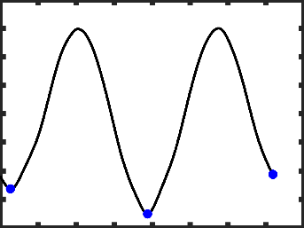
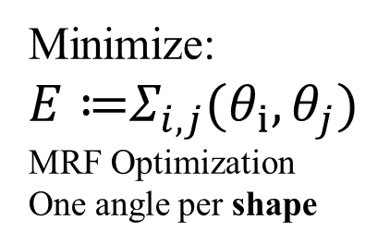
Intracluster alignment
offset
Minimize:$E≔Σ_{i,j}{(θ}_{i},θ_{j})$
MRF Optimization
One angle per shape
offset
Notes:
Now that all autocorrelation descriptors are in a common coordinate frame, we can start optimizing shape alignment.
We connect each shape to its 20 NN and then optimize the sum of pairwise distances with an MRF formulation, where the labels for each shape are the local minima of the shifted autocorrelation functions.
(computed before , added to the offset angle. )
(We smooth the autocorrelation descriptor and compute the local minima for each shape, which form the group of near-symmetries of the shape.)
(These near-symmetries are the potential ambiguities we need to resolve with joint optimization.)
(The problem is we cannot use these group of potential alignments as is in a joint optimization, since they are defined in each shape’s coordinate system.)
(We pick the shape nearest to the cluster center, and estimate an offset angle for each other shape in the cluster by finding the minimum distance of that shape to the picked shape.)
(This way we can bring each shape’s candidate alignments in a common frame. )

Slide 42
Intracluster alignment
Intracluster alignment result
Notes:
This would give us this result for the two clusters of chairs.

Slide 43
Algorithm
Input Autocorrelation descriptors Clusters Results within clusters Co-aligned models
Compute
Autocorrelations
Clustering
Intracluster
alignment
Intercluster
alignment
Notes:
The final step is to bring different clusters into a common alignment.

Slide 44
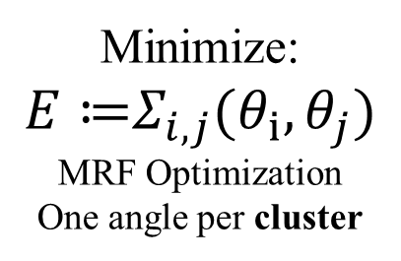
Intercluster alignment
Minimize: $E≔Σ_{i,j}{(θ}_{i},θ_{j})$
MRF Optimization
One angle per cluster
Notes:
We use another MRF optimization, this time, we want to pick one angle per cluster, so that the sum of distances between shape pairs in different clusters is minimized.
Since the number of clusters is small, and we want to produce the best possible alignment between them, we use a dense graph, connecting all cluster pairs.
For each cluster pair we pick a set of nearest shapes in autocorrelation space and add an edge between them.
In our toy example we might pick these two pairs, in our experiments we used 20 pairs per cluster pair to ensure robustness.
(Finally, we align the clusters together. )

Slide 45
Intercluster alignment
Final result
Notes:
Adding the cluster angle to the angle we found before, gives us the final alignment per shape.

Slide 46
Results

Slide 47
Datasets
From [KLM*13]:
100 bikes
100 chairs
100 helicopters
104 aeroplanes
From Trimble warehouse:
32 snowmobiles
100 cars
100 cups
100 ships
100 sofas
1000 chairs
Notes:
We created a ground truth alignment benchmark with 10 datasets (available on our project page).
You can see here some subset of our data.
The initial random alignments we gave as input to our method are in gray and our method’s result in green.

Slide 48

Evaluation Metric
$$a\left(i,j\right)=|\left(θ_{i}^{gt}−θ_{j}^{gt}\right)−\left(θ_{i}^{}−θ_{j}^{}\right)|$$
Notes:
We measure absolute value of the difference between ground truth and retrieved angles for each pair of shapes.

Slide 49
Per class performance
Notes:
Here we show the quality of our results as the number of pairwise alignment errors below the angle threshold shown on the x-axis.
Similar to all shape matching techniques, our method performs worst for objects with many near-symmetries

Slide 50
Efficiency improvement
Notes:
Uniform constrained to 11 degree increments

Slide 51
Efficiency improvement
 | Ours (s) | Uniform (s) | Ours (#Ei,j) | Uniform (#Ei,j)
Sofas | 18.2 | 345.1 | 1902 | 29184
Helicopters | 124.6 | 450.4 | 12180 | 36544
Snowmobiles | 7.6 | 69.4 | 818 | 5824
Chairs (big) | 3001 | 12149.5 | 291273 | 930528
Cars | 23.8 | 435.3 | 2614 | 37696
Cups | 116.3 | 434.6 | 11699 | 36320
Ships | 17.6 | 384.6 | 1900 | 30400
Bikes | 45.5 | 472.7 | 3560 | 32224
Chairs | 93.6 | 428.4 | 9046 | 34688
Aeroplanes | 135.2 | 349.5 | 14300 | 30944
Notes:
Here is a more detailed analysis of the efficiency improvements with our method.
We get up to 16 times speedup in the ships dataset
In general, efficiency is best if there are few rotational symmetries

Slide 52
Efficiency improvement

Slide 53
Effect of clustering
Notes:
Clustering vs. jointly aligning all shapes (all shapes in same cluster)
Since shape in the same cluster, having similar geometry, can be aligned more robustly.

Slide 54
Effect of supervision
Chairs
Aeroplanes
Notes:
Manual inter-cluster alignment
Larger for chairs since alignment between chairs and benches is not always clear
Smaller for airplanes, since alignment is usually clear between clusters

Slide 55
Limitations
Efficient with small number of near-symmetries
Can be sensitive to outliers
Include texture and non-geometric cues in alignment
Future Work
Notes:
The main limitations of our method are …
Since our method assumes that shapes can be aligned reasonably well, outliers can degrade the performance of our method.

Slide 56
Thank you!
Code and data available:
http://geometry.cs.ucl.ac.uk/projects/2015/coalignment/

