Slide 1

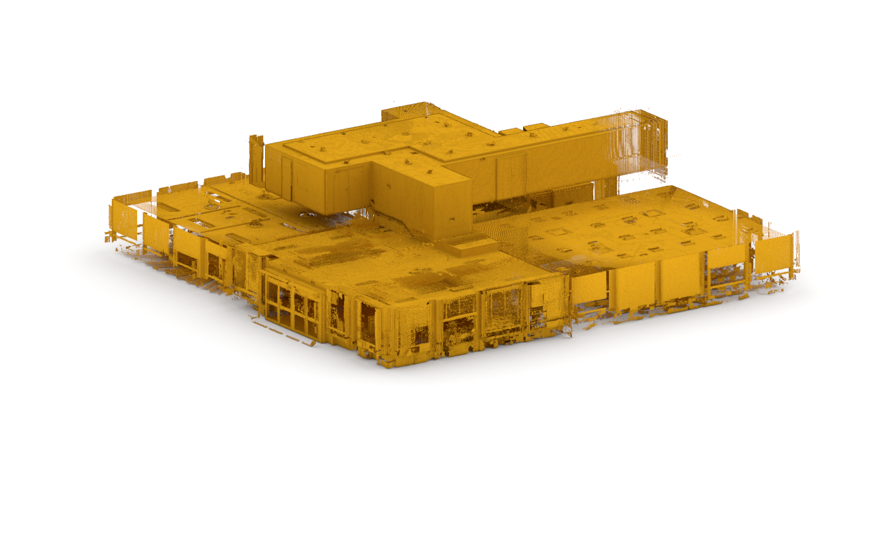
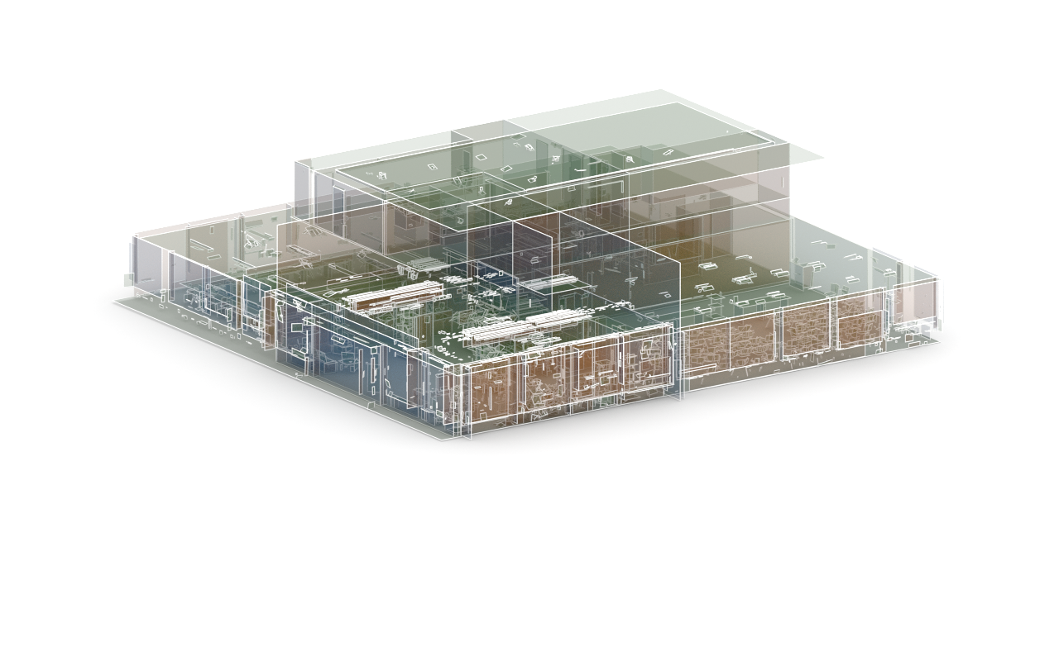

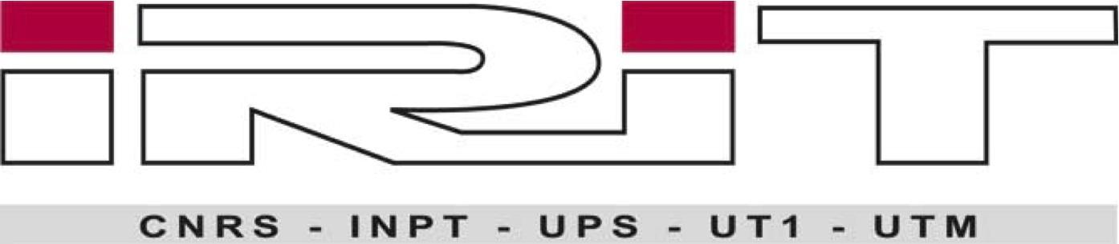
RAPter:
Rebuilding Man-made Scenes with
Regular Arrangements of Planes
Your logo on white
centered in this space
Aron Monszpart
Gabriel J. Brostow
Nicolas Mellado
Niloy J. Mitra
Notes:
Don’t say names, if introduced
I am going to present you with…
This is joint work between…

Slide 2
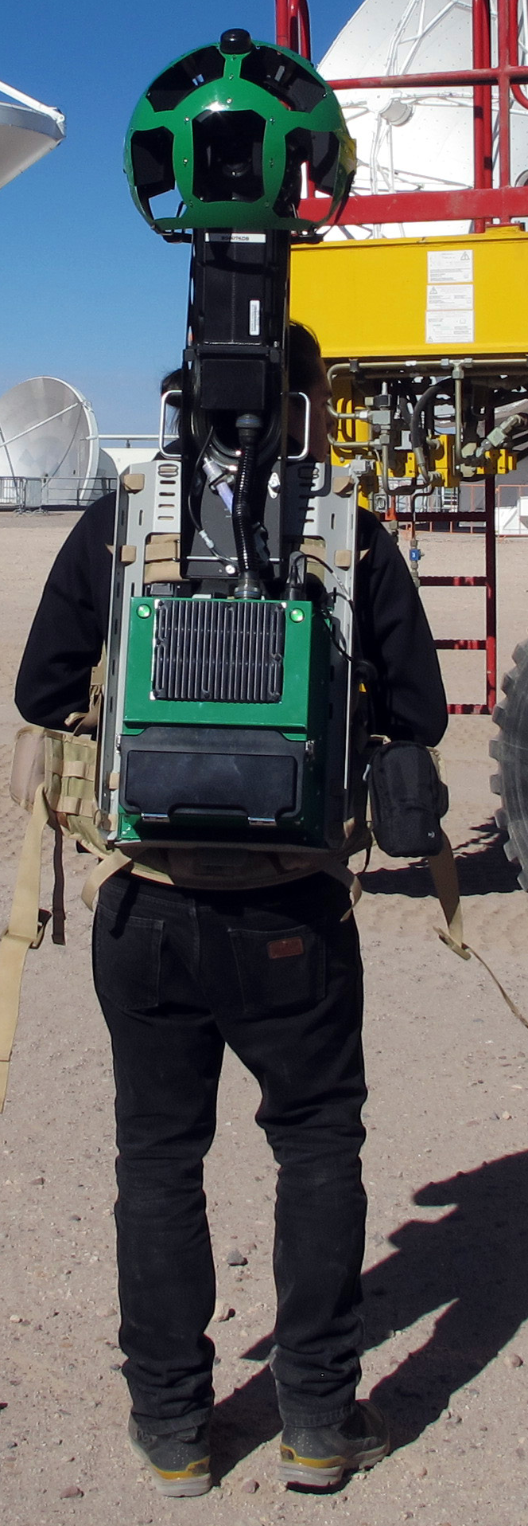
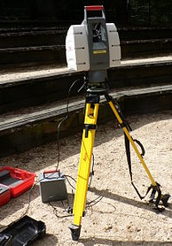
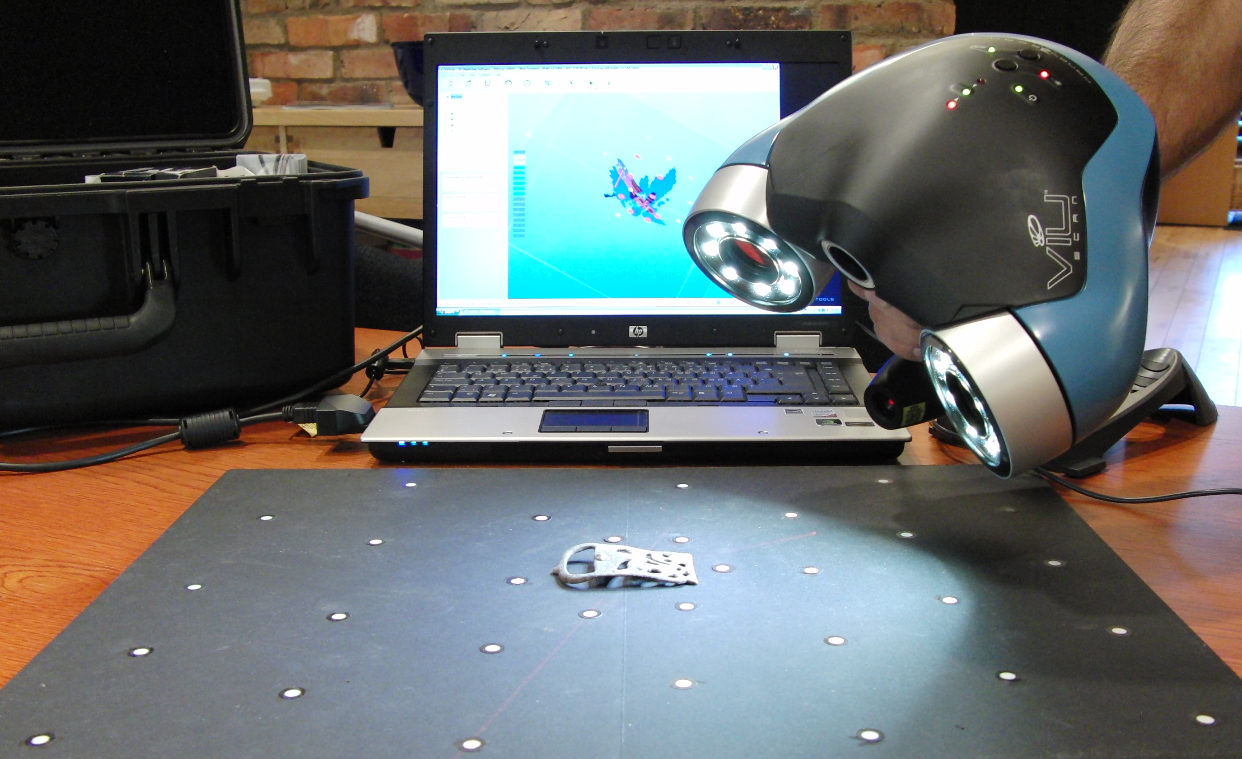
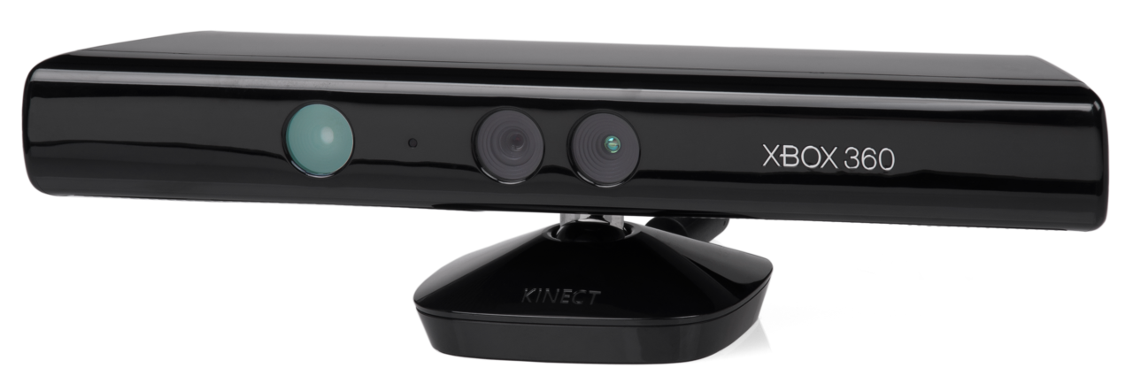

3D scanning is accessible
Notes:
“3D scanning is now easy, the quality depends on your budget”
Backpack: https://upload.wikimedia.org/wikipedia/commons/thumb/6/68/Google_Street_View_at_ALMA_AOS.jpg/1024px-Google_Street_View_at_ALMA_AOS.jpg
Lidar: https://commons.wikimedia.org/wiki/File:Lidar_P1270901.jpg
VIU handheld: https://commons.wikimedia.org/wiki/File:VIUscan_handheld_3D_scanner_in_use.jpg
Kinect: https://commons.wikimedia.org/wiki/File:Xbox-360-Kinect-Standalone.png
http://www.gim-international.com/content/article/integrated-lidar-thermal-and-imagery-system
http://ww1.prweb.com/prfiles/2014/10/17/12259559/3.jpg

Slide 3
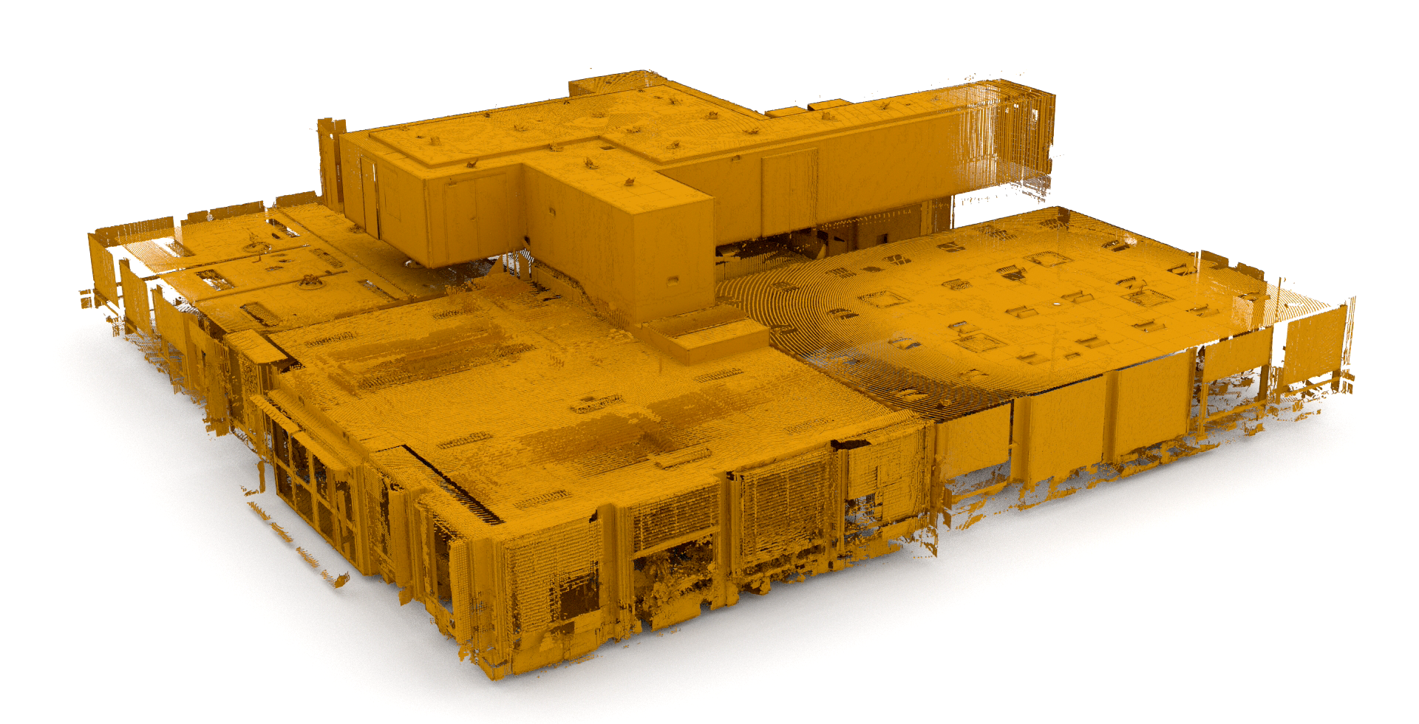
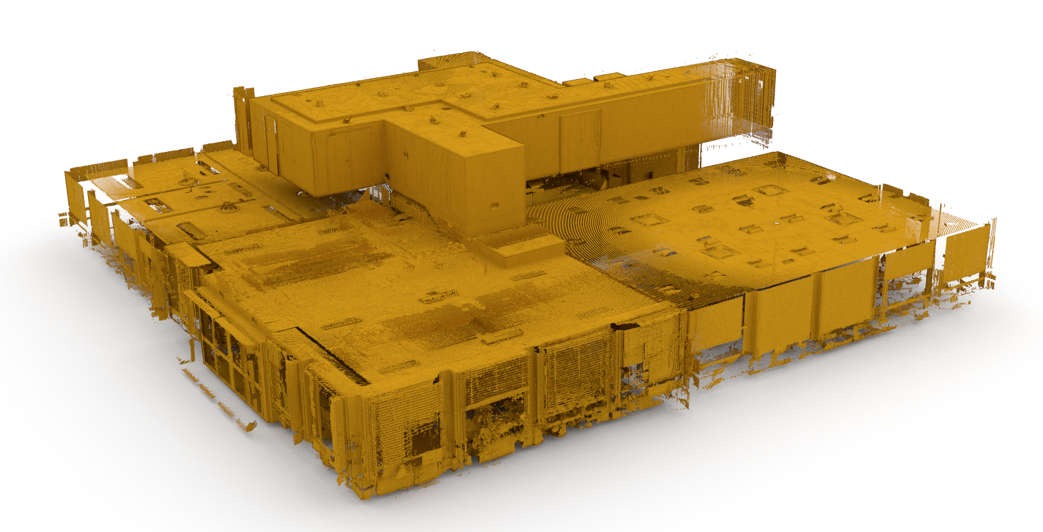
Scanning large scenes
4M points
LiDAR scan
Data:
[Oesau al. ‘14]
Notes:
Given enough money and time, one can get such large scans, as this one, which contains 4 million points.
TODO: re-render close-up

Slide 4
Motivation to scan
Visualization
Animation, VFX
Augmented reality
3D printing
Notes:
The reason behind scanning can be versatile, be it animation or 3D printing.
But what’s wrong with …

Slide 5
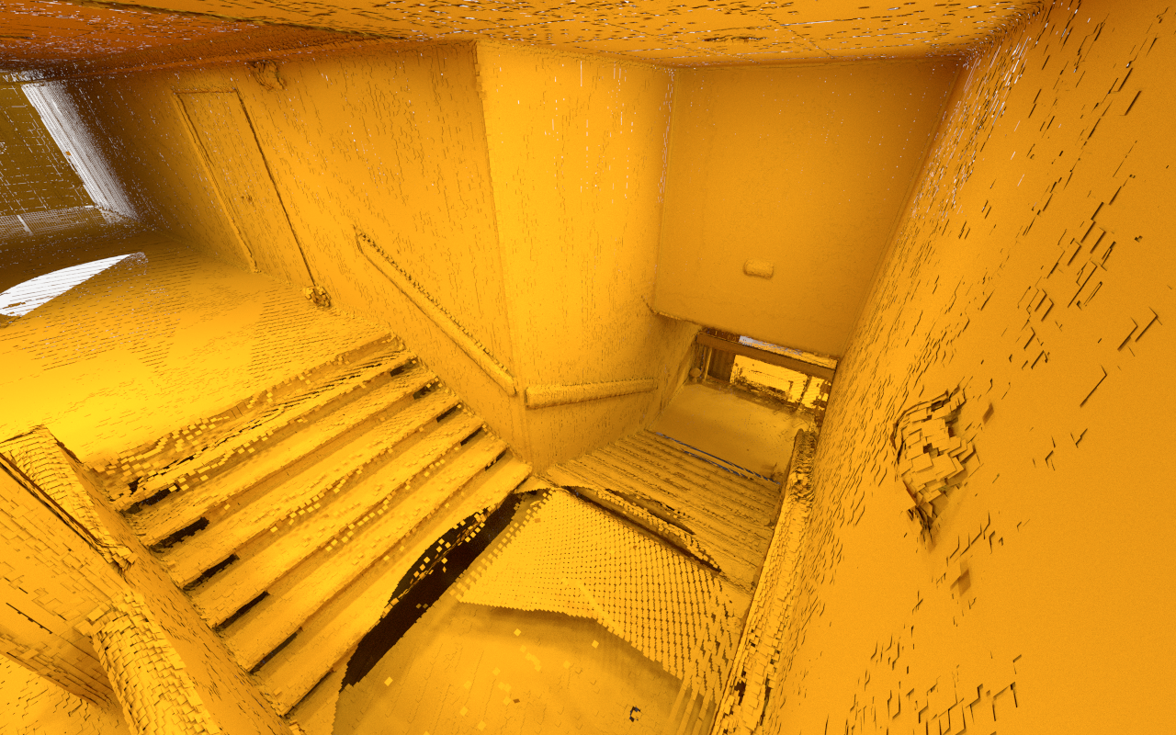
Processing large pointclouds
Notes:
Why is it messy?
Given a scene, [CLICK] we look for regions of points that can be explained by flat polygons.
Our definition of regularity says, that it’s good to fit planes that are parallel to each other.
[CLICK] Like these pairs [CLICK]
It is also good to find planes, that are perpendicular to each other [CLICK]

Slide 6
Man-made scenes contain redundancy
Notes:
Why is it messy?
Given a scene, [CLICK] we look for regions of points that can be explained by flat polygons.
Our definition of regularity says, that it’s good to fit planes that are parallel to each other.
[CLICK] Like these pairs [CLICK]
It is also good to find planes, that are perpendicular to each other [CLICK]

Slide 7
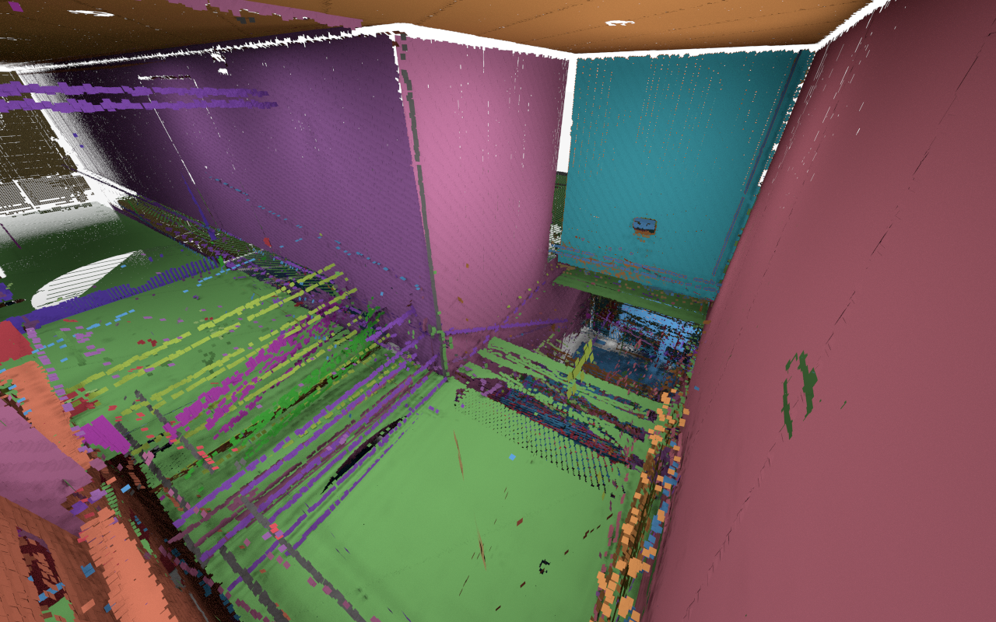
Plane detection output
Planes not detected
Relations missed
1.5°
87°
[Schnabel ‘07]
Notes:
Regurlariy!
To explain -> 2D
---
We have shown, that using regularity allows us to do a much better job
- Relations that we thought should be there, are not there [CLICK]
- Parts of the scene with too little points don’t get enough support to get their own geometry [CLICK]
TODO: recolour back wall away from brown

Slide 8
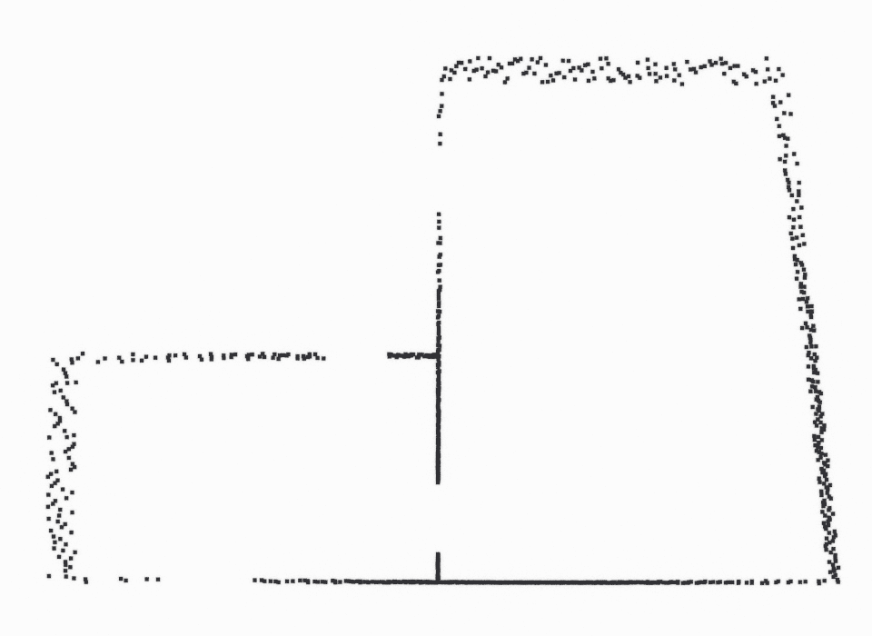
Regularity defined
Input:
0 °
90 °
Notes:
Let’s assume, that you are given this scan of the interior of an apartment. They also tell you, that there are some special relations between the planes in this scene, namely that walls are most probably parallel or perpendicular to each other. They’d like an accurate reconstruction of the input, since they will need to give it to the interior designer for further processing.

Slide 9
Perfect regularity: parallel
Input:
0 °
90 °
0°
0°
Notes:
Identical colours show parallel normals, i.e.,
Light green lines are parallel with each other, so are dark green.

Slide 10
Perfect regularity: parallel
Input:
0 °
90 °
0°
0°
Notes:
By regularity, we measure the closeness of the relationship between our planes to these user-specified relationships.
Perfect regularity occurs, when two planes are related exactly as the user expects them to be.
I.e. these walls are parallel.

Slide 11
Perfect regularity: orthogonal
Input:
0 °
90 °
90°
Notes:
We also know, that the two greens are perfectly perpendicular.
We call such an abstraction a RAP, regular arrangements of planes.

Slide 12
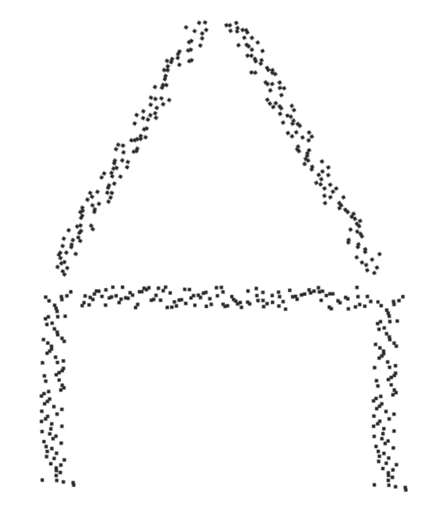
Perfect regularity: custom
Input:
0°
90°
60°
60°
90°
0°
Notes:
You want to keep the
With our approach we allow the use to express custom constraints

Slide 13
Naïve – unlucky outcome
Notes:
How can you do that?
[CLICK] You pick a plane. You look around, find something that can be aligned using the input relations, you align it, then pick the next one, and so on.
Obviously, this can very easily go wrong.
But let’s assume we are lucky.

Slide 14
Naïve – lucky outcome
Notes:
then, you end up with a similar result.
Anything, that was close to one of the ideal relations, was recovered. Those are the green lines in this image.
Others were not recognized, since the recording included too much sensor error.
Of course, you could try to solve this by increasing the threshold for identifying these relations.

Slide 15
Regular Arrangements of Planes
Notes:
Great, we have this scene solved!
But will this work for a larger scene?

Slide 16
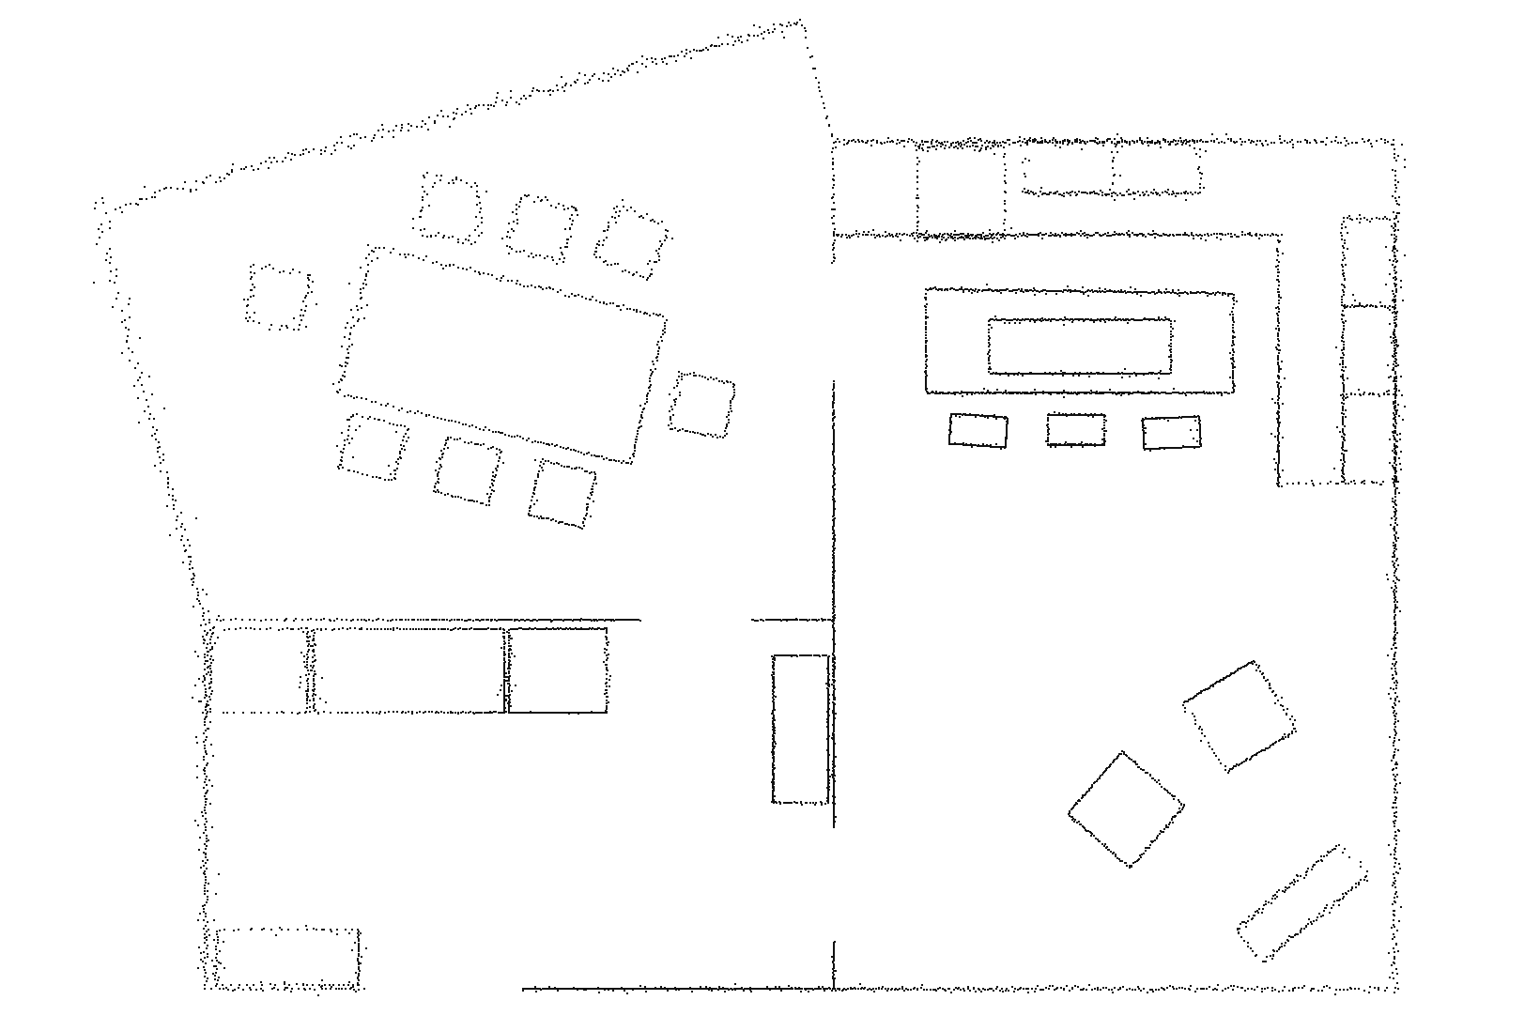
Under-regularized
Notes:
Balance between data fit and
---
This scene for example?
We call this scene under-regularized.
Some of the data is more respected, than we prefer. I.e. we would really want the top left rectangles to be more aligned, i.e. have more similar colours.
The core of the problem is, that the quality of the sampling is spatially varying,
there is no single threshold, that can snap the correct planes to conform to input relations.
If you set that threshold too high, you end up with over-regularization

Slide 17
Over-regularized
Notes:
We call this scene over-regularized,
our reconstruction has low data fidelity.

Slide 18
RAPter’s solution
Notes:
This is our idea of ideal outcome.
Main orientations are identified,
And small, but well supported orientations are respected.

Slide 19
RAPter
Rebuilding Man-made Scenes with
Regular Arrangements of Planes
Raw scans
RAP
    Planes
    Arrangements (relations)
    Segmentation
    (point-plane assignments)
User specified relations:
parallel,
orthogonal,
60 °, …
Input
Output
Notes:
We present you RAPter
We take
Raw scans
Relations as
input, and
abstract the scene with planes and their relations
And point-to-plane segmentation

Slide 20
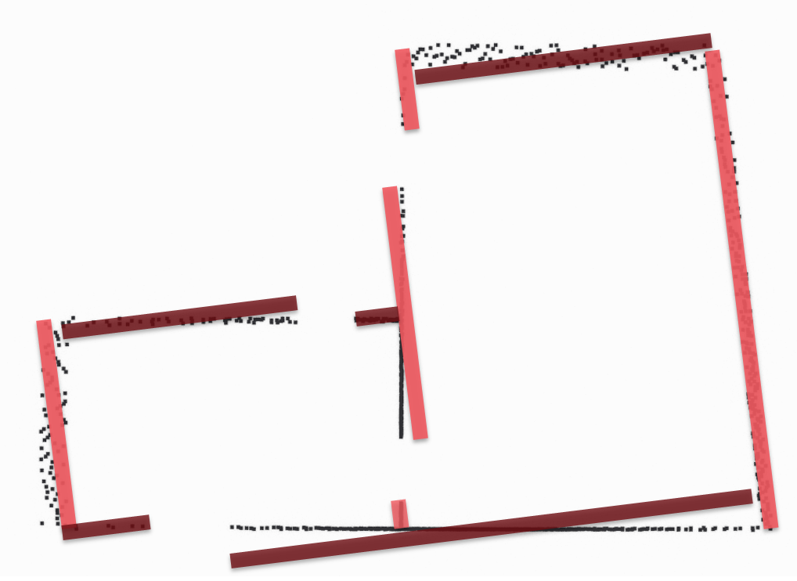
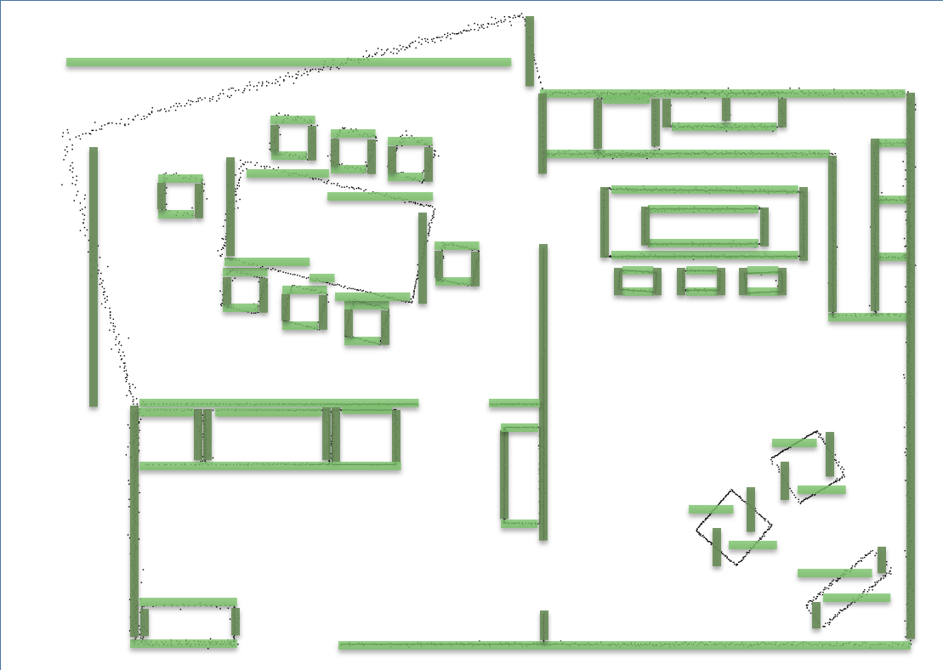
Challenges
Simultaneous selection of primitives and relations
Scalable regularization
Notes:
Greedy can give biased solutions
Naïve pairwise regularization results in fragmented or over-regularized output

Slide 21
Initialization
In:
Pointcloud
Out:
Super-segmentation
Initial fits
Regularize
Keep
4°
85°
Notes:
We could adjust the primitive parameters to respect the constraints, but with increasingly large scenes, that becomes an intractable problem
----
Imagine a simple initialization
We grouped oriented points to a super-segmentation
Fit initial primitives.
Please see paper for details.
Optimize parameters or the primitives – overfitting, error-prone
Selection: we first use this input to generate a superset of primitives, that by definition are respecting the input relations
and then we select the set, that gives you the best balance between regularity and data fidelity.
----
We have seen, that choosing the primitives one by one leads to biased results and over-regularized output.
It’s hard to navigate such a scene, where we for one hand, want this relationship to be perpendicular, …
But we also want this to stay attached to its observed data.

Slide 22
Method
RAPter
Candidate generation
Selection
Notes:
Instead, we map this to a selection problem.
We take the input primitives, we replicate them to by definition respect the input constraints.
That’s what we call candidate generation.
Then, in the next step, we select a combination of primitives and relations that best balances between data and regularity.
----
The key idea of rapter is to map this problem to a simultaneous selection problem.
We first make sure, that the perfectly regular primitives are there to be selected
And then seek out the best combination of those primitives.

Slide 23



Candidate generation
Orientation
$$P_{i→j}$$
Location
(group of points)
$$P_{i→i}$$
$$P_{i→k}$$
Notes:
Take this plane, and to be sure to have a parallel plane at another location, you replicate it
The nature of the input relations might require you to perform transformations during this process.
We denote the initial plane
We do this for all planes
----
As I said, the aim of this step is to ensure, that there exists an alternative plane for each group of points, that ensures, that the whole selection is regular.
The challenge is, that we don’t know, which primitives and which relations to choose in advance.
So we take all primitives, and all relations, and generate candidate planes.
Depending on the data quality, one can use a threshold to throw away very unlikely candidates to speed up the processing time.
TODO: finish animation

Slide 24
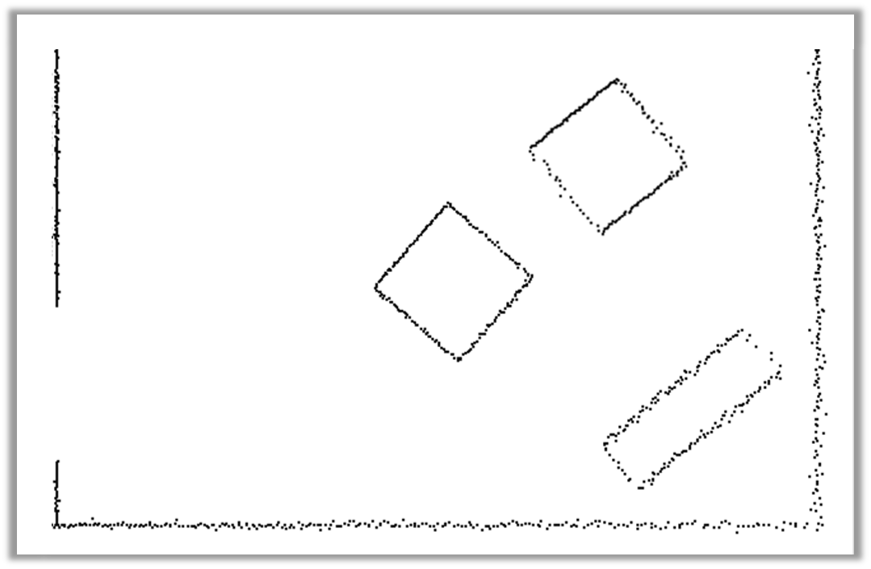
Enriched candidate set
Notes:
Doing that for all input planes and all relations leads to an enriched set of candidates.

Slide 25
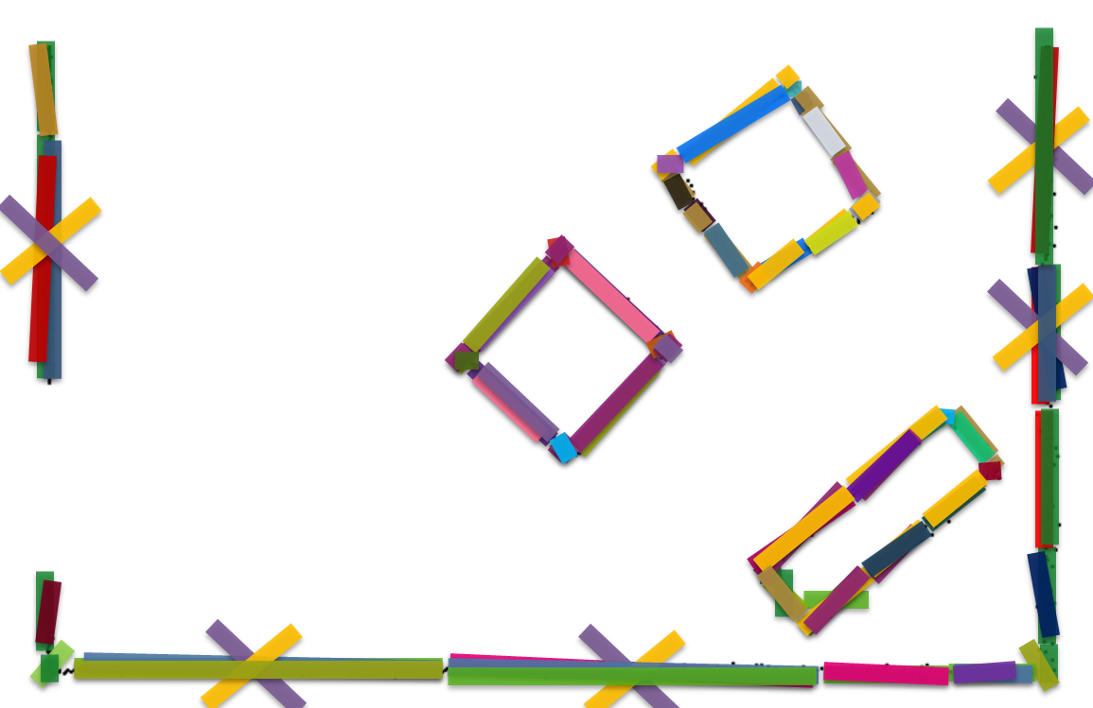
Method
RAPter
Candidate generation
Selection
Notes:
At this stage, by performing Candidate generation, we have ensured, that the perfectly regular explanation for each of the points exists.
[CLICK] As said earlier, instead of selecting primitives 1-by-1, we map the problem to a simultaneous selection problem.
[CLICK] What do we mean by selection?

Slide 26






Selection problem
$$S_{j}$$
$$χ_{i+2→j}$$
$$χ_{i+1→j}$$
$χ_{i→j}$=1
$$χ_{i→j}$$
$$χ_{i+3→j}$$
Notes:
If we look at the previously generated, enriched candidate set, we want to select an arrangement of planes, that both respects the data points observed, and is as much perfectly regular, as possible.
This is possible, because we can now be sure, that the desired solution exists. [CLICK]

Slide 27
Energy minimization
Point fidelity
Neighbourhood
$$\min{{\text{λ} E_{data}+\left(1−\text{λ}\right)E}_{irregularity}+E_{spatial}}$$

Slide 28



Data term
$$P_{i→j}^{ }$$
$$p_{h}^{ }$$
Point-Primitive distance
$${E_{data}=\sum_{j}{\sum_{i}{χ_{i→j}\sum_{p_{h}∈S_{j}}{{d(p_{h},P_{i→j})}^{2}}}}}$$
All locations
All orientations
Points assigned to location

Slide 29
Spatial term
Point fidelity
Neighbourhood
$$\min{{\text{λ}E_{data}+\left(1−\text{λ}\right)E}_{irregularity}+E_{spatial}}$$

Slide 30




Spatial term
$$P_{i→j}$$
$$P_{i→l}$$
$$P_{k→l}$$
$${E_{spatial}=\sum_{\{P_{i→j},{ P}_{k→l}\}∈N }{χ_{i→j} χ_{k→l} C}}$$
All neighbouring locations:
Constant penalty

Slide 31
Pairwise term
Point fidelity
Neighbourhood
$$\min{{\text{λ}E_{data}+\left(1−\text{λ}\right)E}_{irregularity}+E_{spatial}}$$

Slide 32
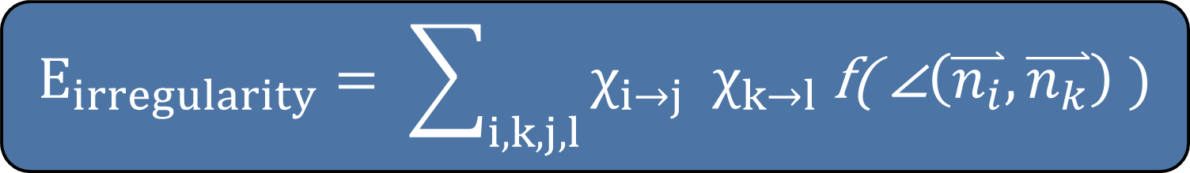
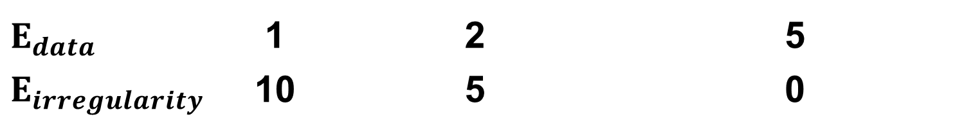

Irregularity term
$$E_{data}$$ | 1 | 2 | 5
$$E_{irregularity}$$ | 10 | 5 | 0
86°
$$E_{irregularity}= \sum_{i,k,j,l}{χ_{i→j} χ_{k→l} \text{f}\text{( ∠}\left(\overset{⃑}{n_{i}},\overset{⃑}{n_{k}}\right) )}$$
88°
90°
5°
3°
0°
$$\text{λ}$$
Notes:
Please refer to the paper for details

Slide 33
Non-greedy, simultaneous selection

Slide 34
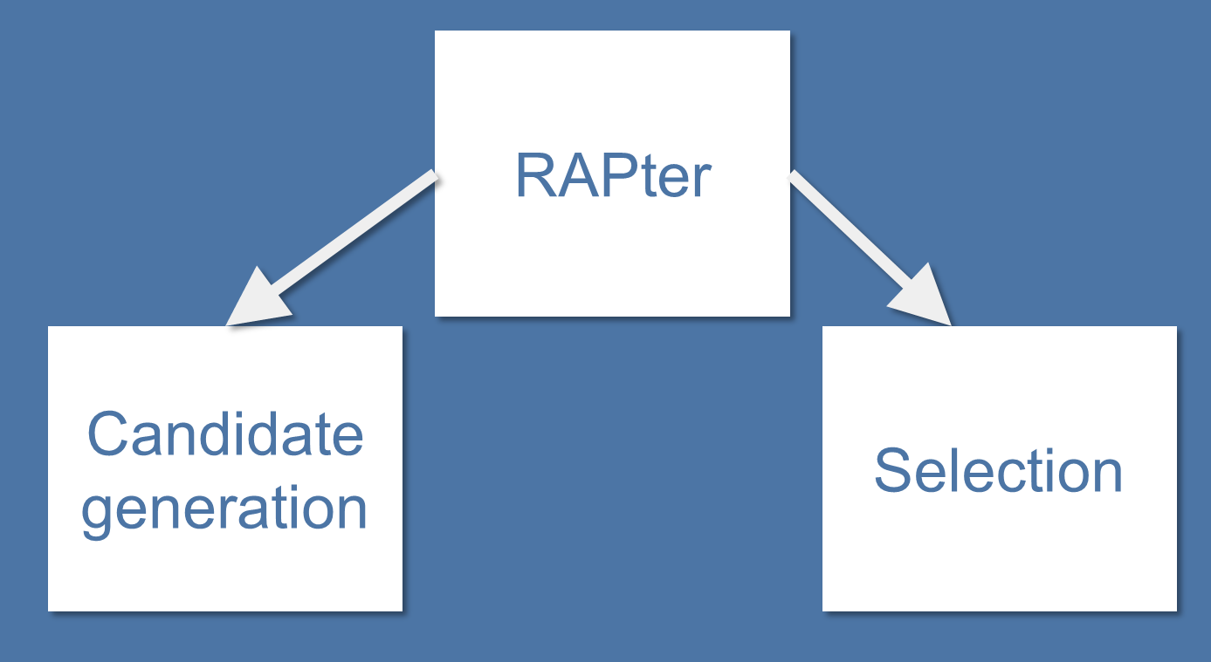
Challenges
Simultaneous selection of primitives and relations
Scalable regularization
Notes:
Greedy can give biased solutions
Naïve pairwise regularization results in fragmented or over-regularized output

Slide 35
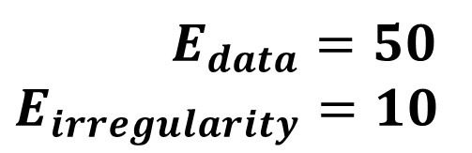


Over-regularized
$$E_{data}=50$$
$$E_{irregularity}=10$$
$$45$$
$$50$$

Slide 36
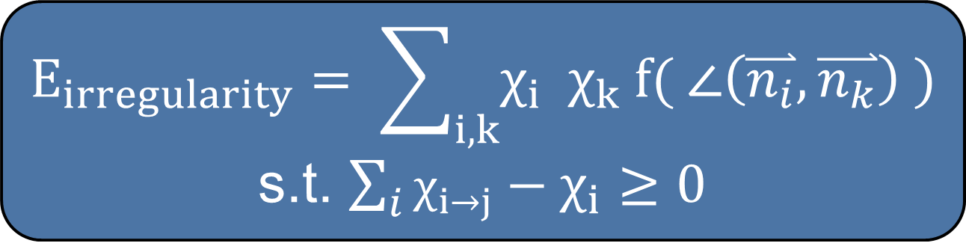
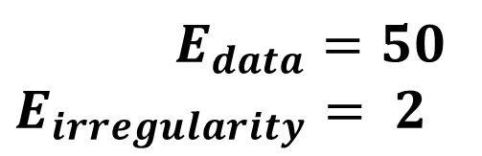






Robust irregularity
$$E_{irregularity}= \sum_{i,k}{χ_{i} χ_{k} \text{f}\text{( ∠}\left(\overset{⃑}{n_{i}},\overset{⃑}{n_{k}}\right) )}$$
s.t. $\sum_{i}{χ_{i→j}}−χ_{i}≥0$
$$45$$
$$30$$
$$E_{data}=50$$
$$E_{irregularity}= 2$$
$$40$$
$$6$$
$$χ_{k}$$
$$χ_{i}$$
$$χ_{i→j}$$

Slide 37
RAPter output

Slide 38
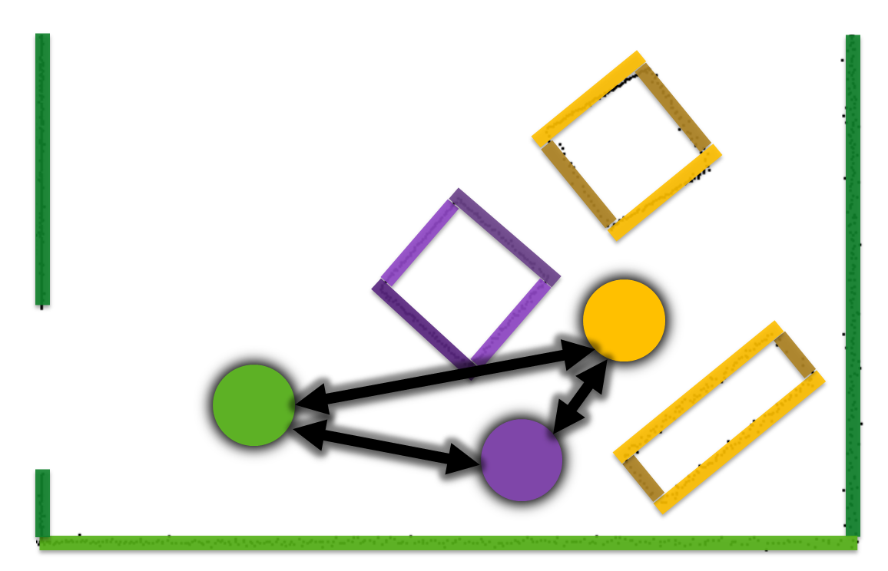
Summary
Simultaneous selection of primitives and relations
Scalable regularization
Notes:
Greedy can give biased solutions
Naïve pairwise regularization results in fragmented or over-regularized output

Slide 39
Related work

Slide 40
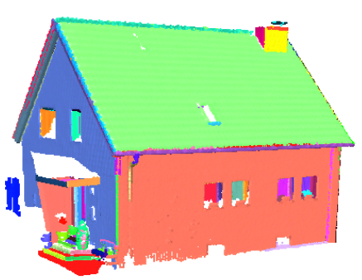


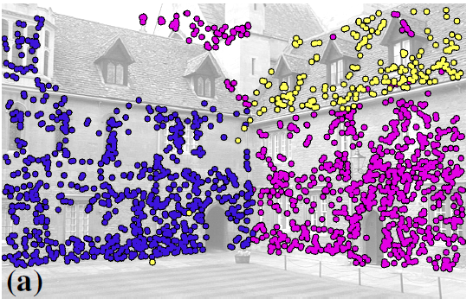
Related work
 | Non-local regularity | Simultaneous (non-greedy) | Preserve orientation groups
[Schnabel et al. 2007] [Isack and Boykov 2012]
[Li et al. 2011]
[Straub et al. 2014]
[Pham et al. 2014]

Slide 41
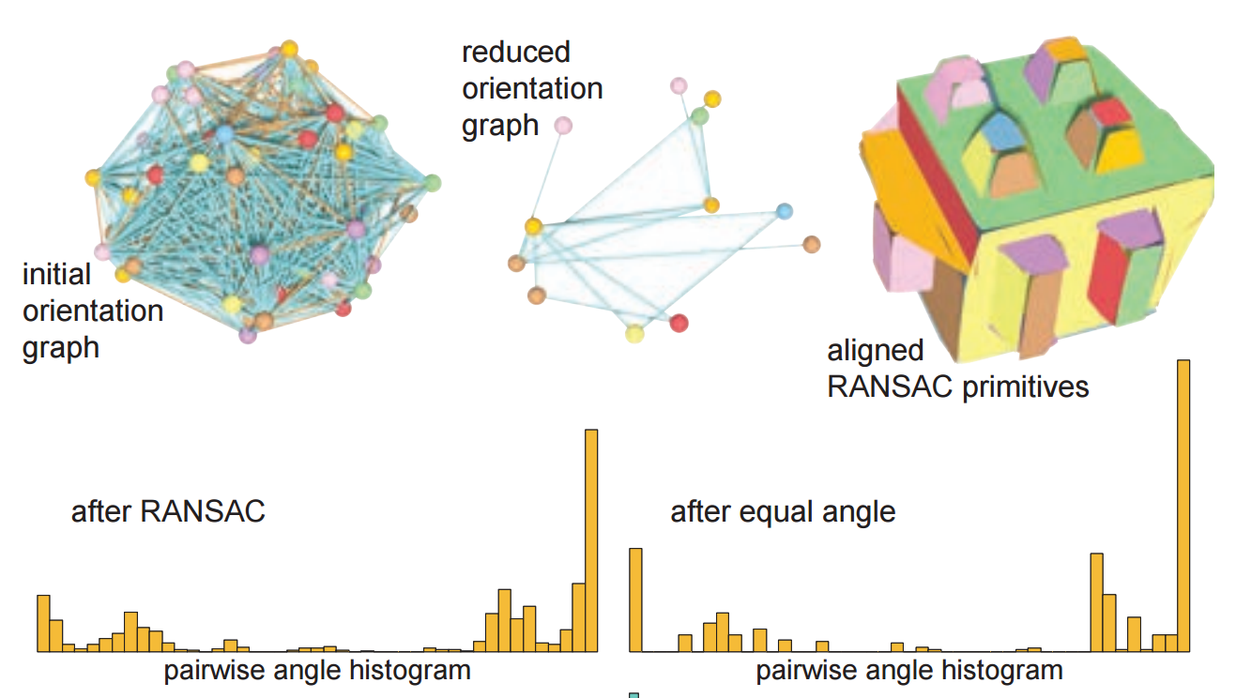
Related work
 | Non-local regularity | Simultaneous (non-greedy) | Preserve orientation groups
[Schnabel et al. 2007] [Isack and Boykov 2012]
[Li et al. 2011]
[Straub et al. 2014]
[Pham et al. 2014]

Slide 42
Related work
 | Non-local regularity | Simultaneous (non-greedy) | Preserve orientation groups
[Schnabel et al. 2007] [Isack and Boykov 2012]
[Li et al. 2011]
[Straub et al. 2014] |  |  | ?
[Pham et al. 2014]
Notes:
Mixture of Manhattan frames allows you to get the regularity in a non-greedy way
It’s hard to tune it to preserve scene diversity

Slide 43
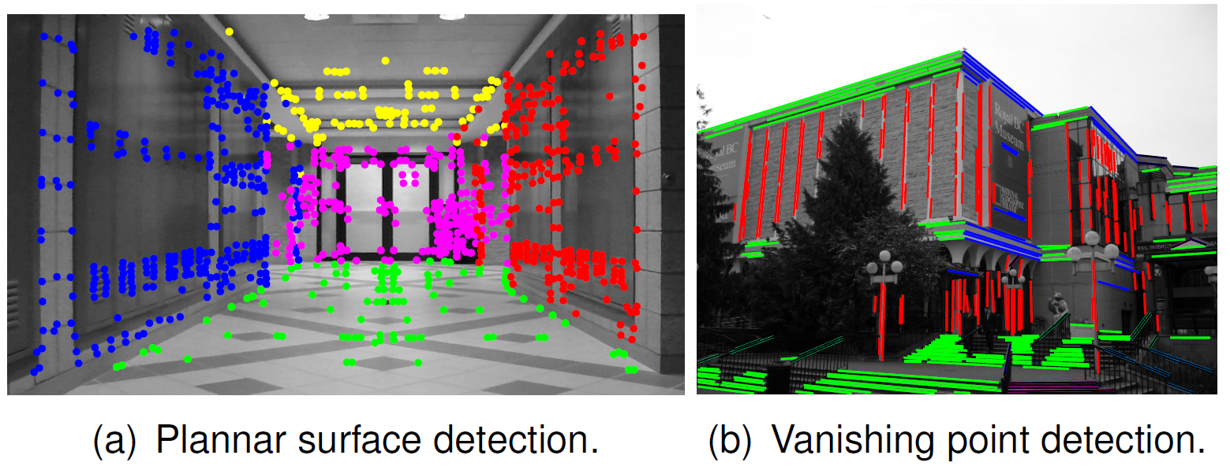
Related work
 | Non-local regularity | Simultaneous (non-greedy) | Preserve orientation groups
[Schnabel et al. 2007] [Isack and Boykov 2012]
[Li et al. 2011]
[Straub et al. 2014] |  |  | ?
[Pham et al. 2014]
Notes:
You do not address the scalability issue
Large scenes + preserve diversity

Slide 44
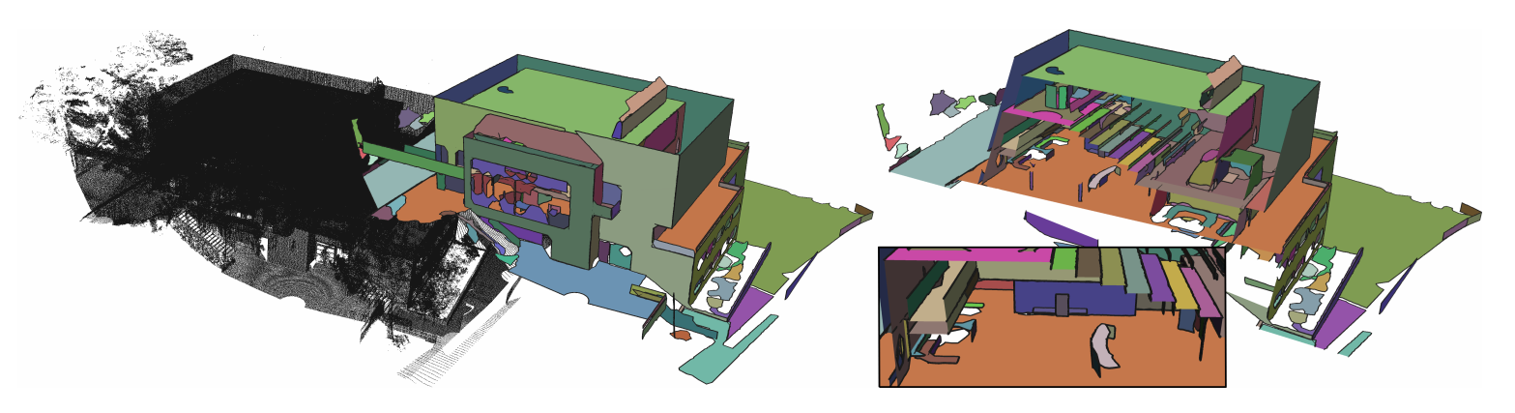
Related work
Oesau and Lafarge and Alliez:
Planar Shape Detection and Regularization in Tandem, Computer Graphics Forum 2015

Slide 45
Related work
 | Non-local regularity | Simultaneous (non-greedy) | Preserve orientation groups
[Schnabel et al. 2007] [Isack and Boykov 2012]
[Li et al. 2011]
[Straub et al. 2014]
[Pham et al. 2014]
RAPter

Slide 46
Results

Slide 47
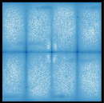
“Euler” (4M points) – Input cloud
Input pointcloud (LiDAR)
Distribution of point normals
Data: [Oesau al. 2014]
Notes:
LiDAR data from [Zheng et al. 2010]

Slide 48
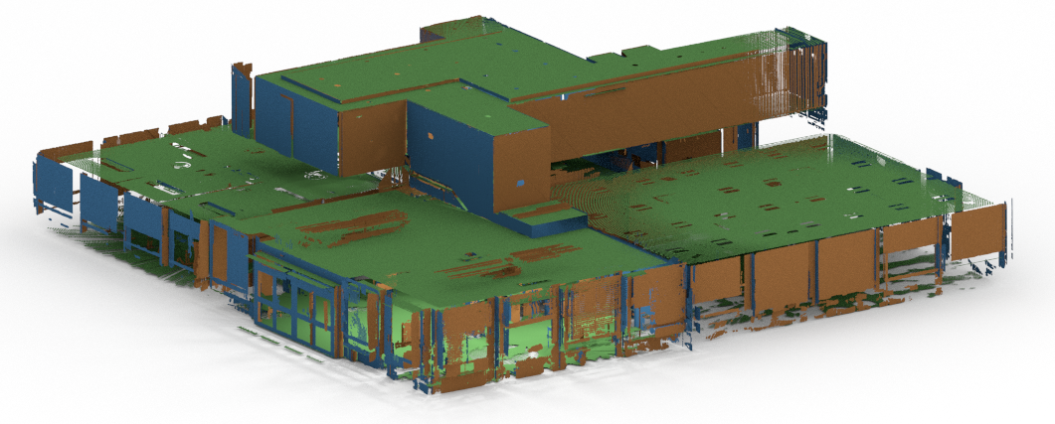
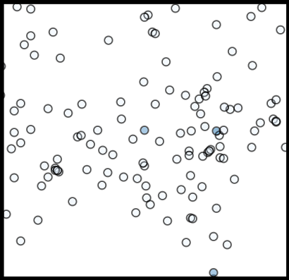
“Euler” (4M points) – RAPter cloud
Notes:
We fit planes, we cluster in the normal domain
You can see, that we have identified the main orientations,
But we preserve diversity, otherwise we would only have 3 points

Slide 49
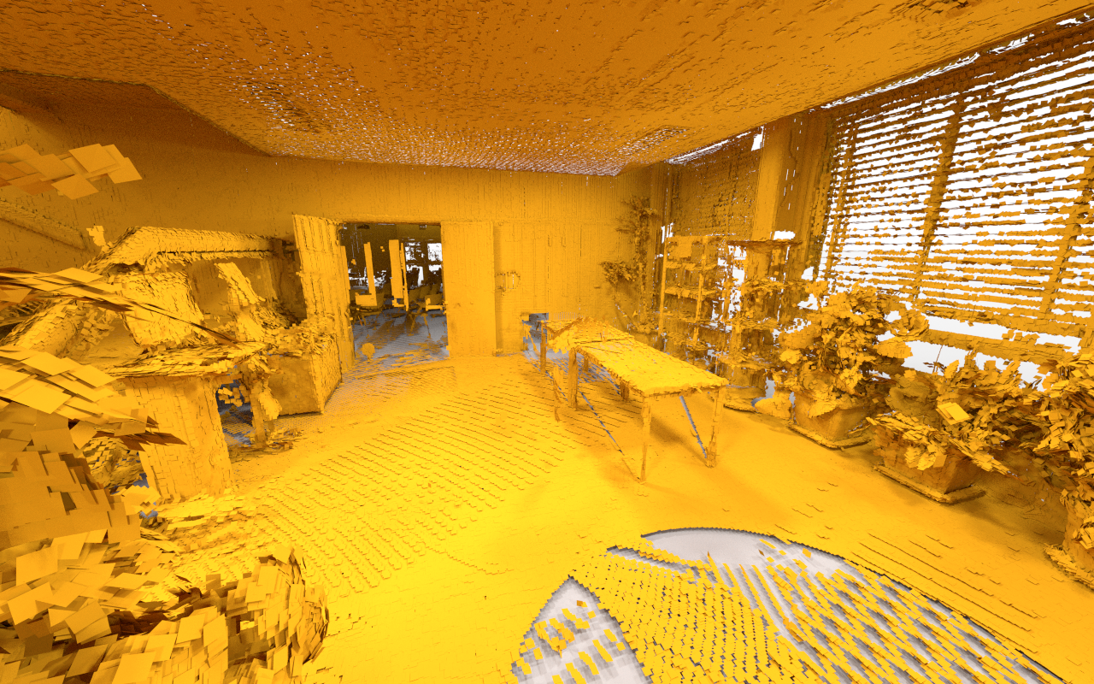
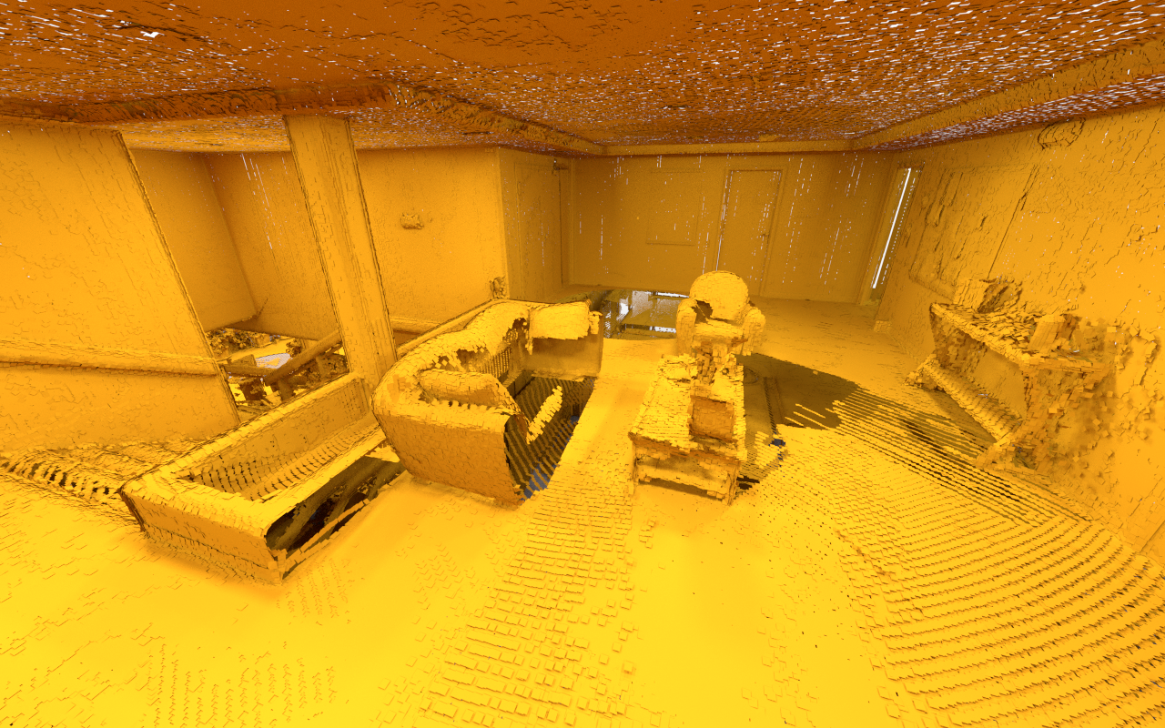
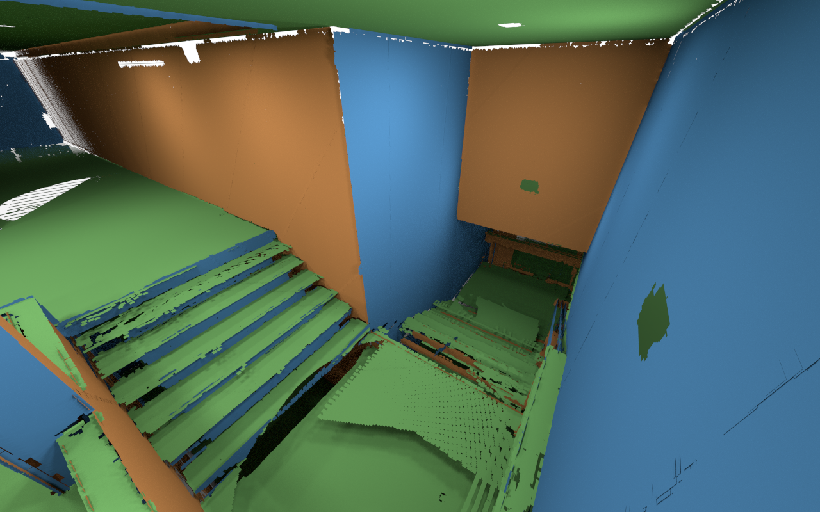
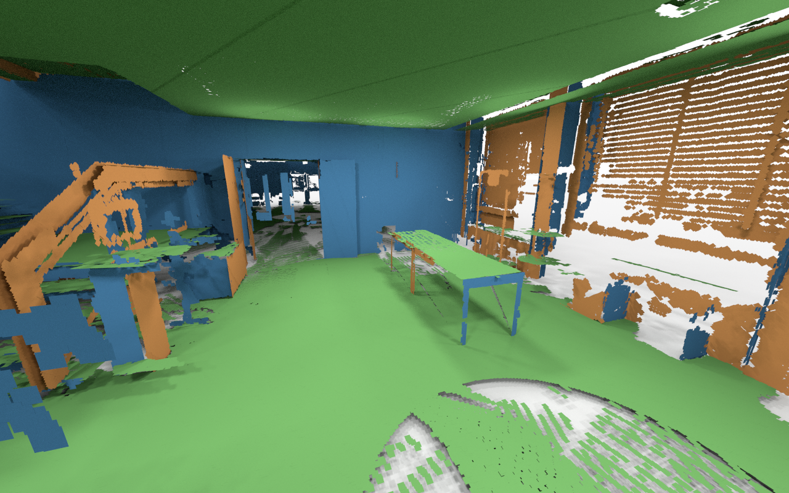
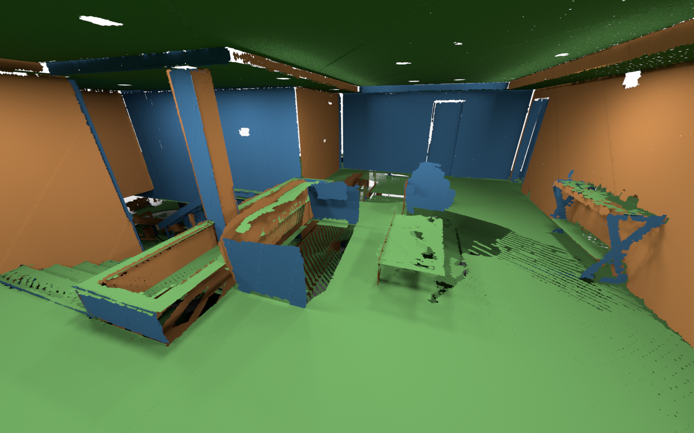
“Euler” (4M points) - Inside views

Slide 50
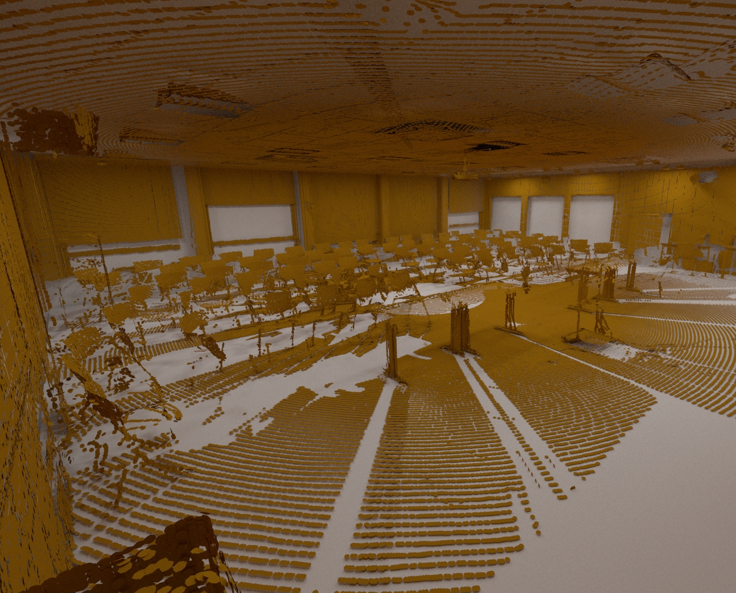
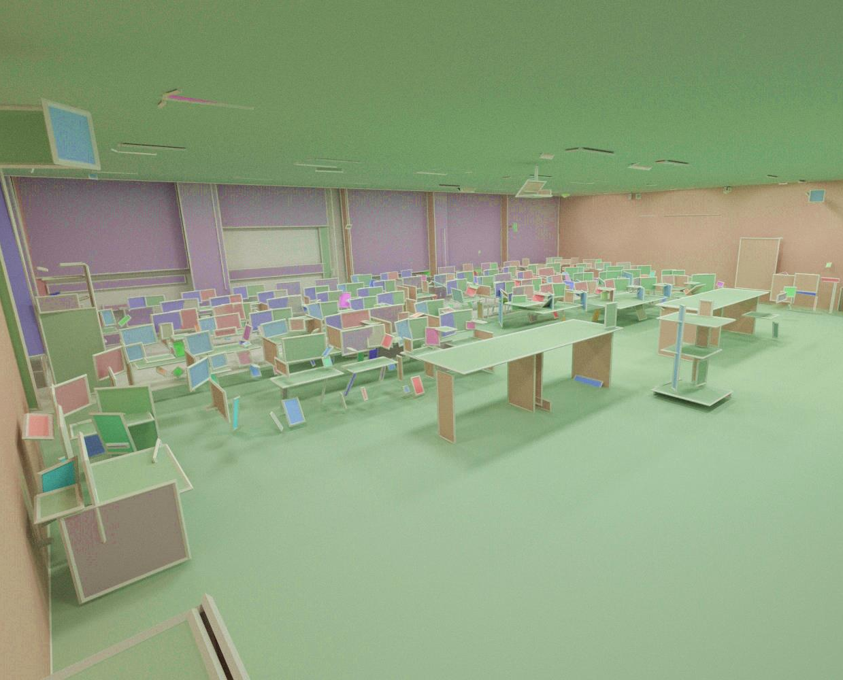
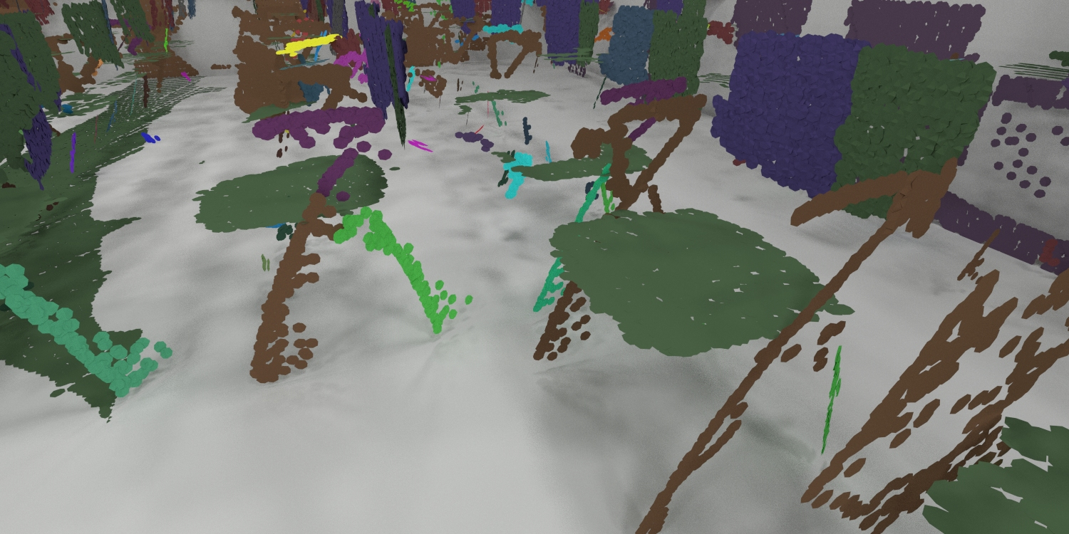
“Euler” (4M points) – RAPter cloud

Slide 51
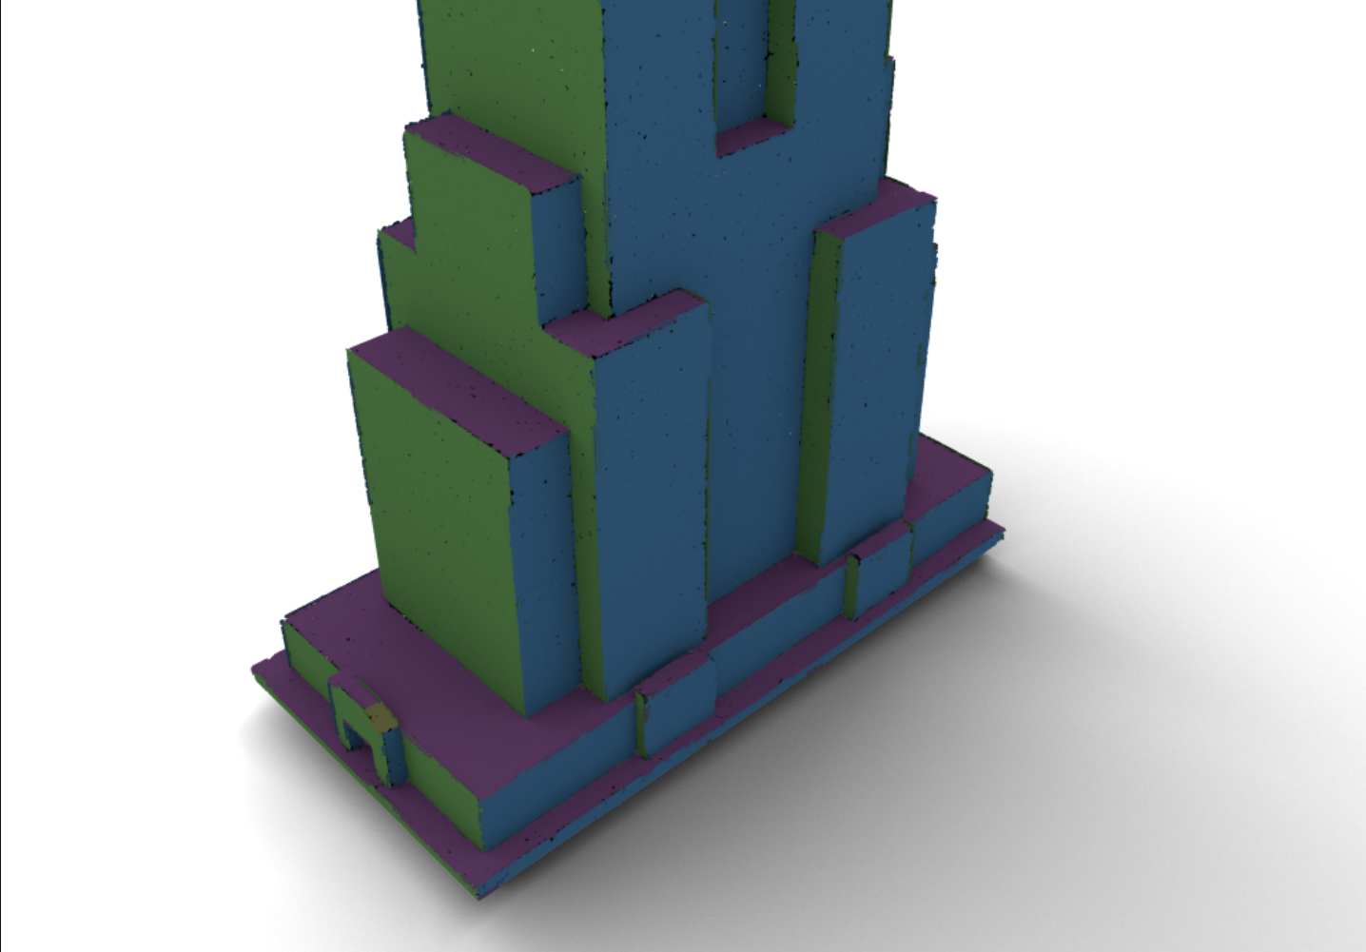
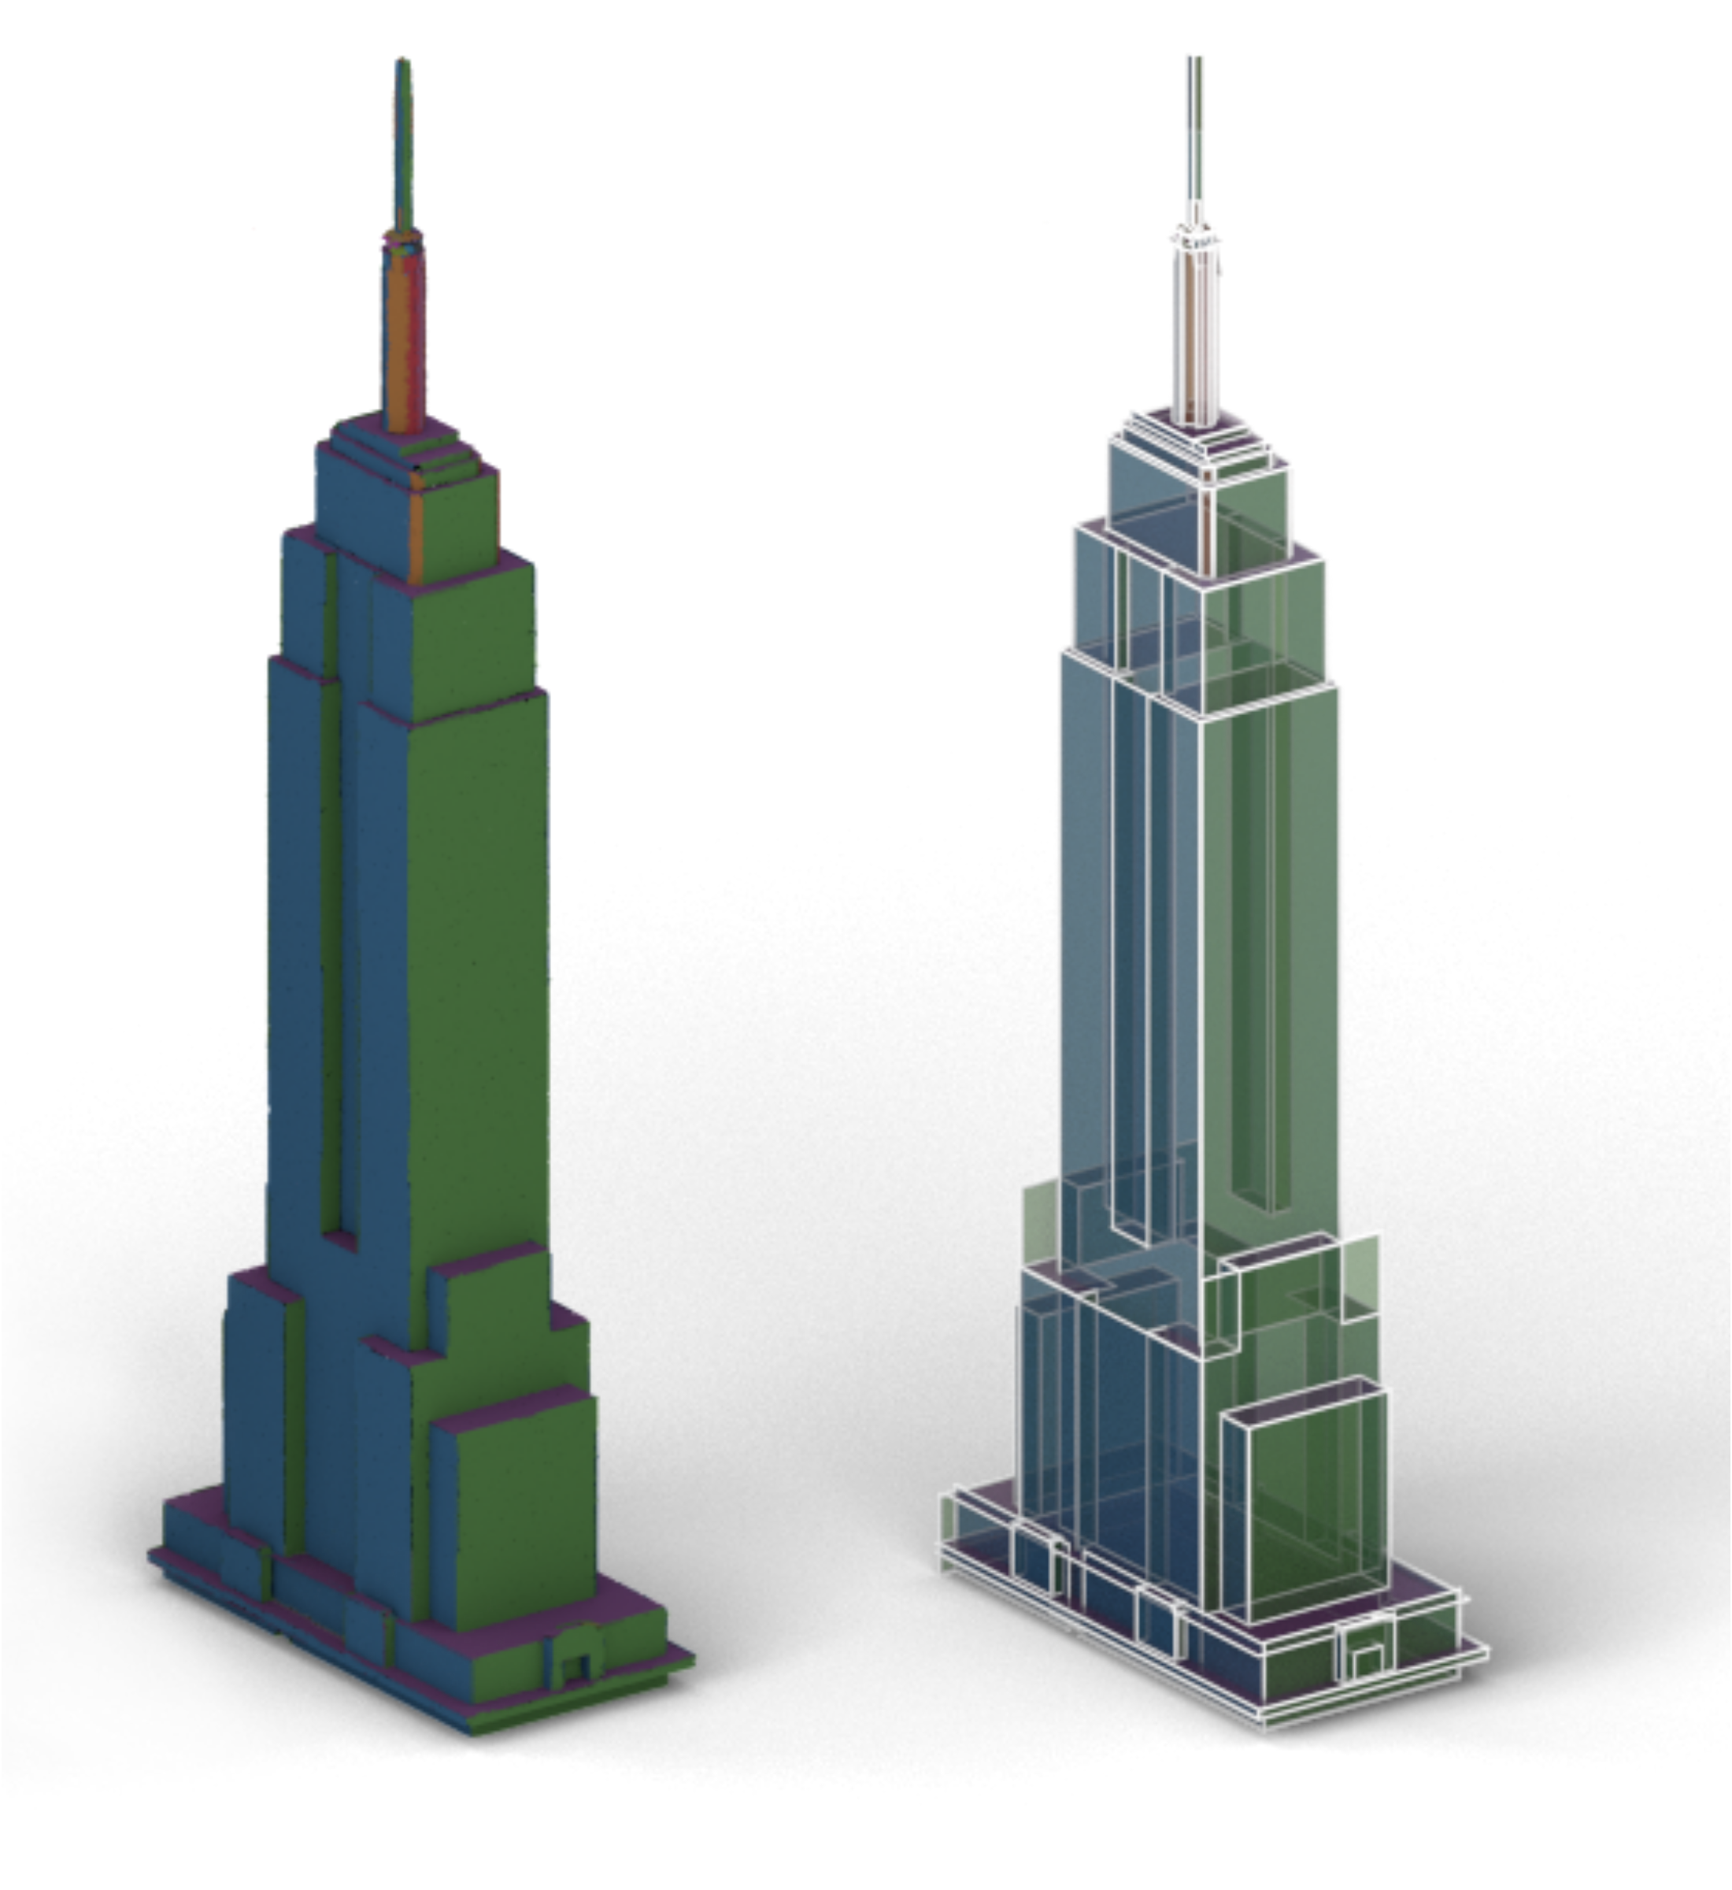
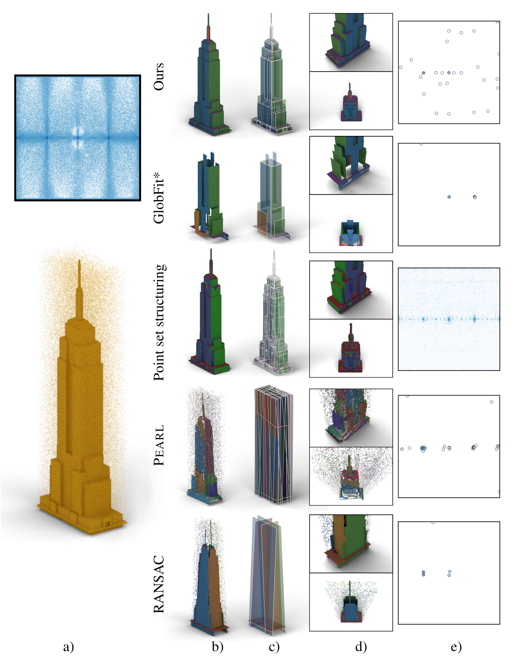

“Empire” (1.2M points)
Data: [Lafarge and Alliez 2013]
Notes:
Syntethic data from [Lafarge and Alliez 2013]
Distribution is plotted using carthesian mapping of unit sphere to a 2D rectangle. Each blue point corresponds to a PCA orientation of the input pointcloud.

Slide 52




Other results
“Nola” (#800k)
“Lans” (#1.2M)
Notes:
Nola – occlusion
Lans – input directions

Slide 53
Evaluation
Qualitative
Quantitative (see paper)

Slide 54
Limitations
Input:
  Preferred relations + Scale parameter
  Future work: auto-detection
Quadratic programming solver
  Quadratic constraints
Notes:
imagine this for very large scenes can become very large
- we use multi-scale approach
- we use quadratic solvers for quadratic constraints, and this slows down the process
- however, we have shown that we can solve for clouds of millions of points

Slide 55




Special thanks to
Anonymus Reviewers
Florent Lafarge
Neil Smith
Hui Lin
David Vanderhaghe
Julian Straub
Simon Julier
Duygu Ceylan
Moos Hueting
Melinos Averkiou
Peter Hedman
James Hennessey
Clement Godard
Martin Kilian
Bongjin Koo
Veronika Benis
Thank you!
(Data and code online!)
ERC Starting Grant SmartGeometry
(StG-2013-335373)
Marie Curie CIG
ANR Mapstyle project (ANR-12-COORD-0025)
EU project CR-PLAY (no 611089) www.cr-play.eu

Slide 56
References
[Schnabel07] Schnabel, Wahl and Klein: Efﬁcient RANSAC for point-cloud shape detection, CGF 2007

Slide 57

Evaluation
Comparison
Input segments
Globfit
Ours
Notes:
Comparison of greedy versus simultaneous

Slide 58


