Slide 1
Open3D: Crowd-Sourced Distributed Curation of City Models
Zhihan Lu
Paul Guerrero
Niloy J. Mitra
Anthony Steed
University College London
Notes:
I will talk about a system we are currently working on for crowd-sourced collaborative curation of city models

Slide 2
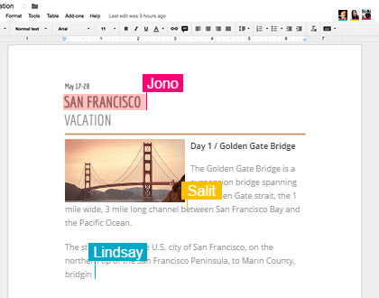
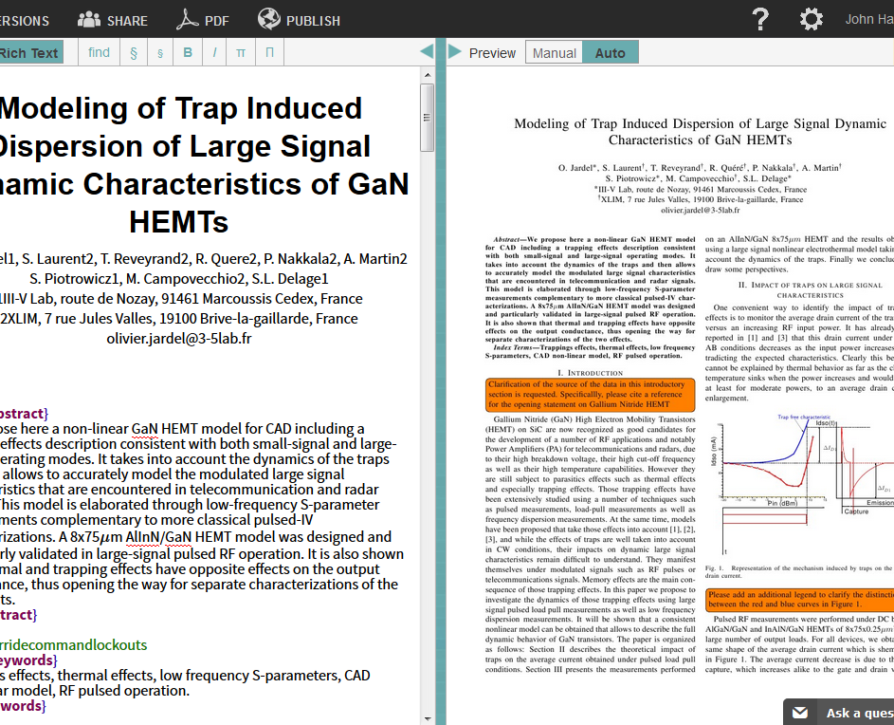
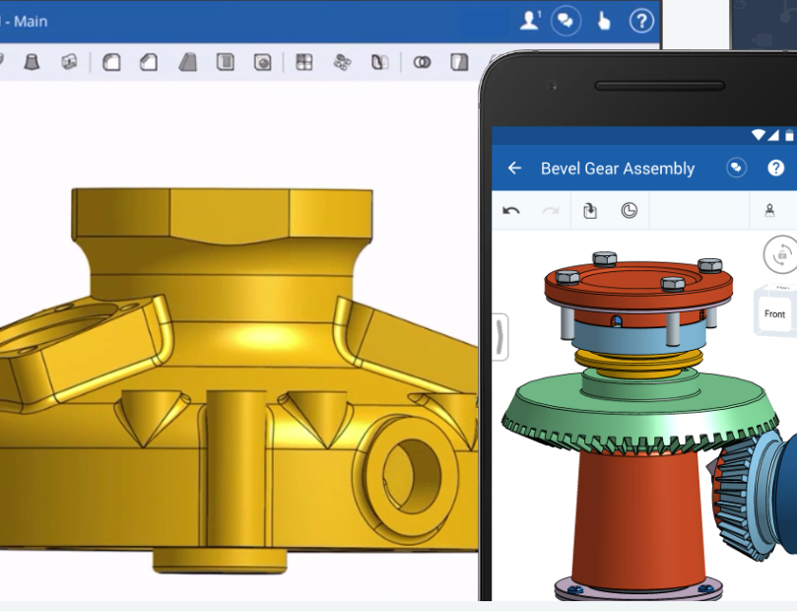
Collaborative Editing
Google Docs:
Office Documents
Overleaf:
LaTeX Documents
OnShape:
CAD / 3D Models
v
Notes:
There are some well-known collaborative editing systems
Small teams: google docs, overleaf, onshape
Do not scale well to a crowd-sourced setting where we might have hundreds or even thousands of concurrent collaborators that edit extremely large data sets.

Slide 3
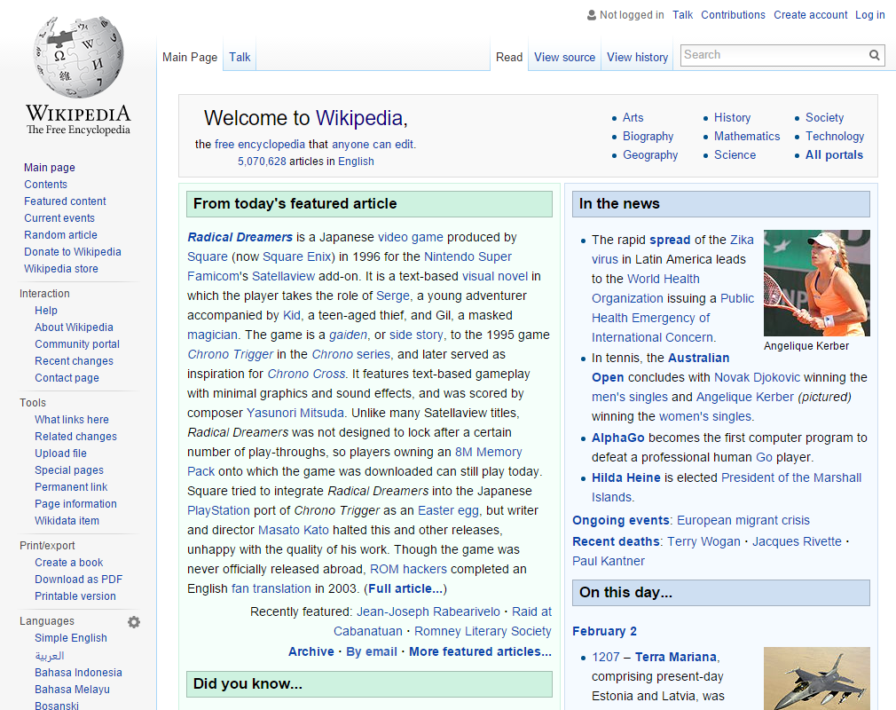
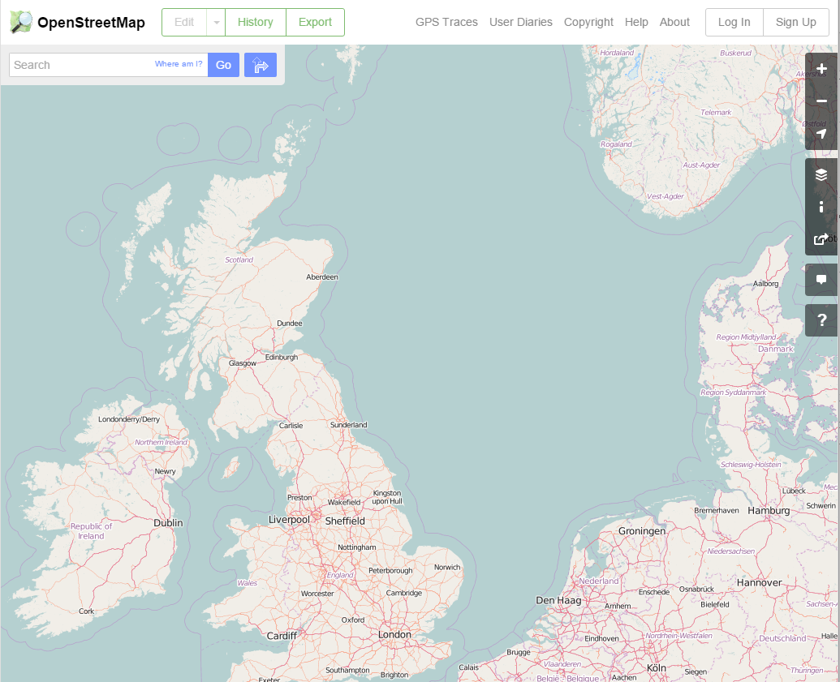
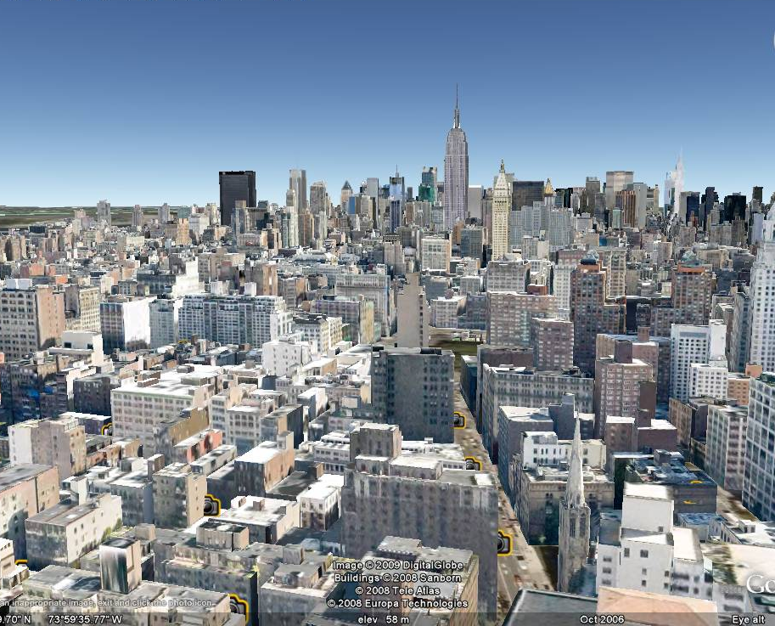
Crowd-Sourced Editing
?
Large 3D City Models
Wiki:
Large Document Collections
OpenStreetMap:
Large 2D Maps
v
v
v
Notes:
For crowd-sourced systems, there are also a few well-known examples, including wiki, openstreetmap
But what about large 3D city models?
This is where our system comes in.

Slide 4
Challenges
?
Large 3D City Models
Challenges:
Large-Scale City Models
Crowd-Sourced Editing
v
Notes:
We address two main challenges with our system:
- Editing or creating the huge amount of detailed geometry editing necessary for a city model
- second, the challenge of crowd-sourcing this editing with a large group of concurrent collaborators

Slide 5
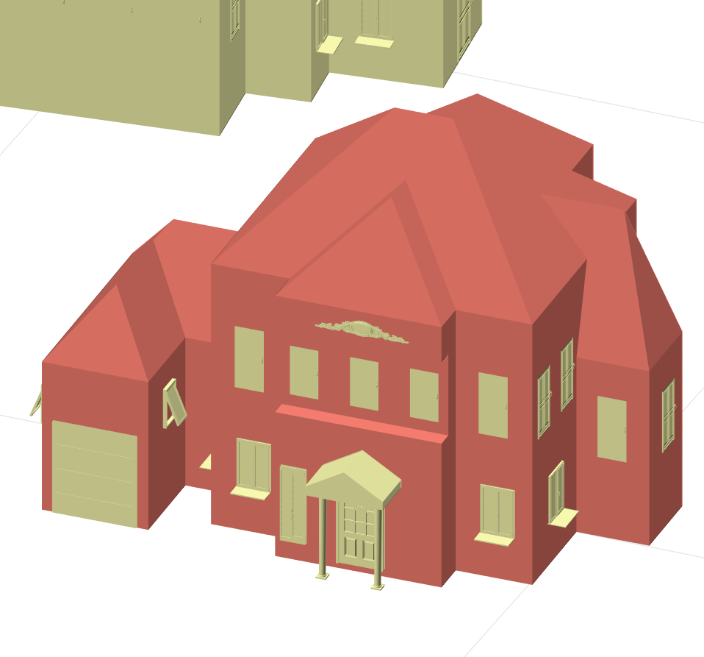
Goal 1: Large-Scale City Models
Large 3D City Models:
Efficient and easy-to-use editing of similar (but not identical) 3D assets
Traditional Mesh Modeling
Parametric Modeling
Creating a single object is intuitive and efficient
Creating the parametric model is difficult
roof
height
façade width
Changing or adapting objects is difficult
Changing or adapting objects is easy
garage width
façade height
window height
Autocad 2013 (autodesk.com/products/autocad)
Implicit parametric model
create parametric model implicitly during traditional editing session
Notes:
When modeling a large city, the main difficulty is modeling the large amount of buildings.
In a typical city, there is a large variety of buildings, but there are usually also large groups of buildings that are similar and differ only in a few properties
like the height, or the window style, or the placement of the front door.
For modeling these buildings there are traditionally two approaches:
For example changing the height of a building or the style of its facade
Is a difficult problem that may require almost as much effort as creating the building in the first place.
For parametric modeling, which includes procedural modeling, it is the opposite:
…
In our setting, we can’t use either of these extremes, since we don’t want to create each building individually and we don’t want a system that is difficult to use, since we want to attract as many users as possible.
we can’t directly use parametric models, since they would severly limit the user that can use our system
and traditional mesh modeling is too inefficient and does not make use of the fact that a lot buildings that only differ by a few properties.
So we try to find a middle ground between these two extremes, with an approach we call implicit parametric modeling
Opted for a locking-based scheme instead, plan to include more fine-grained locking and a merge-later approach for individual lockable parts in a future version

Slide 6
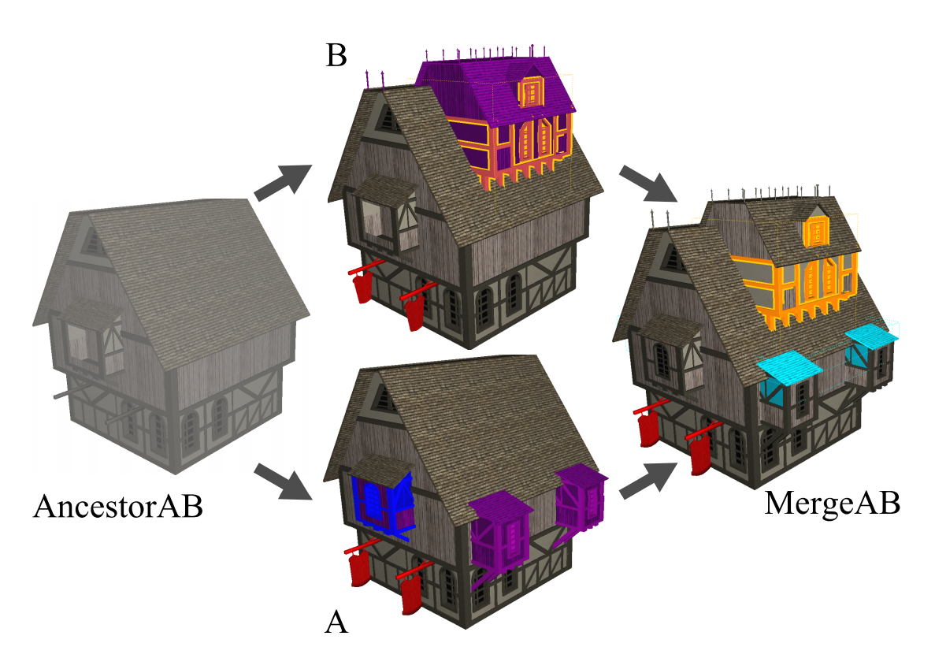
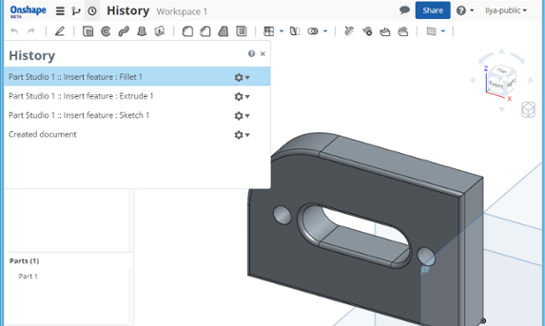
Goal 2: Crowd-Sourced Editing
Collaborative Editing:
Ensure consistency of 3D assets
OnShape (microversions)
3D Diff
Works well for small teams
Not well suited for our use case: can get inefficient for large models and hundreds of
concurrent collaborators
OnShape (onshape.com)
Doboš and Steed
3D Diff: an interactive approach to mesh differencing and conflict resolution
Part-based locking approach
Notes:
There has been some work towards collaborative 3D modeling in the recent past.
One system is OnShape, which uses something called microversions to ensure consistency for a small team of collaborators
Another approach is using a versioning system as done in 3D Repo
Work well on small teams, but can easily get very messy with hundreds or thousands of concurrent collaborators
Opted for a locking-based scheme instead, currently we lock individual buildings.
One locked part can only be edited by one user at a time.
In a future version, we plan to include more fine-grained locking and a merge-later approach for individual lockable parts that is based on the same implicit parametric model we use for editing

Slide 7
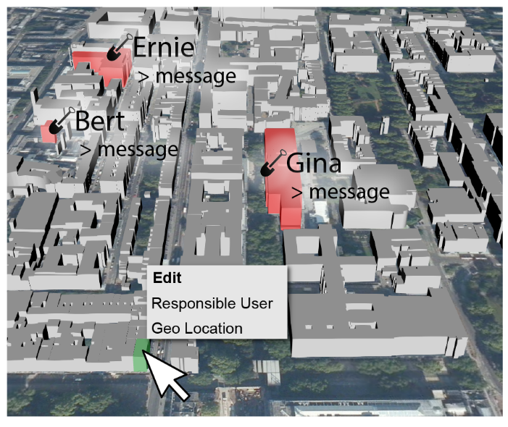
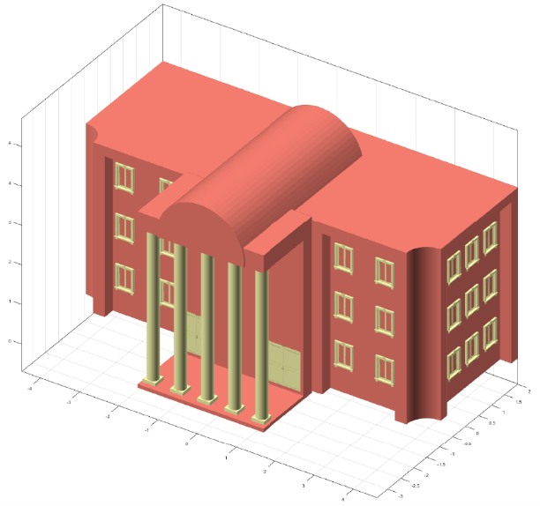
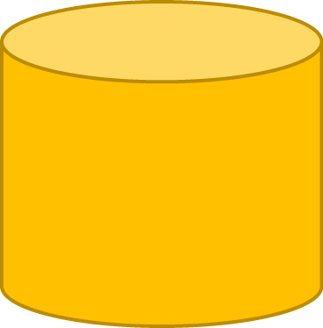
Open3D System Overview
v
Open3D
Server
lock &
serve model
Open3D Browser
Open3D Editor
serve models
update model
& unlock
send model selection
Notes:
Consists of three main components
Browser displays the entire model
Here can view models that are currently being edited by other users
We also plan to include a social hub in future work
Models are streamed from our second component, the Open3D server
I am going into the formats in the next slide
Clicking on a building allows the user to edit that building in the third main component, the model editor.
This editor implements our implicit parametric modeling approach that allows existing buildings to be modified efficiently.
Buildings currently being edited are locked on the server and unlocked once editing has concluded.
We chose to split the system into these three main components and use a clear and simple-to-use interface so individual components are exchangeable.
(As editor, for example, we currently use a research prototype written in Matlab that will need to be exachanged with web-based editor in the future.)

Slide 8
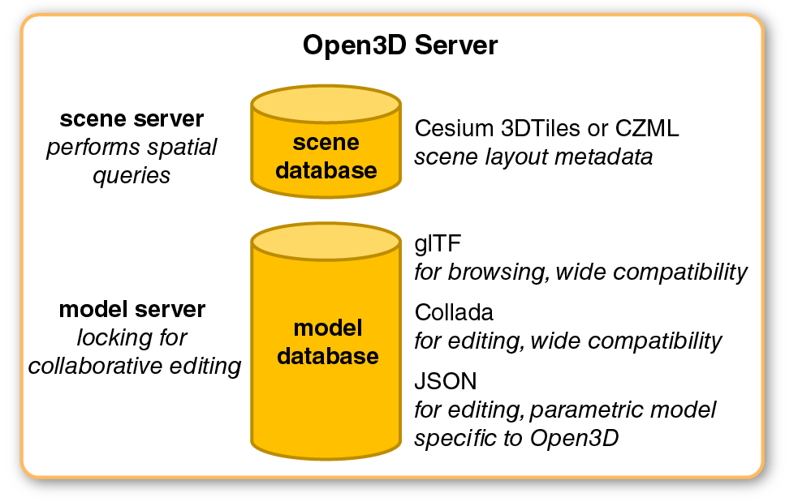
Scene and Model Formats
Notes:
On the server, the city is stored as a set of individual buildings, with locations stored in a scene file.
Scene metadata may be delivered either hierarchically using Cesium 3D Tiles, or as a flat list of building positions using CZML.
We chose these formats because 3D tiles CZML is maintained by the same team the developed 3D Tiles, so the two formats have good compatibility
Models are

Slide 9
Data Flow
Notes:
Communication between components uses simple RESTful requests, mainly between the server and one of the other two components.
Only the model selection is sent from browser directly to editor after the user selects a building to edit.

Slide 10
Open3D System Overview
v
Open3D
Server
Open3D Browser
Open3D Editor
Notes:
Consists of three main components
Browser displays the entire model
Here can view models that are currently being edited by other users
We also plan to include a social hub in future work
Models are streamed from our second component, the Open3D server
Clicking on a building allows the user to edit that building in the third main component, the model editor.
This editor implements our implicit parametric modeling approach that allows existing buildings to be modified efficiently.
Buildings currently being edited are locked on the server and unlocked once editing has concluded.
We chose to split the system into these three main components and use a clear and simple-to-use interface so individual components are exchangeable.
(As editor, for example, we currently use a research prototype written in Matlab that will need to be exachanged with web-based editor in the future.)

Slide 11
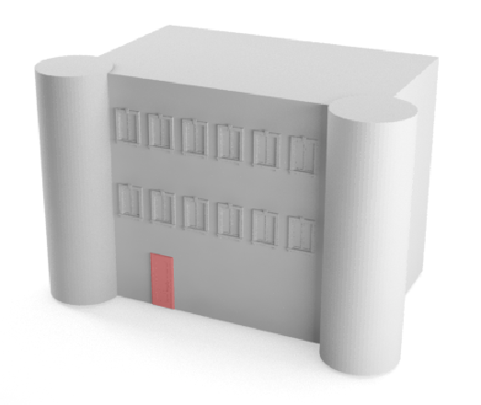
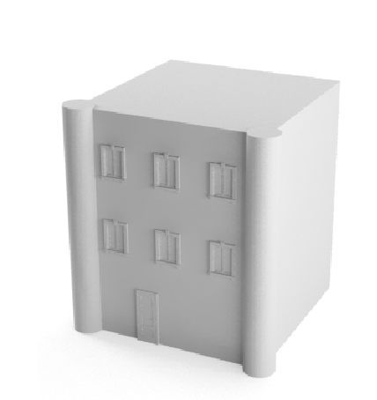
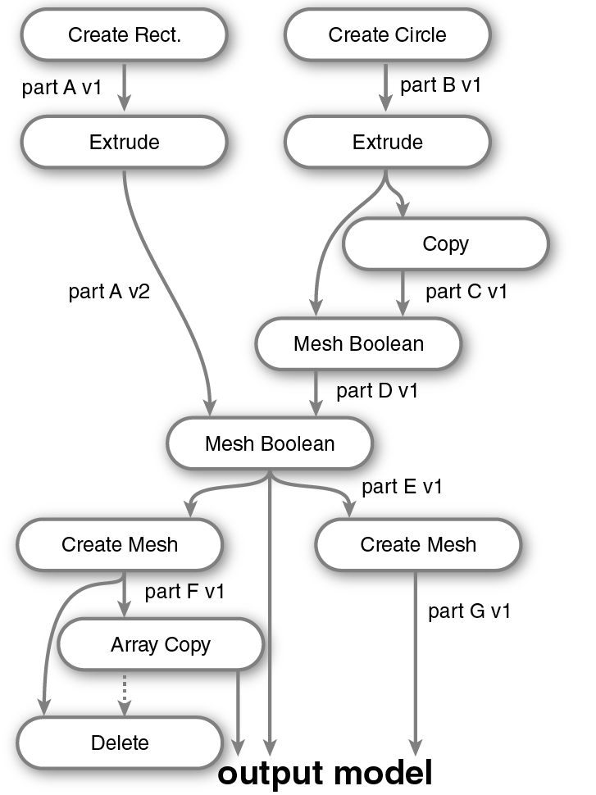
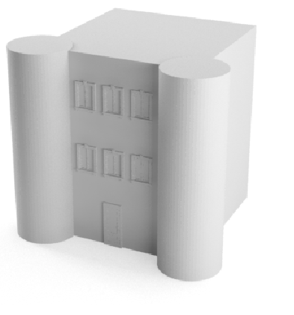
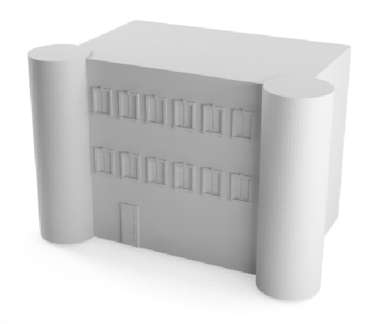
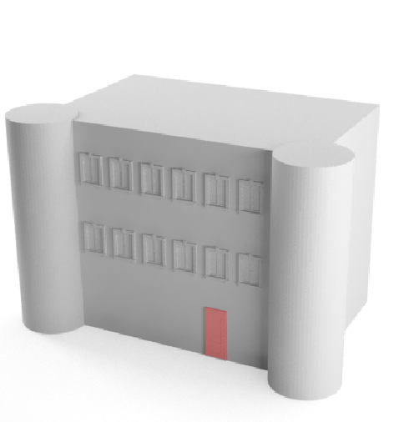
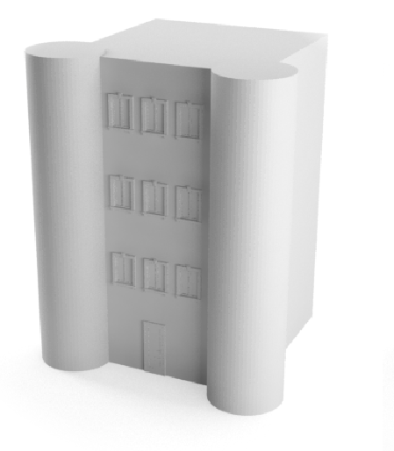
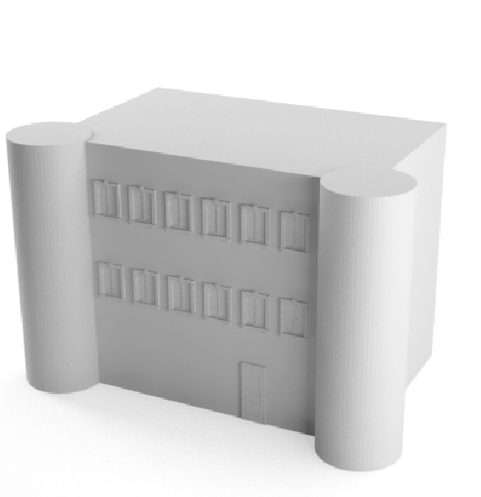
Implicit Parametric Model
Operation Graph
original
A
B
A change width
B change radius
C change height
C
A & D
D change retarget type

Slide 12
GIS Import
GIS data source
height data
footprint data
initial model
Create Polygon
Extrude
(optional: roof)
Open3D Server
Notes:
OS Mastermap

Slide 13
Results
Notes:
Next I am going to show some initial eexperiments we performed with our method

Slide 14
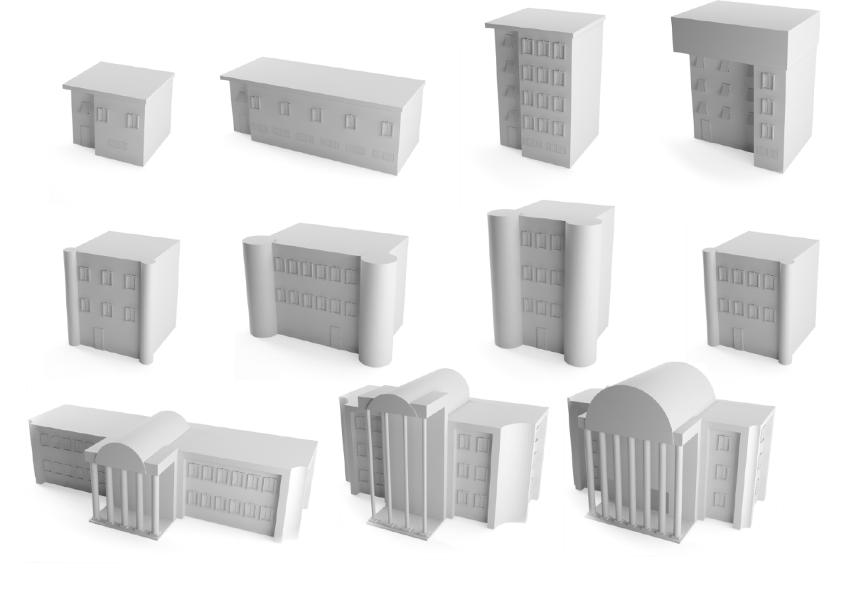
Modeling Examples
original building
variations (3 changes or less)
27 operations
15 operations
53 operations

Slide 16
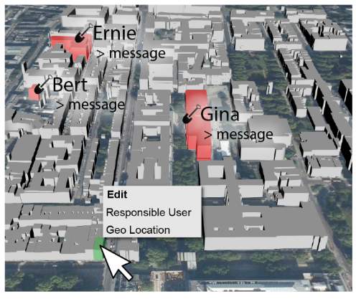
Conclusions
Crowd-sourced editing of large city models
Specialized modelling approach: Implicit parametric model
Simple conflict prevention: part-based locking mechanism
v
Notes:
Open3D is a system for crowd-sourced editing of large city models
Solves two key challenges, modeling and collaboration by
Introducing a specialized modeling approach: implicit parametric modeling
And by implementing a simple form conflict prevention using a part-based locking mechanism

Slide 17
Limitations
Ongoing work, some features are still missing
Only targeted at cities
Only geometry, editing textures/materials not yet supported
Reference for accurate reconstruction still missing (at submission)

Slide 18
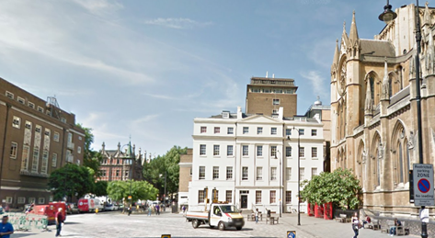
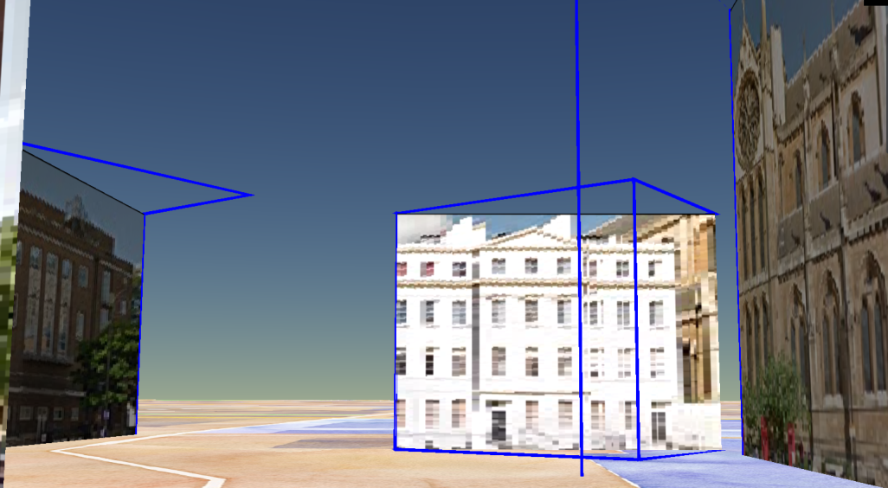
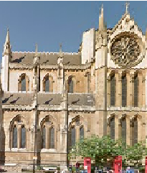
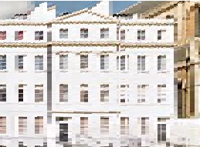
Future Work: Reference Façade Textures
Google Street View Panoramas (contain depth data)
+
Rectified geolocated reference façade textures
…
Notes:
In the meantime, we have implemented a solution that used google street view panoramas
to extract geolocated reference façade textures
That can be used as a modelling reference in the editor

Slide 19
Thank You!
geometry.cs.ucl.ac.uk/projects/2016/open3d-system

Slide 20
Editing Cycle
Notes:
Including creating the initial model

Slide 21
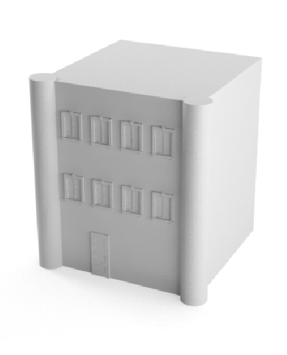
B & E
E change spacing
Notes:
This is ongoing work and here we present the details of a very early, but functional version of the system.
This also means that some parts are still missing, for example the UI overlay you can see on top left is still a mockup of the UI we plan to implement soon

