Slide 1
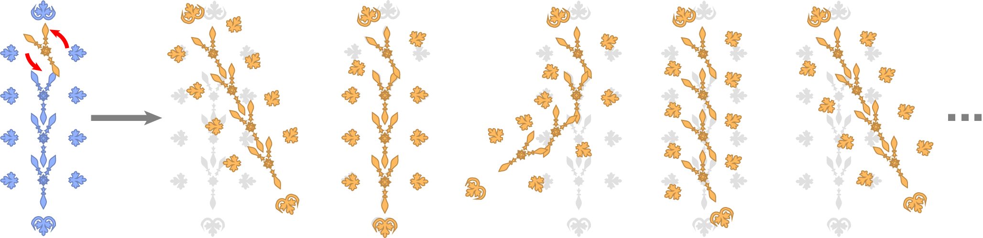
PATEX: Exploring Pattern Variations
Paul Guerrero
University College London
Gilbert Bernstein
Stanford University
Wilmot Li
Adobe Research
Niloy J. Mitra
University College London

Slide 2

Patterns
Notes:
Patterns can come in a large variety of arrangements, from very symmetric compositions (right) to more organic arrangements (left).
In designs, they are frequently used as to add visual interest to filled regions, as main design element, or as backdrop to a primary design element.
Our work focuses on patterns that are arrangements of discrete elements, like the examples you can see here.
One common characteristic of these patterns is that they exhibit certain amount of structural regularity.

Slide 3

Structural Regularity in Patterns
Notes:
In patterns on the right this is immediately apparent, for example some elements share a common distance to the central element or exhibit rotational symmetry

Slide 4

Structural Regularity in Patterns
Notes:
Even in the leftmost pattern, there is some regularity, for example in the watermelon seeds, the leafs on the branch next to it, or the segments of the orange.
This structural regularity is just as characteristic of the pattern as the shape of individual elements; changing this regularity changes the way the pattern looks.
However, in current editors there is no support for working with this structure.
Modifying the structure requires changing each element manually so that they form the modified structure.

Slide 5
Pattern Variations
Facilitate exploration of pattern variations
Notes:
Our goal is to facilitate the exploration of possible variations of this structure
In a typical exploratory editing, the user might have a rough direction, but not a concrete target pattern in mind.
We aim to provide a tool that lets the user explore different concrete alternatives of realizing that rough direction.

Slide 6

Traditional Workflow: Editing Each Element
Facilitate exploration of pattern variations
Notes:
Take for example the pattern on the right …

Slide 7
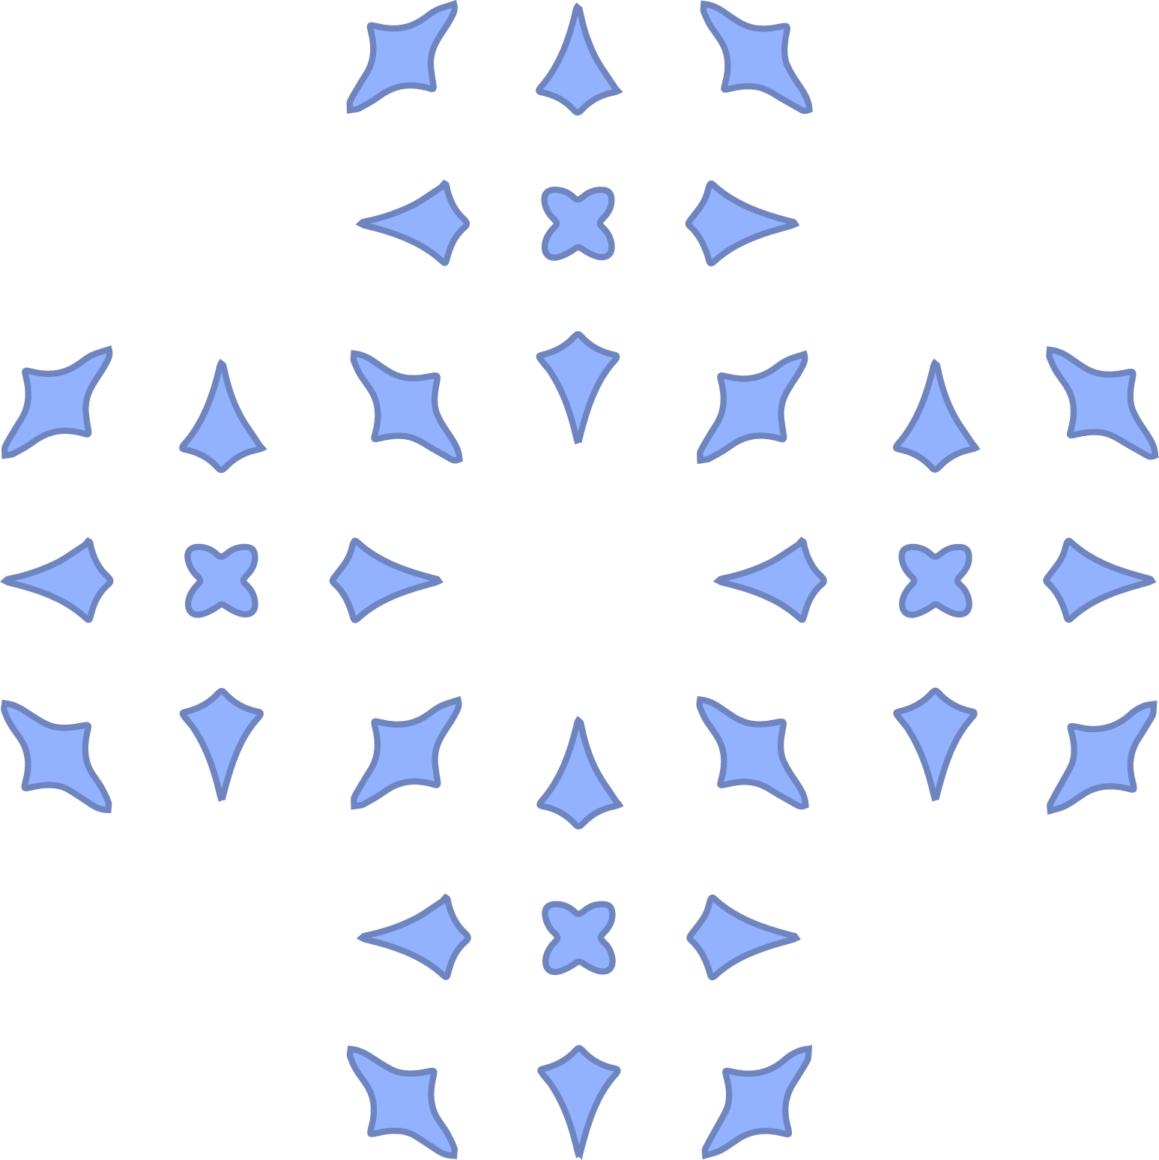
Traditional Workflow: Editing Each Element
Facilitate exploration of pattern variations
“Increase spacing”
Notes:
… and assume the task is create a variation with increased element spacing.
Our two main goal are then
avoiding the inefficient and repetitive task of modifying each pattern element separately
And second, exploring a large number of possible alternatives to achieve the given task.

Slide 8
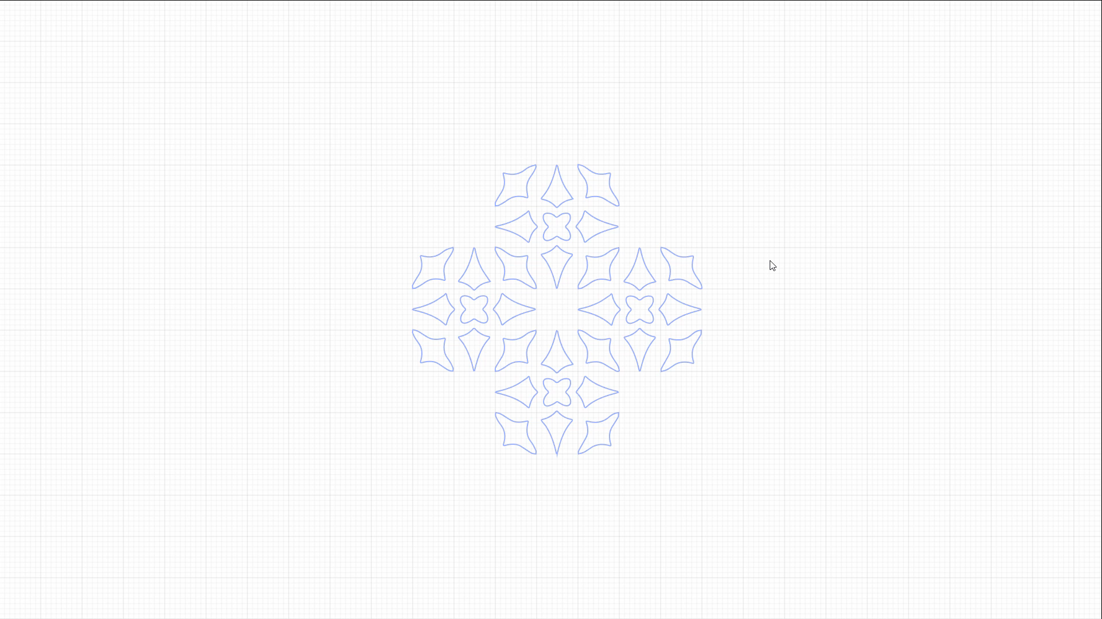
Traditional Workflow: Editing Each Element
“Increase spacing”
…
3x
Notes:
In traditional vector editing tools, getting a variation of the pattern with increased spacing can require a lot of repetitive operations.
Even worse, if we want to find a slightly different variation afterwards, say with a little bit more or less spacing, we have to repeat all of these operations
With so much effort required to get to each pattern variation, the exploratory phase of designing a pattern can be time-consuming.

Slide 9





Problem Statement
Changing the structure without changing each pattern element separately
Exploring a large number of possible alternatives
Pattern with known structure
User modification
+
Notes:
We want to improve upon this workflow in two ways:
First, we want to avoid editing each element separately to increase efficiency
And second, we want to let the user explore several alternatives of realizing a given task.
To do that, we try to solve the following problem:
Given a pattern with known structure and a user modification of one or several elements, what are possible variations of the pattern that respect the user edit and maintain some part of the pattern structure?
One idea that might come to mind is to use a fixed set of constraints to model the pattern structure, for example the constraint that all elements share the same orientation or are aligned horizontally
And solve for element poses that respect the user edit and the constraints.

Slide 10
Multiple Variations
+

Slide 11






Multiple Variations
overcomplete structure
user modification
original pattern
variation 1
variation
+
“horizontal”
variation 2
variation 3
variation 4
“orthogonal to orientation”
“horizontal & mirrored”
variation 5
variation 6
…
Notes:
And that does indeed give us a useful variation
But even for this simple pattern, there are a lot of other interpretations of the pattern structure that result in other interesting variations.
For example, we could interpret the elements as being aligned orthogonal to their orientation,
Or the orientations to be symmetric about the central element
which gives us a different variation
These interpretations are not compatible with each other, they use different mutually conflicting sets of constraints.
In general, only the original pattern lies at the intersection of all of these interpretations.
Our key idea is to use on overcomplete representation of the pattern structure that combines all of these constraints.
To generate variations for a given user edit, we choose subsets of these constraints.
Note that our goal is not to rank these variations or generate all possible variations.
Instead, given a user edit and the overcomplete pattern structure, we want to find a set of distinct variations (that is large enough to facilitate pattern exploration).
In our experience, 5-10 variations are enough to facilitate pattern exploration

Slide 12

Notes:
When working directly with this overcomplete pattern structure, a different workflow is possible
Which lets us create …
… and explore different pattern variations much more efficiently

Slide 13
PATEX
PATtern EXploration
Notes:
Next I am going to give an overview of our proposed approach.

Slide 14
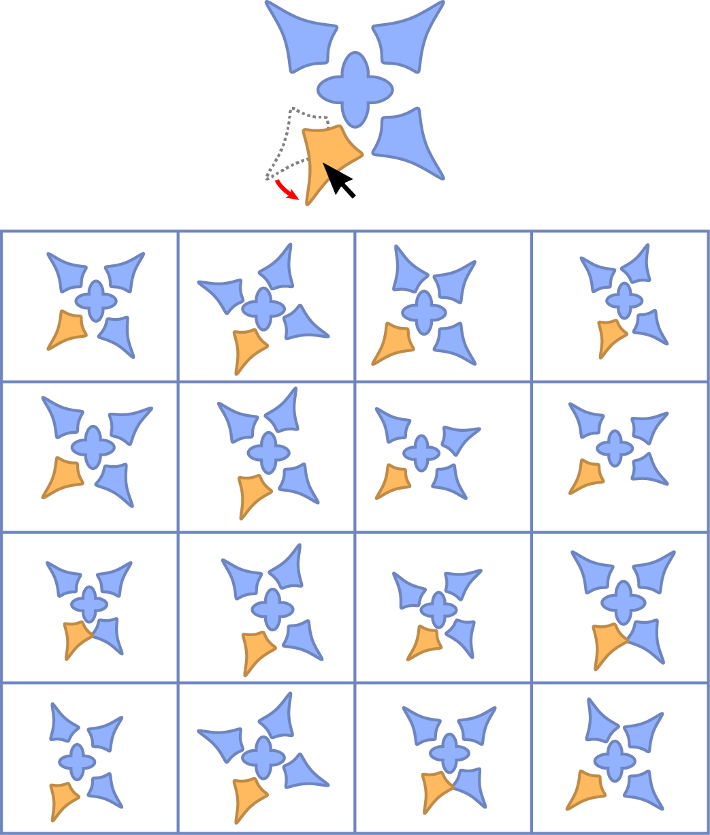
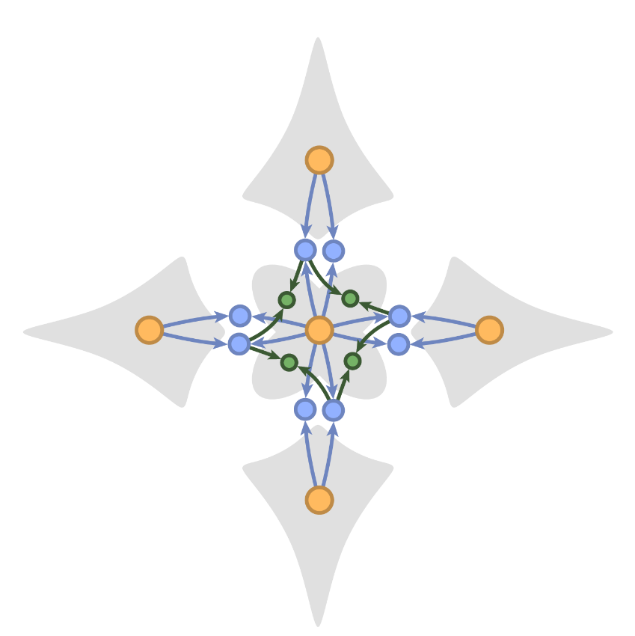
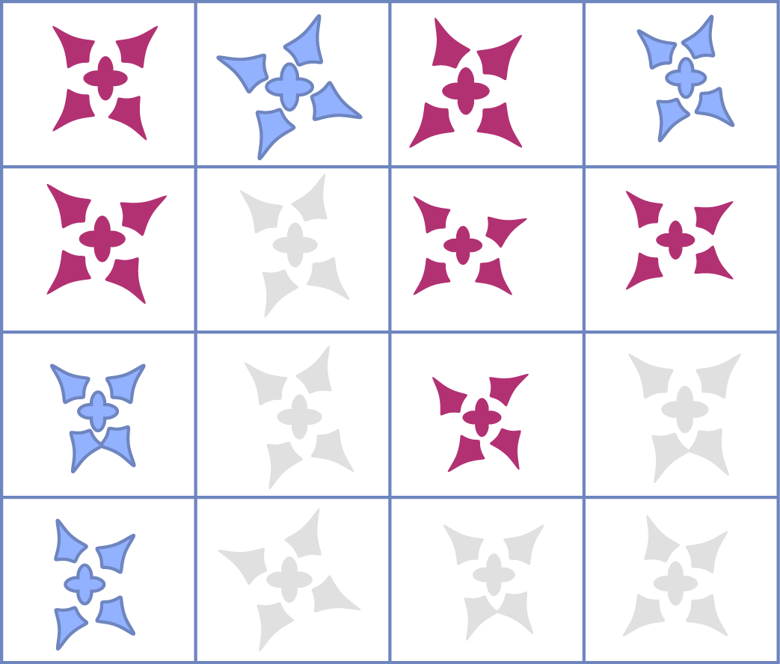
PATEX Overview
main step
Input
1
2
Computing
Pattern Variations
Choosing
Pattern Variations
Pattern Elements
The Pattern Graph
unintuitive
duplicate
good
Notes:
In our method, we describe the structure of a pattern using a pattern graph, a hierarchy of binary geometric relationships
We then find a large set of pattern variations by choosing different subsets of the pattern graph.
This is the main enabling step of our method.
Then, we use simple heuristics to pick a subset of these variations that is intuitive and free of duplicates, so we can present it directly to the user.

Slide 15


Pattern Elements
simple polygons
Notes:
The input to our method, apart from the user edit
are the pattern elements, given as a set of simple polygons
And the pattern graph …

Slide 16
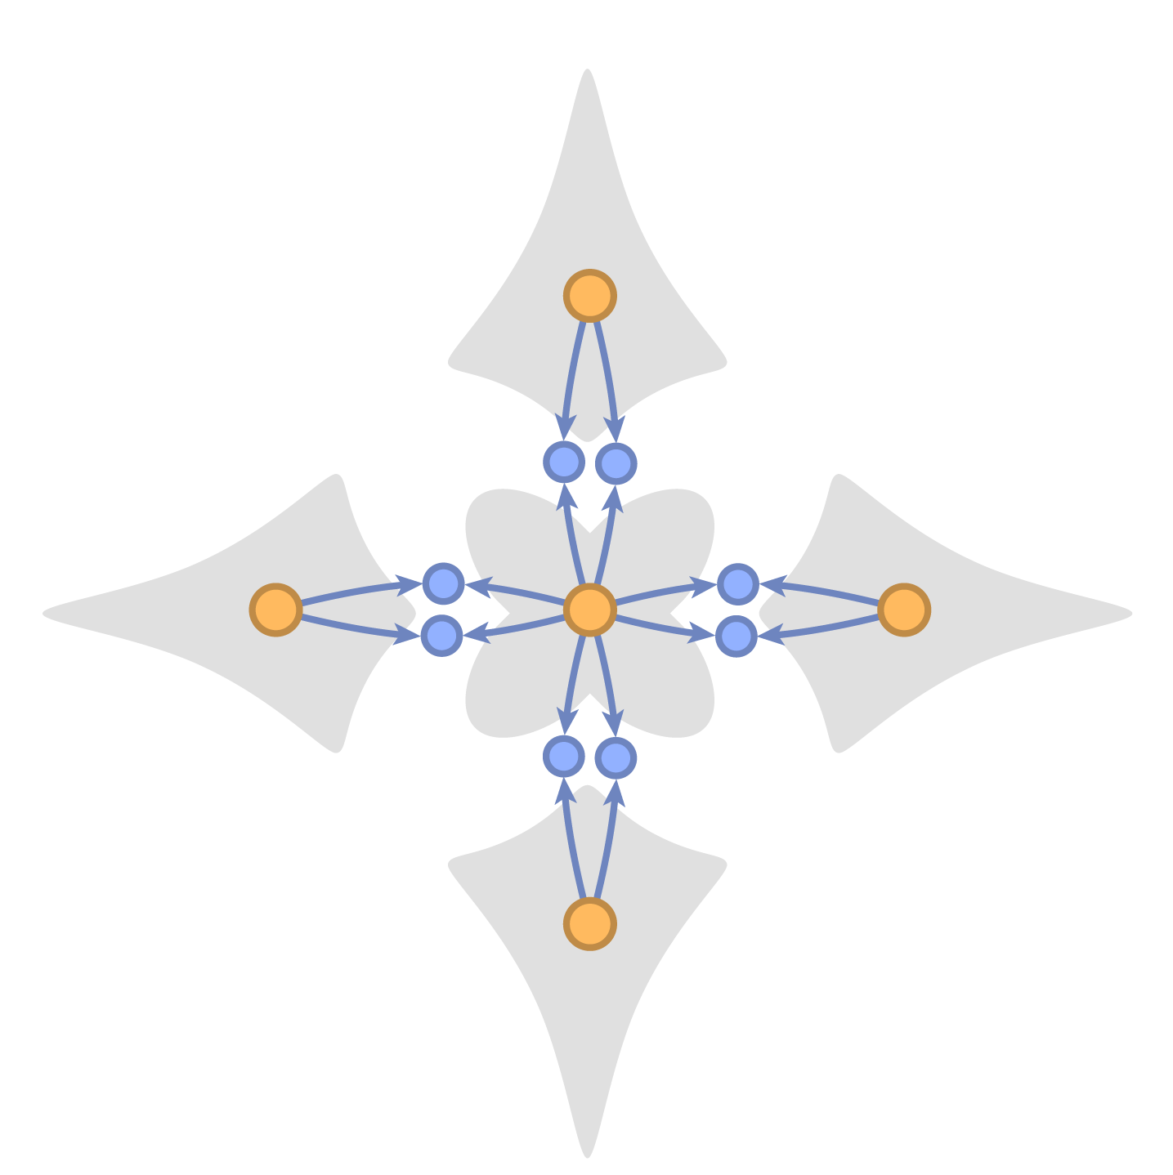
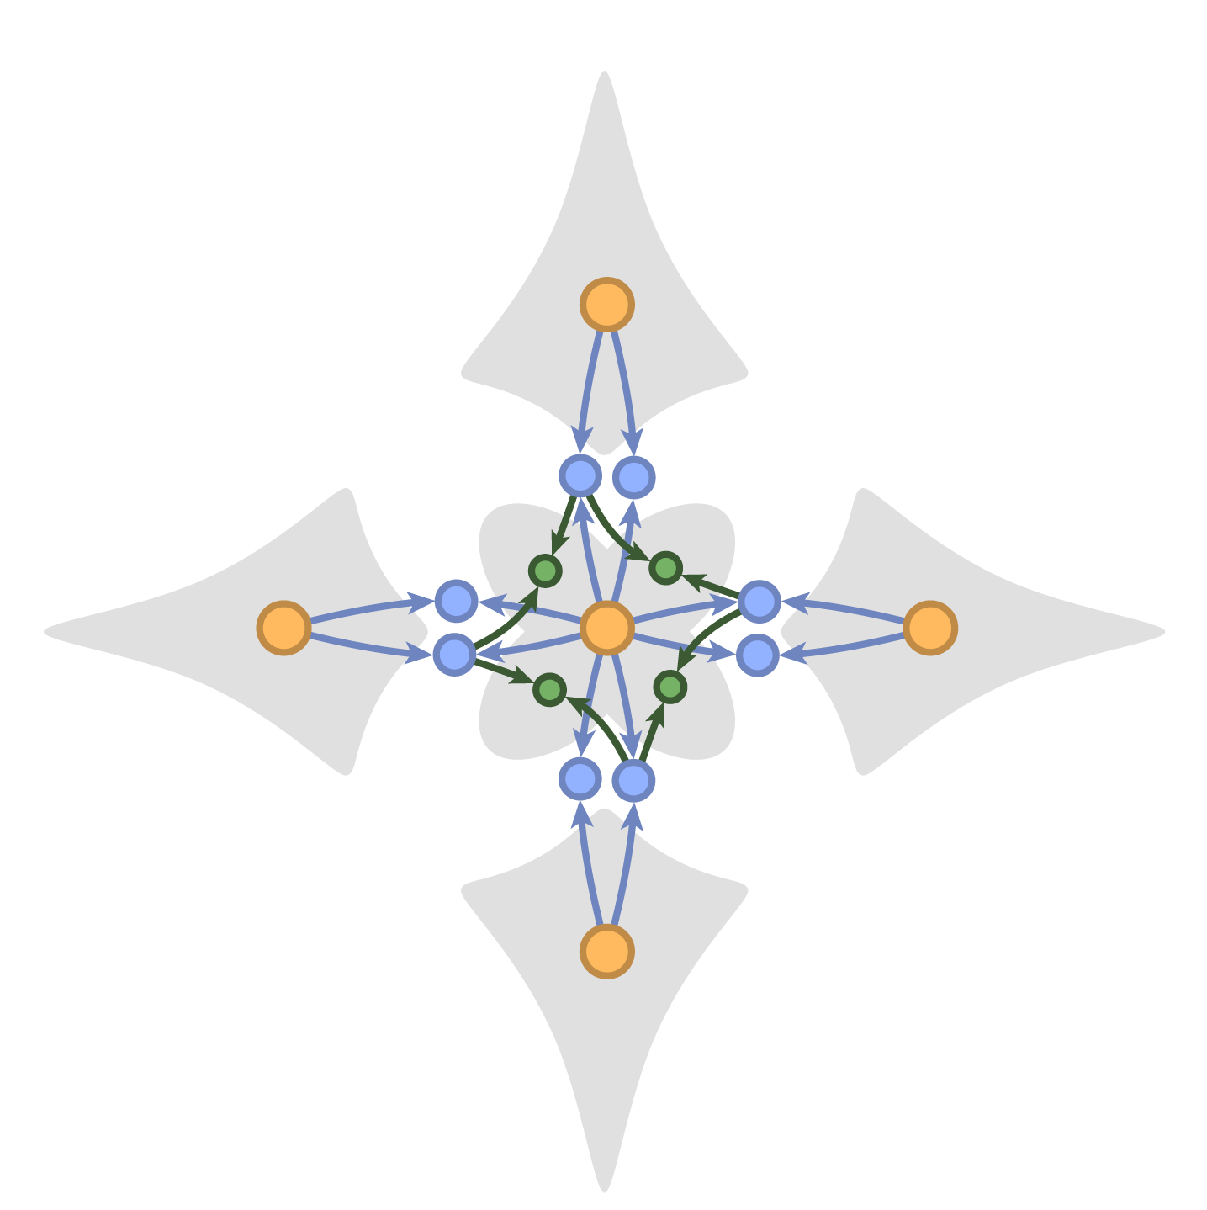
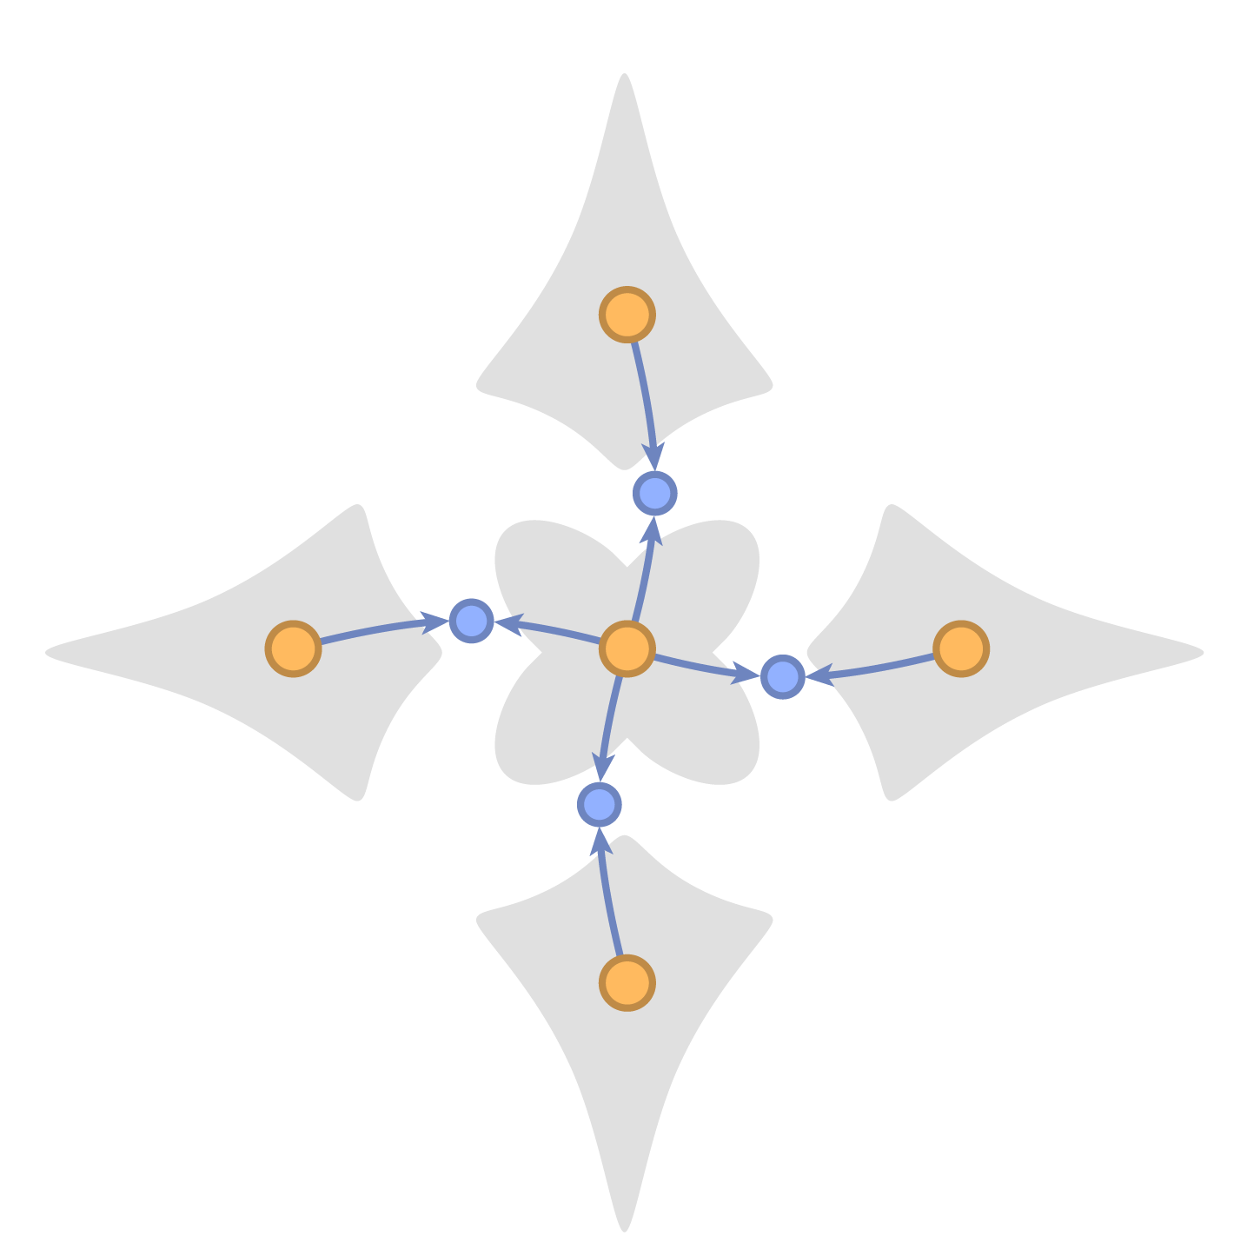
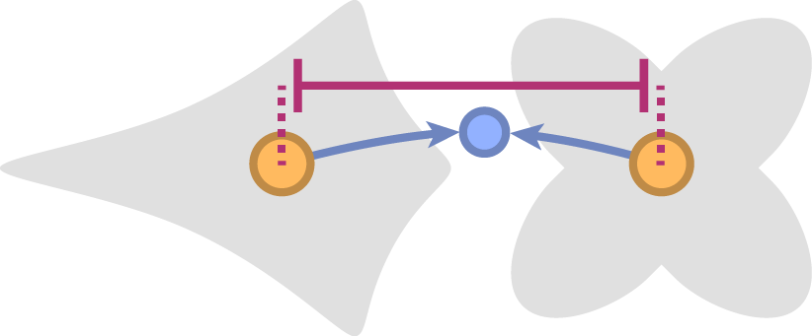
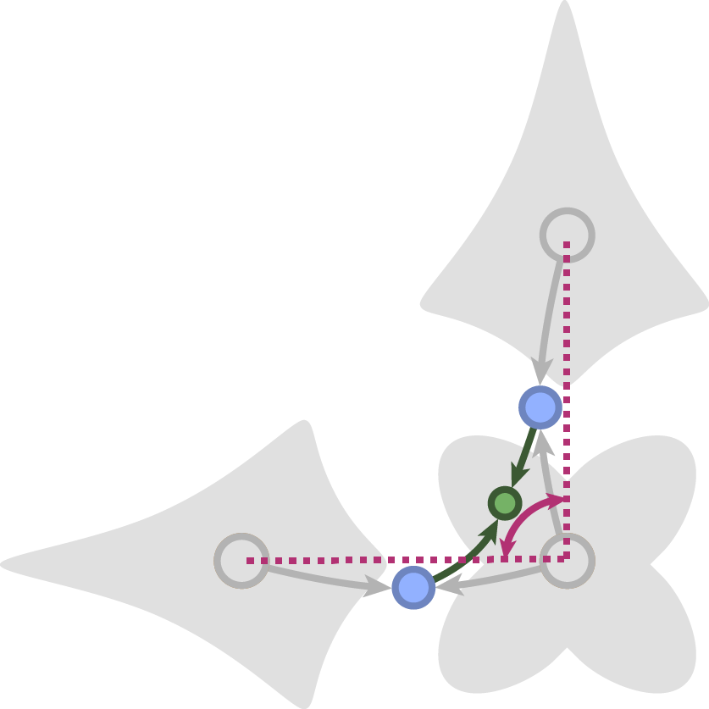
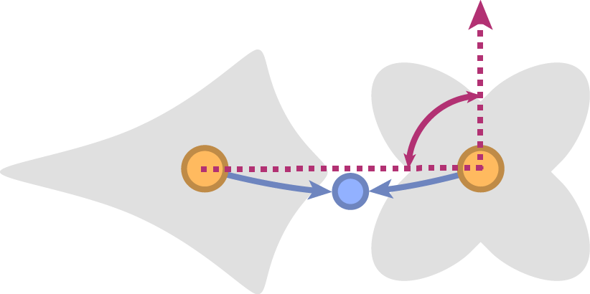
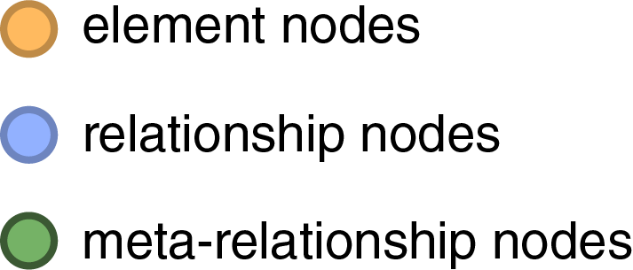
The Pattern Graph
relationships:
relationship hierarchy:
centroid distance
right angle
centroid direction
element nodes
…
…
relationship nodes
higher-level relationship nodes
Notes:
… which consists of element nodes (yellow circles), connected by relationship nodes (blue circles)
Relationships quantify an aspect of the geometric relationship between two elements with a single value
For example, the centroid distance relationship quantifies the distance between two element centroids and the centroid direction the direction from the first to the second centroid in coordinate frame of the first element
Relationships based on other properties of the elements, such as the boundary, are possible as well.
A hierarchy of these relationships can be used to describe more complex relationships, like elements arranged in a right angle
Meta-relationships quantify the relationship between two relationship values, for example the difference or ratio between two relationship values.
For example, a right angle relationship between three elements can be constructed with two centroid direction relationships and difference meta-relationship.
Meta-relationship can be applied to other meta-relationships
for example to define a “same angle” relationship that involves four elements.

Slide 17
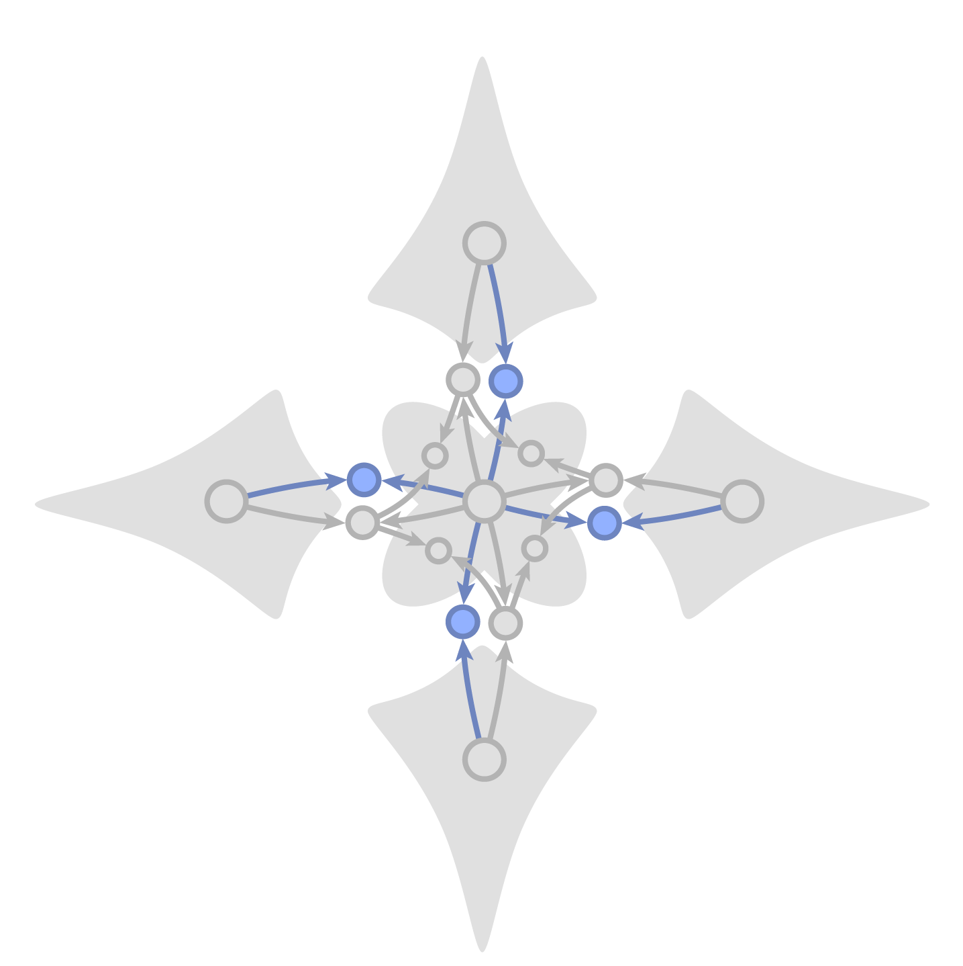
The Pattern Graph
relationships:
group 1: same centroid distance
relationship hierarchy:
centroid distance
right angle
centroid direction
element nodes
…
…
relationship nodes
hierarchy of relationship nodes
Notes:
The regularity of a pattern structure is represented by relationship groups.
These groups contain relationships of the same type and with the same value
In this example the distance relationships form a group since they all have the same distance
As well as the angle difference relationships since they are all 90 degrees

Slide 18
PATEX Overview
main step
Input
1
2
Computing
Pattern Variations
Choosing
Pattern Variations
Pattern Elements
The Pattern Graph
unintuitive
duplicate
good
Notes:
So this is how we describe the pattern structure.
In our work, we assume this pattern graph is given for any given pattern.
In a complete pattern editing workflow, we would extract this pattern graph from the arrangement of elements
But we consider this to be an orthogonal pattern recognition problem, so we did not go into that
Next, we show how this graph can help us find pattern variations

Slide 19
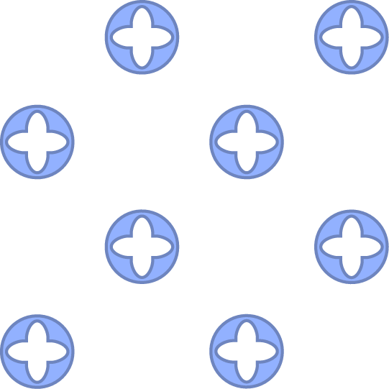
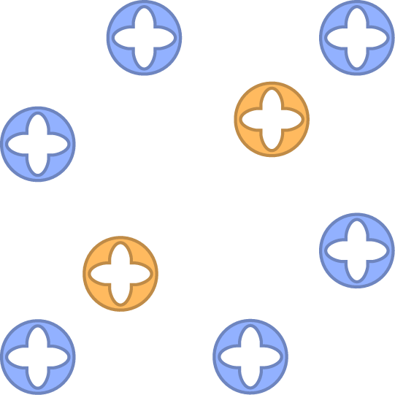
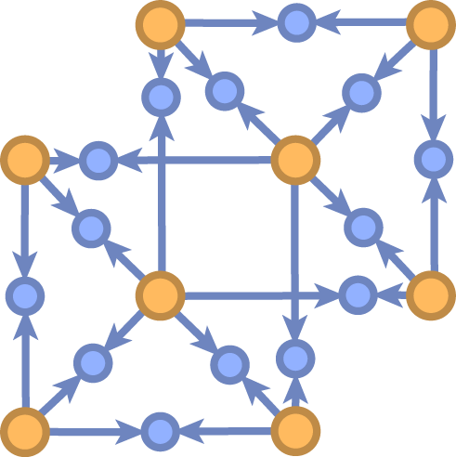
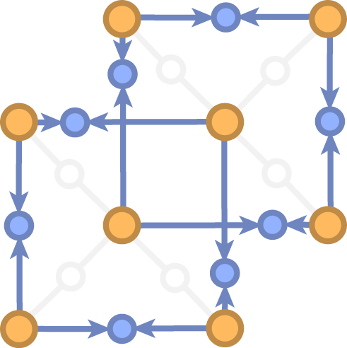
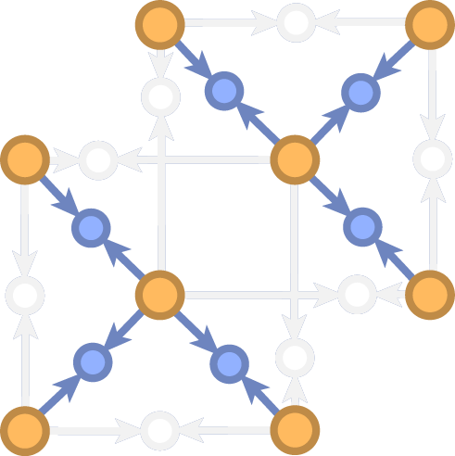
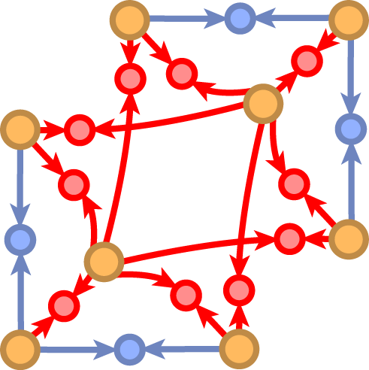
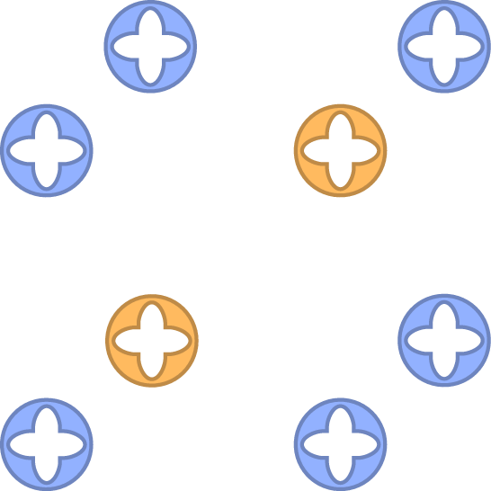





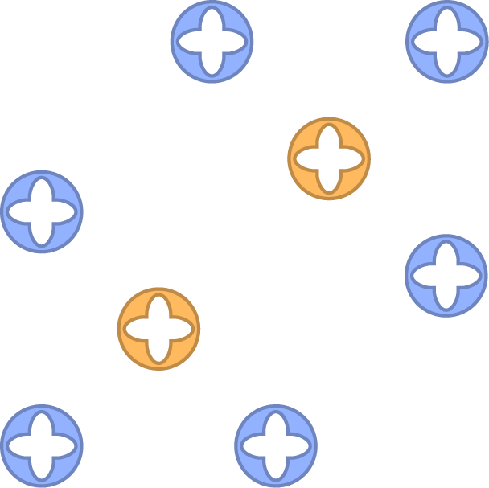
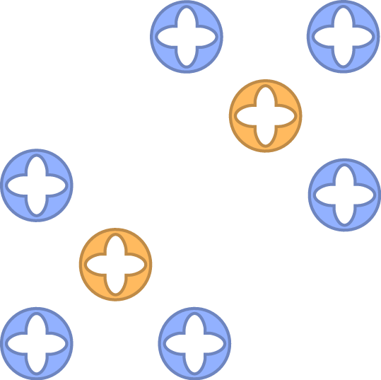
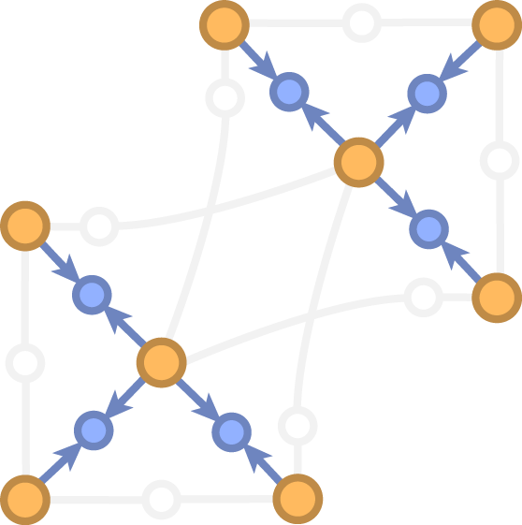
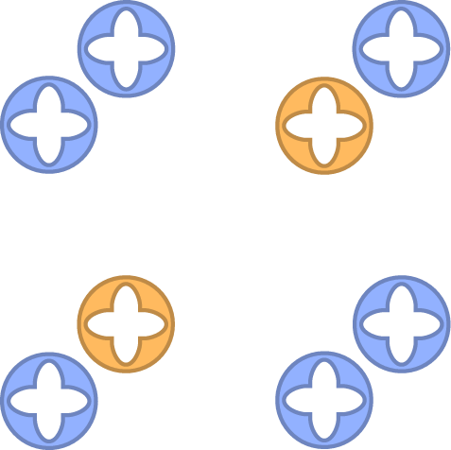
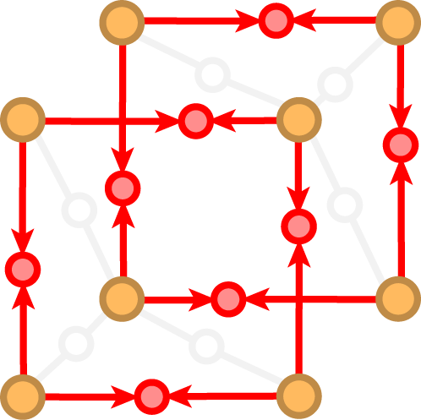
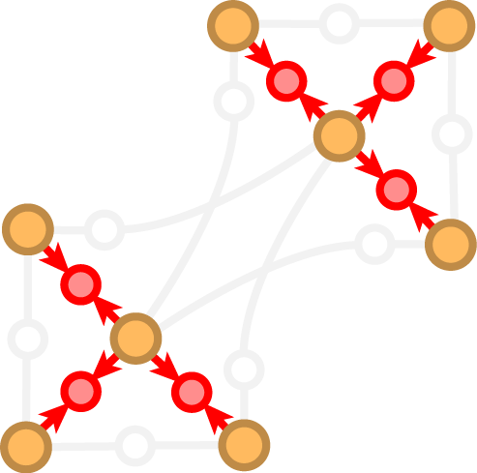
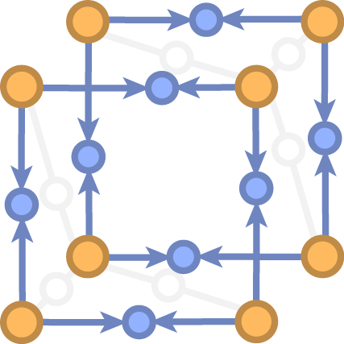
Computing Pattern Variations
original pattern
user modification
changed
elements
changed
relationships
Keep or Change or Drop
…
Notes:
Take for example this pattern and the user modification shown on the right
This is the corresponding pattern graph. For clarity we show all relationships that may exist between two elements with a single blue node.
The pattern graph is an overcomplete representation of the pattern structure:
It contains several possible interpretations of the structure.
One interpretation are these interlocking rectangles
A different interpretation might be these two triangle structures.
The edit changes some part of the pattern structure, shown in red
and makes is necessary to disambiguate these interpretations.
Each Interpretation results in a different variation
We can list all possible variations by deciding for each relationship whether to constrain it to its original value, to its changed value, or whether to drop it from the pattern graph.
For example, constraining the relationship that form rectangles to the original values and dropping all other relationship gives us the first variation
Changing the distance relationships to the new values gives us the second variation
Doing the same thing with the triangle relationships gives us the two variations on the right.
Note that the number of variations is exponential in the number of relationships
We will discuss how to find a good subset of these variations later on
For now we will concentrate one of these variations, characterized by a set of relationship fixed either to the original or to a modified value.
We can find the element poses corresponding to a variation using constrained optimization.

Slide 20



Updating Element Poses
pattern state
pose of
pose of
values of
Notes:
We start with formalizing the state of a pattern, which can be described by the element poses and the value of each relationship.
This is somewhat redundant, because relationship values can be deduced from the element poses.
But including them in the state reduces direct dependencies between state variables and makes the optimization problem sparse.

Slide 21




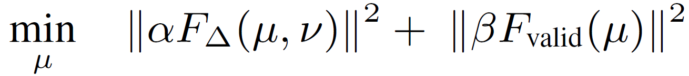
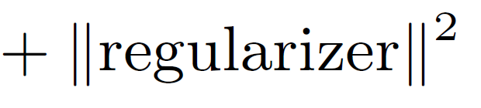
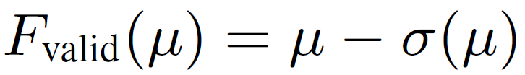
Updating Element Poses
pattern state
: original
: modified
: variation 1
: variation 2
Keep:
Change:
: relationship values
from elements
Accurate:
Valid:
Notes:
We denote the state of the original pattern with tau
Nu is the state of the modified pattern
And mu the state of a variation.
We fix the our choice of kept or changed relationships with hard constraints.
The brackets denote selecting a subset of the state, in this case the value of kept and changed relationships.
Then, we search for a state mu that optimizes two properties of a pattern variation:
First, the edit accuracy, measured as difference to the modified state nu.
And second, we optimize the validity of the pattern.
Since both element poses and relationship values are part of the state, they do not need to correspond to each other.
The pattern is only in a valid state if they do, for example if the relationship value for the distance between two elements corresponds to the distance obtained from the corresponding element poses.
This is expressed by the function sigma that computes relationship values from element poses (which should match the relationship values in the state).
Finally, we add a regularizer that prefers changing as few elements and relationships as possible
Since the relationship functions may be non-linear, this is a non-linear optimization
We use it to get the final pattern variation.
For a quick preview of a variation, we use a linear approximation

Slide 22
Linear Approximation

Slide 23
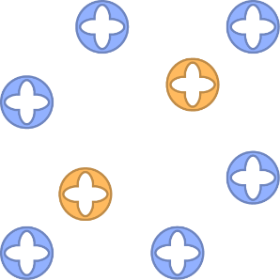
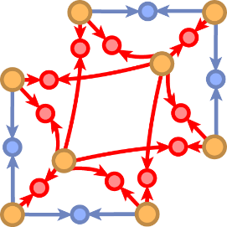
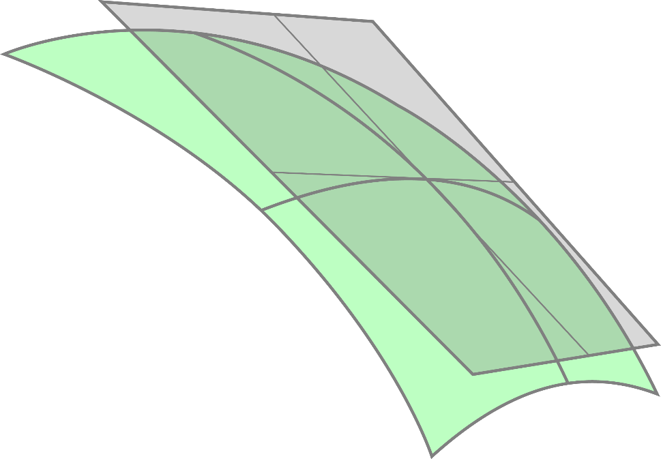
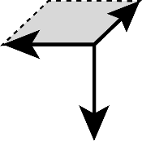


Linear Approximation
Vector-valued objective (L2 norm is scalar objective function):
: modified
linear approximation
of zero-set at
Linear Taylor expansion:
0
solve for
Keep
Change
Drop
zero-set manifold
of objective
Notes:
We then decompose the individual terms of the objective into a vector-valued function
And approximate it with a linear Taylor Expansion at the modified state nu
Since the hard constraints are constants, we can fix this part of the state, consisting of the relationship values for kept and changed relationships.
and solve for the remaining state that is free to change, which includes the element poses and the dropped relationship values.
Intuitively, the fixed constraints introduce changes that take the state away from the zero-set of the objective function, along the fixed dimensions of the pattern state.
The pattern is generally not in a valid state anymore after changing relationship values without changing element poses
Our solver then finds the closest state on the linear approximation of the zero-set manifold that can be reached along the free dimensions of the pattern state, which is generally close to the actual manifold.
With this linear approximation, we can quickly compute the patterns for a set of candidate variations.
This will be essential for identifying a good subset of variations

Slide 24
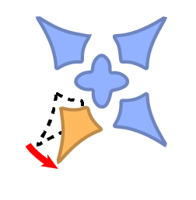








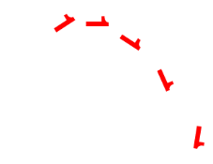
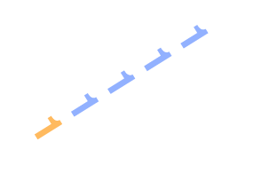
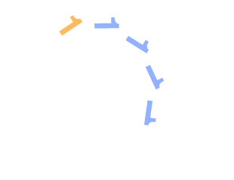
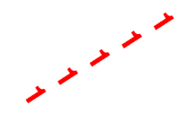
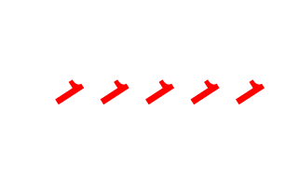
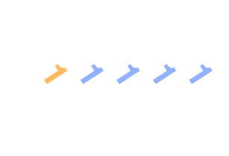
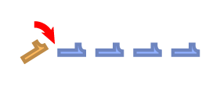







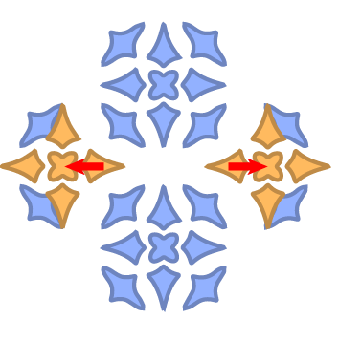

Linear Approximation: Accuracy
non-linear solution
linear approximation errors
original pattern &
user modification
variation1
variation2
variation3
variation4
Notes:
Here we show the accuracy of the linear approximation.
Linear approximation is shown with black lines in front of the colored non-linear solutions
In most cases the approximation is quite accurate
The approximation errors in the middle row are the largest we observed in any of our patterns (including much larger ones)

Slide 25
PATEX Overview
main step
Input
1
2
Computing
Pattern Variations
Choosing
Pattern Variations
Pattern Elements
The Pattern Graph
unintuitive
duplicate
good
Notes:
There is an exponential number of possible variations, one for each combination of relationship choices, whether to keep, change or delete a relationship.
This set of variations contains large subsets of duplicate patterns, some invalid patterns and some unintuitive variations.
In the next step, we pick a subset of variations that is valid, distinct and intuitive.
Note that this subset does not need to represent all possible variations of a pattern
in our experience, showing 5-10 different suggestions is often enough to facilitate exploration

Slide 26

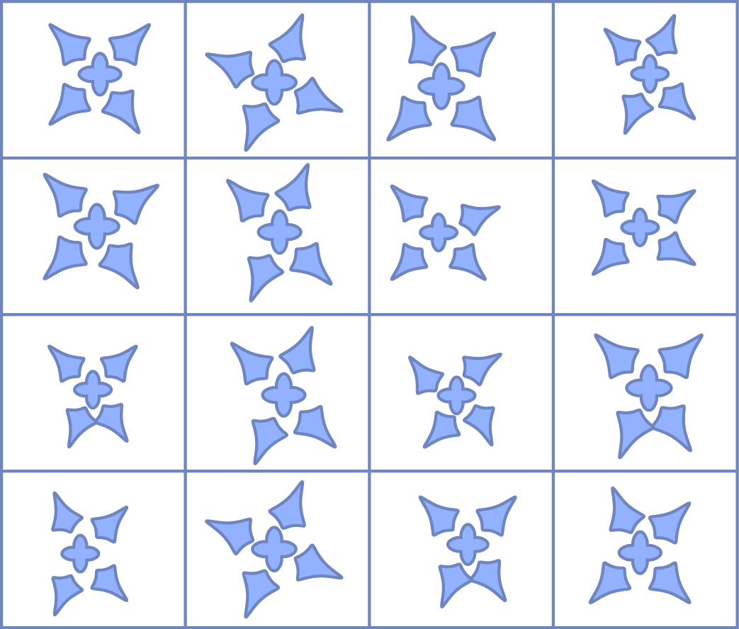
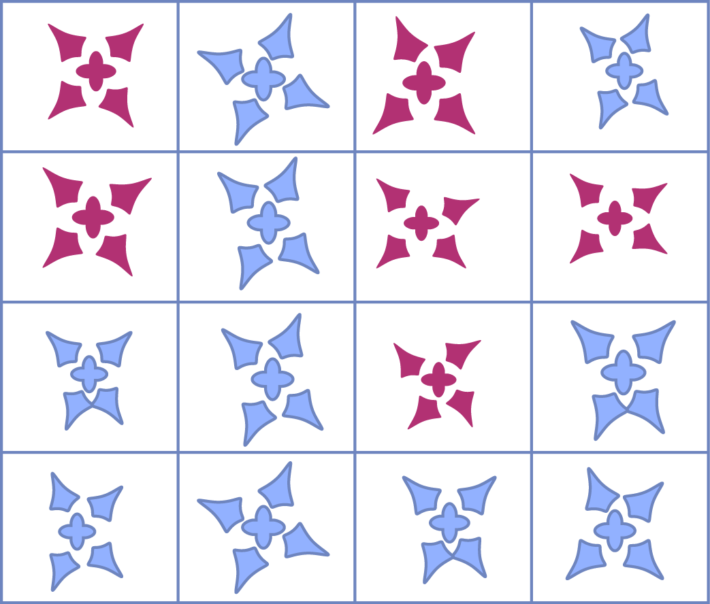


Choosing Pattern Variations
Pick random samples (e.g. = 10000)
# of variations
Intuitive filter:
Prefer changing few relationship groups
Pick random samples (e.g. = 150)
and approximate solution
Valid & distinct filter:
Objective Value below threshold
distance of relationship values above
threshold
good variations
unintuitive
duplicate
Notes:
We start by picking a random subset of fixed size from full set of variations.
This subset contains a large enough set of interesting variations, which we continue to filter in the next steps.
Some of the variations are not immediately intuitive responses to the user edit.
While it is hard to define what an intuitive response to the edit is, we have identified one property that consistently causes unexpected variations:
Variations that change multiple relationship groups introduce too much change at once to understand what is going on.
So we filter out patterns where too many groups change at once.
Next, we filter out invalid and duplicate variations.
To do that, we need to know the final element poses. But we cannot solve the optimization problem for a huge number of variations, so we employ two strategies:
We pick a smaller random subset of the remaining variations and then apply our linear approximation to that subset.
Using the approximated solutions, we can easily identify invalid patterns by their high objective value
And duplicate patterns by similar relationship values.
What remains is our final set of valid, distinct and intuitive variations that is shown to the user.

Slide 27
Results
Notes:
We performed several experiments with our method

Slide 28
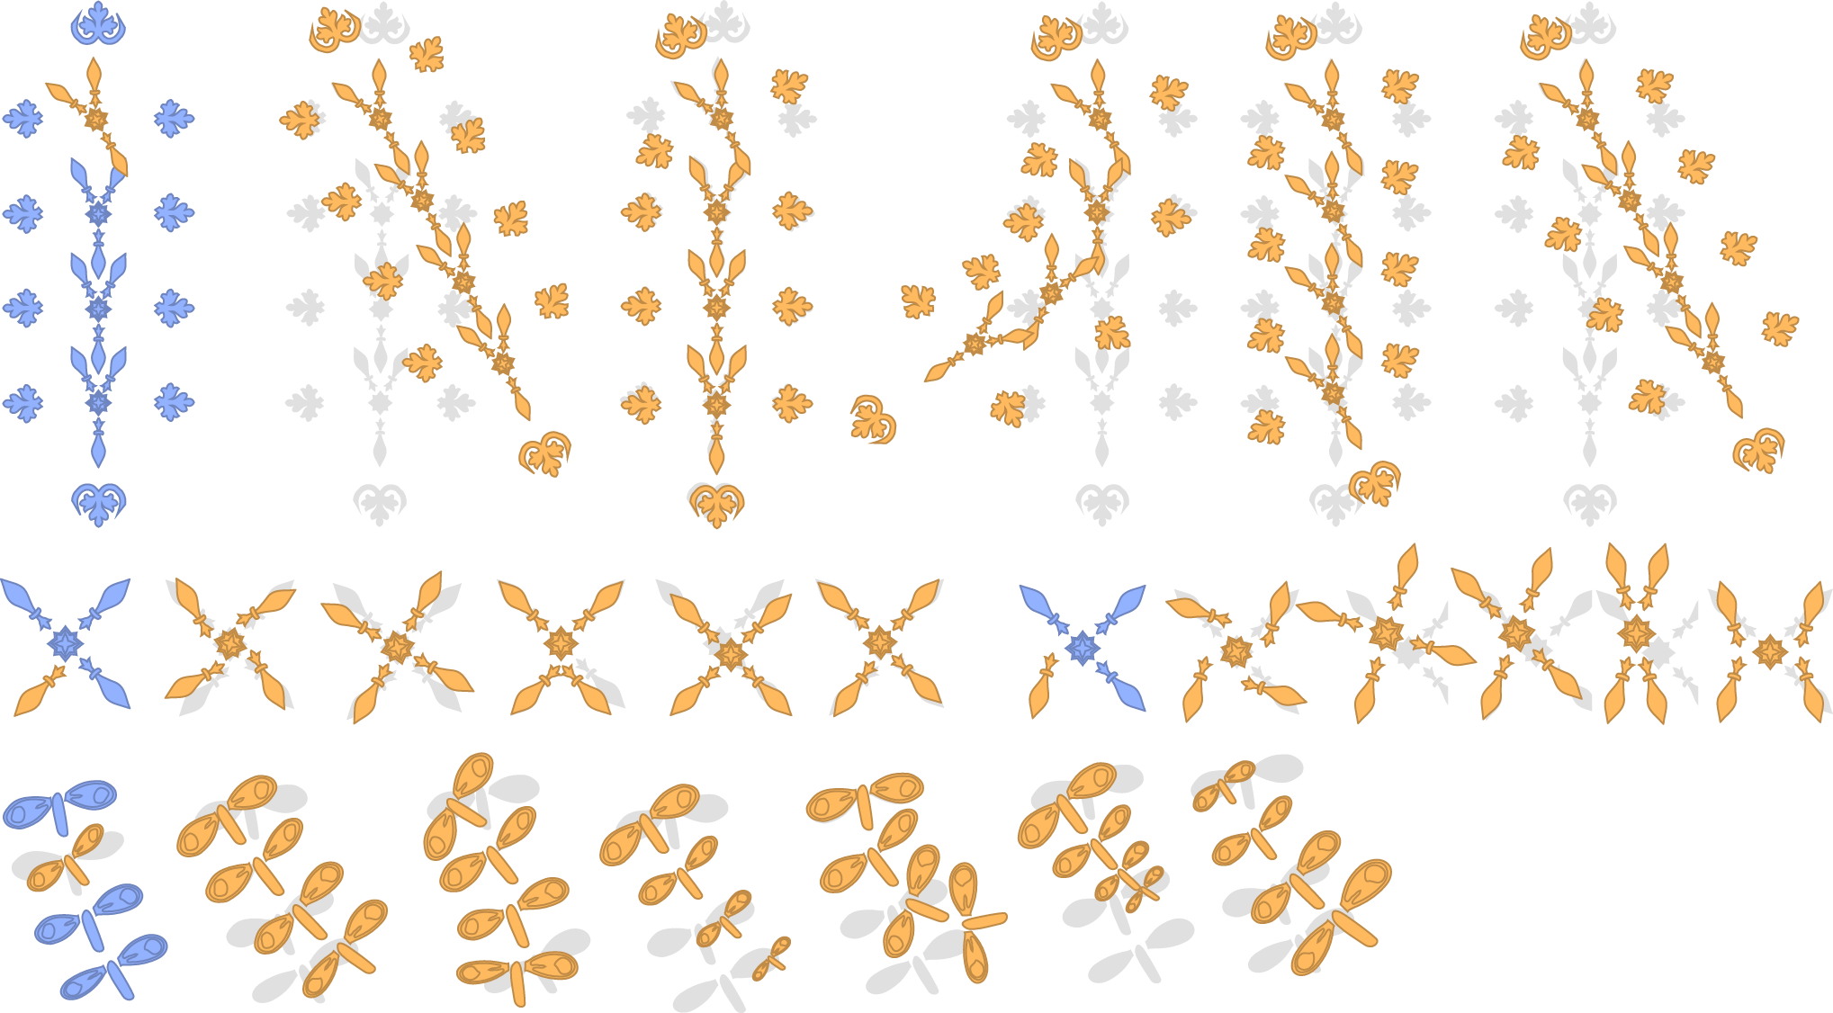
Variations
Notes:
Here we show several variations of four smaller to medium-sized patterns.
Note that the patterns are distinct and intuitive
A user study suggests that they could also be used as inspiration for a designers, since it may be hard to come up with and preview all of these variations

Slide 29
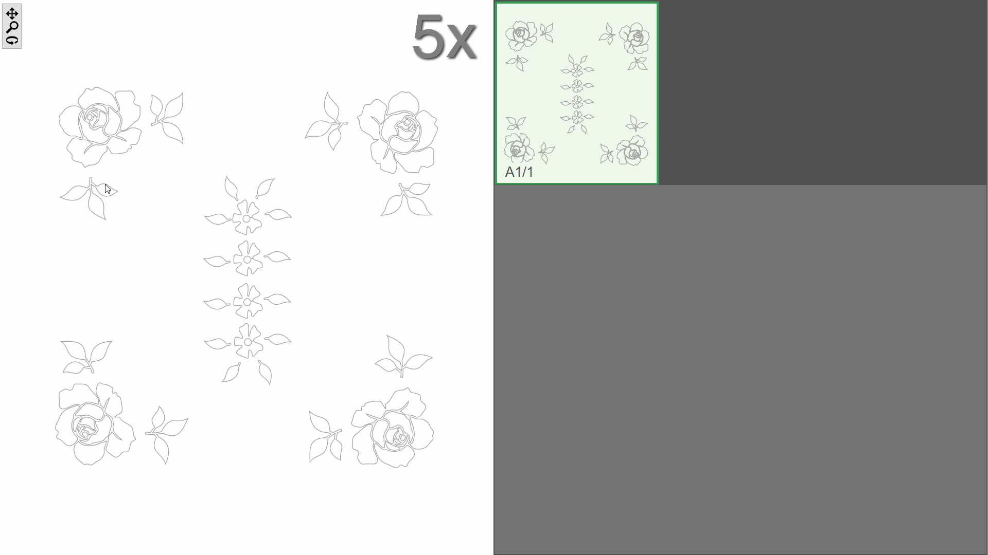

Slide 30
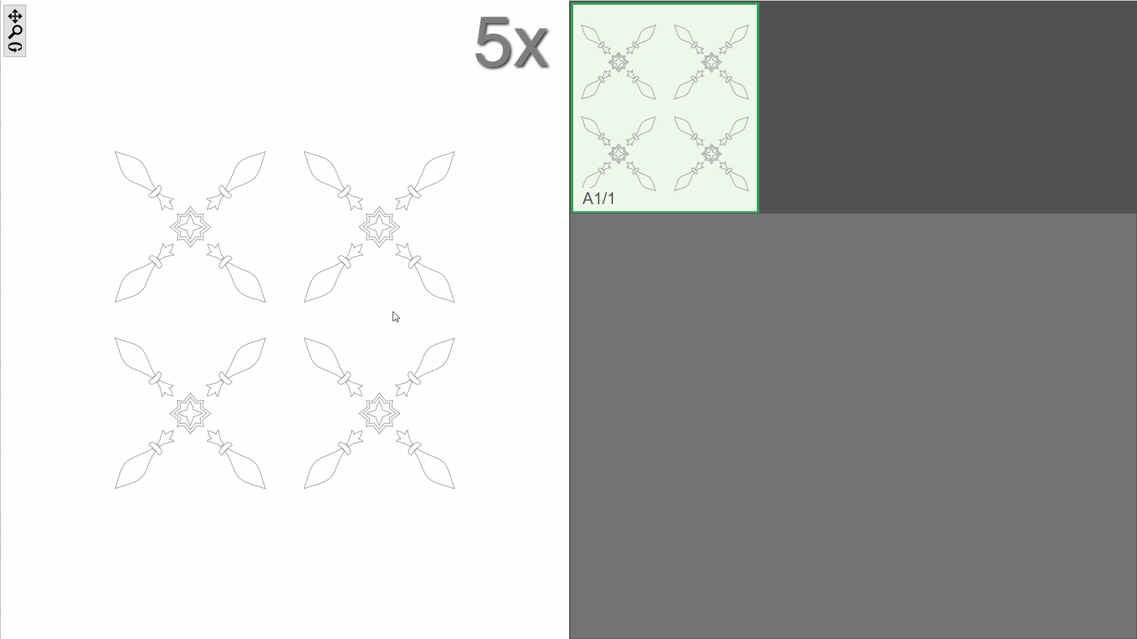

Slide 31
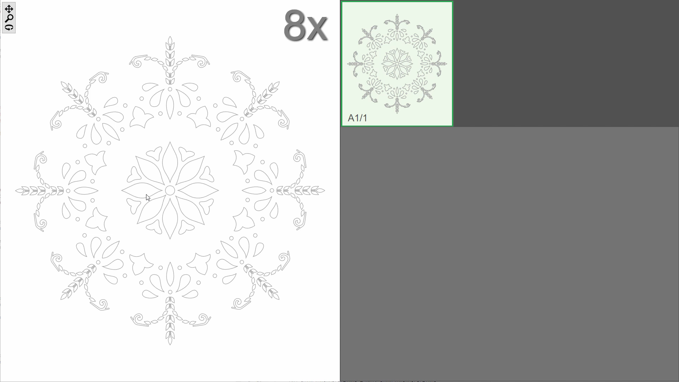
Notes:
Here we show parts of a few editing sessions.
On the left-hand side the user can modify elements of the pattern.
The right-hand side show variations for the current operation in the last row.
Variations from previous operations are shown in previous rows, making it possible to backtrack and pick a different choice.
For a more extended video please visit our website. There we also show an alternative user interface.

Slide 32


Slide 33



Additional Edit Session Results
original
18 operations,
8 variations used
12 operations,
6 variations used
original
6 operations,
3 variations used
6 operations,
3 variations used
2 operations,
1 variations used
original
7 operations,
4 variations used
Notes:
Here are some additional results of editing sessions.
As you can see it is possible to create quite distinct patterns using few operations.
The number of operations performed is shown below each result.

Slide 34


Conclusion and Limitations
PATEX is a method to interactively explore pattern variations.
Variations corresponding to different structure interpretations are found by:
Using an overcomplete representation of the pattern structure
Picking subsets of this representation to get concrete interpretations
(Filtering out undesirable/duplicate results using a fast approximation)
Notes:
We have shown that variations of a pattern can be explored efficiently
By representing the pattern structure using an over-complete representation that combines many different interpretations.
Picking different interpretations then corresponds to choosing different subsets of this structure and results in a large set of variations
We have presented one possible way to pick a subset from this list of variations, combining random sampling with a quick linear approximation, but other approaches are possible

Slide 35
Limitations and Future Work
Limitations
Elements cannot be added or removed
The linear approximation may be inaccurate in some cases
Future Work
Automatic Pattern Graph Extraction
Data-driven Evaluation of Pattern Variations
Notes:
Our method can currently not be used for finding variations with more / fewer elements. The pattern graph does not change during an editing session.
And our linear approximation may be inaccurate in some cases, introducing some error in the previews of possible variations.
Some interesting directions for future work include
Automatically finding the pattern graph from the arrangement of elements, resulting in a powerful method for editing element arrangements
Replacing our simple heuristics for filtering variations with a more data-driven techniques, for example learning to evaluate patterns from ratings provided by users.

Slide 36



Thank You!
3x
code (soon) : geometry.cs.ucl.ac.uk/projects/2016/pattern-variations
Notes:
To download the code, an extended video of our method and additional material, please visit our website.

Slide 37


Controlling the Number of Variations
Notes:
Finally we show how the number of variations we evaluate using our linear approximation influences the final number of valid and distinct variations we get.
On the y-axis we show what fraction of all available valid and distinct variations we get for different numbers of linear approximations.
Here we assume that convergence happens at around 2000 linear evaluations, which is true for most patterns and does not necessarily depend on the complexity of the pattern.
The number on the x-axis is the main factor for the performance of our method and can be tuned for the desired level of interactivity.
A more advanced implementation could also continue computing linear evaluations and adding more variations in a background thread for improved interactivity.
As you can see, there are diminished returns above approximately 150 evaluations for most patterns, so this is the number we chose for our experiments.

Slide 38



