Slide 1
Relationship Template for Creating
Scene Variations
Xi Zhao
Xi’an Jiaotong University
Ruizhen Hu
Shenzhen University
Paul Guerrero
Niloy Mitra
University College London
Taku Komura
Edinburgh University

Slide 2
Relationships in a Scene
Notes:
There are many types of spatial relationships in a daily life scene,
some are simple, such as the toys on the chest of drawers, pictures hang on the wall;
But some are more complex, such as the hat on the stand, the flower in the vase;

Slide 3
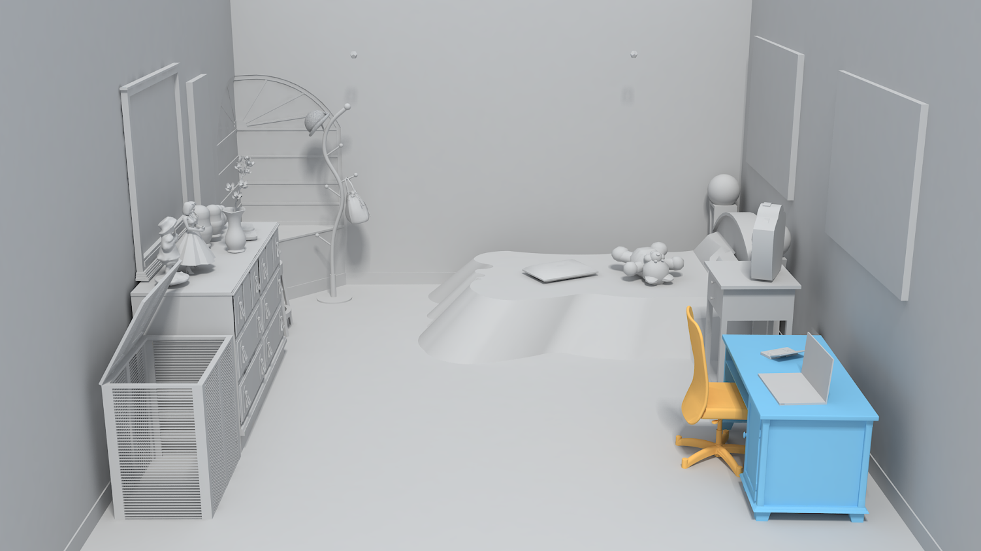
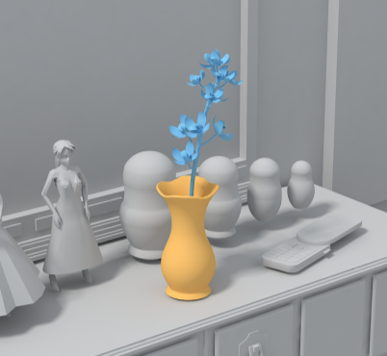
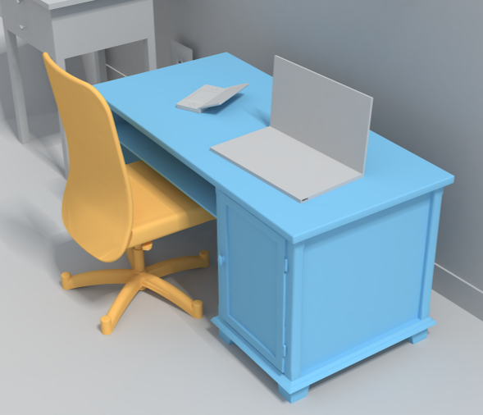
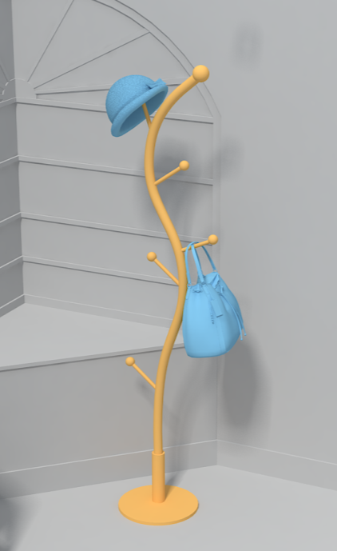
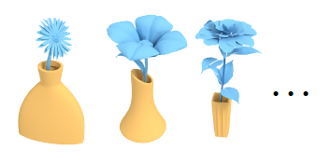
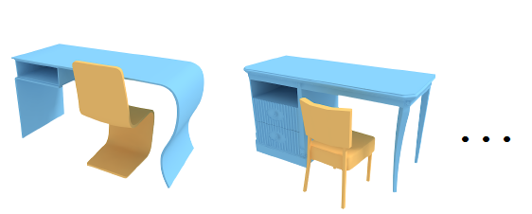
How to make variations of complex relationship?
Notes:
it’s time consuming to manually make such scenes, because the objects has to be in specific relative configurations to form the relationship;
[Objective]
To save the labor, we propose a method to creating variations for such scenes
Given a exemplar, our method can synthesize object pairs in a relationship similar to the exemplar
For example, put different flowers into different vases, tuck different chairs under different desks…

Slide 4
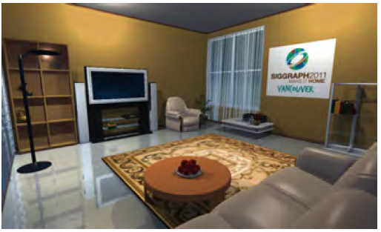
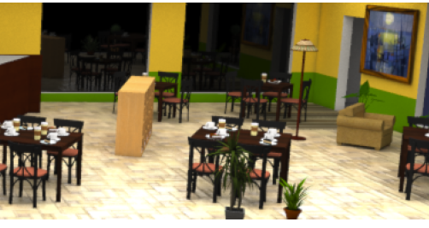
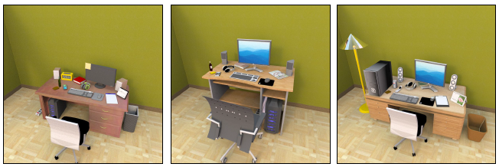
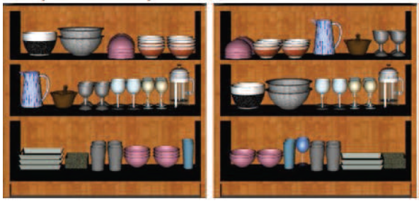
Existing Methods
L.-F. Yu, S.-K. Yeung, C.-K. Tang, D. Terzopoulos, T. F. Chan, and S. J. Osher, “Make it home” SIGGRAPH 2011
Y.-T. Yeh, L. Yang, M. Watson, N. D. Goodman, and P. Hanrahan, “Synthesizing open worlds with constraints using locally annealed reversible jump MCMC,” SIGGRAPH 2012
M. Fisher, D. Ritchie, M. Savva, T. Funkhouser, and P. Hanrahan, “Example-based Synthesis of 3D Object Arrangements” SIGGRAPH ASIA2012
L. Majerowicz, A. Shamir, A. Sheffer, and H. H. Hoos, “Filling your shelves: Synthesizing diverse style-preserving artifact arrangements,” TVCG 2014.
Notes:
These methods provide effective systems to synthesize indoor scenes.
They cannot handle complex spatial relations due to their simple centroid-based relationship representation. Our work focus on handing complex relations.
Additionally, several methods require an extensive scene database as input, while we only work with a single example scene.
about the previous method -> their representation -> their problem -> the representation we make use of -> our solution

Slide 5
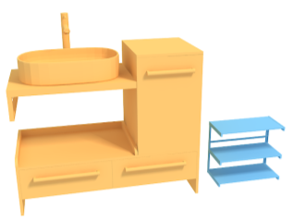
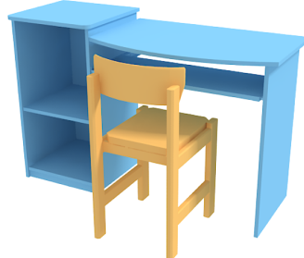
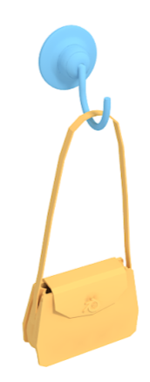
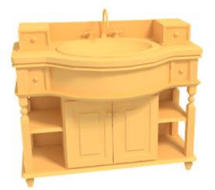
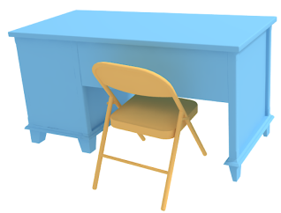
Limitation of Previous Representations
example scene
example scene
example
scene
new
scene
new scene
new scene
Notes:
Traditional methods: Relative vector / individual shape matching (example 1)
They do not work for complex relations (example 2, might be ok if we add orientation constraints; example 3, totally don’t work)
Because “switching individual object” does not consider spatial relationship between the two parts
And “relative vector" abstract the object to be a single point, it contains too little information of spatial relationships

Slide 6
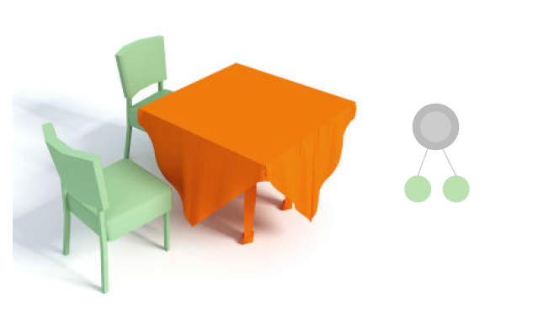
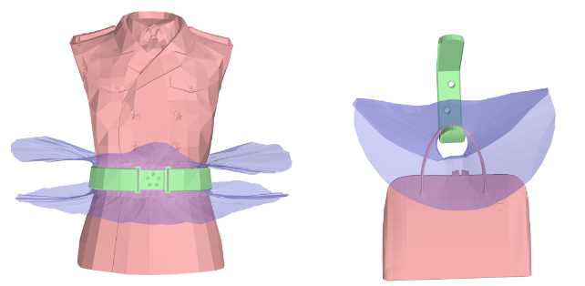
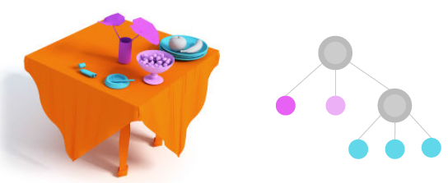
The Representation We Use: IBS
X. Zhao, H. Wang, and T. Komura, “Interaction Bisector Surface,” TOG2014.
R. Hu, C. Zhu, O. van Kaick, L. Liu, A. Shamir, and H. Zhang, “Interaction Context (ICON)” SIGGRAPH2015
Notes:
We use IBS to synthesis new scenes
Emphasize: we don't want to replace a full synthesis pipeline, but instead provide a component for a synthesis pipeline that can be used to synthesize these complex relationships

Slide 7
Our Method

Slide 8
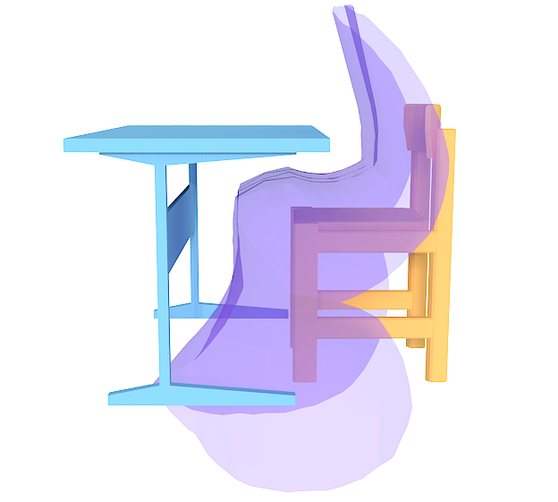
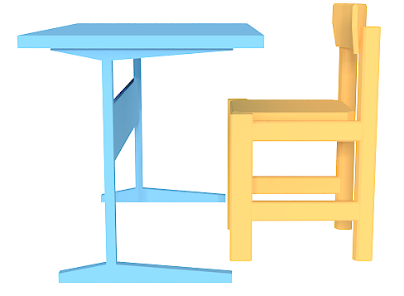
Overview
Example scene
1.Template construction

Slide 9
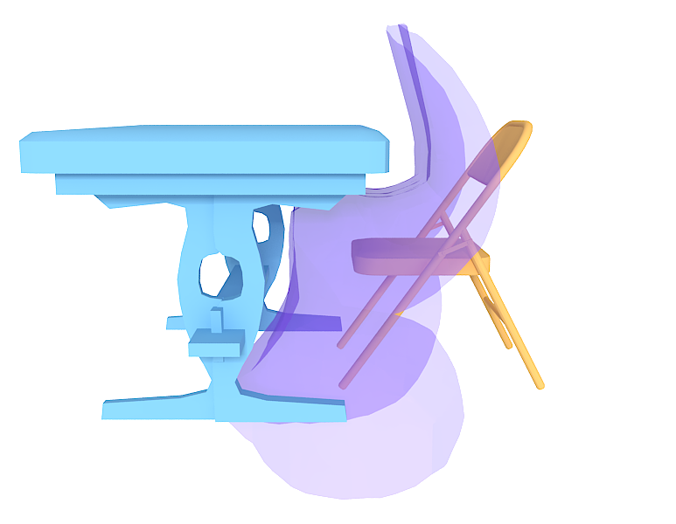
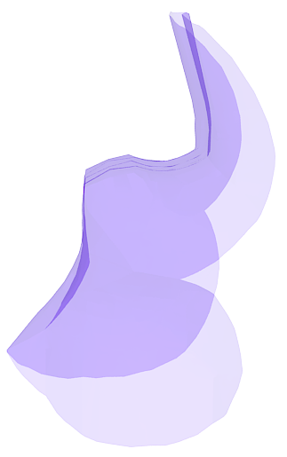
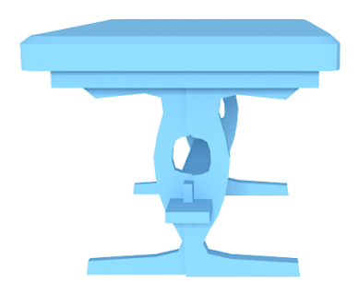
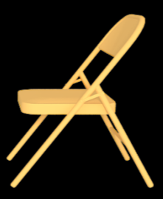
Overview
Novel object 1
Novel object 2
1.Template construction
2. Object fitting

Slide 10
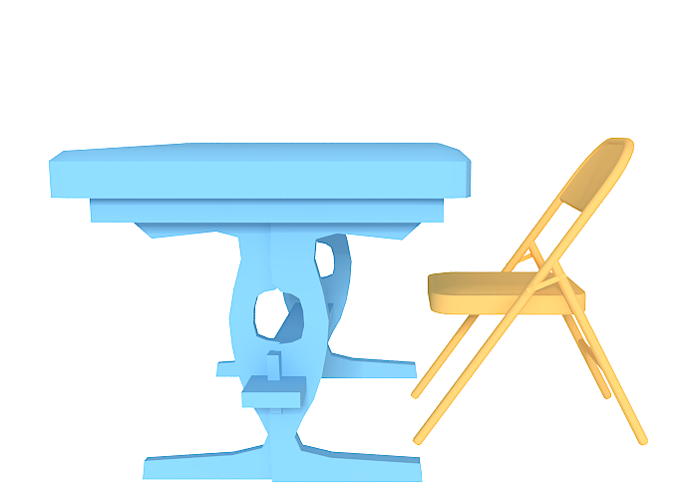
Overview
Result
1.Template construction
2. Object fitting
3. Scene synthesis

Slide 11
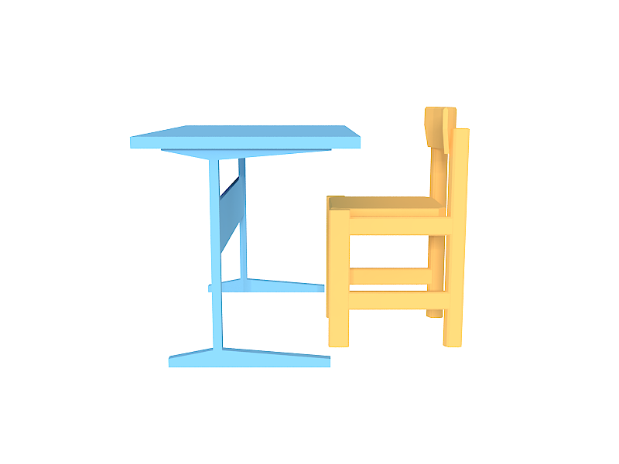
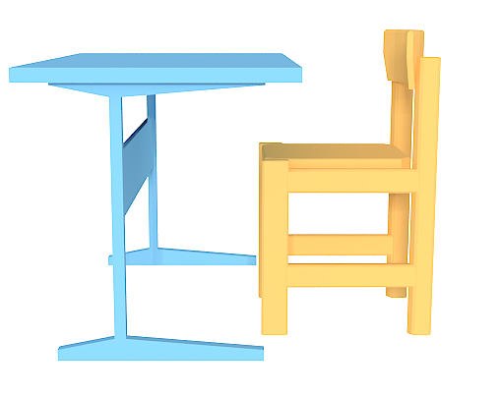
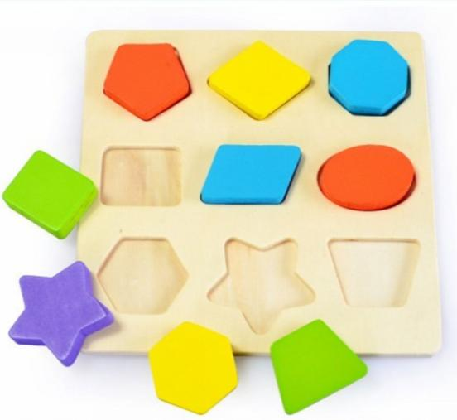
Relationship Template: Abstraction of The Open Space
1.Template construction
2. Object fitting
3. Scene synthesis
Notes:
We are using open space as a template
The open space is like the board of the puzzle.
we build the template from the open space instead of the objects themselves.

Slide 12
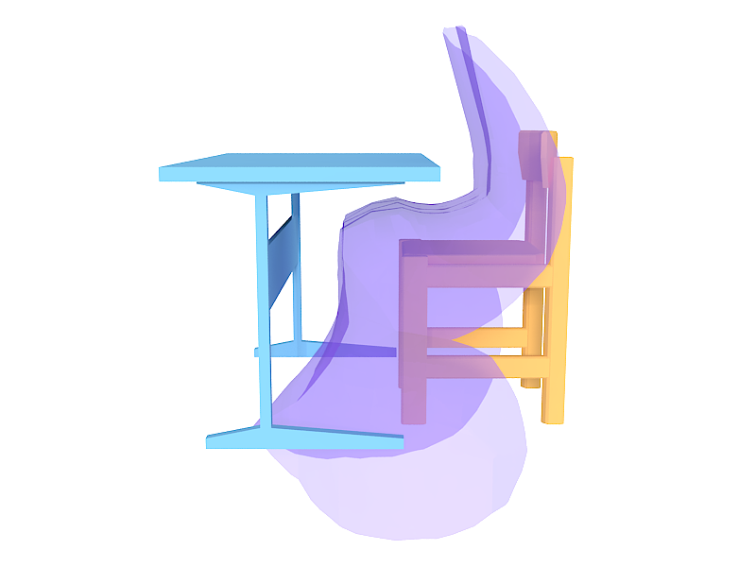
Template Construction: IBS
Interaction Bisector Surface(IBS)
1.Template construction
2. Object fitting
3. Scene synthesis
Notes:
We want to build the template from the open space of the scene (to abstract the spatial relationship).
To compute the template we use IBS.
The IBS of a scene is a surface consisting of the set of points equidistant from neighboring objects in a scene. (in 2D… in 3D…)
The IBS divides the open space of the scene into N subspaces, each of which corresponds to one object in the scene

Slide 13
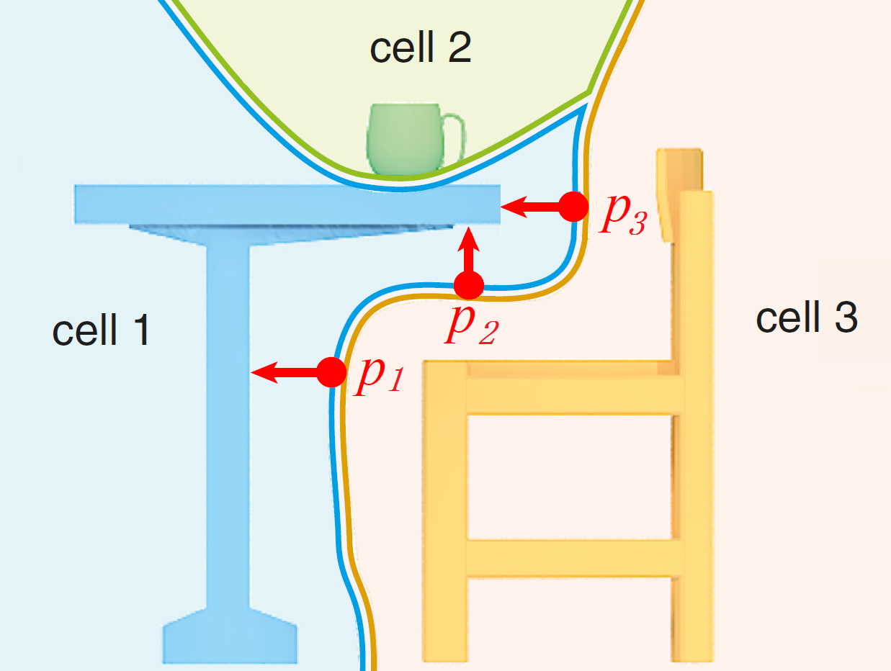
Template Construction: Cells and Features
1.Template construction
2. Object fitting
3. Scene synthesis
Notes:
(The motivation of using SCF)
From point of template to the closest point on the desk, we can build a vector (the red arrows)
Feature1: The size of the vector can describe the distance from the template point to the object
Feature2: The direction of the vector can describe the relative direction between the two parts (p2 shows the surface part of the desk is above the template)
But how to tell the difference between p1 and p3? (the distance and direction are not descriptive enough)

Slide 14
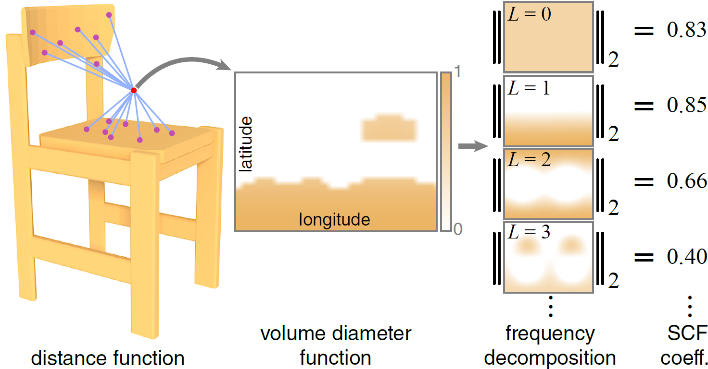
Shape Coverage Feature (SCF)
1.Template construction
2. Object fitting
3. Scene synthesis
Notes:
The definition and computation of SCF:
To compute the SCF at the red point, we sample the boundary distance around the point and normalize it to get the volume diameter function.
SCF coefficients are the power of this function in each frequency band.

Slide 15
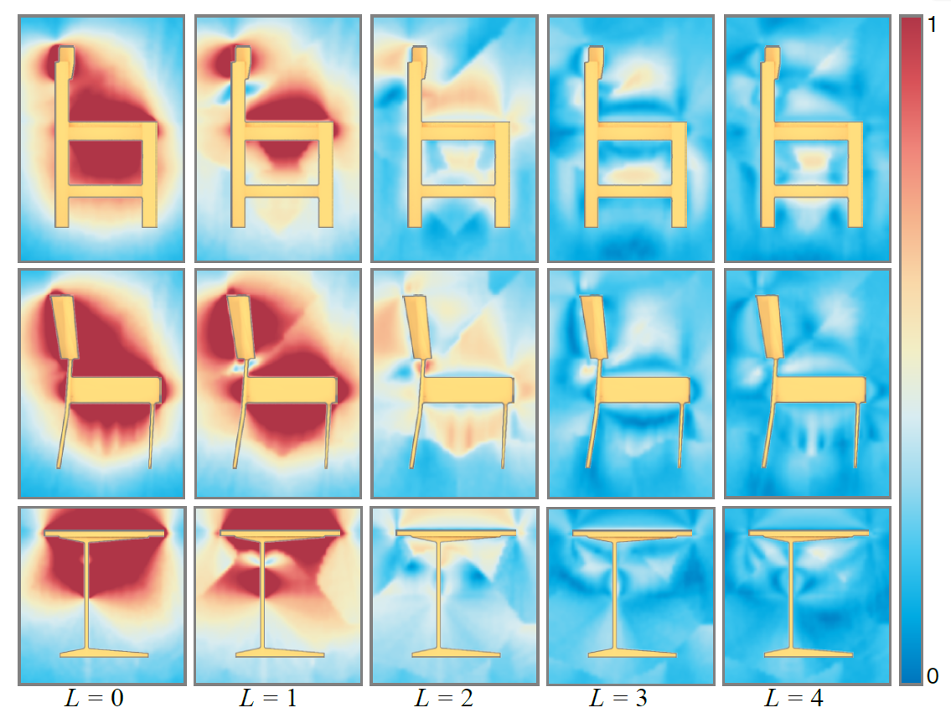
SCF Coefficients
Chair(1)
Chair(2)
Desk
1.Template construction
2. Object fitting
3. Scene synthesis
Notes:
SCF coefficients in the open space around different objects (two chairs and a desk – sideview) are shown as color maps.
Values are clamped to 1 to preserve contrast for smaller coefficients.
In each row, we show coefficient values of bands 0 to 4 for the object shown in the foreground.
Why good? The distributions are different for different types of models (chair vs. desk), also robust to the change of local geometry(chair1 vs. chair2)

Slide 16
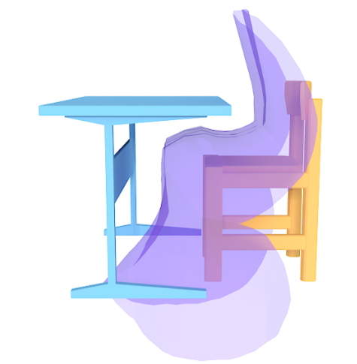
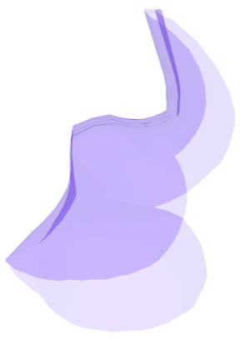
Object Fitting: the idea
Example scene
Template
Template
Template
Template
Novel object
1.Template construction
2. Object fitting
3. Scene synthesis
1.Template construction
2. Object fitting
3. Scene synthesis
Notes:
The open space of a scene is defined as the free space outside the objects/template mesh.
The idea here is to fit the object to the template: find a good configuration of the object around the template so that the spatial relationship is kept
Fitting object to template = fitting template to object
For computation convenience, we move the template in the object’s open space to find the best fit

Slide 17
What is a good fitting?
Similarity measurement (fitting score)
1.Template construction
2. Object fitting
3. Scene synthesis
Notes:
We need to evaluate how well an object with a given rigid transformation fit the template,
So we define a similarity function based on comparing the cell features of the novel object to the cell features of the template
To do this we first sample points on the, then accumulate the difference between distance, direction and scf features
Then the problem comes down to finding the maximum of S_final

Slide 18
Initial Matching
Geometric hashing
ROI
1.Template construction
2. Object fitting
3. Scene synthesis
Notes:
To find the best fitting, we use geometric hashing method to match the template points and the candidate points
This fitting process only produces an approximate match due to the finite sampling density of open space points.

Slide 19
Reduce the Search Space
Find the region of interest (ROI)
Candidate
points
sliding
window
1.Template construction
2. Object fitting
3. Scene synthesis
Notes:
We reduce our search space to regions that are likely to contain good candidates.
This is similar to the bag of visual words concept, where the goal is to search for a volume that contains point sets with high matching score.
More specifically, we first do the Feature points clustering,
then pre-compute features values at a uniform grid of points in the open space around the novel object
Then we use a “sliding window” to test all different sub-regions of the open space
After finding the ROI, we ignore other points in the open space and only consider the points in the ROI
Within the ROI, we do the geometric hashing

Slide 20
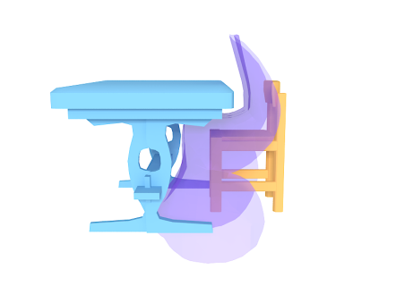
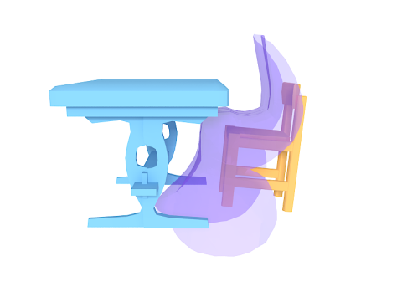
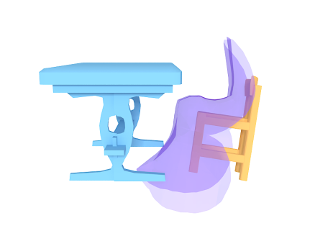
Refinement
ICP style refinement
1.Template construction
2. Object fitting
3. Scene synthesis
Notes:
We iteratively refine the coarse matching results by maximizing the similarity function

Slide 21
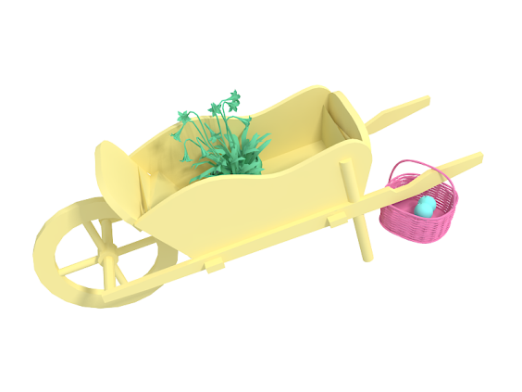
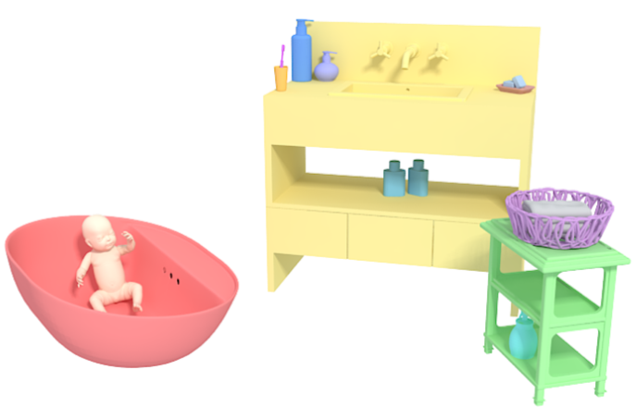
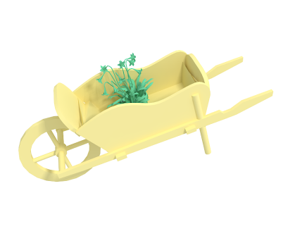
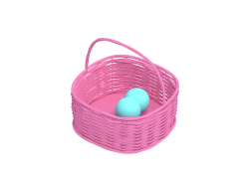
Larger Scenes
Scene hierarchy
Combine with other scene synthesis system
M. Fisher, D. Ritchie, M. Savva, T. Funkhouser, and P. Hanrahan, “Example-based Synthesis of 3D Object Arrangements” SIGGRAPH ASIA2012
1.Template construction
2. Object fitting
3. Scene synthesis
Notes:
For scenes composed of more than two objects, directly placing objects into the template cells can be overly restrictive.
By using a scene hierarchy, we decompose the synthesis to a sequence of pairwise synthesis (describe the example).
For the bathroom scene we combine our approach with Fisher’s method to show that our method can be used as a component of existing scene synthesis pipelines.
To create the variations for the bathroom scene, objects in complex relationships, such as the baby in the bathtub, toothbrush in the cup, are synthesized
by our method, then merged and placed as single objects into the scene using The arrangement and layout models of Fisher’s method.

Slide 22
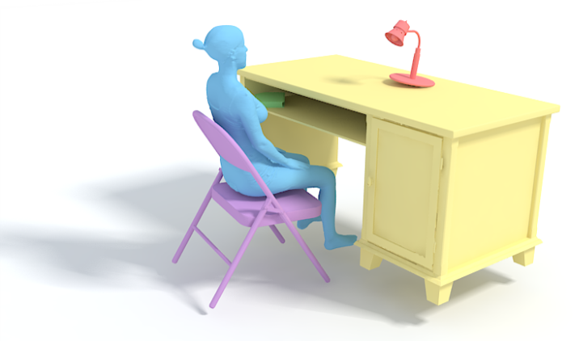
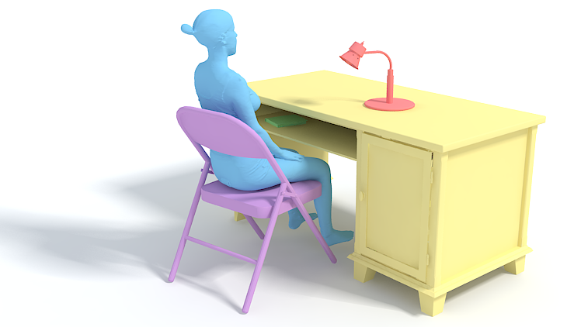
Capturing Scene Semantics
Without semantic constraints
With semantic constraints
1.Template construction
2. Object fitting
3. Scene synthesis
Notes:
Realistic scenes usually contain constraints that are not captured purely by the geometry of relationships.
Resolving placement ambiguity, Contact constraints, Upright constraints, Floor constraints, Collision constraints

Slide 23
Results and Evaluations

Slide 24
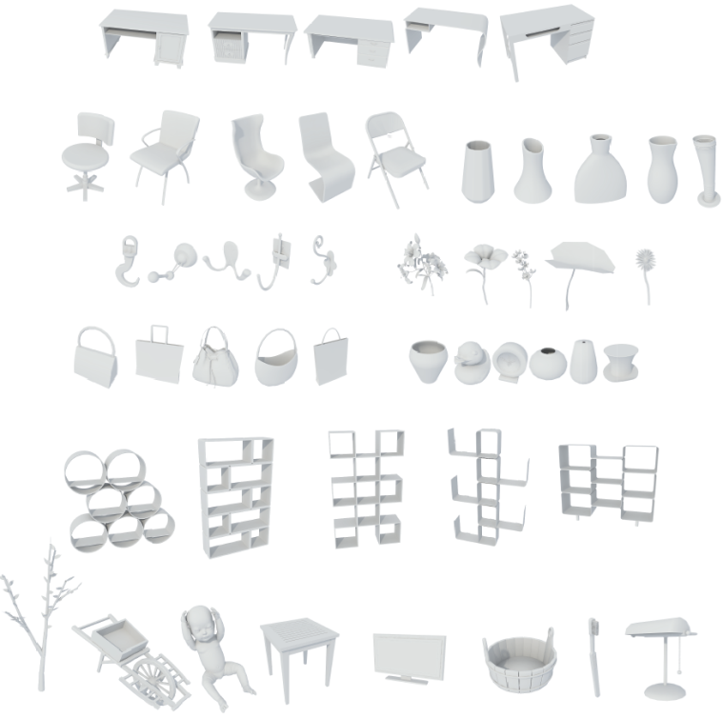
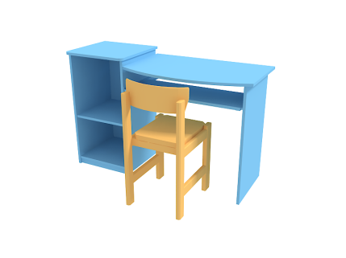
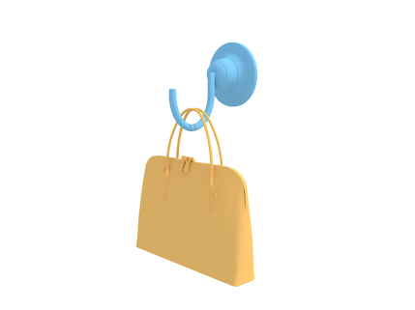
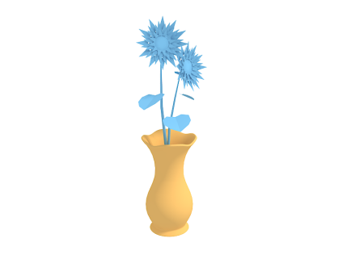
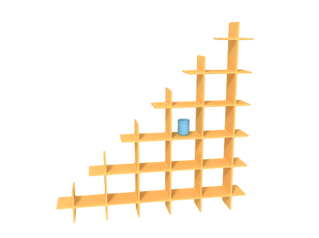
Pairwise Experiment: Our Method vs. ShapeSPH*
Input
*T. Funkhouser et al., “Modeling by example,” in ACM Transactions on Graphics (TOG), 2004, vol. 23, pp. 652–663.
Notes:
The input of our experiments are four example scenes and a database of unlabeled objects
We use both our method and the ShapeSPH method to synthesize all possible combinations of retrieved object pairs and rank them based on their combined fitting score.
Baseline method: ShapeSPH
Objects in the example pair are replaced separately with database objects using global shape alignment

Slide 25
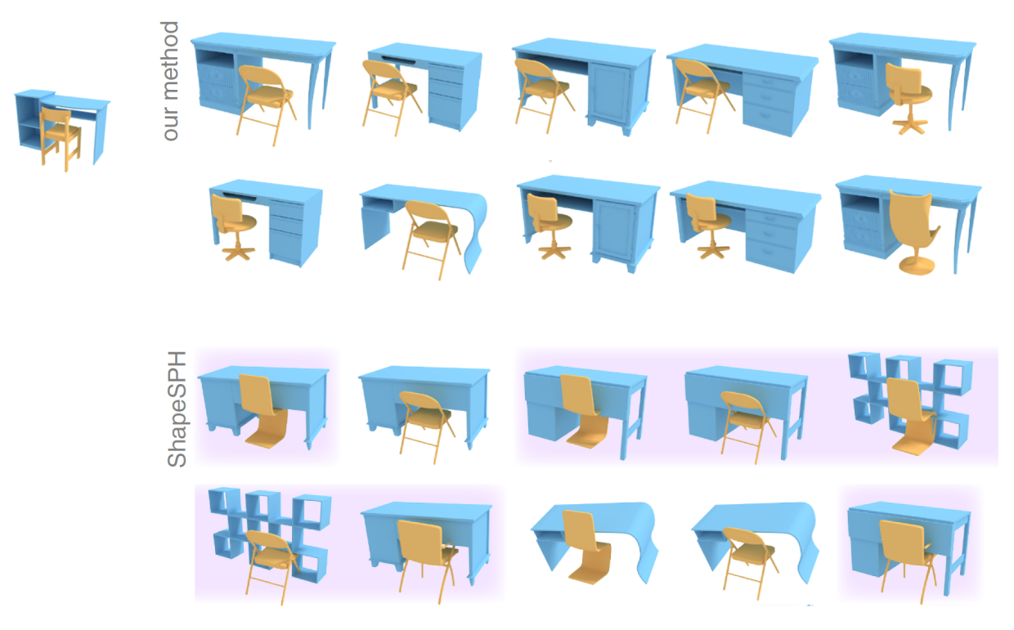
Pairwise Experiment: Results
Notes:
The incorrectly synthesized pairs are marked with purple background
Here our method performs better (there are less incorrect results), because we describe and optimize for the geometric relationship between these objects
The baseline method produces a large number of false positives, because it only takes into account the geometry of individual example objects

Slide 26
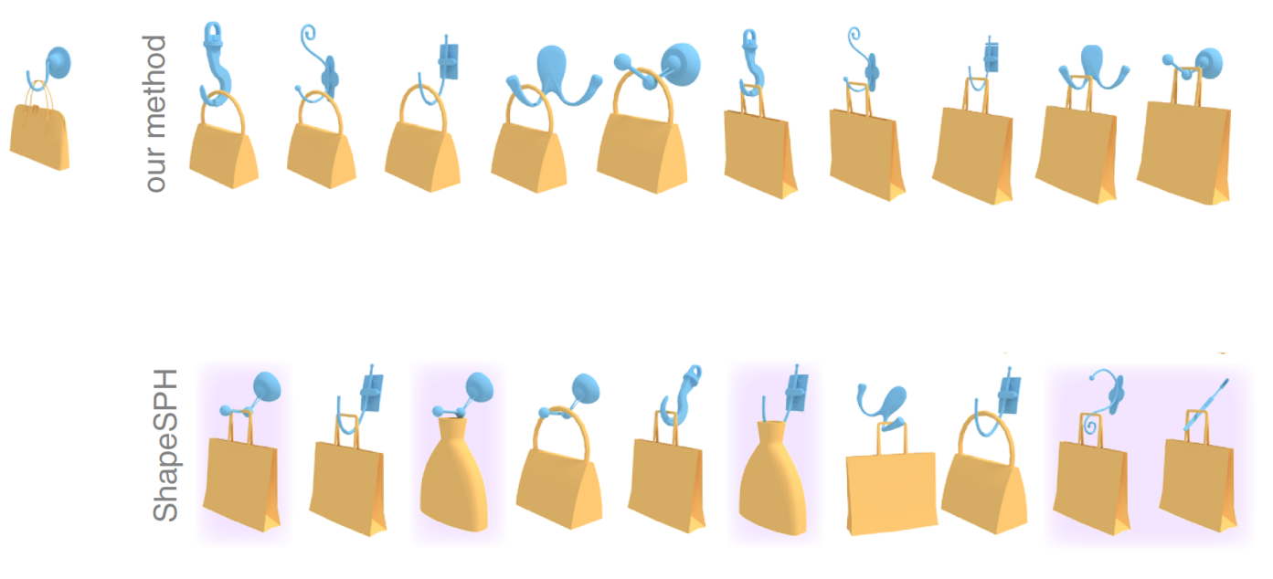
Pairwise Experiment: Results

Slide 27
Pairwise Experiment: Results

Slide 28
Pairwise Experiment: Results

Slide 29
Larger Scene Experiment
Input scene
Results - Ours
Results - [Fisher et al. 2012]
Notes:
We compare our results against results obtained from Fisher et al.[2012] using the same input scene.

Slide 30
Larger Scene Experiment
Input scene
Results - Ours
Results - [Fisher et al. 2012]

Slide 31
Larger Scene Experiment
Input scene
Results - Ours
Results – [Fisher et al. 2012]

Slide 32
Larger Scene Experiment: Evaluation
User study interface
Notes:
We rated plausibility of each synthesized scene via a user study.
Users are shown images of two randomly picked scenes and asked to judge which object arrangement is more realistic.
The study was performed in Mechanical Turk.

Slide 33
Larger Scene Experiment: Evaluation
Notes:
Using the BradleyTerry Model [Hunter 2004], we obtained a ‘realism’ or ‘plausibility’ score for each image from the results of these pairwise
comparisons, as well as probabilities for each image to be judged more realistic than any other image in the dataset.

Slide 34
Spatially Repeated Objects
Notes:
For synthesizing scenes where the same spatial relations can be found at various locations, such as hats hung at multiple hatholders, we find multiple candidate locations around the stand and do the object fitting several times.
By doing this we produce scenes with different hatholders and hats.
Similarly we can produce these objects-on-shelf scenes

Slide 35
Conclusion
We propose a method for creating variations of scenes that include complex relationships.
We propose a novel feature “SCF” to encode the geometry of the open space.
Our method can augment existing scene synthesis methods.

Slide 36
Limitations and Future Work
Only consider rigid IBS
Future work:
Add flexibility to the relationship template
Learn a parametric model of the relationship template

Slide 37
Acknowledgement
Anonymous reviewers
Anonymous Mechanical Turk users
Ylab in XJTU
China Postdoctoral Science Foundation
National Science Foundation of China
Guangdong Science and Technology Program
Shenzhen Innovation Program
The ERC starting Grant SmartGeometry
Marie Curie CIG
EPSRC Grant
FP7 TOMSY
Notes:
Thanks!

