Slide 1
SMASH: Physics-guided Reconstruction of Collisions from Videos
Aron Monszpart¹
Nils Thuerey²
Niloy J. Mitra¹
¹University College London ²Technical University of Munich

Slide 2
Analytic motion from video
Notes:
The main question we address in this project is whether
- we can learn something about the internal properties of rigid objects just by observing them interacting?
Can this give us a clearer picture of their motion

Slide 3
Analytic motion from video
Notes:
Ouptput = Internal physical properties + motion

Slide 4
Goal
Reconstruction of pairwise collisions in 3D
Position, velocity
Orientation, angular velocity
Relative mass
Coefficient of restitution
Can be retrieved without observing the exact moment of collision (collision detection)
At all times
Notes:
We are capturing
Internal physical parameters
How objects move

Slide 5
Collision reconstruction under-constrained
Internal properties are not visible
Occlusion at collision time
Physics as regularizer!
Notes:
Reconstructing collisions is under-constrained because:
Internal physical properties are not visible
Significant proportions of occlusion at collision time
A small change in how they collide results in very large changes in their trajectories

Slide 6
Goal
Reconstruction of pairwise collisions in 3D
Position, velocity
Orientation, angular velocity
Relative mass
Coefficient of restitution
Can be retrieved without observing the exact moment of collision (collision detection)
At all times
Acquisition of internal physical properties
Reconstruction of collision (motion)
Notes:
The key message is, acquiring internal physical properties allows us to better reconstruct the motion of colliding objects, which in turn improves our physical measurements.

Slide 7
Related work
Animation (forward simulation)
Tracking
[Popovic00]
[Salzman11]
Notes:
We want to obtain internal properties by observing dynamic objects,
Forward simulation has well-known science
Tracking uses physical regularization when reasoning based on how a sparse set of forces influence the motion of the objects
this is a novel problem in such unconstrained capture setting
there is no work doing that in this unconstrained setting

Slide 8
Related work
[Wu15]
[Lerer16]
Notes:
More recently, there have been works, that explore with the help of a simulator, whether a deep learning network can learn to predict certain events which are related to something “unseen”.

Slide 9
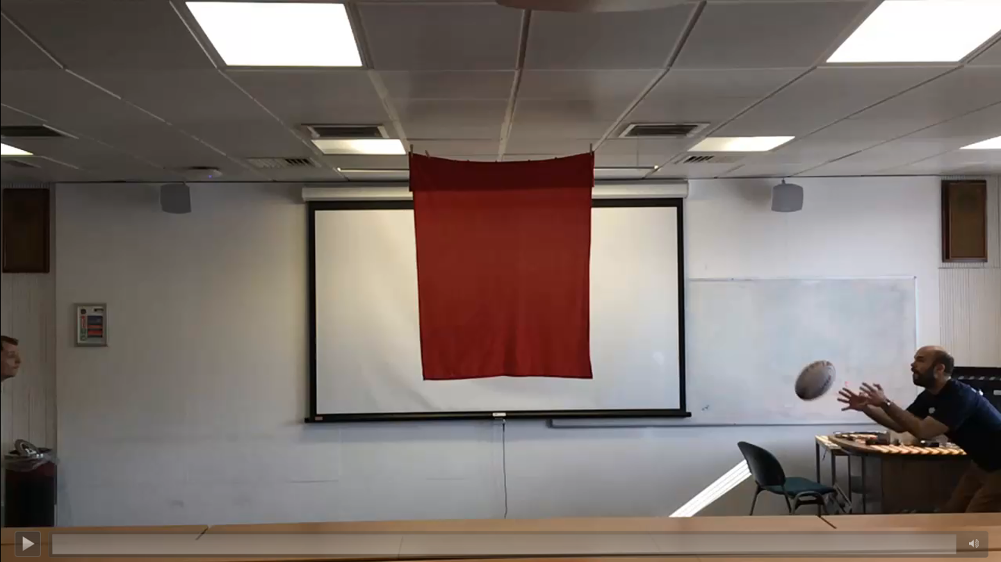
System
Extract
Observations
Reconstruct
Collisions
3D positions and velocities
3D orientations and angular velocities
Relative mass
Coefficient of Restitution
Notes:
Once we get the velocity estimates, we can calculate a number that can capture the amount of energy retained, which we call CoR

Slide 10
Physics
Away from collision
At moment of collision
Conservation of momentum
Linear (orthogonal to gravity)
Angular
Conservation of momentum
Linear
Angular
Energy is not created
Notes:
At collision:
Total momentum
Total energy
During flight before and after collision, per object:
Linear: orthogonal to gravity
Angular: No external torques except zero-sum gravity

Slide 11
Optimization
$${argmin}_{θ}\sum_{τ∈Terms}{}$$
$$+ Physics regularization$$
$$Data$$
$${+ f}^{mom}$$

Slide 12
Physics
Away from collision
At moment of collision
Conservation of momentum
Linear (orthogonal to gravity)
Angular
Conservation of momentum
Linear
Angular
Energy is not created
Linear momentum
$$\sum_{\left.i∈\{a, b\right\}}{m_{i}v_{i}^{pre}}$$
$$=\sum_{\left.i∈\{a, b\right\}}{m_{i}v_{i}^{post}}$$
$$v_{a}$$
$$p_{a}$$
$$↺$$
$$w_{b}$$
Angular momentum
$$\sum_{\left.i∈\{a, b\right\}}{I_{i}w_{i}^{pre}}$$
$$m_{a}$$
$$I_{b}$$
$$+ p_{i}×\left(m_{i}v_{i}^{pre}\right)$$
$$=\sum_{\left.i∈\{a, b\right\}}{I_{i}w_{i}^{post}+p_{i}×(m_{i}v_{i}^{post})}$$
Notes:
No external torques, so total linear and total angular momentum is conserved

Slide 13
Optimization – Momentum term
$${argmin}_{θ}\sum_{τ∈Terms}{}$$
$$Data$$
$${+ f}^{mom}$$
$f^{mom}= {\left\|\sum_{\left.i∈\{a, b\right\}}{m_{i}v_{i}^{post}}−m_{i}v_{i}^{pre} \right\| }^{2}$+
Linear momentum:
$$\sum_{\left.i∈\{a, b\right\}}{m_{i}v_{i}^{pre}}=\sum_{\left.i∈\{a, b\right\}}{m_{i}v_{i}^{post}}$$
$${\left\|\sum_{\left.i∈\{a, b\right\}}{I_{i}w_{i}^{post}+p_{i}×(m_{i}v_{i}^{post})}−I_{i}w_{i}^{pre}− p_{i}×\left(m_{i}v_{i}^{pre}\right)\right\| }^{2}$$
Angular momentum:
$$\sum_{\left.i∈\{a, b\right\}}{I_{i}w_{i}^{pre}+ p_{i}×\left(m_{i}v_{i}^{pre}\right)}=\sum_{\left.i∈\{a, b\right\}}{I_{i}w_{i}^{post}+p_{i}×(m_{i}v_{i}^{post})}$$

Slide 14
Optimization – Impulse term
$${argmin}_{θ}\sum_{τ∈Terms}{}$$
$$Data$$
$${+ f}^{mom}$$
$${+ f}^{imp}$$

Slide 15
Physics
Away from collision
At moment of collision
Conservation of momentum
Linear (orthogonal to gravity)
Angular
Conservation of momentum
Linear
Angular
Energy is not created
$$m_{a}v_{a}^{post}=m_{a}v_{a}^{pre}+$$
$$jn$$
$$m_{b}v_{b}^{post}=m_{b}v_{b}^{pre}−$$
$$jn$$
$$jn$$
$$x_{a}^{col}$$
$$x_{b}^{col}$$
$$I_{a}w_{a}^{post}=I_{a}w_{a}^{pre}+x_{a}^{col}×$$
$$jn$$
$$I_{b}w_{b}^{post}=I_{b}w_{b}^{pre}−x_{b}^{col}×$$
$$m_{a}$$
$$jn$$
$$I_{b}$$
$$jn$$
Notes:
From the same conservation law, a tighter coupling between the velocities and angular velocities can be achieved using the impulse as a “slack variable”.
We use both of these sets of equations to ensure, that physics is respected and that the solver does not hide the error in either the linear or the angular momentum parts.

Slide 16
Optimization – Impulse term
$${argmin}_{θ}\sum_{τ∈Terms}{}$$
$$Data$$
$${+ f}^{mom}$$
$${+ f}^{imp}$$
$$m_{a}v_{a}^{post}$$
$$=$$
$$m_{a}v_{a}^{pre}+$$
$$−$$
$${\left.\right\|}^{2}+$$
$$jn$$
$$m_{b}v_{b}^{post}$$
$$=$$
$$m_{b}v_{b}^{pre}−$$
$$−$$
$${\left.\right\|}^{2}+$$
$$I_{a}w_{a}^{post}$$
$$=$$
$$I_{a}w_{a}^{pre}+x_{a}^{col}×$$
$$−$$
$${\left.\right\|}^{2}+$$
$$I_{b}w_{b}^{post}$$
$$=$$
$$I_{b}w_{b}^{pre}−x_{b}^{col}×$$
$$−$$
$${\left.\right\|}^{2}$$

Slide 17
Optimization – Kinetic energy term
$${argmin}_{θ}\sum_{τ∈Terms}{}$$
$$Data$$
$${+ f}^{mom}$$
$${+ f}^{imp}$$
$${+ f}^{ke}$$

Slide 18
Physics
At moment of collision
Away from collision
Conservation of momentum
Linear
Angular
Energy is not created
Conservation of momentum
Linear (orthogonal to gravity)
Angular
$$\sum_{\left.i∈\{a, b\right\}}{m_{i}{v_{i}^{pre}}^{2}}$$
$$+\sum_{\left.i∈\{a, b\right\}}{{w_{i}^{pre}}^{T}I_{i}w_{i}^{pre}}$$
$$v_{a}$$
$$↺$$
$$w_{b}$$
$$≥\sum_{\left.i∈\{a, b\right\}}{m_{i}{v_{i}^{post}}^{2}}+\sum_{\left.i∈\{a, b\right\}}{{w_{i}^{post}}^{T}I_{i}w_{i}^{post}}$$
$$m_{a}$$
$$I_{b}$$
Notes:
No change in height, Kinetic energy is

Slide 19
Optimization – Kinetic energy term
$${argmin}_{θ}\sum_{τ∈Terms}{}$$
$$Data$$
$${+ f}^{mom}$$
$${+ f}^{imp}$$
$${+ f}^{ke}$$
$${+ f}^{g}$$
$$f^{ke}=1\left(E_{kin}^{pre}>E_{kin}^{post}\right)$$
-
$$\sum_{\left.i∈\{a, b\right\}}{m_{i}{v_{i}^{pre}}^{2}}$$
$$\sum_{\left.i∈\{a, b\right\}}{{w_{i}^{pre}}^{T}I_{i}w_{i}^{pre}}$$
$${\left.\right\|}^{2}$$
$$\sum_{\left.i∈\{a, b\right\}}{m_{i}{v_{i}^{post}}^{2}}+\sum_{\left.i∈\{a, b\right\}}{{w_{i}^{post}}^{T}I_{i}w_{i}^{post}}$$
-
$$+$$
$$≥$$
$${f^{g}=\left(1−(R\left( \right) . )\right)}^{2}$$
Notes:
The camera can be a bit off, we correct for the camera not being vertical

Slide 20
Optimization – Data term
$${argmin}_{θ}\sum_{τ∈Terms}{}$$
$${+ f}^{ori}$$
$${ f}^{pos}$$
$$Data$$
$${+ f}^{mom}$$
$${+ f}^{imp}$$
$${+ f}^{ke}$$
$${+ f}^{g}$$
$$f^{ori}=\sum_{j=1}^{\left|\left\{q_{j}^{obs}\right\}\right|}{{\left(q\left(t_{j}\right)−q^{obs}(t_{j})\right)}^{2}}$$
$$f^{pos}=\sum_{i=1}^{\left|\left\{frames\right\}\right|}{{\left\|Kp\left(t_{i}\right)−p^{obs}(t_{i}) \right\|}^{2}}$$
Projection matrix
3D position (estimated)
2D position (observed)
Orientations (estimated)
Orientations (observed)
Notes:
Now we can obtain these from the video

Slide 21
Modeling - naive
6 degrees of freedom for each frame?
How to respect physics?
$$min{\left(\frac{v_{t}{−v}_{t−1}}{∆t}−g\right)}^{2}$$
$$v_{t}$$
$$v_{t−1}$$
Notes:
If you first fit, and then the velocity estimates will be wrong
(add arrows)

Slide 22
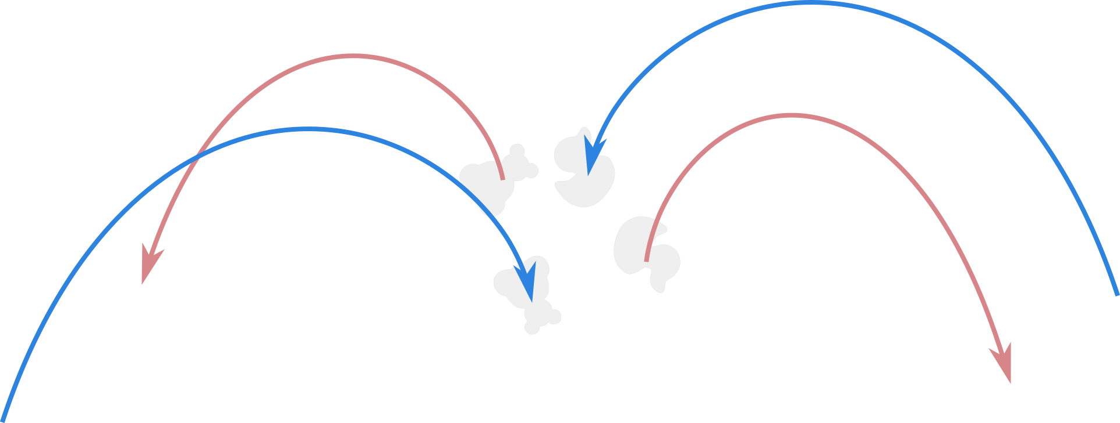
Physics
Away from collision
At moment of collision
Conservation of momentum
Linear (orthogonal to gravity)
Angular
Conservation of momentum
Linear
Angular
Energy is not created
$$k_{b}^{pre}=R\left(t\right)I_{b}^{0}R^{T}(t)w_{b}(t)$$
$$k_{a}^{post}=R\left(t\right)I_{a}^{0}R^{T}(t)w_{a}(t)$$
$$p\left(t\right)=R\left(\begin{matrix}b_{1}t \\ −\frac{g}{2}t^{2}+b_{2}t \\ 0\end{matrix}\right)+b_{3}$$
constant
$$R\left(t\right)I_{b}^{0}R^{T}\left(t\right)w_{b}\left(t\right)=k_{b}^{post}$$
$$k_{a}^{pre}=R\left(t\right)I_{a}^{0}R^{T}(t)w_{a}(t)$$
Notes:
Parabola
4xk

Slide 23
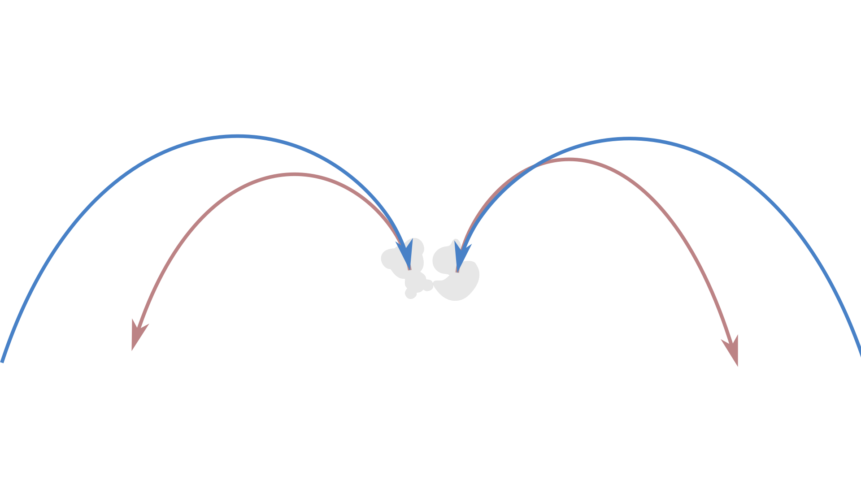
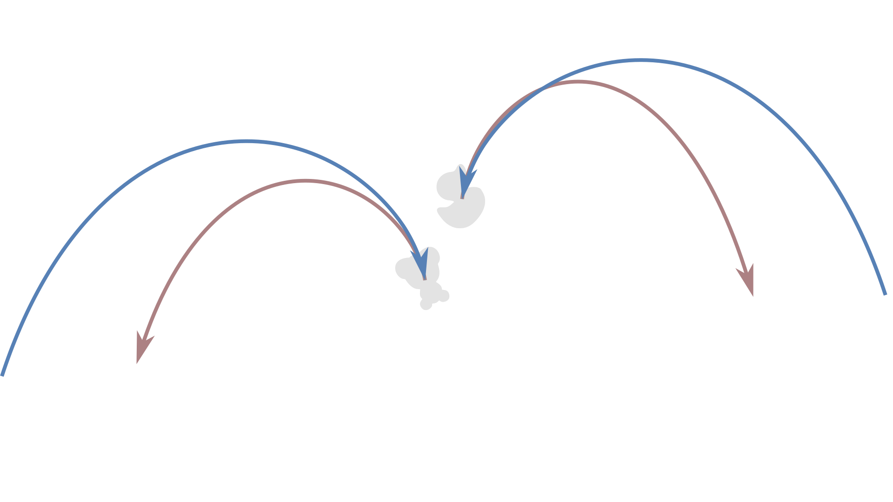
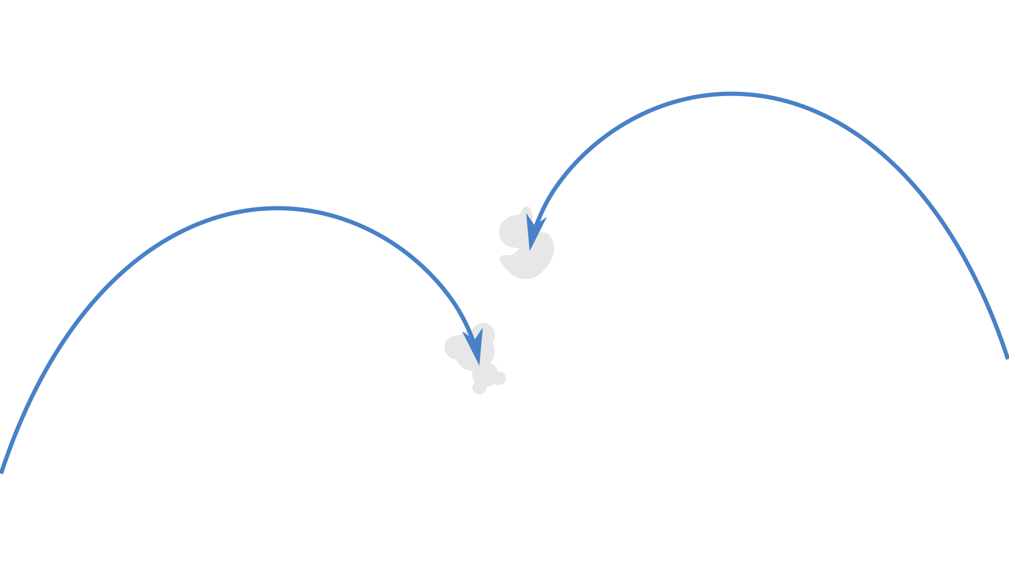
Model
Instantaneous collision:
Same object does not move
Same object does not rotate
Physically plausible
$$↺$$
$$↺$$

Slide 24
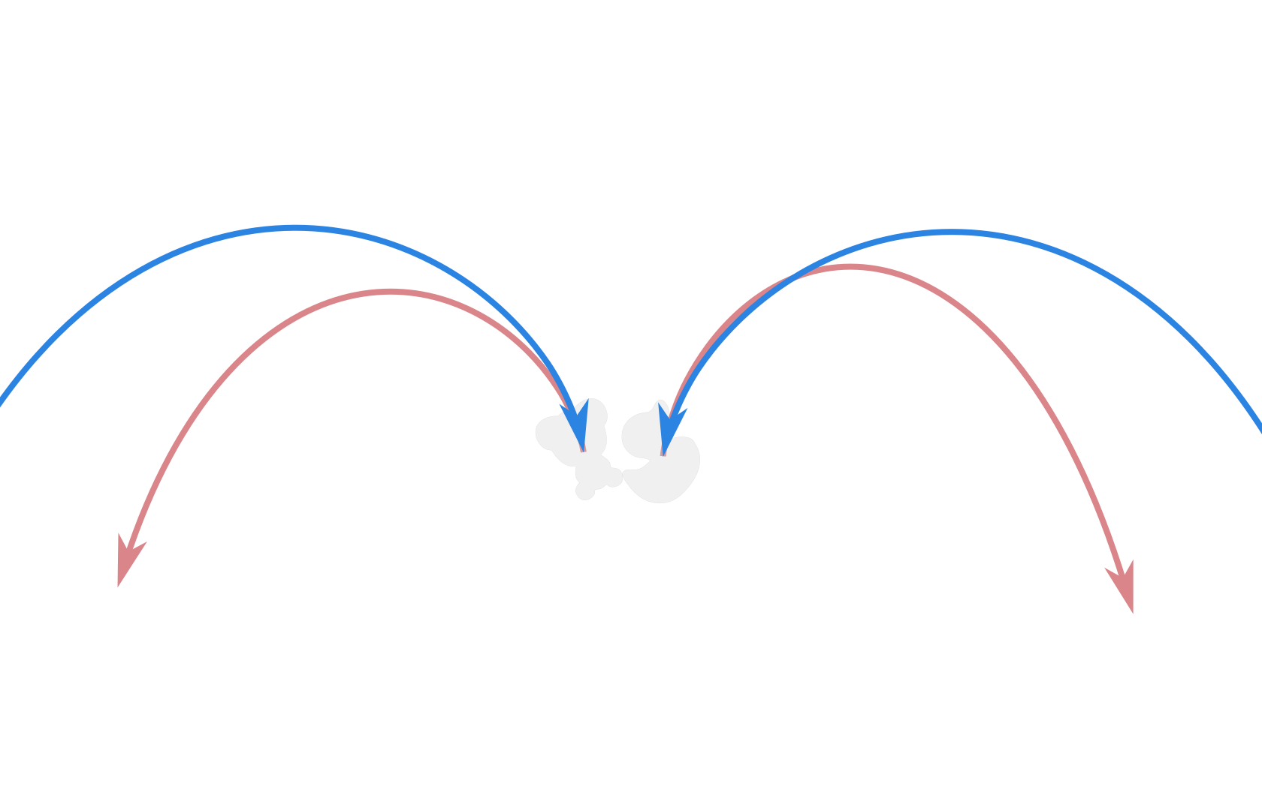
Model
$$R\left(−,β_{X},β_{Y1}\right)$$
$$b_{1}^{a,pre},b_{2}^{a,pre}$$
g
$$b_{1}^{b,pre},b_{2}^{b,pre}$$
$$β_{Y0}^{b,pre}$$
$$β_{Y0}^{a,pre}$$
Gravity direction (2)
Collision positions (2x3)
Rotations around gravity (4x1)
Parabola shape (4x2)
Collision orientations (2x4)
Momenta (4x3)
Collision time (1)
Collision point (3)
Impulse (3)
$$k_{}^{a,pre}$$
$$k_{}^{b,pre}$$
$$β_{Y0}^{a,post}$$
$$β_{Y0}^{b,post}$$
$$q_{}^{a,col}$$
$$q_{}^{b,col}$$
$$b_{1}^{a,post},b_{2}^{a,post}$$
$$b_{1}^{b,post},b_{2}^{b,post}$$
$$k_{}^{a,post}$$
$$jn$$
$$k_{}^{b,post}$$
$$b_{3}^{a}$$
$$b_{3}^{b}$$
Euler-YXY:
$$R\left(β_{Y0},β_{X},β_{Y1}\right)=R\left(β_{Y1},\left(\begin{matrix}0 \\ 1 \\ 0\end{matrix}\right)\right)R\left(β_{X},\left(\begin{matrix}1 \\ 0 \\ 0\end{matrix}\right)\right)R\left(β_{Y0},\left(\begin{matrix}0 \\ 1 \\ 0\end{matrix}\right)\right)$$
x4
x1
$$p\left(t\right)=R\left(β_{Y0},β_{X},β_{Y1}\right)\left(\begin{matrix}b_{1}(t−t^{col}) \\ −\frac{g}{2}{(t−t^{col})}^{2}+b_{2}(t−t^{col}) \\ 0\end{matrix}\right)+b_{3}$$
$$q\left(t\right)=q^{col}+\frac{t−t^{col}}{2}\left(\begin{matrix}0 \\ w(t)\end{matrix}\right)⨂q^{col}$$
$$, w\left(t\right)=I^{−1}(t)k$$
Notes:
No colours

Slide 25
Assumptions
Rigid objects
Collision instantaneous (impulse model)
Air drag negligible
Friction negligible
3D scans of objects available (to acquire orientation)
Motion approximately parallel to camera

Slide 26
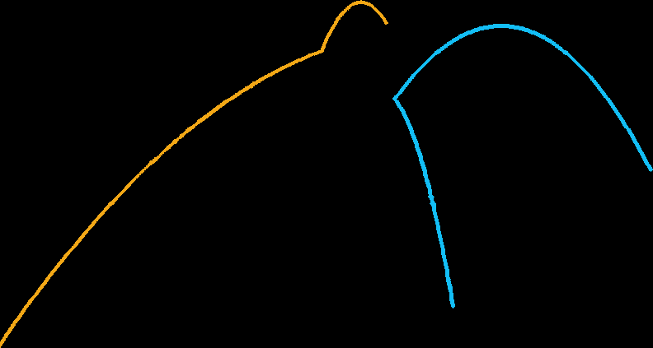
System
Labelled 2D positions
Extract
Observations
Reconstruct
Collisions
Extract
Positions
Bounding boxes
Initial parabolas
Extract
Orientations
Labelled 3D orientations
Notes:
Once we get the velocity estimates, we can calculate a number that can capture the amount of energy retained, which we call CoR

Slide 27
System
Labelled 2D positions
Extract
Observations
Reconstruct
Collisions
Extract
Positions
Bounding boxes
Initial parabolas
Extract
Orientations
Labelled 3D orientations
3D positions and velocities
3D orientations and angular velocities
Relative mass
Coefficient of Restitution
Notes:
Once we get the velocity estimates, we can calculate a number that can capture the amount of energy retained, which we call CoR

Slide 28
Initialize positions
Segmentation: [Zivkovic04, Teh and Chin89] (in OpenCV)
Orientations: [Loper and Black00]

Slide 29
Initialize orientations
[Loper and Black00]

Slide 30
System
Labelled 2D positions
Extract
Observations
Reconstruct
Collisions
Extract
Positions
Bounding boxes
Initial parabolas
Extract
Orientations
Labelled 3D orientations
3D positions and velocities
3D orientations and angular velocities
Relative mass
Coefficient of Restitution
Notes:
Once we get the velocity estimates, we can calculate a number that can capture the amount of energy retained, which we call CoR

Slide 31
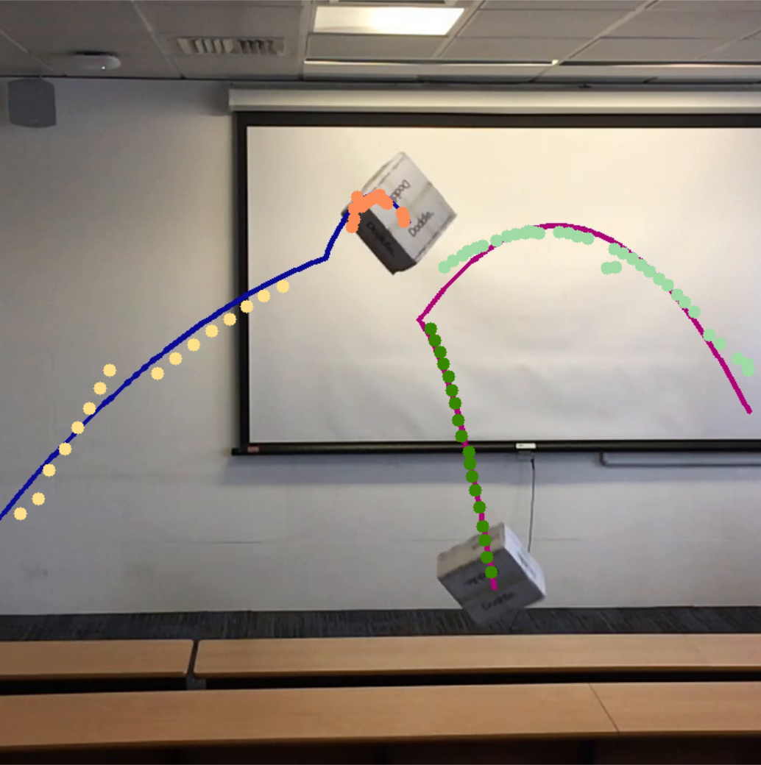
Coefficient of restitution
Ratio of kinetic energy retained after collision
Energy is transformed to heat, sound and deformation energy
$$v_{}^{a,pre}$$
$$v_{}^{b,pre}$$
$$n$$
$$v_{}^{a,post}$$
$$v_{}^{b,post}$$
…
…
$$c= \frac{v_{}^{b,post}−v_{}^{a,post}}{v_{}^{a,pre}−v_{}^{b,pre}}$$
$$=−\frac{v_{rel}^{post} }{v_{rel}^{pre} }$$
$$∙n$$
$$\left( \right)∙n$$
$$\left( \right)∙n$$
$$∙n$$
Notes:
What is coefficient of restitution?

Slide 32
System
Initialize Positions
Video
Bounding box
3D Scan 1
Bounding box
3D Scan 2
Initial parabolas
Labelled 2D positions

Slide 33
System
Initialize Positions
Video
Initialize Orientations
Bounding box
3D Scan 1
Bounding box
3D Scan 2
Initial parabolas
Labelled 2D positions
Labelled 3D orientations
$${\left\{\left\{p_{i}^{obs},t_{i}^{obs}\right\}\right\}}_{i=1}^{|\left\{frames\right\}|}$$

Slide 34
System
Initialize Positions
Video
Initialize Orientations
Bounding box
3D Scan 1
Bounding box
3D Scan 2
Initial parabolas
Labelled 2D positions
Labelled 3D orientations
$${\left\{\left\{p_{i}^{obs},t_{i}^{obs}\right\}\right\}}_{i=1}^{|\left\{frames\right\}|}$$
Reconstruct
Collisions
$${\left\{\left\{q_{i}^{obs},t_{i}^{obs}\right\}\right\}}_{i=1}^{8≤}$$
3D positions and velocities
3D orientations and angular velocities
Relative mass
Coefficient of Restitution

Slide 35
Results
Input video
Collision reconstruction (no physics engine)
Notes:
No text

Slide 36
Evaluation (real)
Notes:
Video
Focus on spinning rugby, show numbers, for more, check paper
videos

Slide 37
Evaluation (real)
Notes:
Video
Focus on spinning rugby, show numbers, for more, check paper
videos

Slide 38
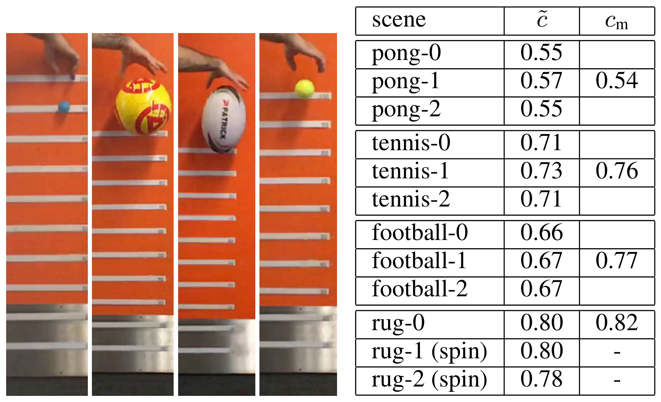
Evaluation (real)
output
approximate “ground truth”
Notes:
Video
Focus on spinning rugby, show numbers, for more, check paper
videos

Slide 39
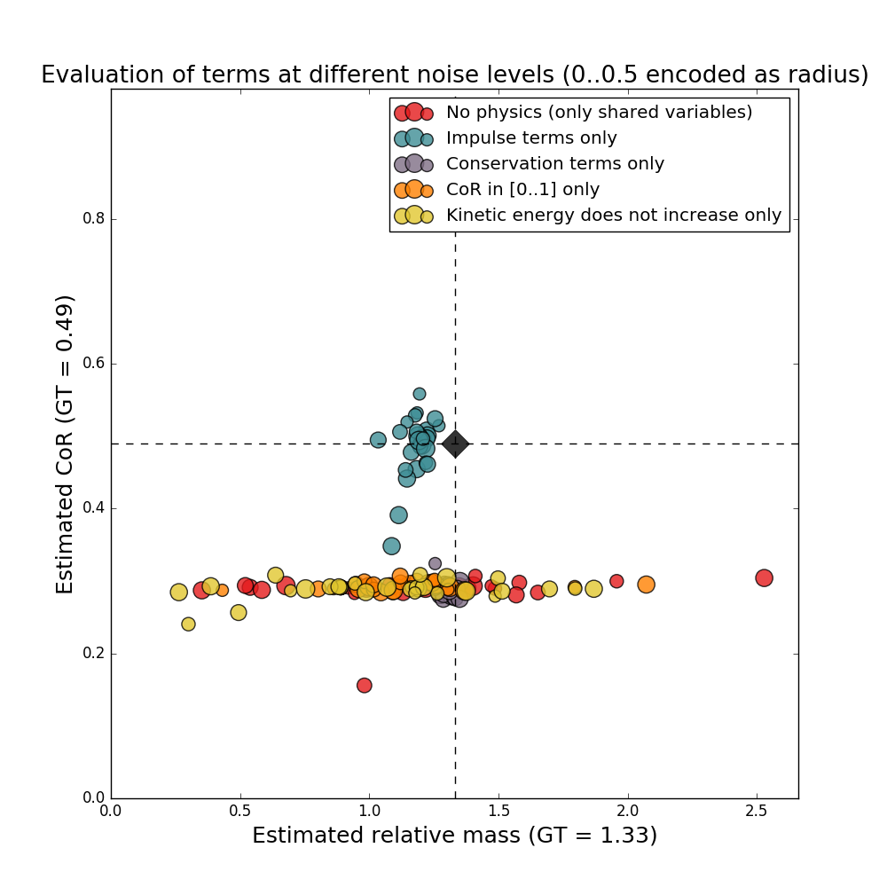
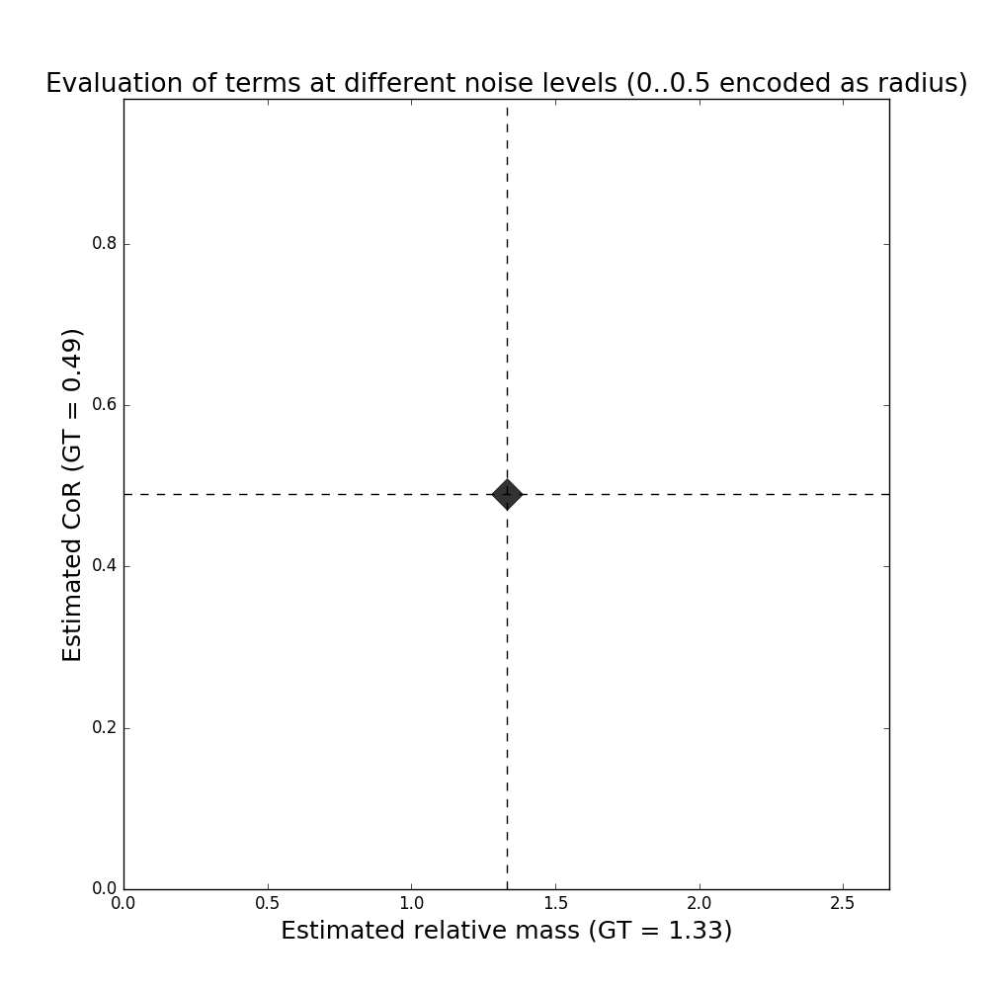
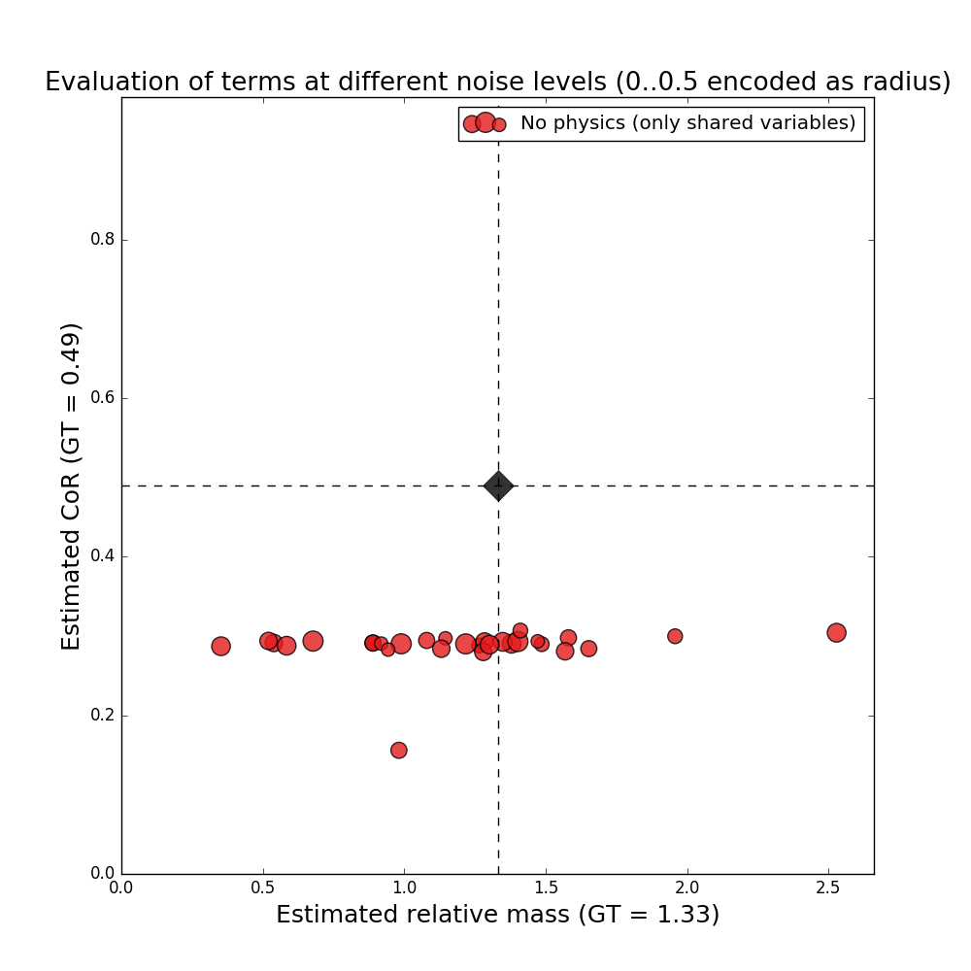
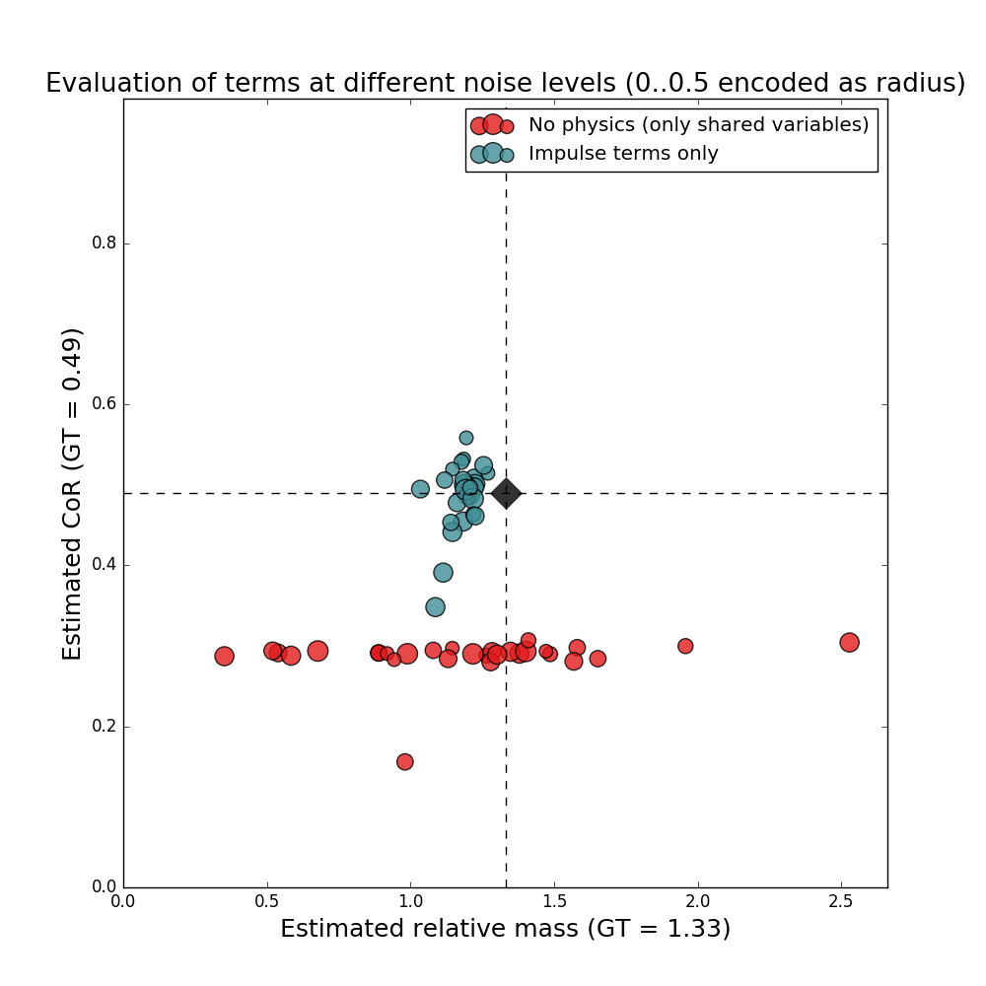
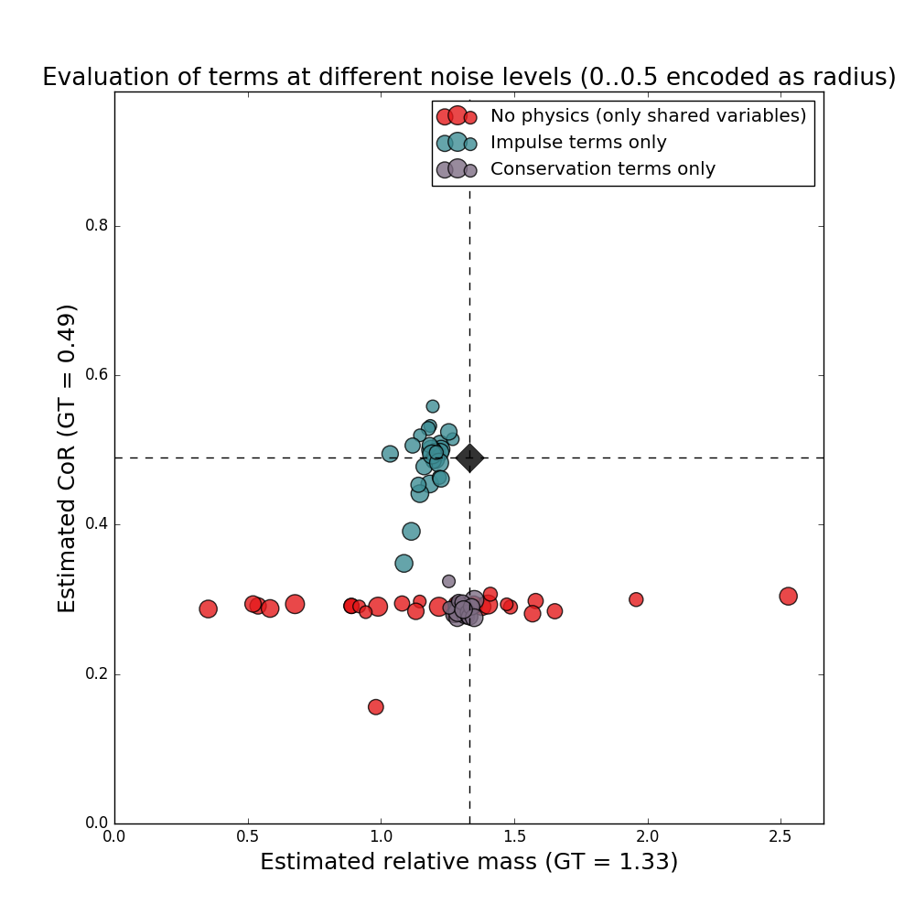
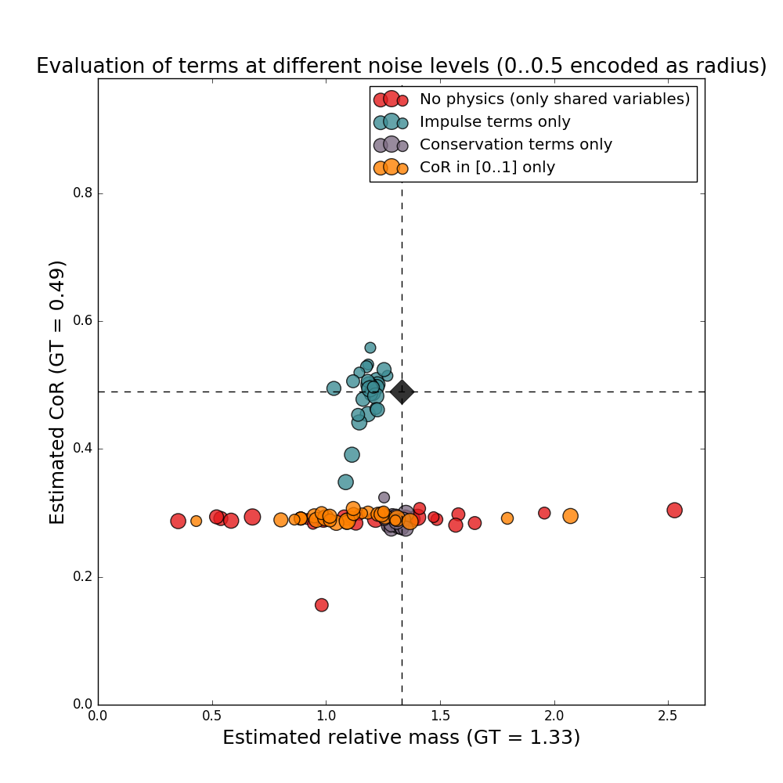
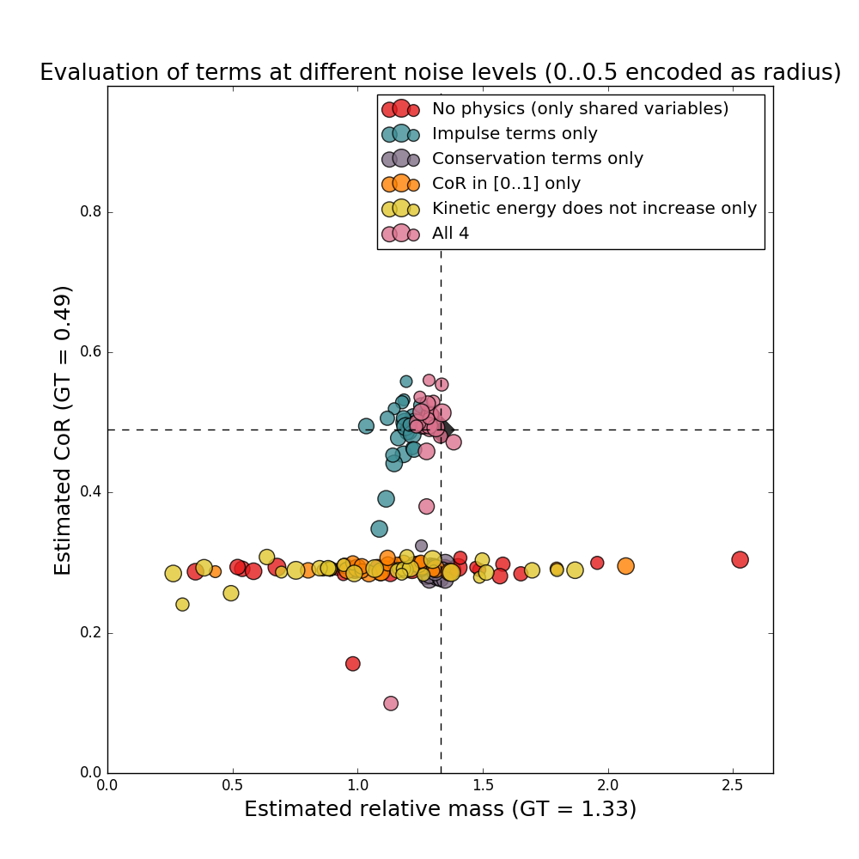
Synthetic evaluation
Bullet physics engine
>2000 experiments
Ground truth
Notes:
Animate graph

Slide 40
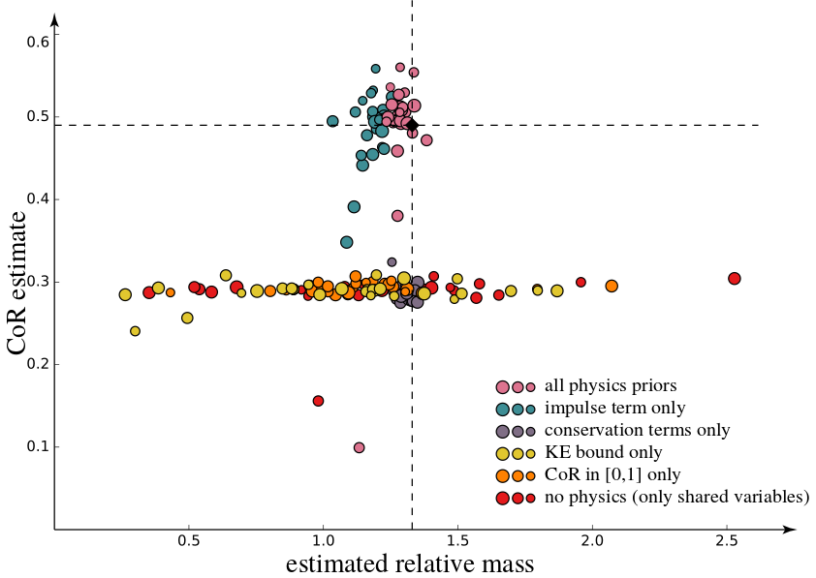
Synthetic evaluation
Bullet physics engine
>2000 experiments
Ground truth
Notes:
Animate graph

Slide 41
Results
Notes:
Show only one,
Short for the other? (zoom?)

Slide 42
Results

Slide 43
Results

Slide 44
Results
Notes:
Fig1 remove
Show only two ( helmet and rugby)

Slide 45
Application
Notes:
Speed up

Slide 46
Limitations and future work
Limitations
Rigid bodies only
Orientations require user input
Friction not modelled
Possible intersections (no collision detection)
Future work
Other internal parameters: e.g., inertia tensor
Fully automatic orientations
Deformable objects
Notes:
Monocular: need to see the effect of gravity (trajectory curvature)

Slide 47
Violation of rigid body assumption

Slide 48
Acknowledgements
Partially funded by
Google PhD Fellowship
ERC Starting Grant SmartGeometry (StG-2013-335373)
ERC Starting Grant realFlow (StG-2015-637014)
UCL Impact
Gifts from Adobe

Slide 49
Thanks! Code and data available at http://geometry.cs.ucl.ac.uk/projects/2016/smash
Notes:
Acquire internal properties
And reconstruction
Work in synergy
Code – if you have problem, let me know

Slide 50
References
[Popovic00] Popovic, Seitz, Erdmann, Popovic, and Witkin: Interactive Manipulation of Rigid Body Simulations, SIGGRAPH 2000
[Salzman11] Salzman and Urtasun: Physically-based Motion Models for 3D Tracking: A Convex Formulation, ICCV 2011
[Wu15] Wu, Yildirim, Lim, Freeman, and Tenenbaum: Galileo: Perceiving Physical Object Properties by Integrating a Physics Engine with Deep Learning, NIPS 2015
[Lerer16] Lerer, Gross, and Fergus: Learning Physical Intuition of Block Towers by Example, CoRR 2016

Slide 51
Scene understanding with unseen priors
Thanks!
Code and data available at http://geometry.cs.ucl.ac.uk/projects/2016/smash

Slide 52
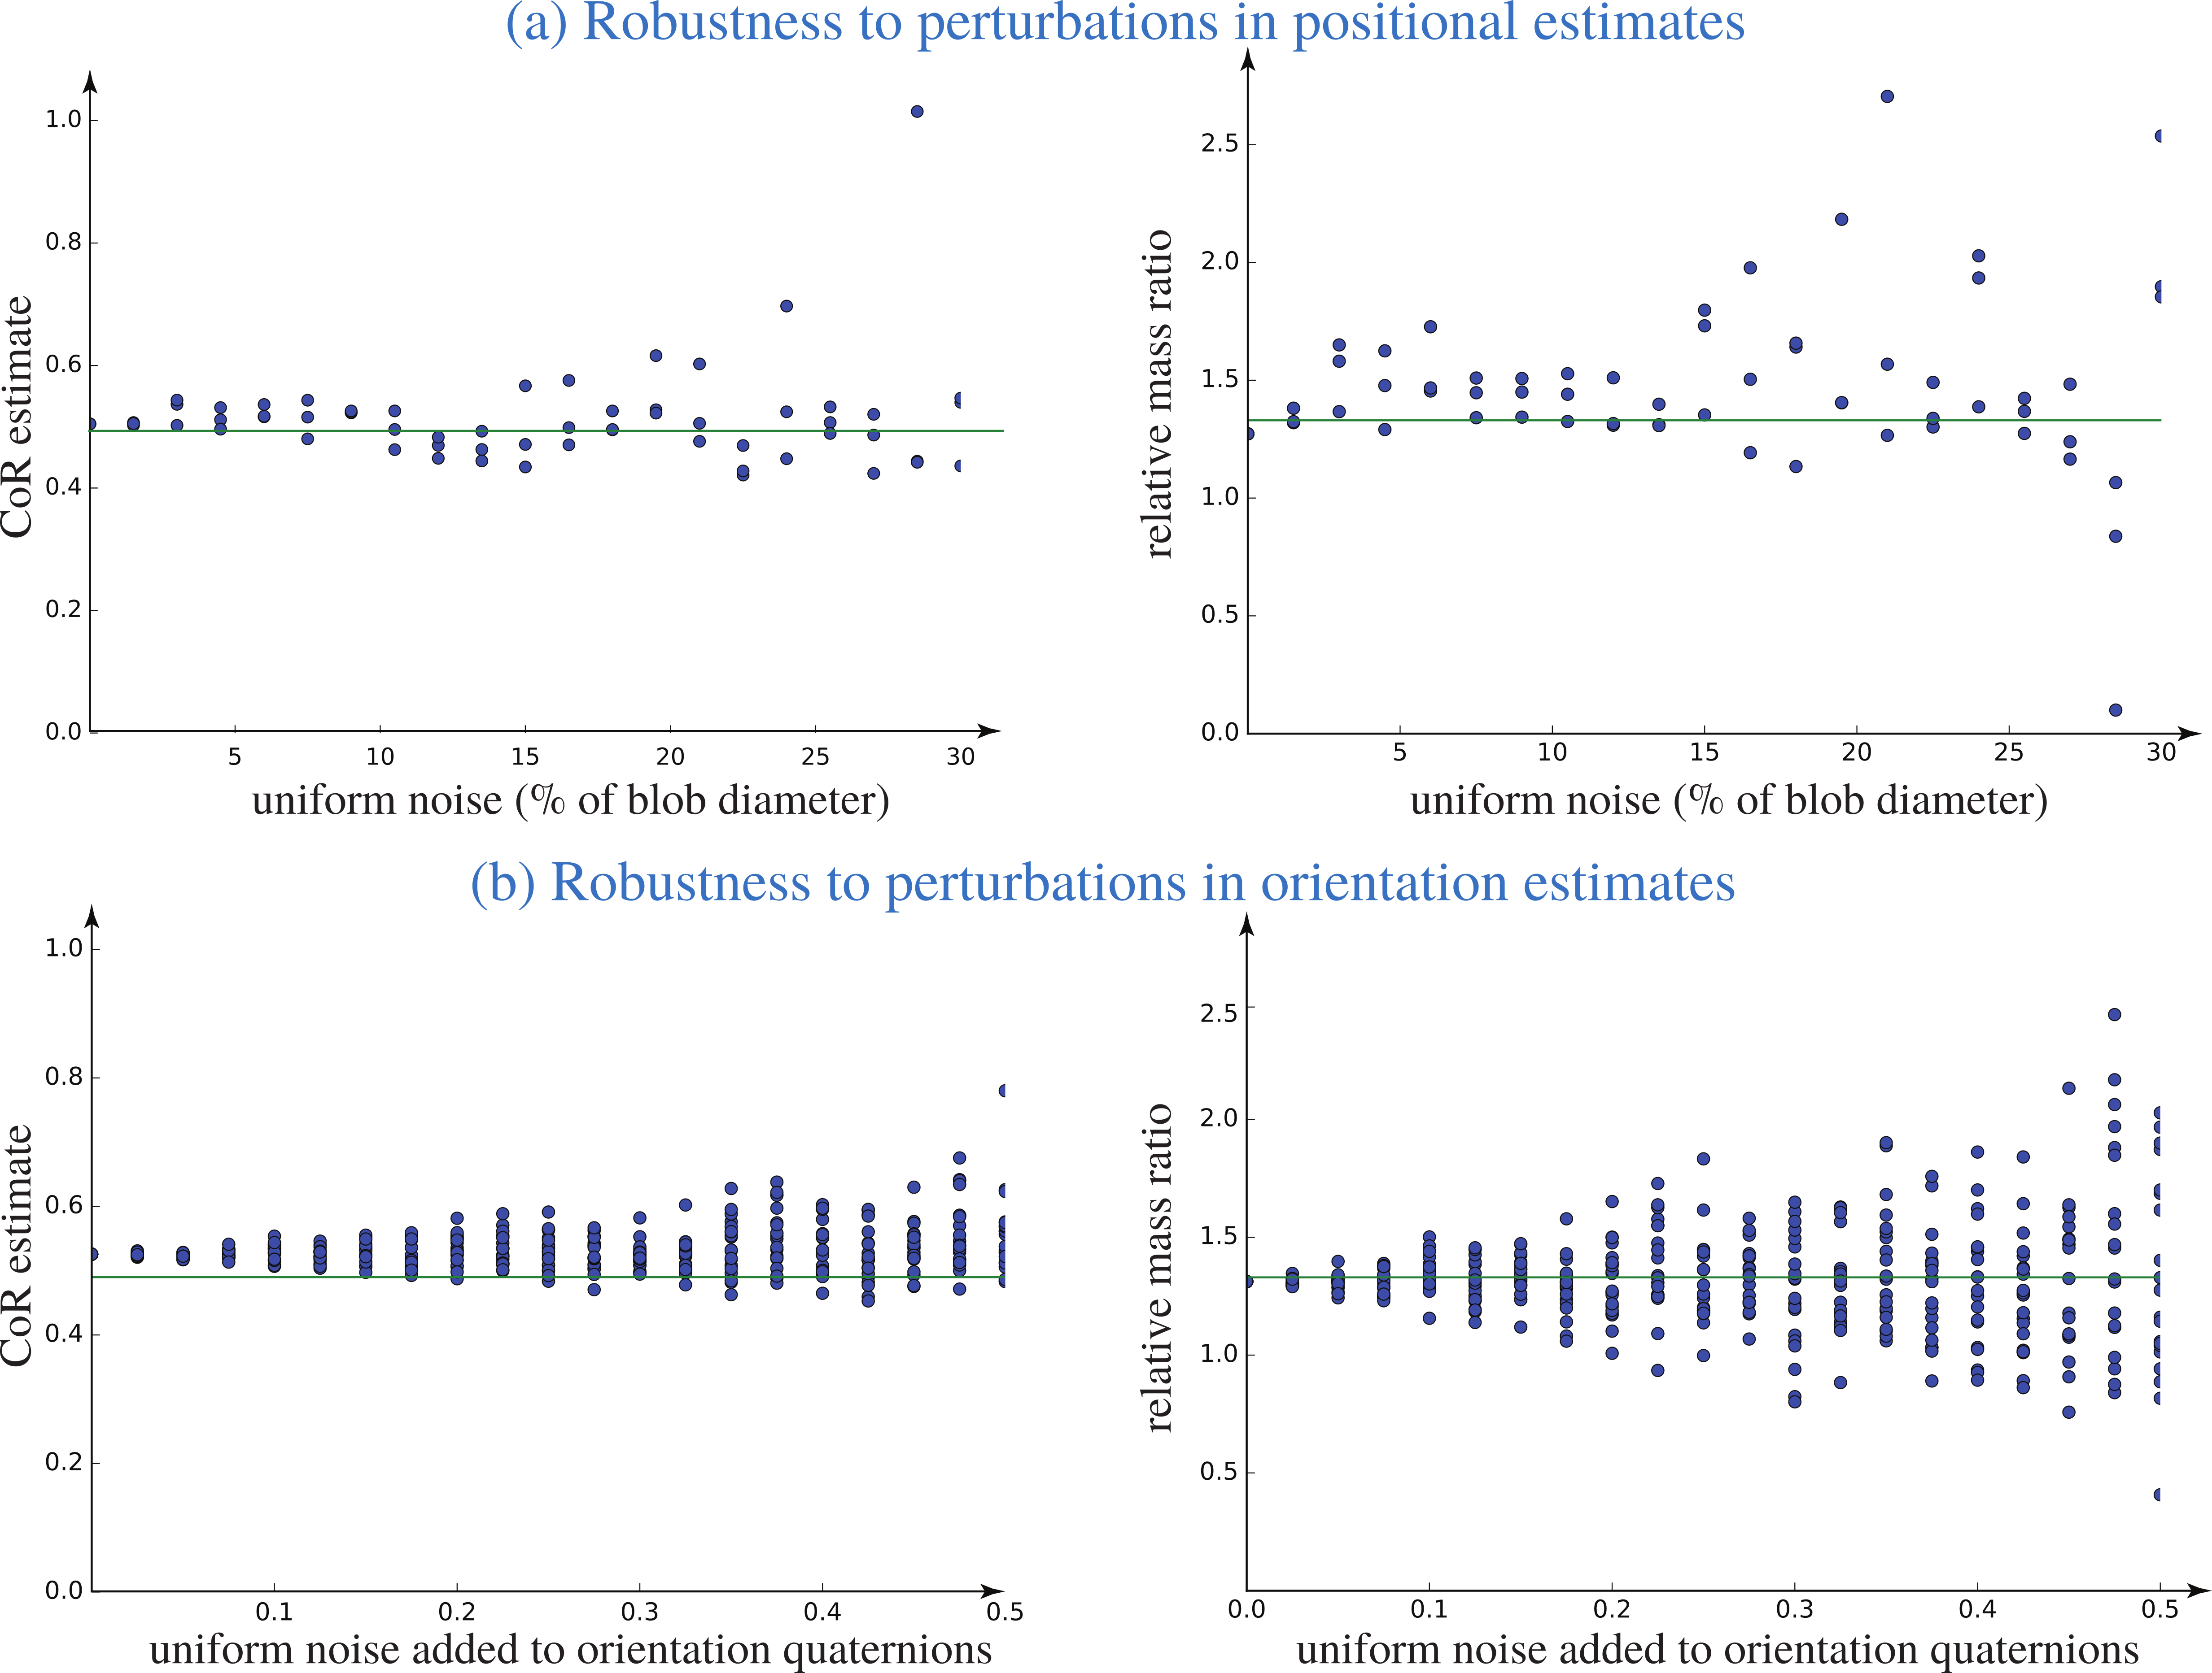
Synthetic evaluation - CoR

Slide 53
Synthetic evaluation - CoR

Slide 54
Synthetic evaluation - CoR

Slide 55
Synthetic evaluation - Mass

