Slide 1
Designing Chain Reaction Contraptions From Causal Graphs
Robin Roussel
Marie-Paule Cani
Jean-Claude Léon
Niloy J. Mitra
University College London
LIX, École Polytechnique
UGA, CNRS, Inria, GINP, LJK
University College London

Slide 2

Notes:
First I’d like to start with a little factoid than I learned recently.

Slide 3
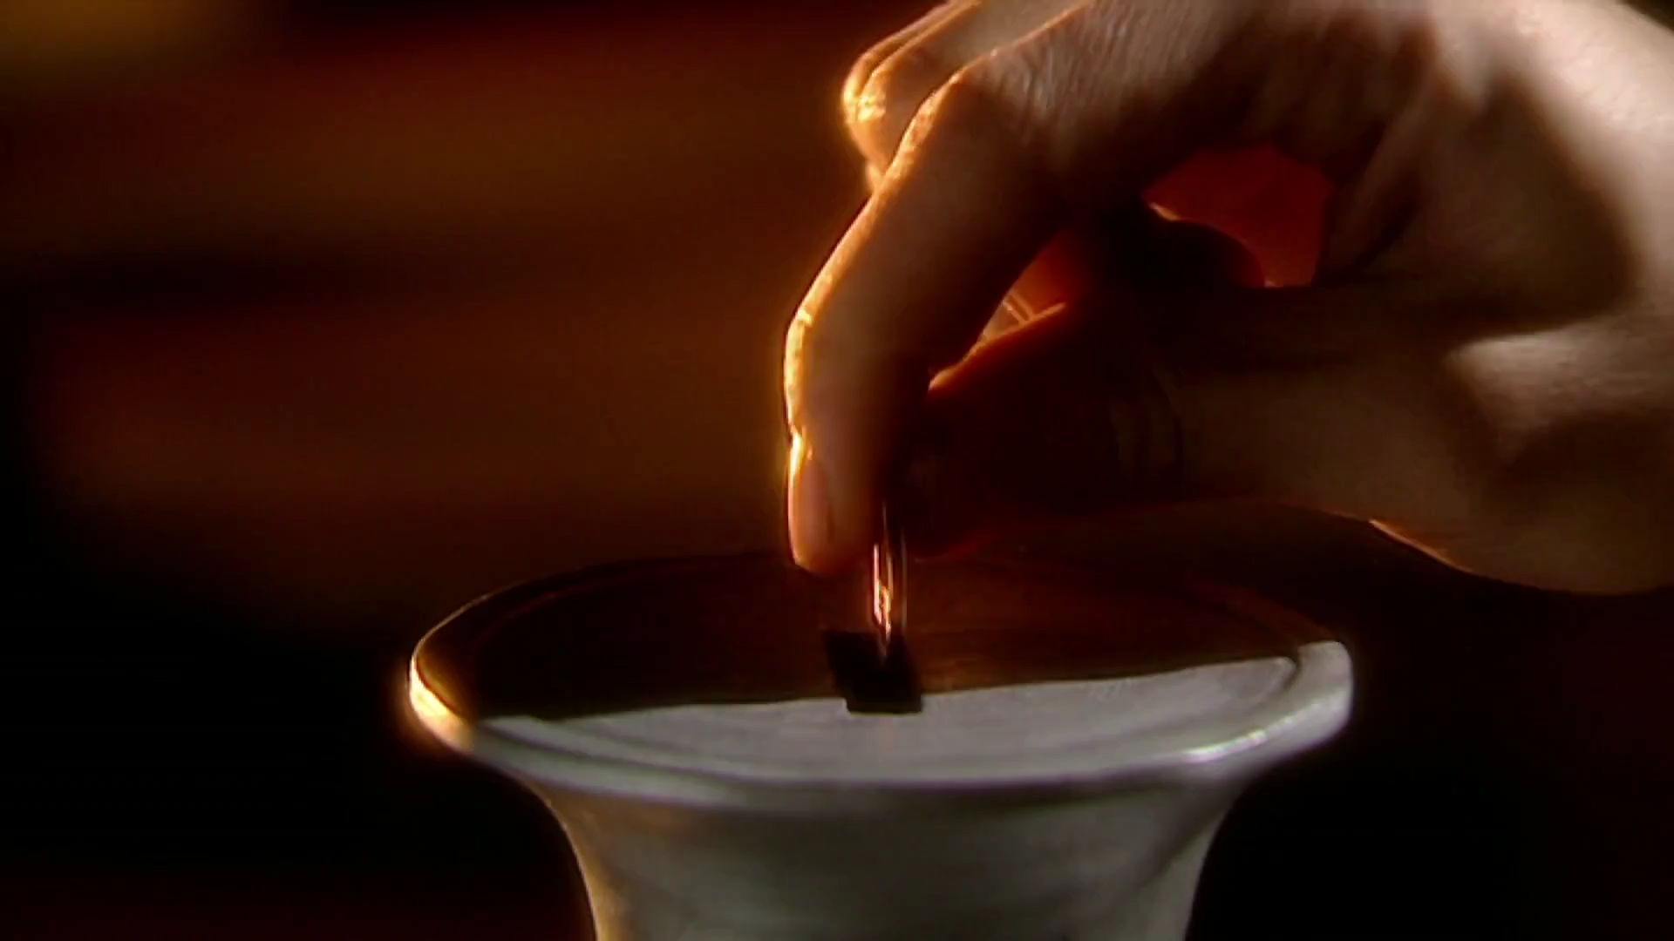
HERON’S VENDING MACHINE
www.youtube.com/watch?v=4SMdjh5QR1g
Notes:
Did you know that the first automatic vending machine (PLAY) was invented by Heron of Alexandria about 2,000 years ago? People would put a coin at the top and holy water would come out. The way it works is quite ingenious: the coin falls on a platform, which opens a valve letting the liquid flow. But then, the coin falls off the platform, which closes the valve.
This kind of invention reminds me of Rube Goldberg Machines.

Slide 4
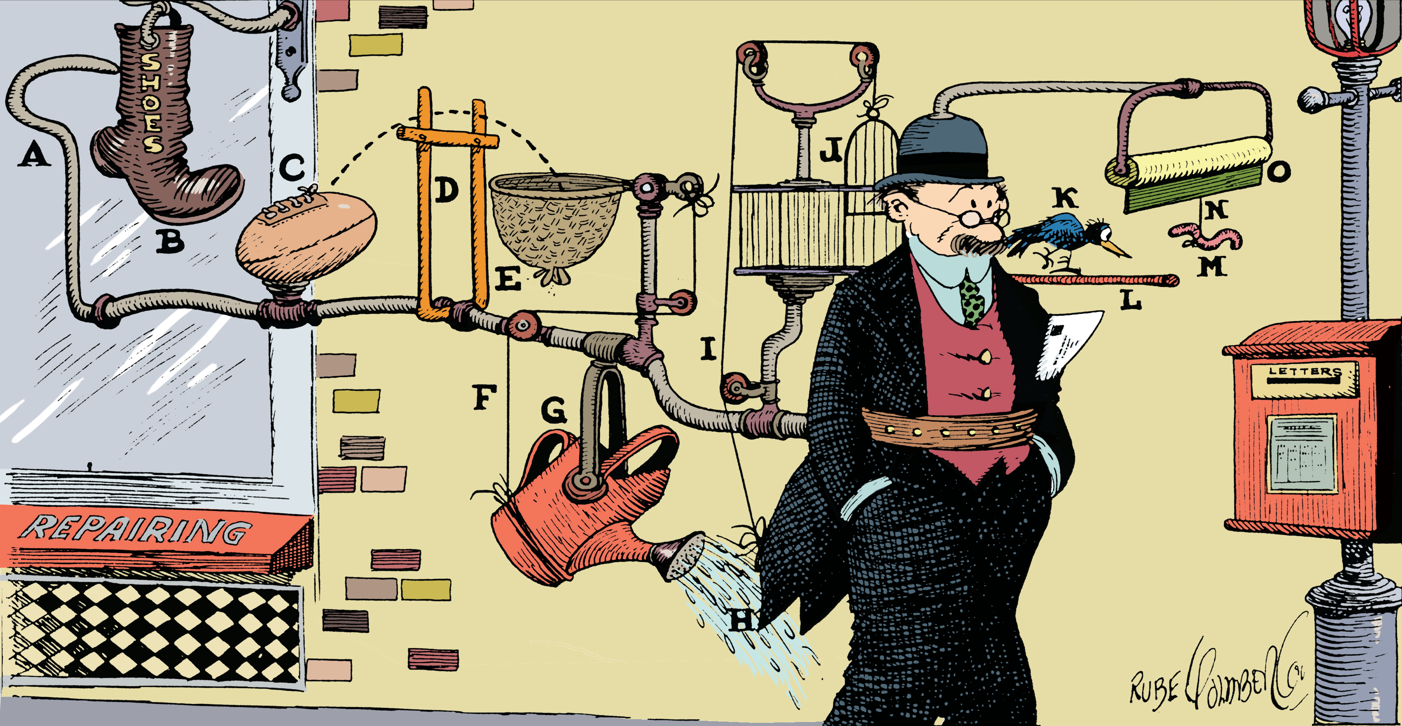
CASE STUDY: RUBE GOLDBERG MACHINES
“Simple Idea to Keep You From Forgetting To Mail Your Wife's Letter” by Rube Goldberg. Source: www.rubegoldberg.com
Notes:
A Rube Goldberg Machine is a contraption/invention that achieves a simple outcome via a complex chain reaction of events.

Slide 5
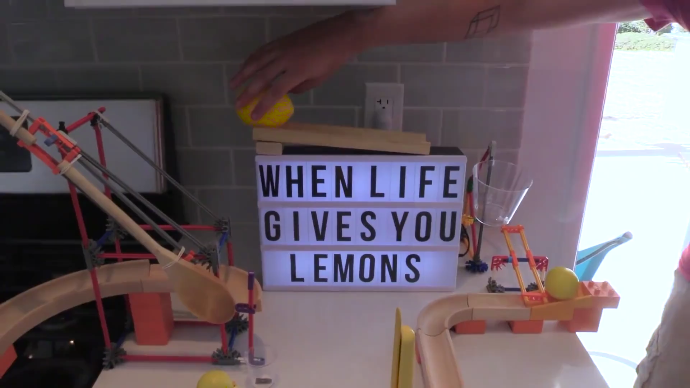
www.youtube.com/watch?v=Av07QiqmsoA
Notes:
Better than a definition, lets’ have a look at a real-life example: (PLAY) (After 10 sec) As you can see, these contraptions are both an art and a science, and require a lot of patience to set up. If we now look at a behind the scenes video, …

Slide 6
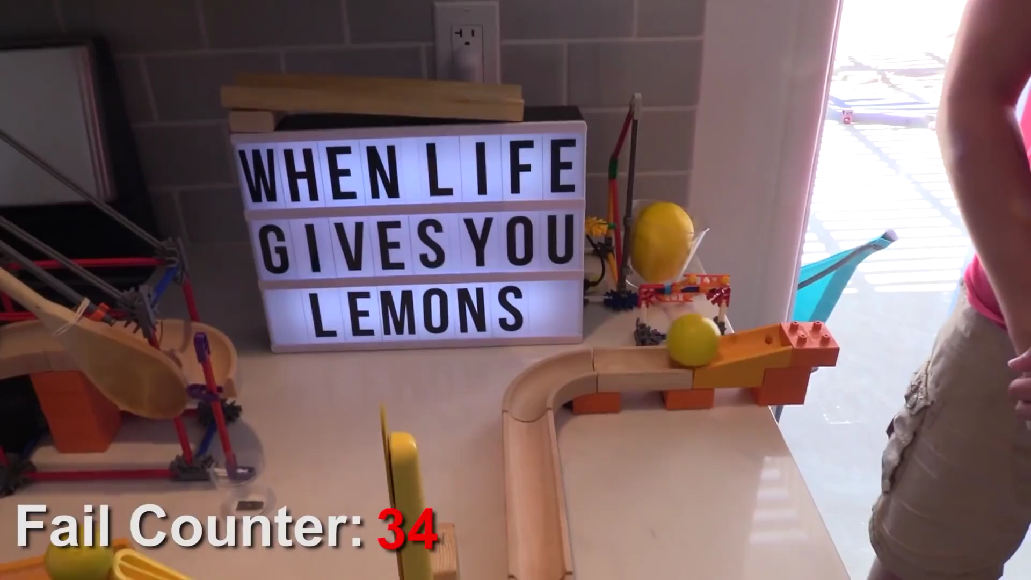
BEHIND THE SCENES
www.youtube.com/watch?v=Av07QiqmsoA
Notes:
… we see that the contraption is extremely sensitive to small changes. And since it is a chain reaction, any failure is fatal.

Slide 7
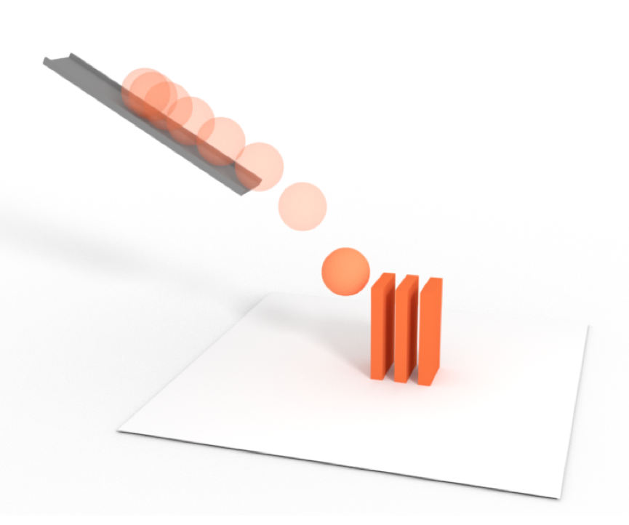
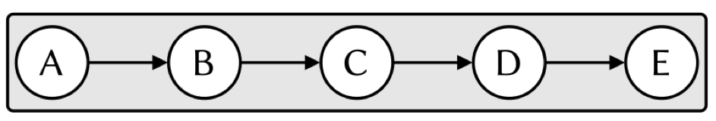
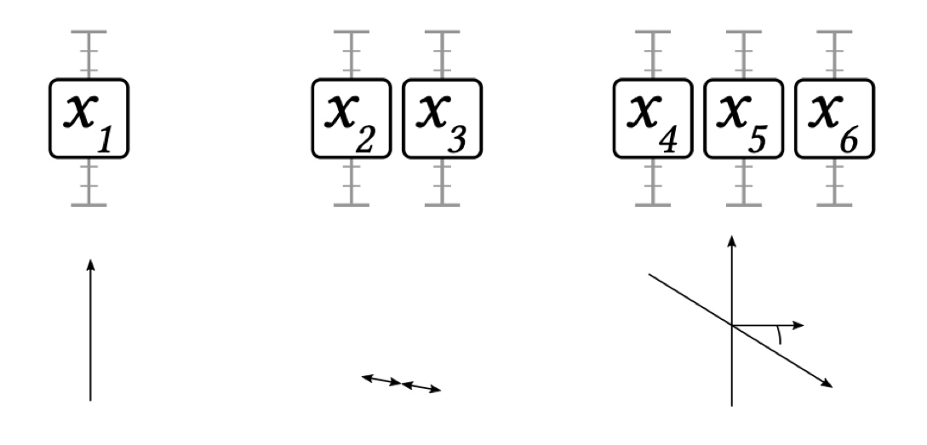
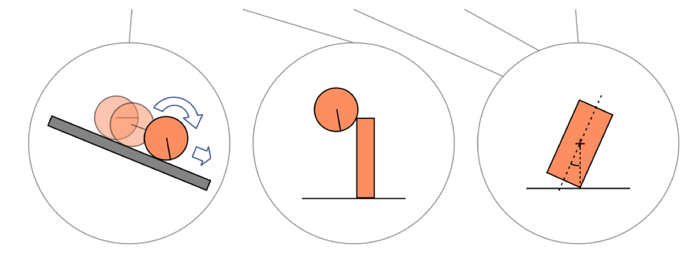
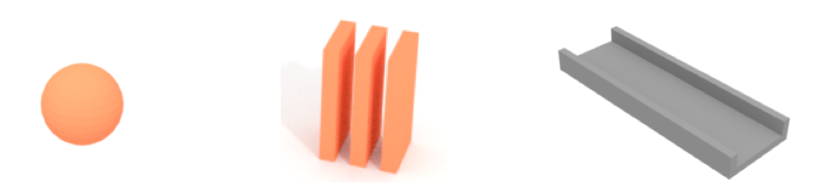
Problem
Causal graph of events
Layout maximizing robustness to modeling bias and manual errors
Notes:
So here, we thought, is an interesting problem: let’s say we want to build a Rube Goldberg machine – we know its components and we know the discrete events (such as “ball hits domino”, ”domino falls”) and the order in which they should happen. We call this sequence the “causal graph”, btw – more on that later).
This is not an animation problem: we want to build this contraption in real life from preexisting components, so we can’t cheat and change gravity! The only thing we can change is the layout.
What we would like is a computational method to find the layout that makes the contraption as robust as possible to the errors involved in the process, which come in two flavors.
Modeling biases come from the fact that we approximate the objects and their physical behavior.
Manual assembly errors, on the other hand, mean that we’re assembling the contraption with our little hands, but reality is messy so whatever the solution we’ll never be able to realize it perfectly.

Slide 8
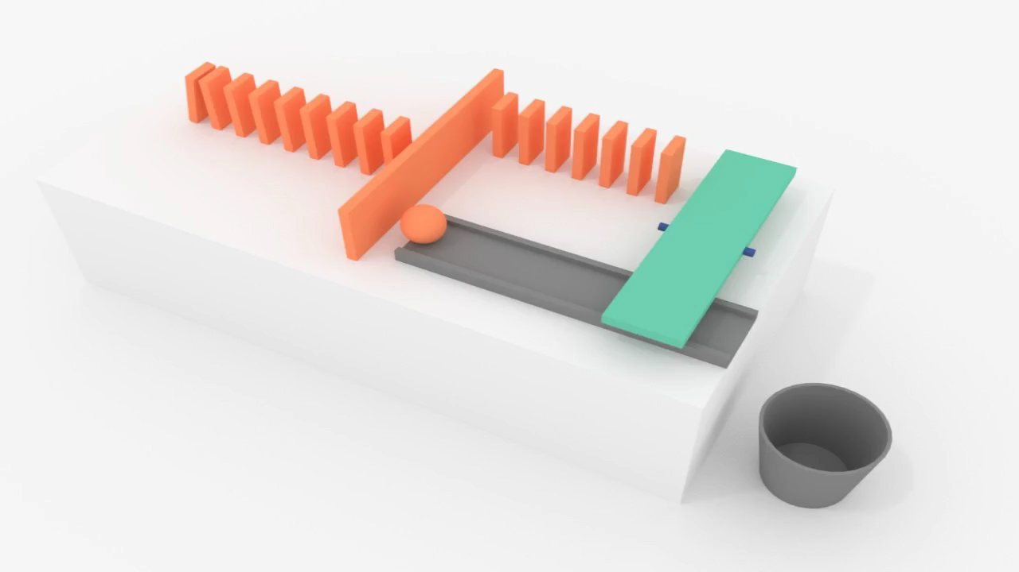
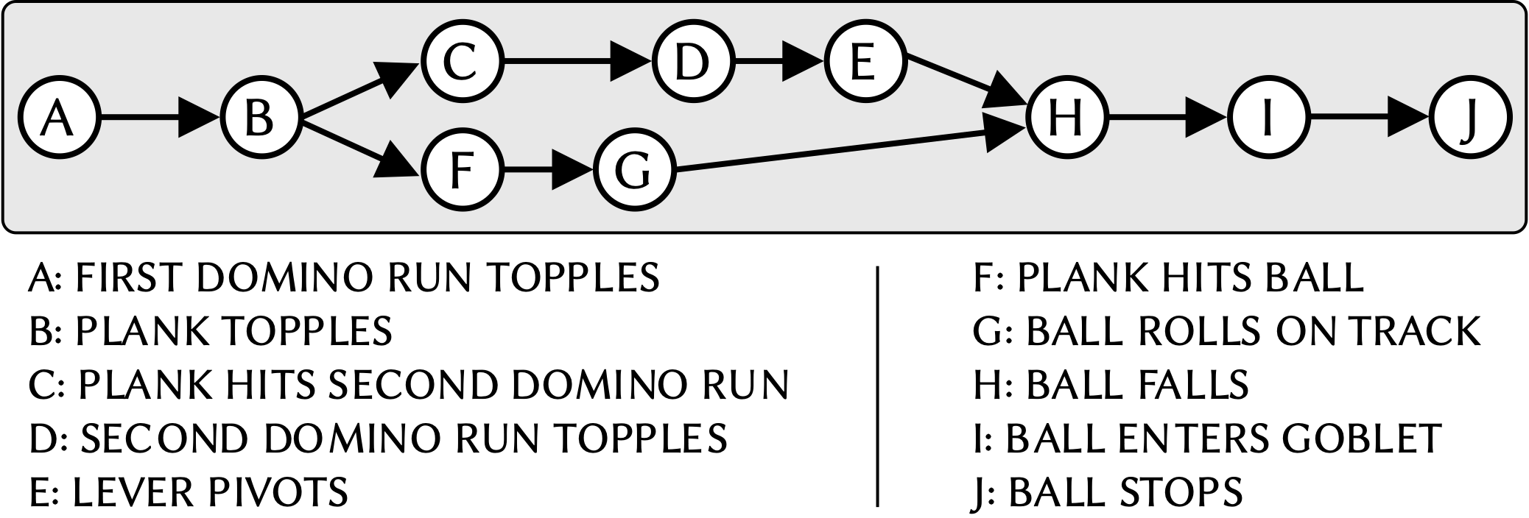
Sub-Problem: Branch Synchronization
Notes:
To make things spicier, events sometimes happen in parallel chains which are expected to end in a certain order. For instance, the green lever needs to be raised so that the ball can roll underneath it.
In other words, the causal graph is not just a long line but a directed acyclic graph.
And as a result, we cannot simply optimize the contraption piece by piece.

Slide 9
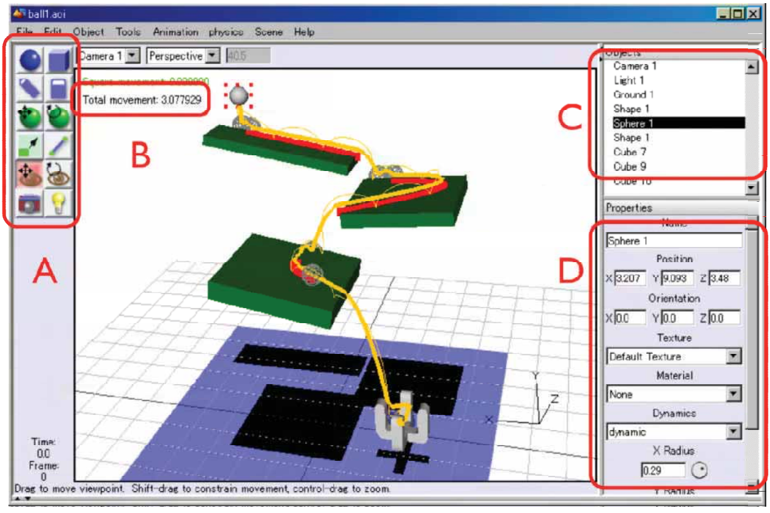
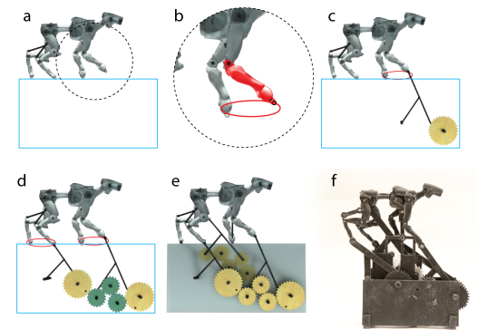
Related Work: Behavior Control Of Contraptions
DIRECT DESIGN
INVERSE DESIGN
[Furuta et al. 2010]
[Coros et al. 2013]
+ Useful for visualization/prediction
− No direct behavior control
+ Direct behavior control
− Continuous motion only
Notes:
Our problem is essentially one of physical behavior control… and while direct design systems are very useful to simulate and visualize an expected real-life behavior, they do not allow the user to control the behavior directly.
Prior works on inverse design, on the other hand, provide such direct behavior control but they only focus on continuous motion – not on chains of discrete events, and a fortiori not on the synchronization of such chains.

Slide 10

Insight
Design space = layout parameters
Smooth.
Physically impossible
✋
Success regions
👍
Notes:
So how do we approach this problem? Let’s visualize the high-dimensional space of all possible layouts of a given Rube Goldberg machine as this 2D projection. Here each point is a different layout.
As you can see, some regions of that space are physically impossible.
We assume that there is at least one region in that space where runs are successful, meaning that all the events happen in the expected order. Moreover, we assume that this region is relatively smooth because the physical phenomena involved are simple enough.
Of course, at first these regions are completely unknown

Slide 11

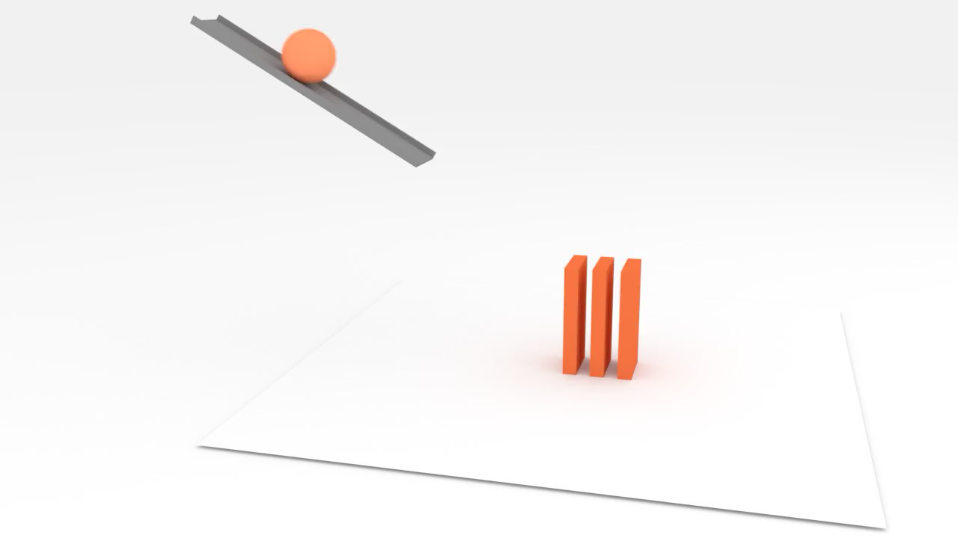
Insight
Design space = layout parameters
Requires sampling and simulation
✓
Notes:
and have generally no explicit closed form representation, which means that we need to rely on sampling, and for each sample point, simulate it under the supervision of the causal graph using a physically based simulator such as Bullet.
Of course this sampling itself introduces errors in the process.

Slide 12
Insight
Design space = layout parameters
Requires sampling and simulation
Most robust layout = farthest from the boundary
Can be approximated well enough
Notes:
Our insight is that the most robust layout is the one that is farthest from the boundary, because it minimizes the probability of being accidentally in the failure zone.
Moreover, under the smoothness assumption that I mentioned before we should be able to approximate it well enough with a sampling-based approach.
The question then, is how to sample?

Slide 13
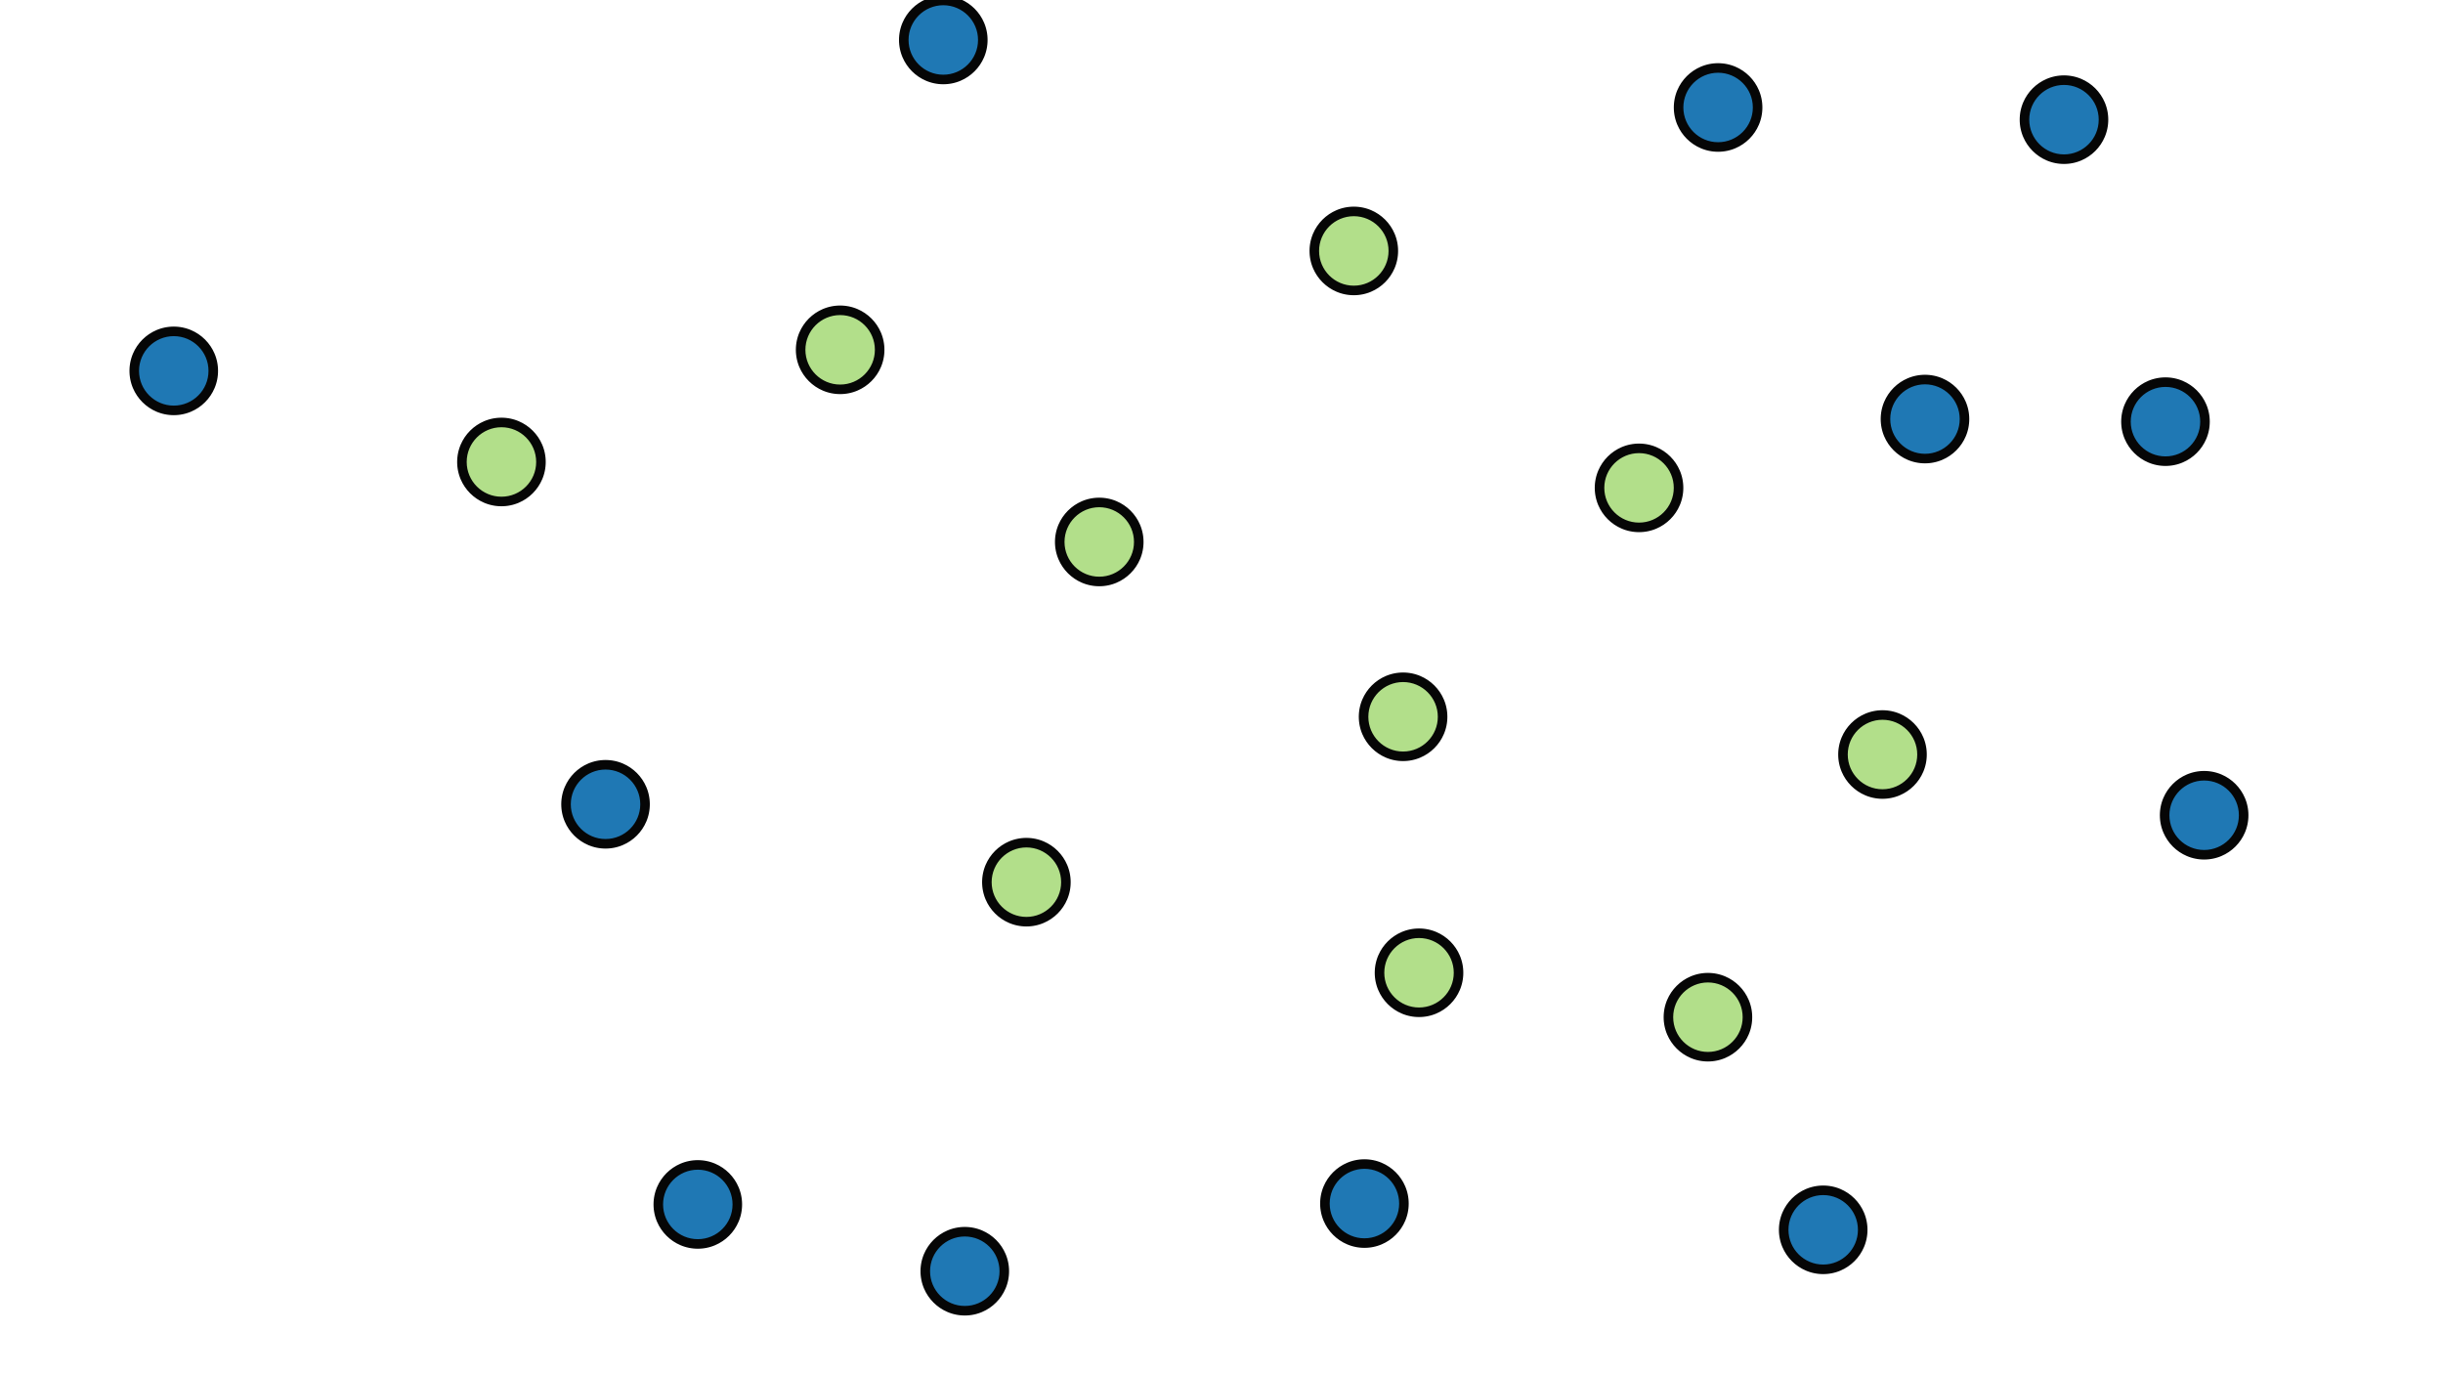
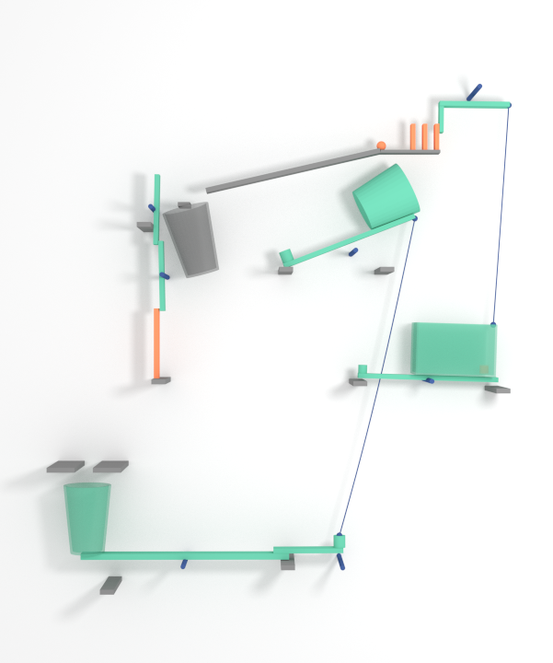
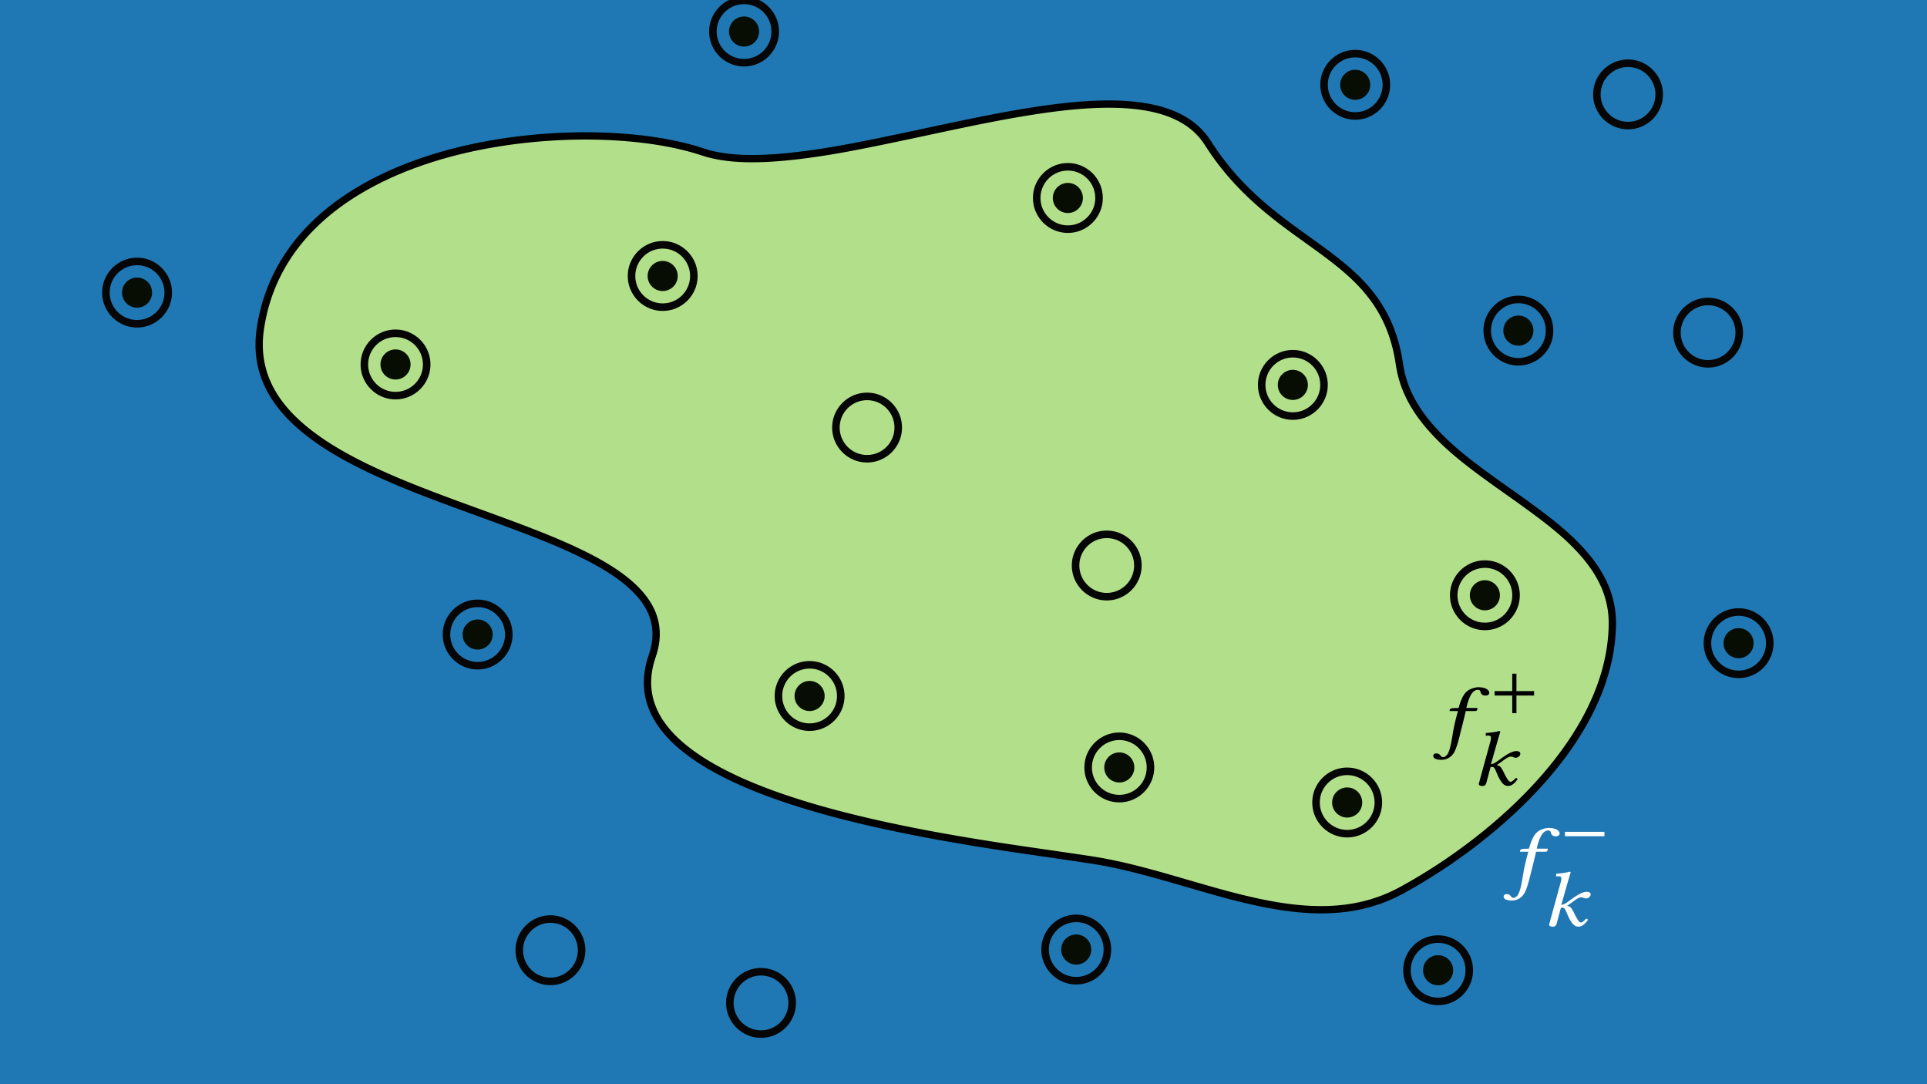
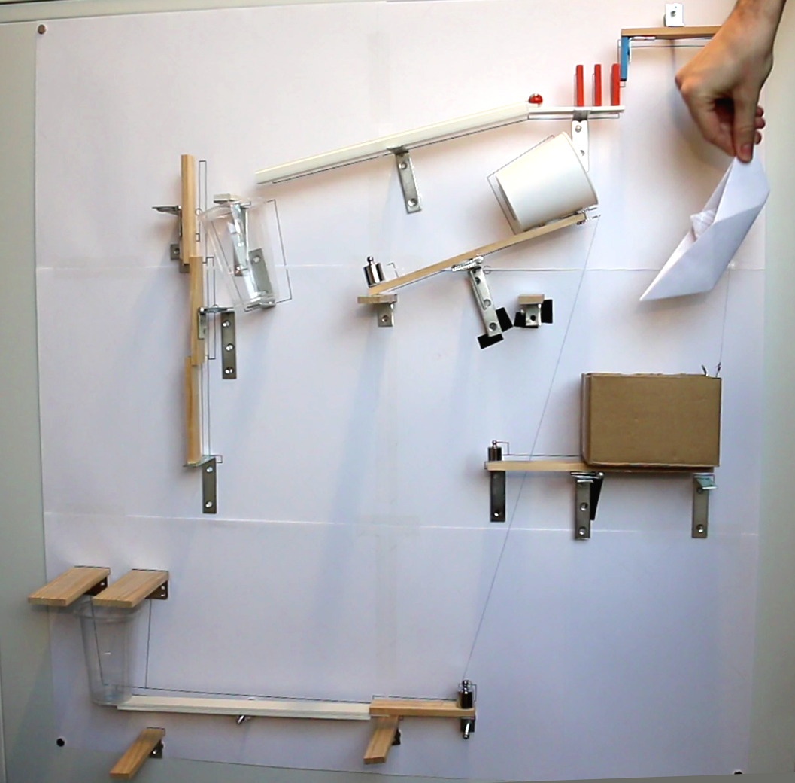
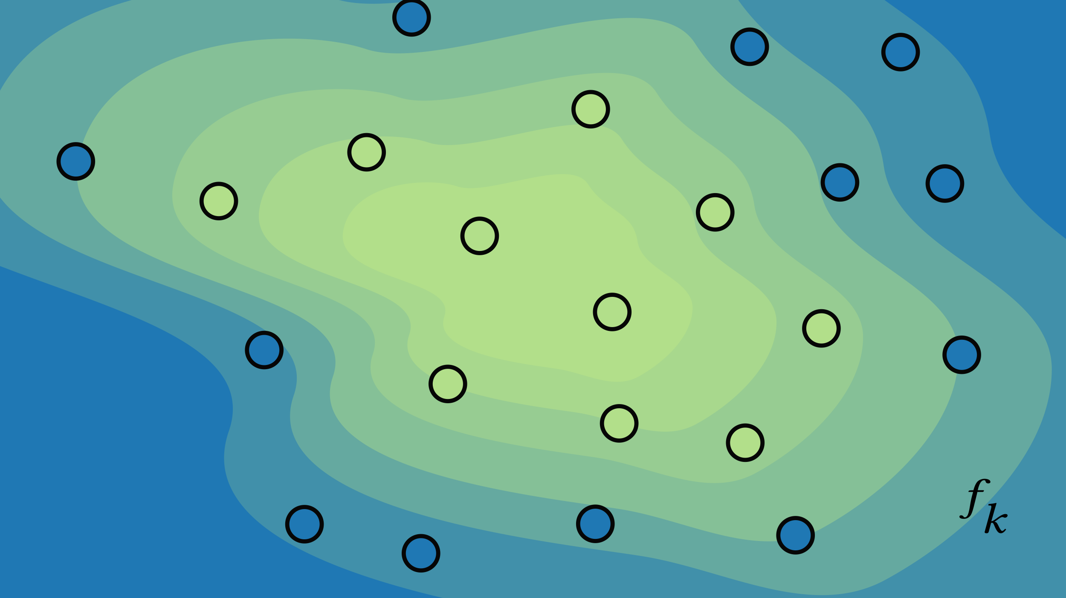
Method Overview
SEARCH
APPROXIMATE
Variables:
layout parameters
OPTIMIZE
Notes:
To reiterate, the input consists of a 3D scene of components with ranges of layout parameter values, and a causal graph of events that we can use to monitor simulations.
Our method works in three main steps.
First, we have an adaptive exploration of the design space. The goal is to get the lay of the land and find enough successful layouts.
Second, we progressively approximate the success region using a technique inspired from Active Learning.
Lastly, we optimize the contraption layout to reach the center of the success region.
In the end we get a layout that we print and use to guide the assembly.

Slide 14
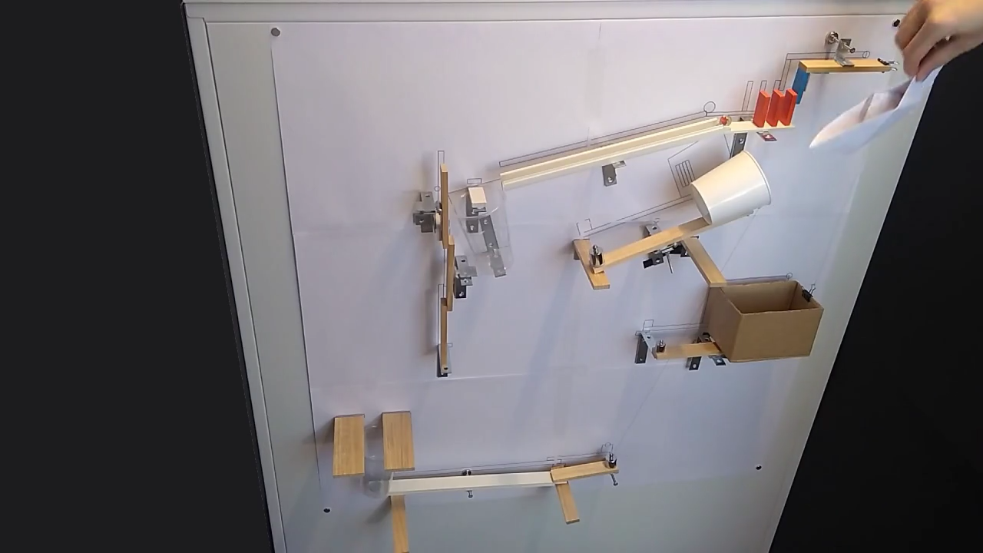
Notes:
Before we dive into the method, here’s an example of result!
Someone puts an object in a box (for example, a SIGGRAPH technical paper) and after some time, hopes that gold coins will fall into the box as well. (PLAY)
There’s a lot more cool results at the end!

Slide 15
Method Overview
SEARCH
APPROXIMATE
Variables:
layout parameters
OPTIMIZE
Notes:
By the way, in this presentation, I will only focus on steps 1 and 2, which are the core contributions of our paper.

Slide 16
SEARCH
Notes:
Now that I have introduced our problem and method, I’m going to describe the search algorithm. So let’s say we have our rough contraption layout and causal graph, and here’s our design space again.

Slide 17
Notes:
In the beginning, there is… well, nothing. We have no samples and no prior, so we draw points from a quasi-random sequence

Slide 18
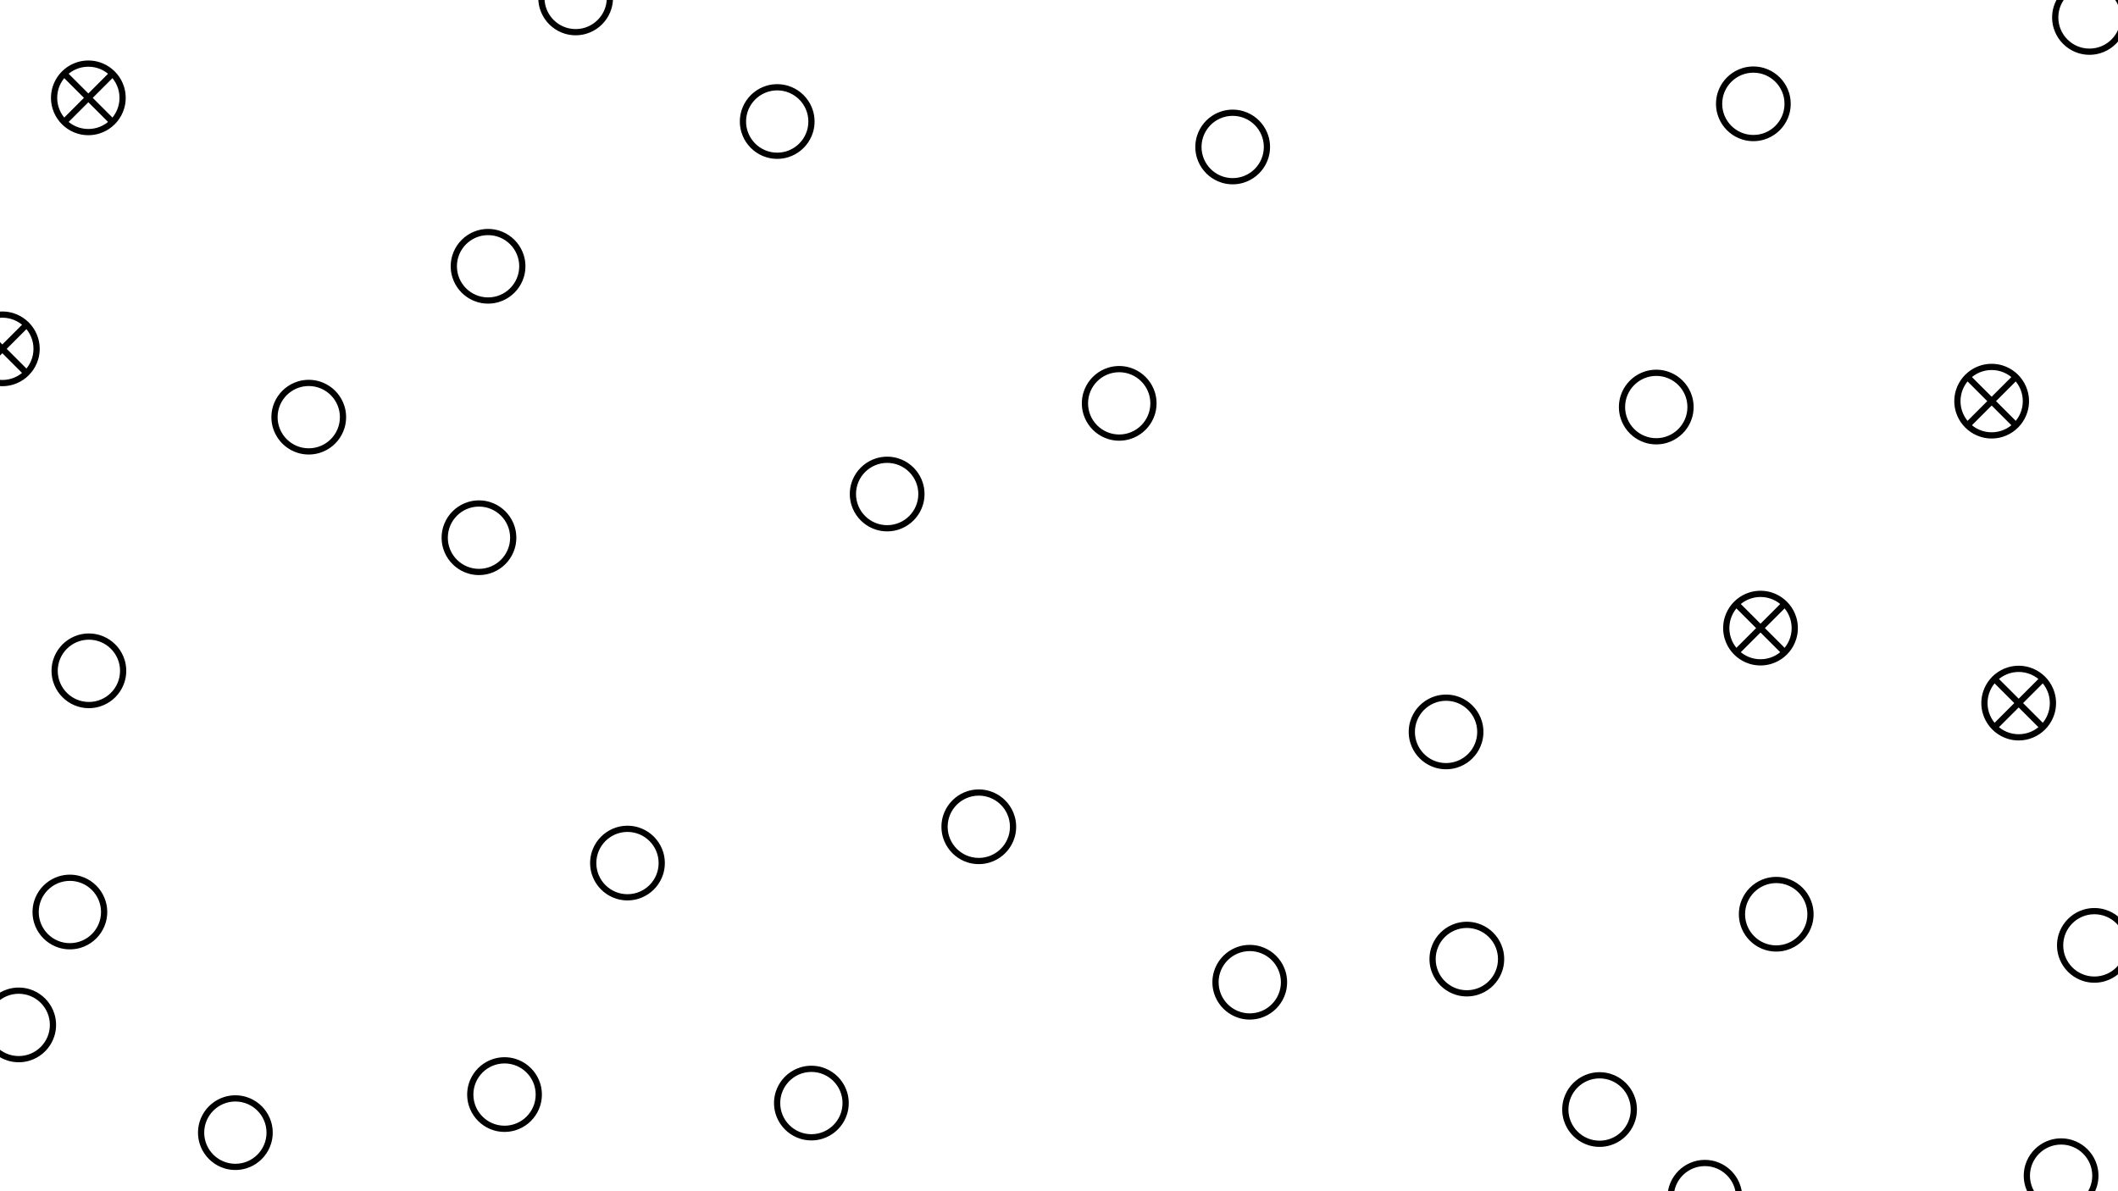
Notes:
And filter those that are physically impossible.
Now if we simulate the valid layouts, it’s pretty likely that the vast majority will fail, but some will fail less bad than others. Because we want a sequence of events to happen in a specific order, we have a way to differentiate between samples …

Slide 19
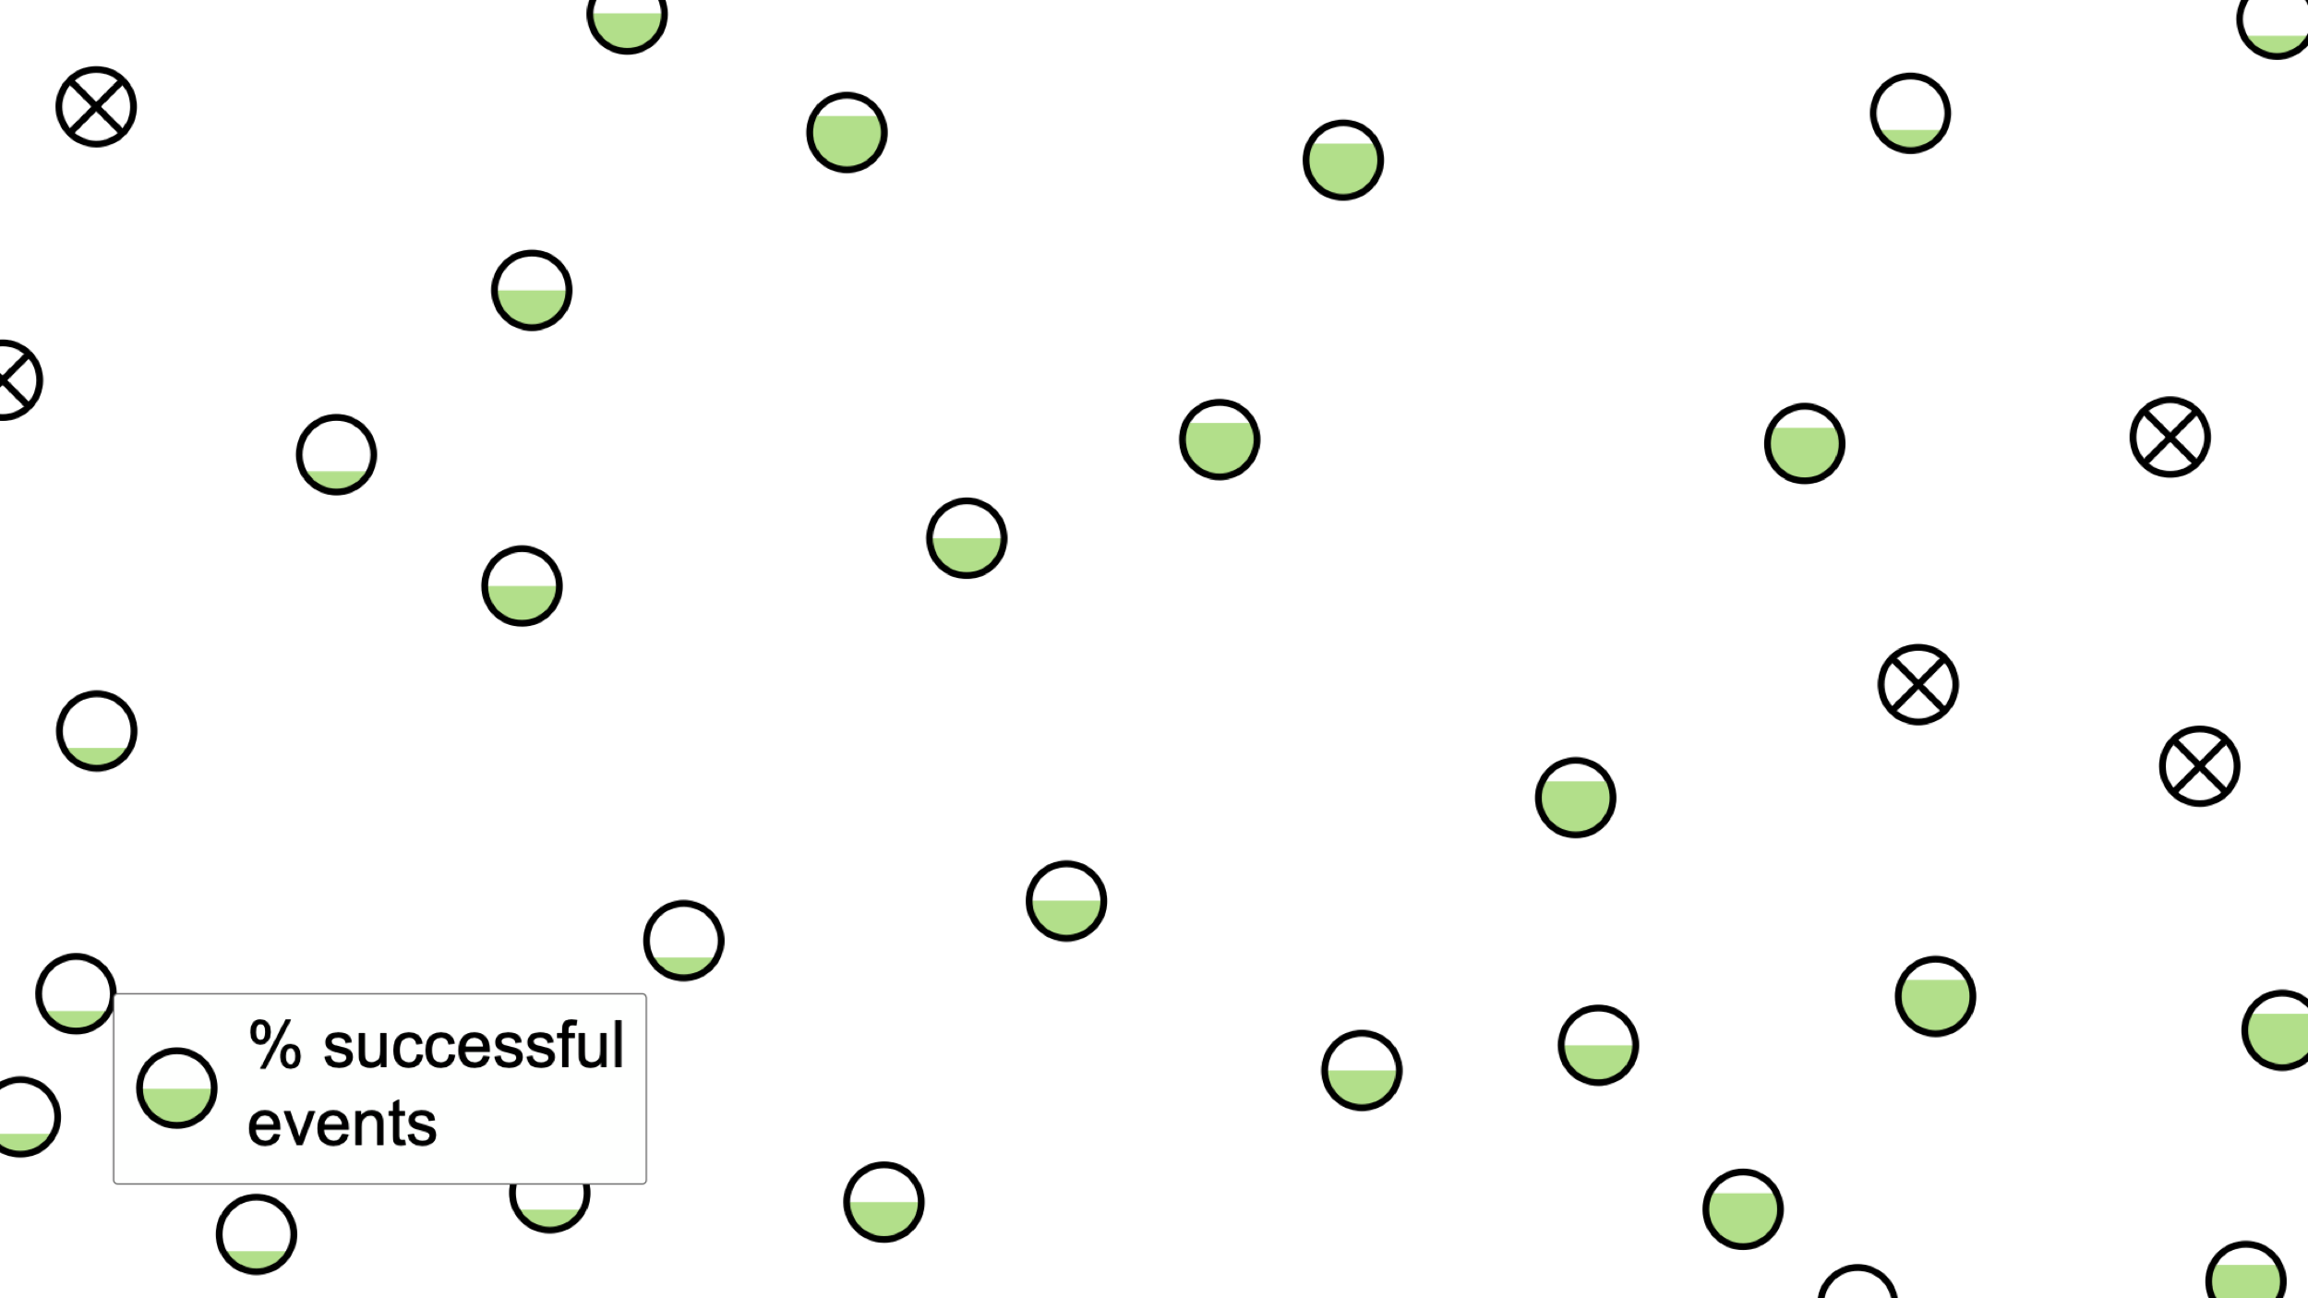
Notes:
… based on how many events happened in this expected order. So now we can focus the search around the most promising regions.

Slide 20
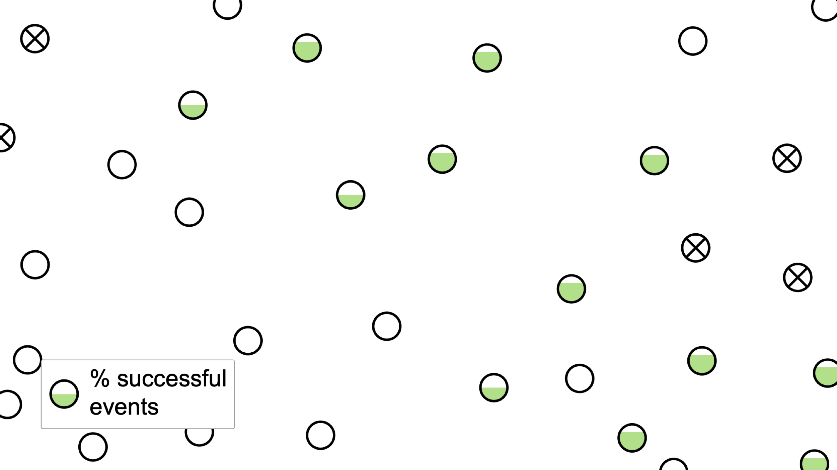
Notes:
By taking the current N best samples

Slide 21
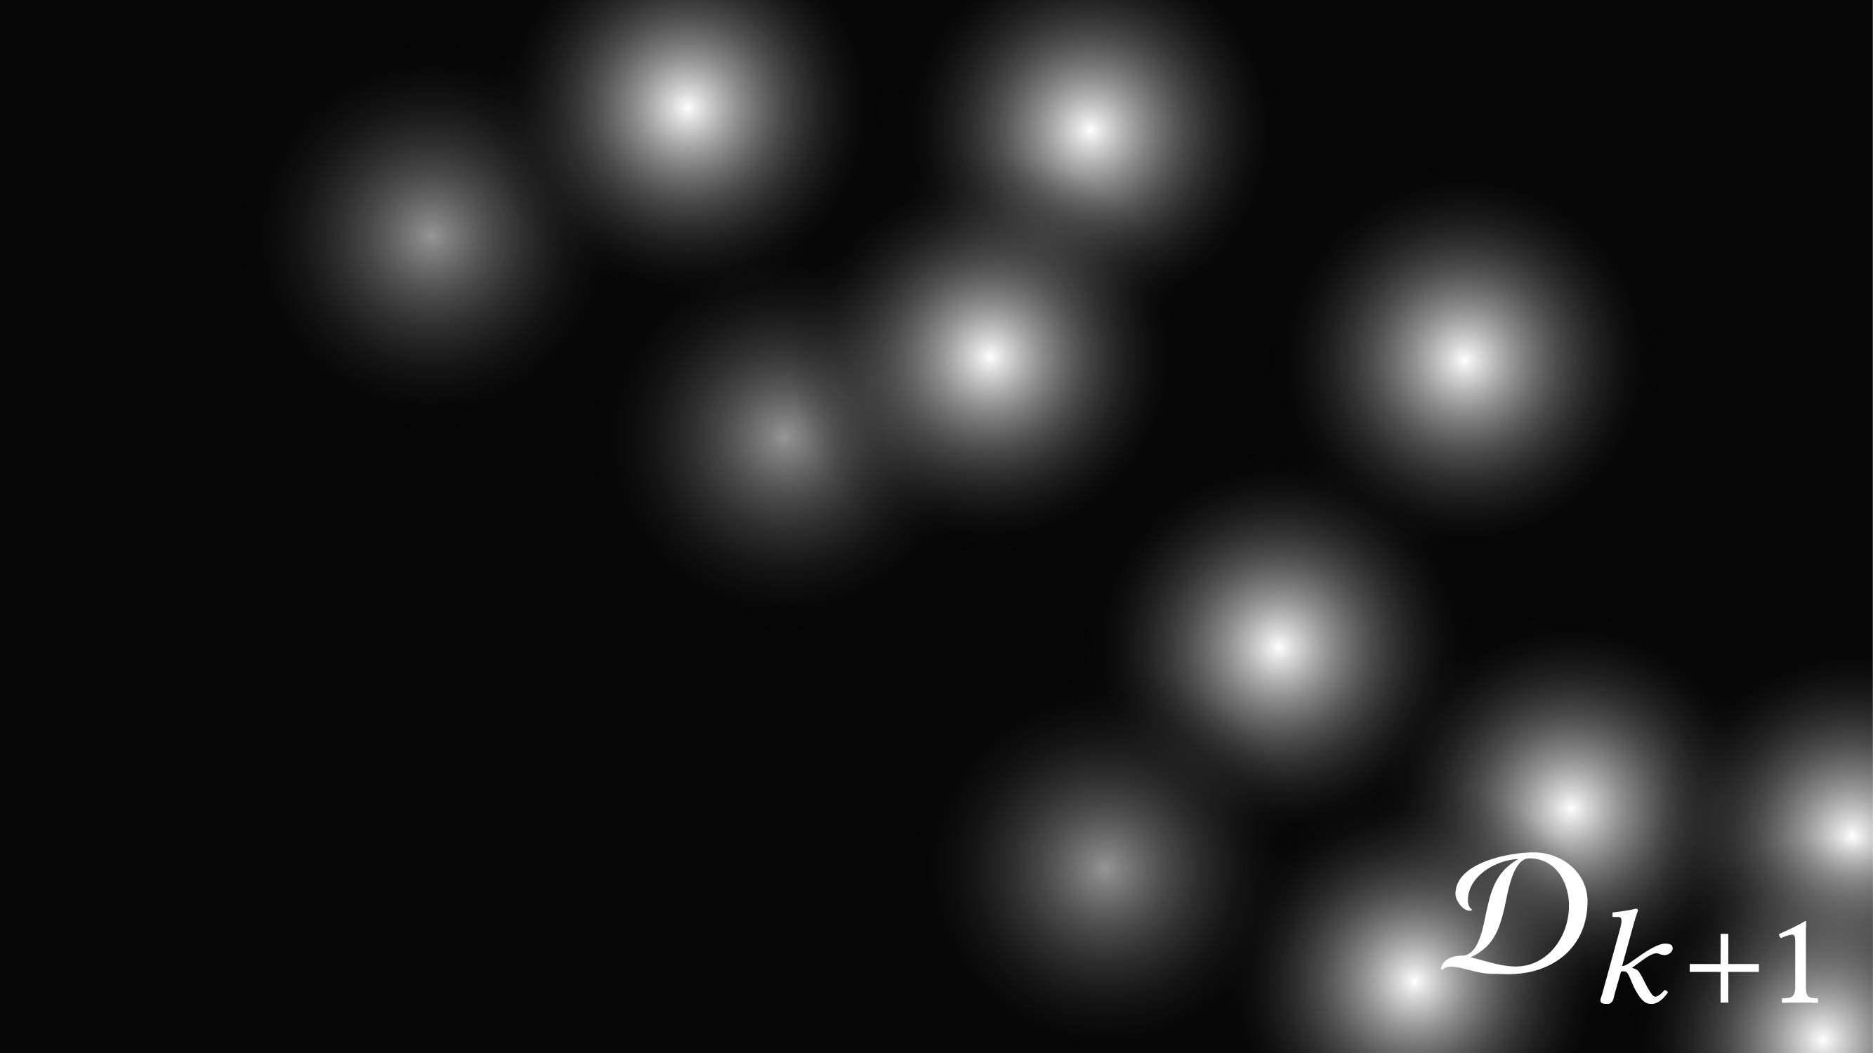
Notes:
And building a mixture of Gaussians where individual weights depend on the degree of success.

Slide 22

Notes:
All we have to do next is draw new samples from this distribution,

Slide 23
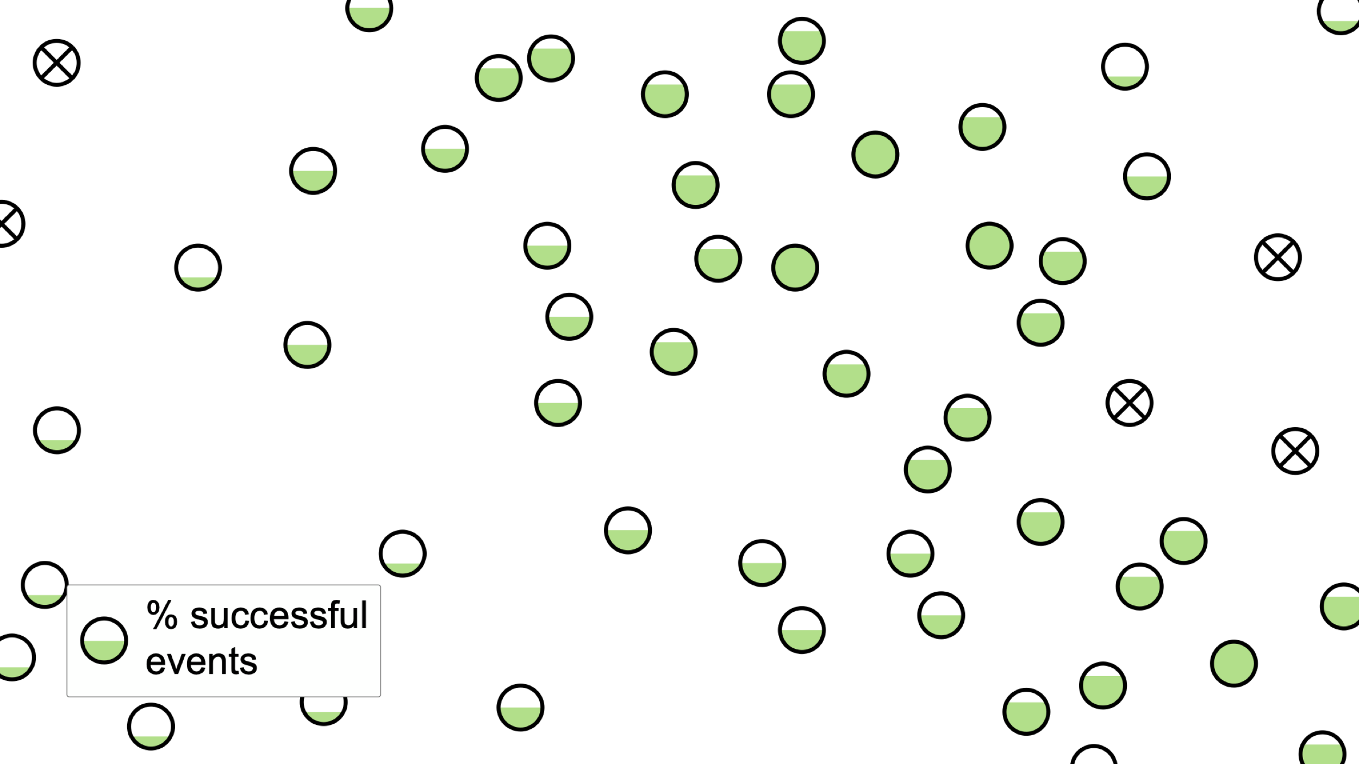
Notes:
simulate them and iterate until we have found enough full successes.

Slide 24
APPROXIMATE
Notes:
Now that we have a good enough idea of where the successful layouts are in the design space, let’s see how we approximate the success region.

Slide 25
Success
Failure
Notes:
Here’s our design space again, this time with simulated layouts. For clarity I’ve zoomed in on what looks like the biggest success region.
Our idea is to cast this problem as a binary classification task based on the position in the design space.

Slide 26
Notes:
Meaning that we’re going to compute a function f that is positive inside the success region and negative outside.
In our work we used a Support Vector Machine (or SVM), with the support vectors shown with dots here.
The reason why we use a classification model is because most models, including SVMs, rely on an underlying continuous decision function…

Slide 27
Notes:
Shown here, whose maximum in the design space is very close to the center we are looking for.
But we can do better than this! Unlike the vast majority of classification problems on fixed datasets, we can generate new samples on the fly. So we use this to improve the accuracy of the classification. So where do we want to add new samples? The most important area to consolidate is the most uncertain one,

Slide 28
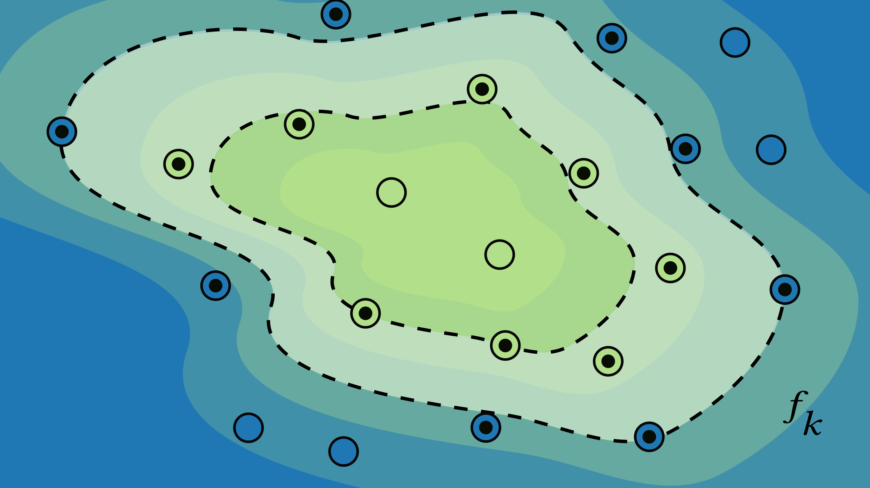
Notes:
Which in this case is around the boundary. Here whether a point is a success or failure is still uncertain. Interestingly, since we use a support vector machine, it’s pretty easy to sample around points that are known to be near the boundary, namely the support vectors!

Slide 29
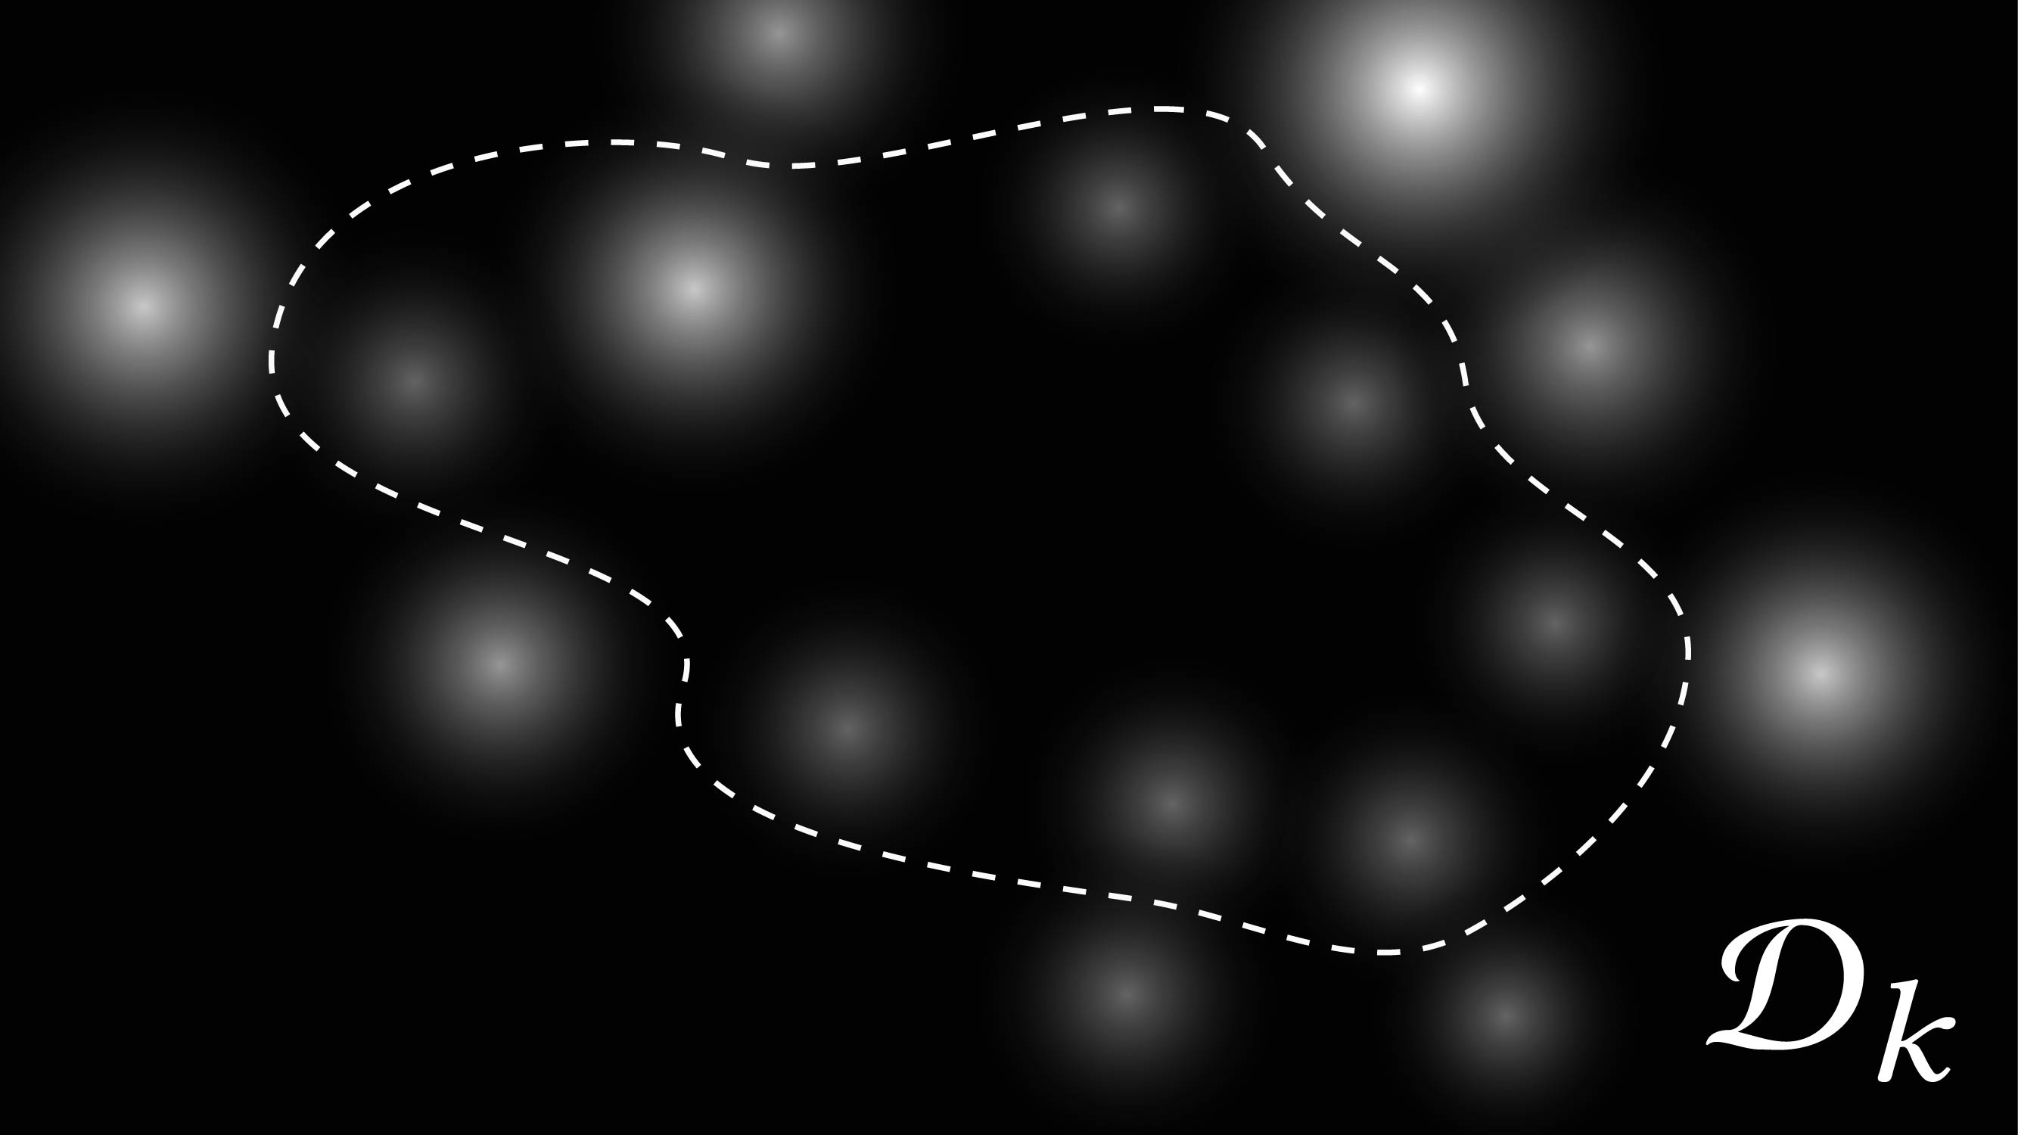
Notes:
So we use a similar approach to what we did in the search step, and compute a mixture of gaussians but using the support vectors this time. Those are farther from the boundary are more uncertain so they are more heavily weighted and their radius is larger.

Slide 30
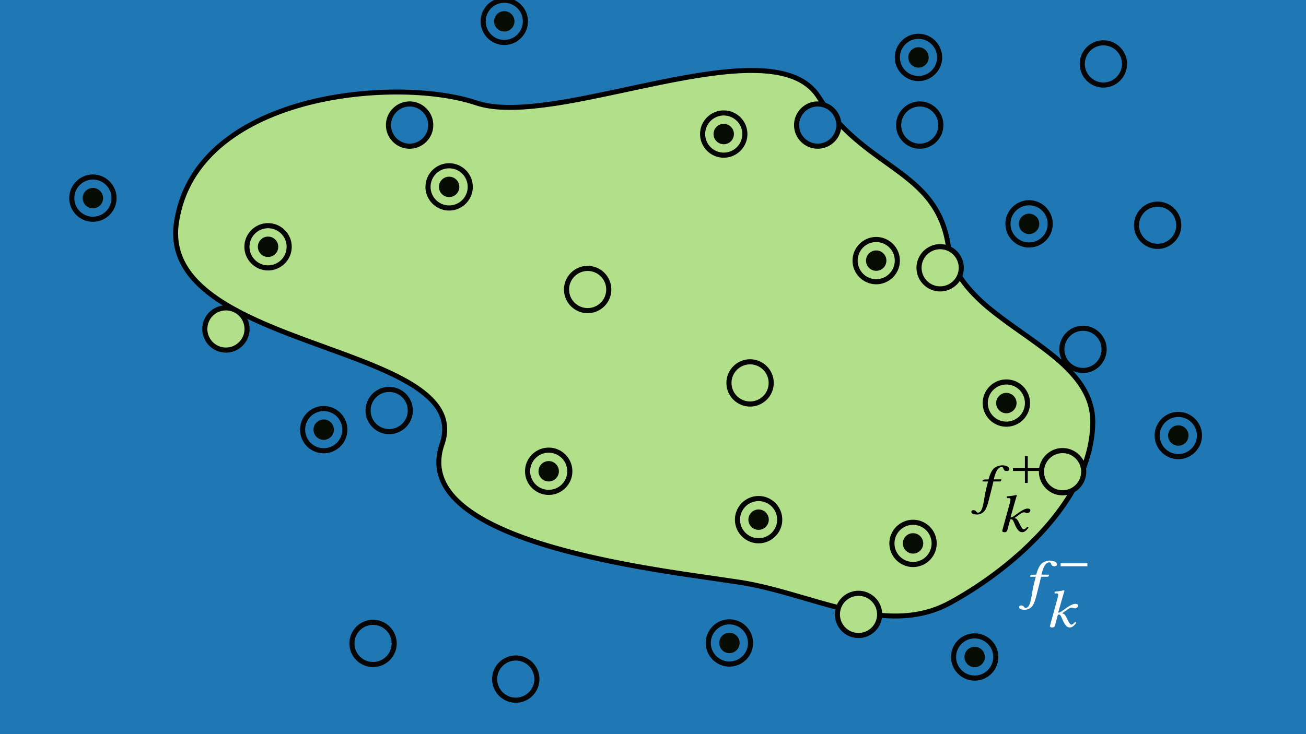
Notes:
If we sample new points using this distribution, we can see that the boundary was indeed a bit wrong in some places!

Slide 31
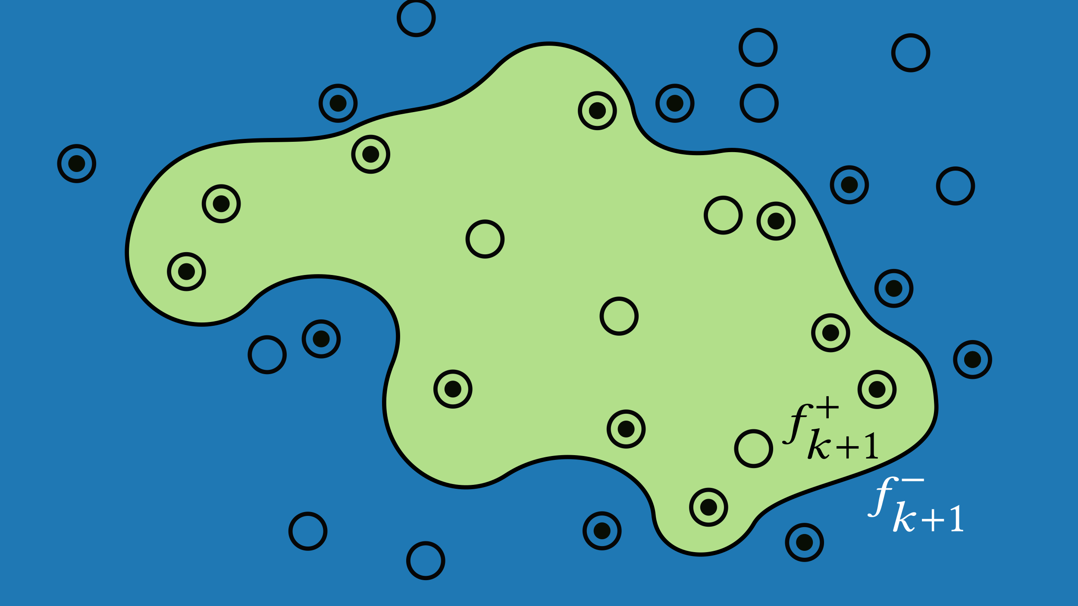
Notes:
And can be improved by training an SVM on this new dataset. For those familiar, this type of approach is known as active learning. We repeat the active learning cycle until we reach a given cross validation accuracy on the training set.
Now while this approximation method works well, we haven’t really taken advantage of the specificity of our problem, and notably the causal graph structure.

Slide 32



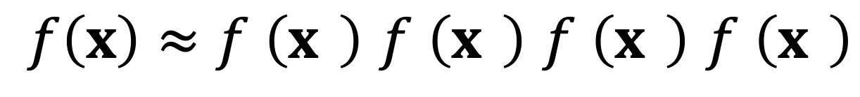



Scaling Up
$$x_{1}$$
$$x_{2}$$
$$x_{3}$$
$$x_{4}$$
$$x_{5}$$
$$x_{6}$$
$f\left(x\right)≈f′\left(x^{′}\right)$ $f′\left(x^{′}\right)$ $f′\left(x^{′}\right)$ $f′\left(x^{′}\right)$
Lower-dimensional
Notes:
We can in fact, make this approach scale to a high number of dimensions by factorizing the decision function into event-specific components that depend on lower dimensional layout vectors.
This mapping is determined by computing correlations between layout parameter values and the success of an individual event given it’s parent’s success.
In the interest of time however, I won’t say too much here so please refer to the paper for details.

Slide 33
Results
QUALITATIVE

Slide 34
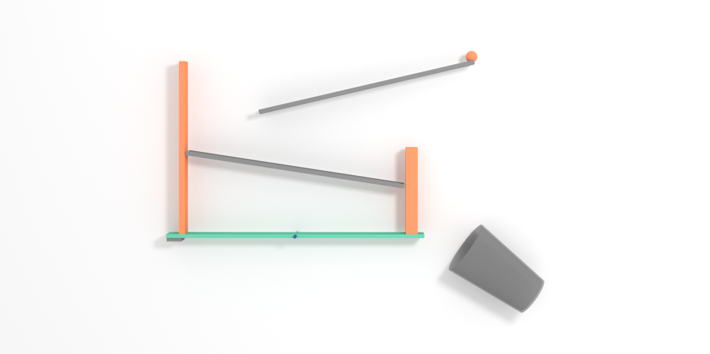
Ball Run

Slide 35

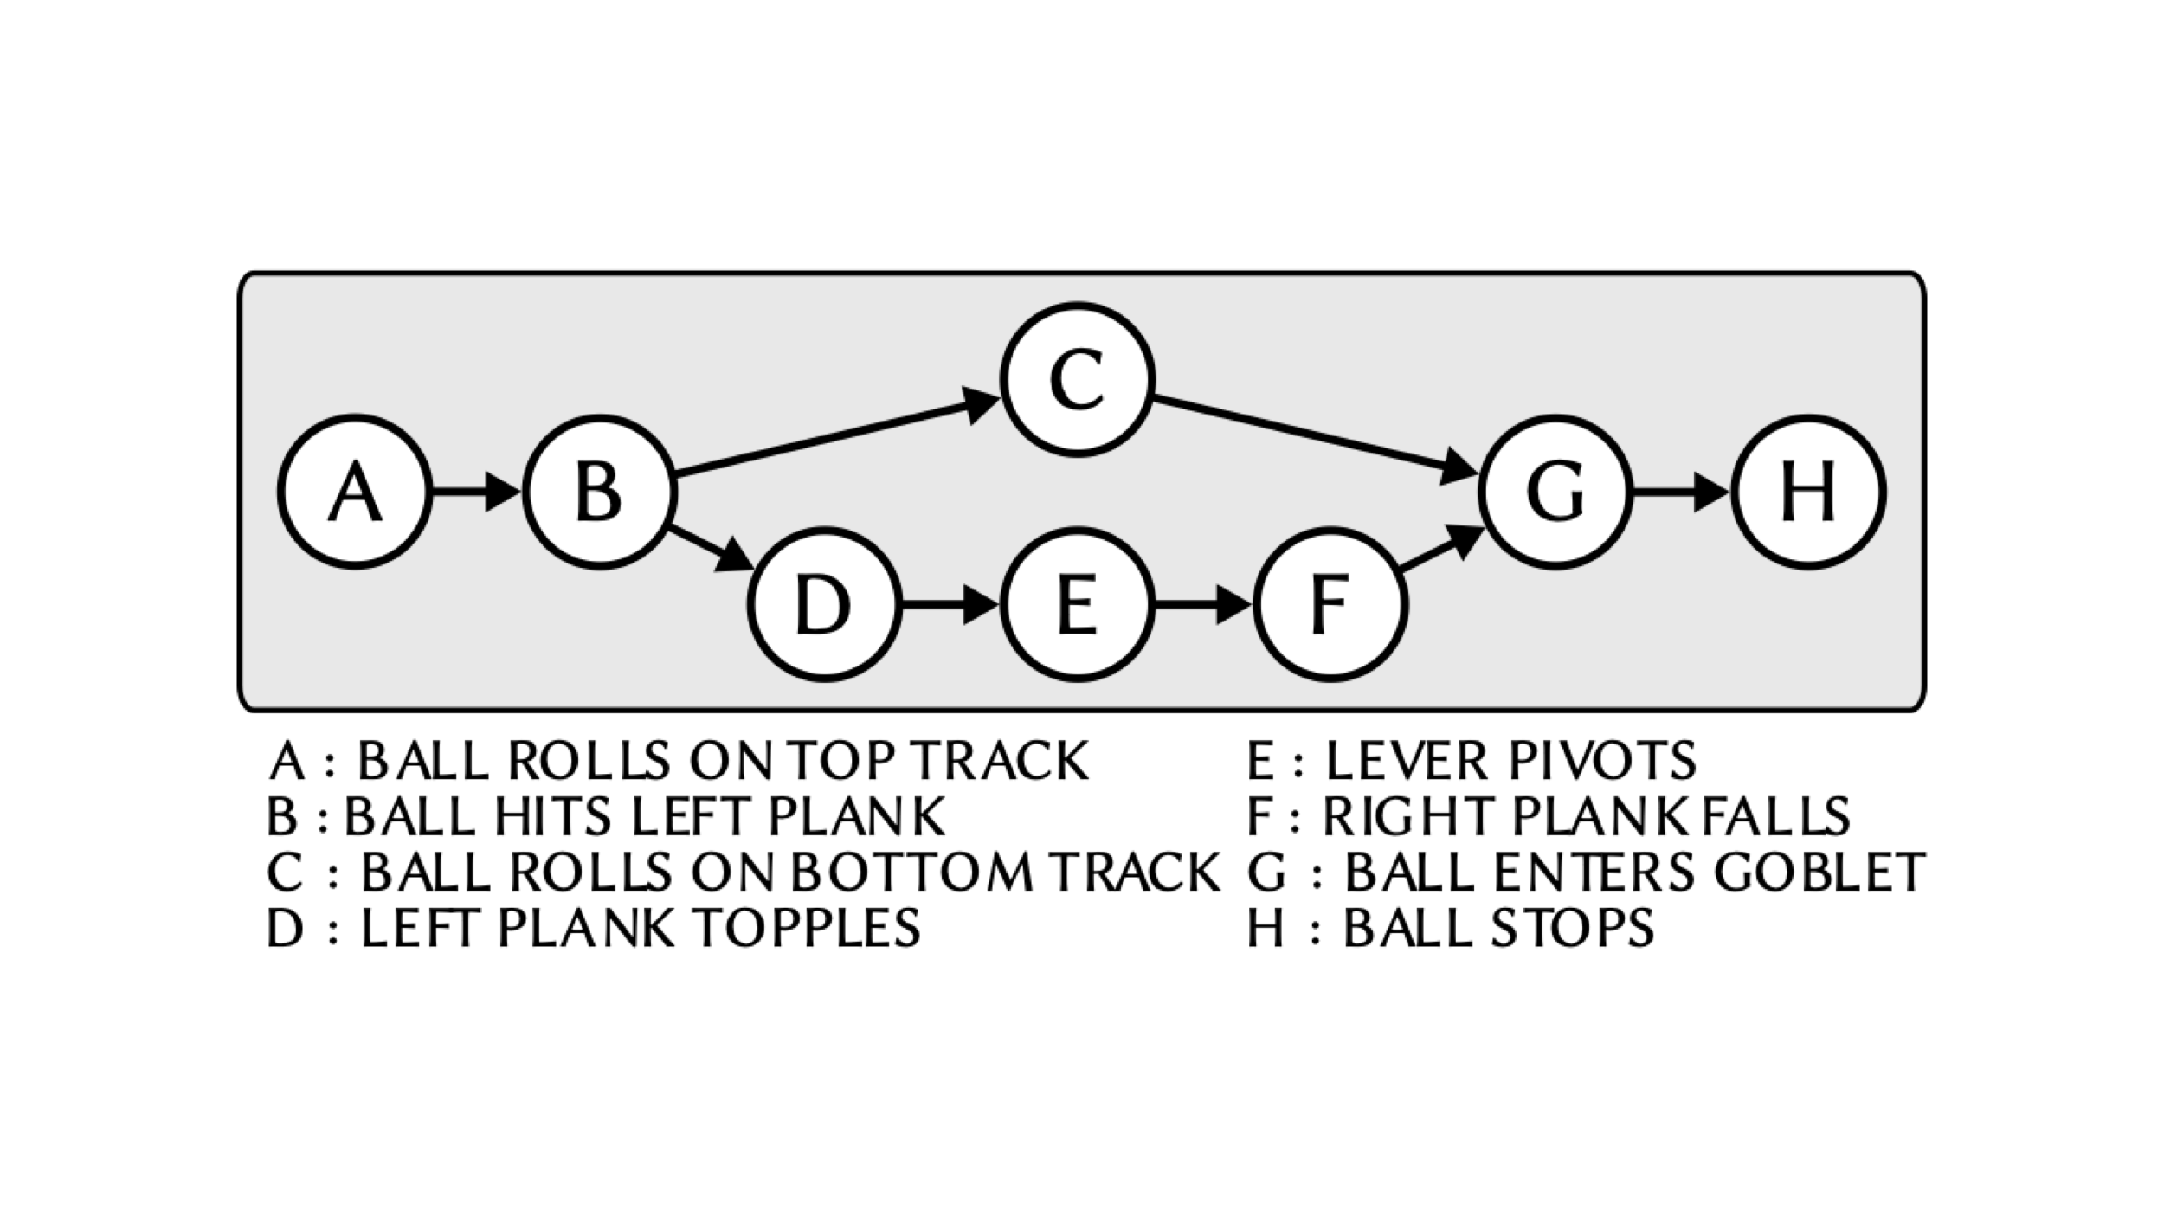
Ball Run
8 design parameters
8 events

Slide 36
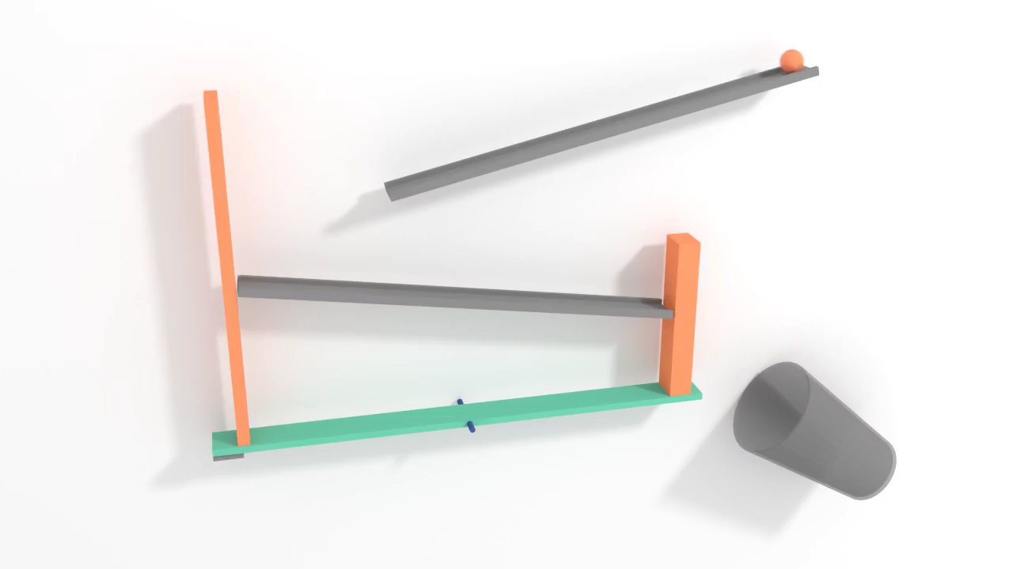

Slide 37
Ball Run

Slide 38
Ball Run

Slide 39
Ball Run

Slide 40
Ball Run

Slide 41
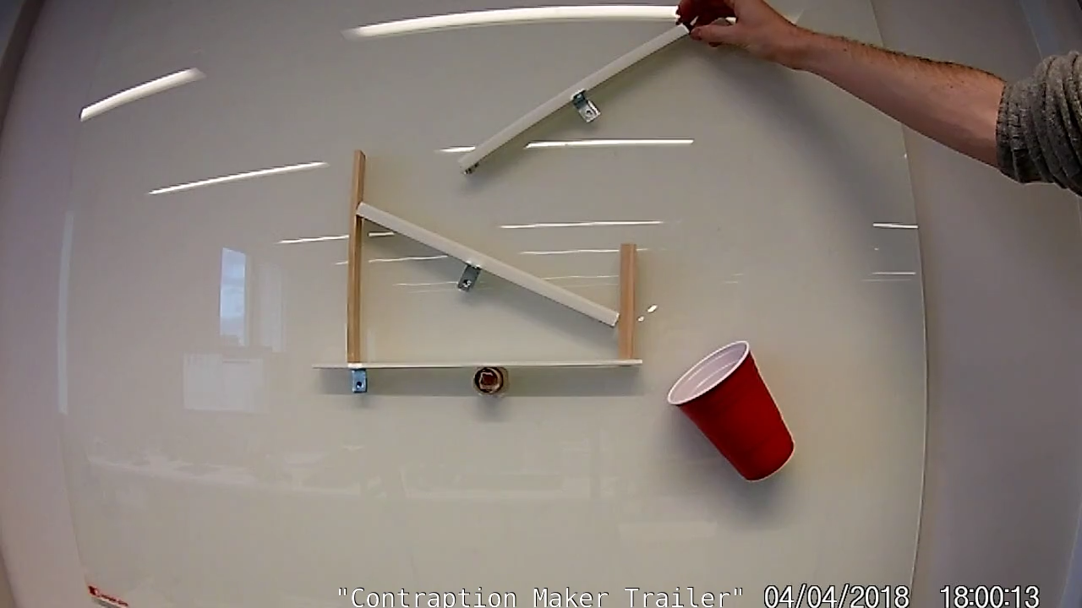

Slide 43
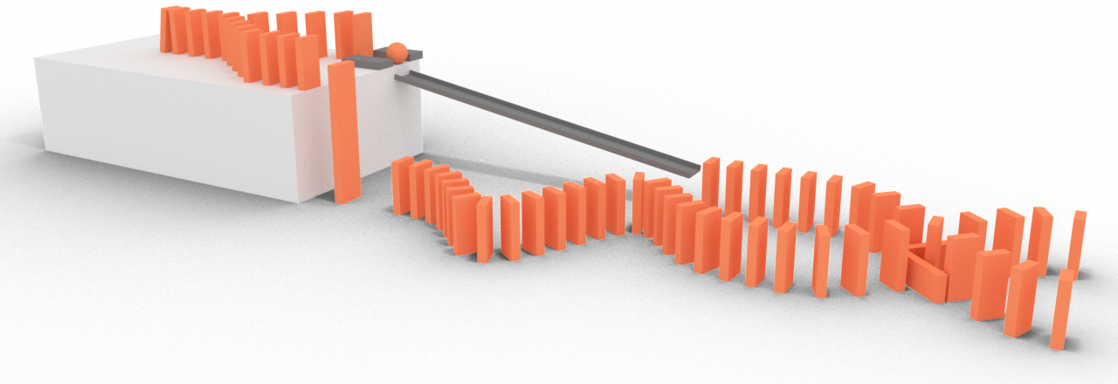
Causality Switch

Slide 44
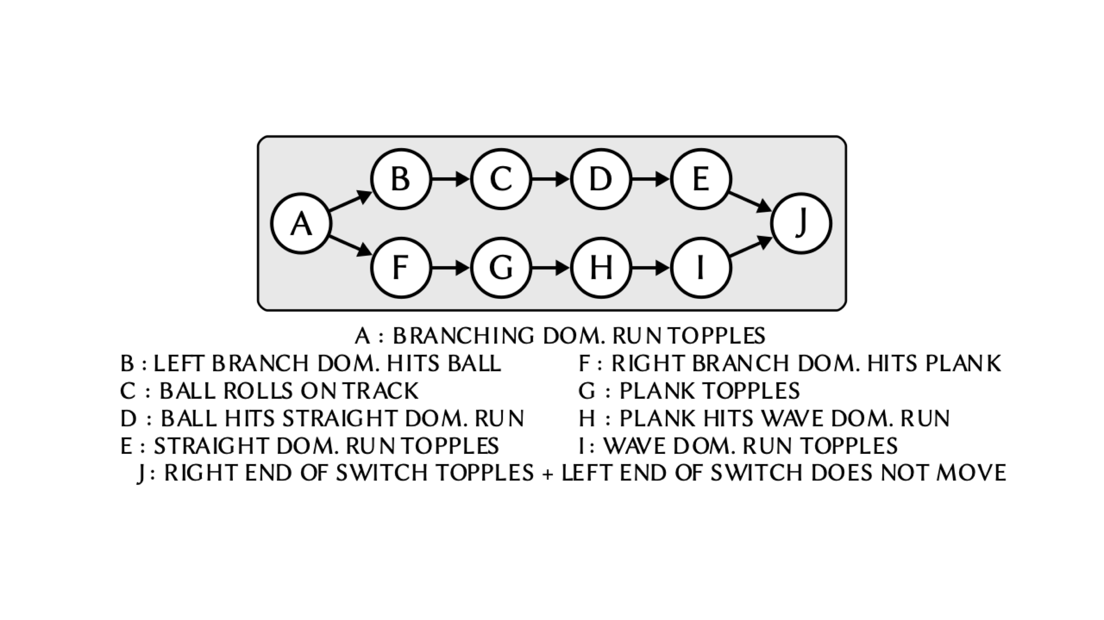

Causality Switch
4 design parameters
10 events

Slide 45
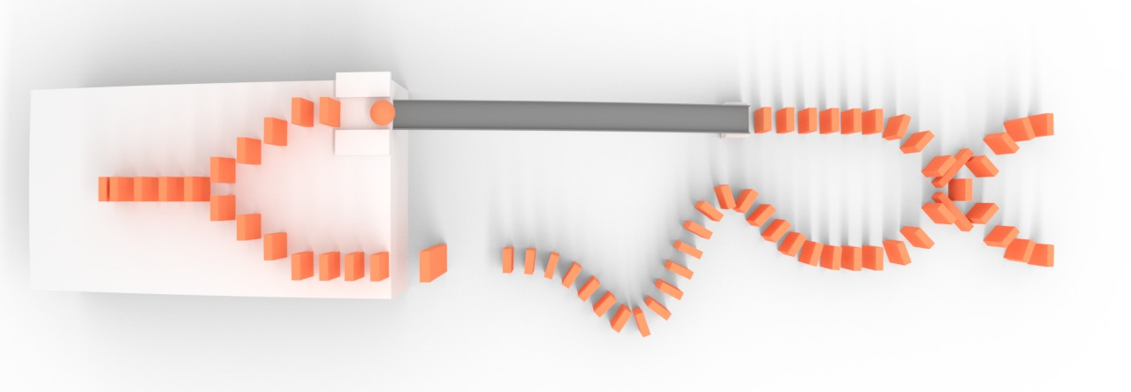
Causality Switch
2 possible
outcomes
Ball run side
Domino run side

Slide 46
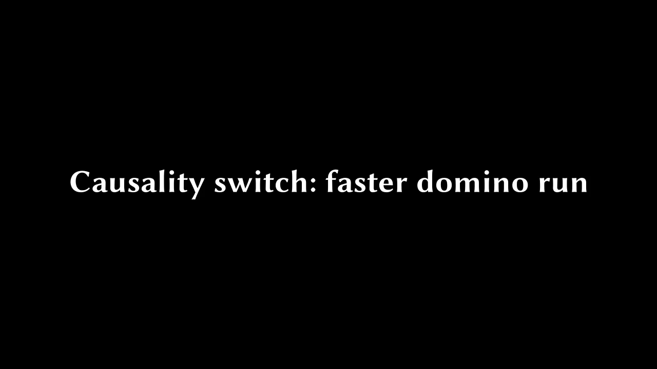

Slide 47
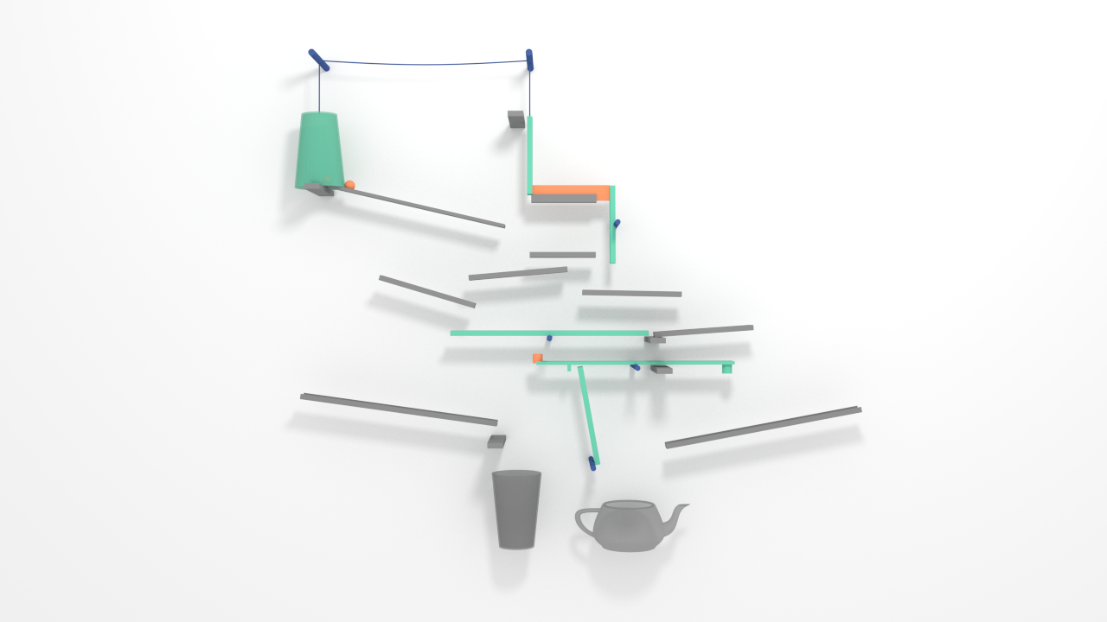
Teapot Adventure

Slide 48

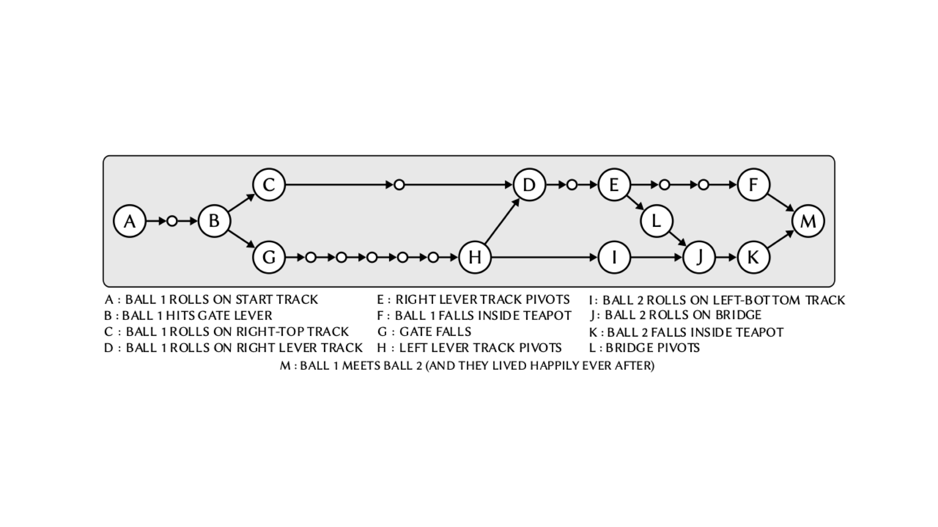
Teapot Adventure
16 design parameters
23 events

Slide 49
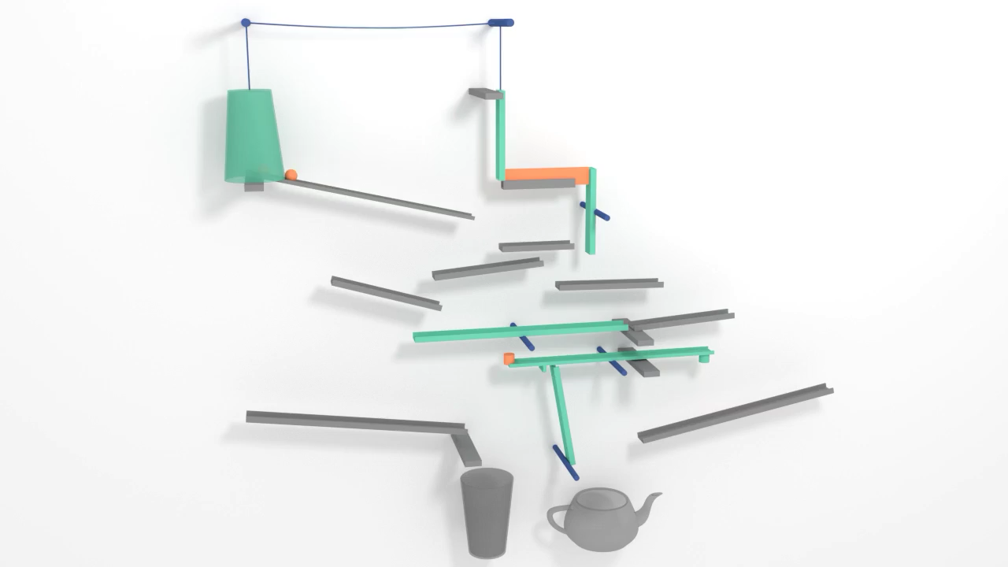

Slide 50
Teapot Adventure
2 balls

Slide 51
Teapot Adventure

Slide 52
Teapot Adventure

Slide 53
Teapot Adventure

Slide 55
Results
QUANTITATIVE
Notes:
We also provide quantitative results. We compare the results obtained with out method to results obtained with alternative approaches. For comparison, we propose the following metric.

Slide 56
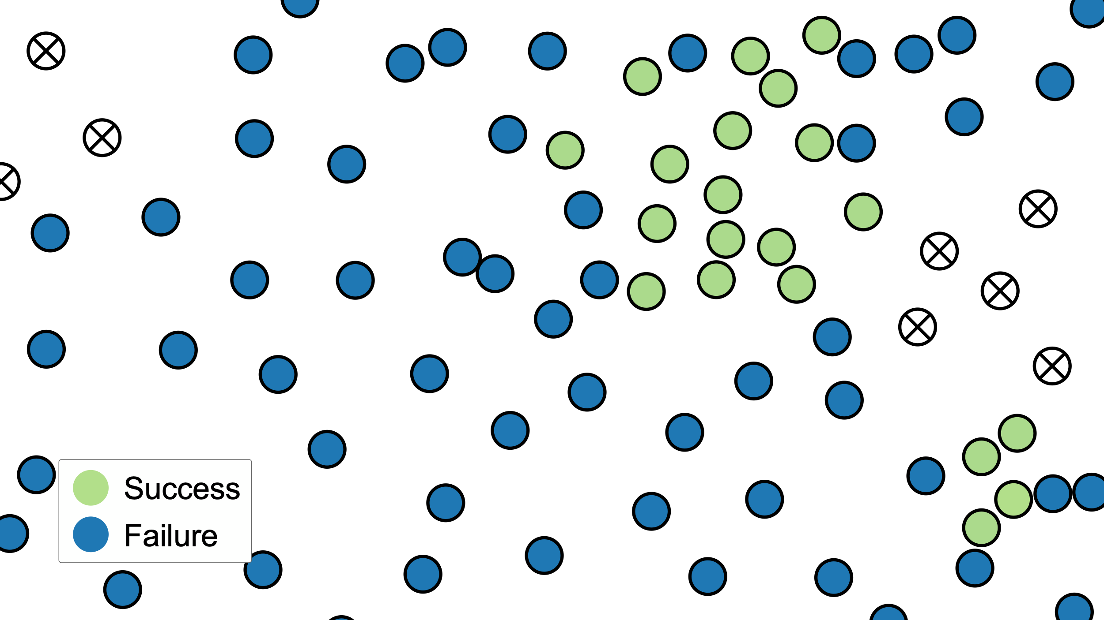
SUCCESS RATE
1.0
0.0
0.0
RADIUS
1.0
Larger area
=
more robust layout
Notes:
Let’s consider this design space with a relatively dense sampling, and let’s say that this is our solution. We define a region around this solution and compute the success rate within this region.
So here, up to this radius the success rate is 1 because all samples are successful.
But if we increase the radius, the success rate decreases.
Our idea is that the most robust solution is the one for which the area under the curve is the largest.

Slide 57

Robustness
SUCCESS RATE
$$d=4$$
BASELINES
B1
B2 :
B3
RADIUS
Notes:
So here’s an example of such plot for a relatively simple contraption with 4 design parameters. We compare it against the solutions of three baselines.

Slide 58
Robustness
SUCCESS RATE
$$d=4$$
BASELINES
B1 Success based
B1 random search
B2 :
B3
RADIUS
Notes:
In baseline 1, we randomly sample the space until we find a single success.

Slide 59
Robustness
SUCCESS RATE
$$d=4$$
BASELINES
B1 Success based
B1 random search
B2 Robustness based
B2 random search
B3
RADIUS
Notes:
In baseline 2, we randomly sample the space again but this time find several successes and pick the best one using the function I’ve just defined.

Slide 60
Robustness
SUCCESS RATE
$$d=4$$
BASELINES
B1 Success based
B1 random search
B2 Robustness based
B2 random search
B3 Robustness based
B3 Bayesian optimization
RADIUS
Notes:
In baseline 3, we perform a Bayesian Gaussian Process Optimization using this function again.
As we can see, our method overperforms the baselines, not only in this case

Slide 61



Robustness
SUCCESS RATE
$$d=4$$
BASELINES
B1 Success based
B1 random search
B2 Robustness based
B2 random search
B3 Robustness based
B3 Bayesian optimization
$$d=8$$
$$d=11$$
$$d=16$$
RADIUS
Notes:
But across all examples presented in this work.

Slide 62
Future Work
Applications: generalize by extending causal graph rules
Audience: automatically generate contraptions from intuitive input
Notes:
While these are good results, this is only a first work in this direction. First, while we have only demonstrated our results on RGMs, we believe that they could be generalized to more useful examples, notably by extending the causal graph rules such as ”if the ball falls, do this otherwise do that”.
Moreover, since these contraptions require a certain level of expertise to invent we are working on a way automatically synthesize them from a more intuitive input.

Slide 63

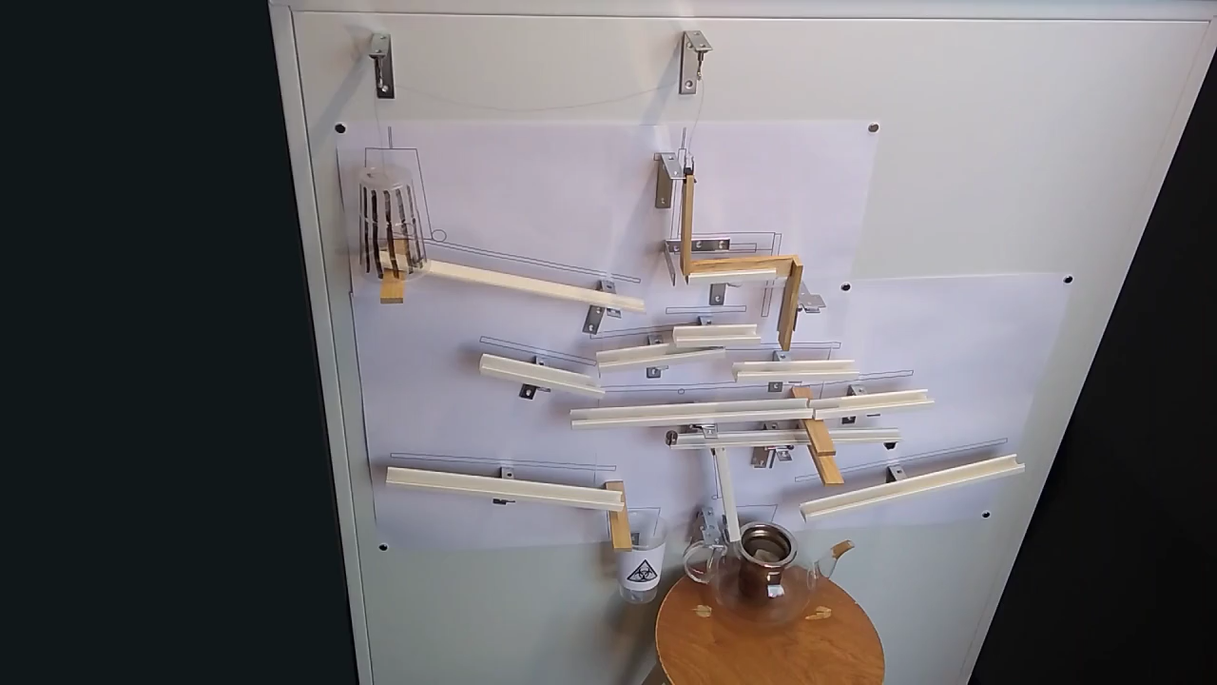
Conclusion
Key points
  Problem is difficult because of errors and synchronization
  We approximate the most robust solution with sampling
  The causal graph is leveraged for efficiency (factorization)
Supplementary material (including code):
geometry.cs.ucl.ac.uk/projects/2019/causal-graphs/

Slide 64
BONUS

Slide 65
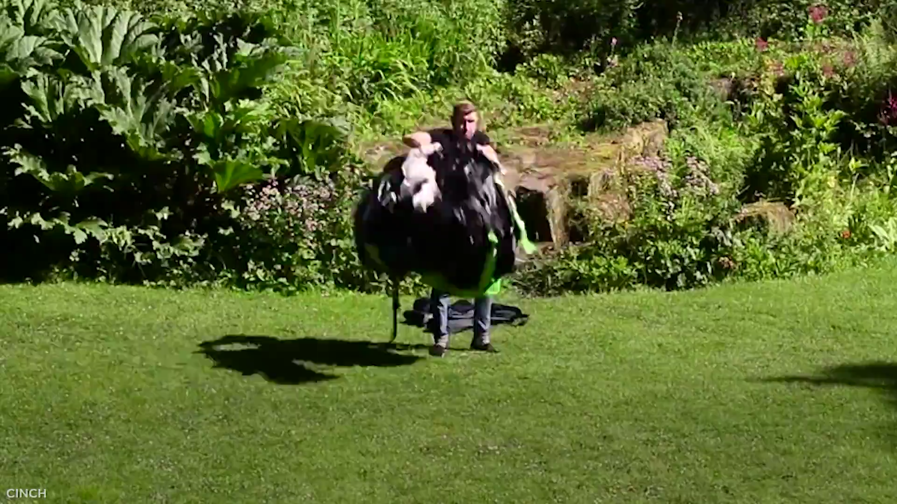

Other Applications
Pop-up tents
Ejection seats

Slide 66
GUI

Slide 67
Related Work: Sampling Techniques
Importance sampling
  Our goal: find successful samples to approximate a probability distribution, not an integral
  We have no prior knowledge to guide the sampling
Markov Chain Monte Carlo
  We use the top N samples and not the latest N
  There is no “rejection” (in the MH sense): all valid points kept (although not all are used in the next step)
Subset simulation (Rare Event Sampling):
  Similar to our Factorization: “intermediate levels” are given by the causal graph
  But we use Query Synthesis instead of MCMC to evaluate conditional probabilities.

Slide 68
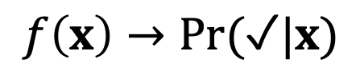
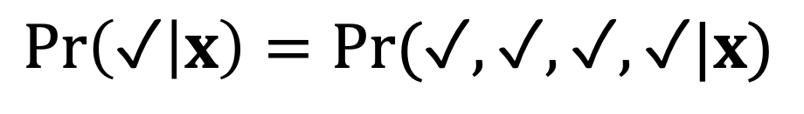
Factorization
$$f\left(x\right)→Pr⁡(✓|x)$$
$$x_{1}$$
$$x_{2}$$
$$x_{3}$$
$$x_{4}$$
$$x_{5}$$
$$x_{6}$$
$$\operatorname{Pr}\left(✓ | x\right)=Pr⁡(✓,✓,✓,✓|x)$$
$\operatorname{Pr}\left(✓ | x\right)=\operatorname{Pr}\left(✓ | x\right)Pr⁡(✓|✓,x)$ $Pr⁡(✓|✓,x)$ $Pr⁡(✓|✓,✓,x)$
$\operatorname{Pr}\left(✓ | x\right)≈\operatorname{Pr}\left(✓ | x^{′}\right)Pr⁡(✓|✓,x′)$ $Pr⁡(✓|✓,x′)$ $Pr⁡(✓|✓,✓,x′)$
Notes:
So our goal here is to go from a single function defined over the entire design space to several smaller functions defined over subspaces. I’ve been voluntarily vague about the decision function, but now I’m going to consider that modulo some mapping, it is equivalent to a probability of success conditioned on the layout parameters.
Consider an abstract causal graph, shown here, with four events and two converging branches. The probability of success of my contraption can be written in terms of the success of the individual events.
Now what’s interesting is that the directed acyclic structure of the causal graph allows us to write the following factorization.
But now we have four probabilities instead of one, and they are still conditioned on all layout parameters. Our idea is that each of these conditional probabilities only depends on a subset of these design parameters, and we can compute these correlations using the samples from the initial Search step. So after we’ve mapped these probabilities to their respective subspaces, we apply to each of them the approximation step that I’ve just described.

Slide 69
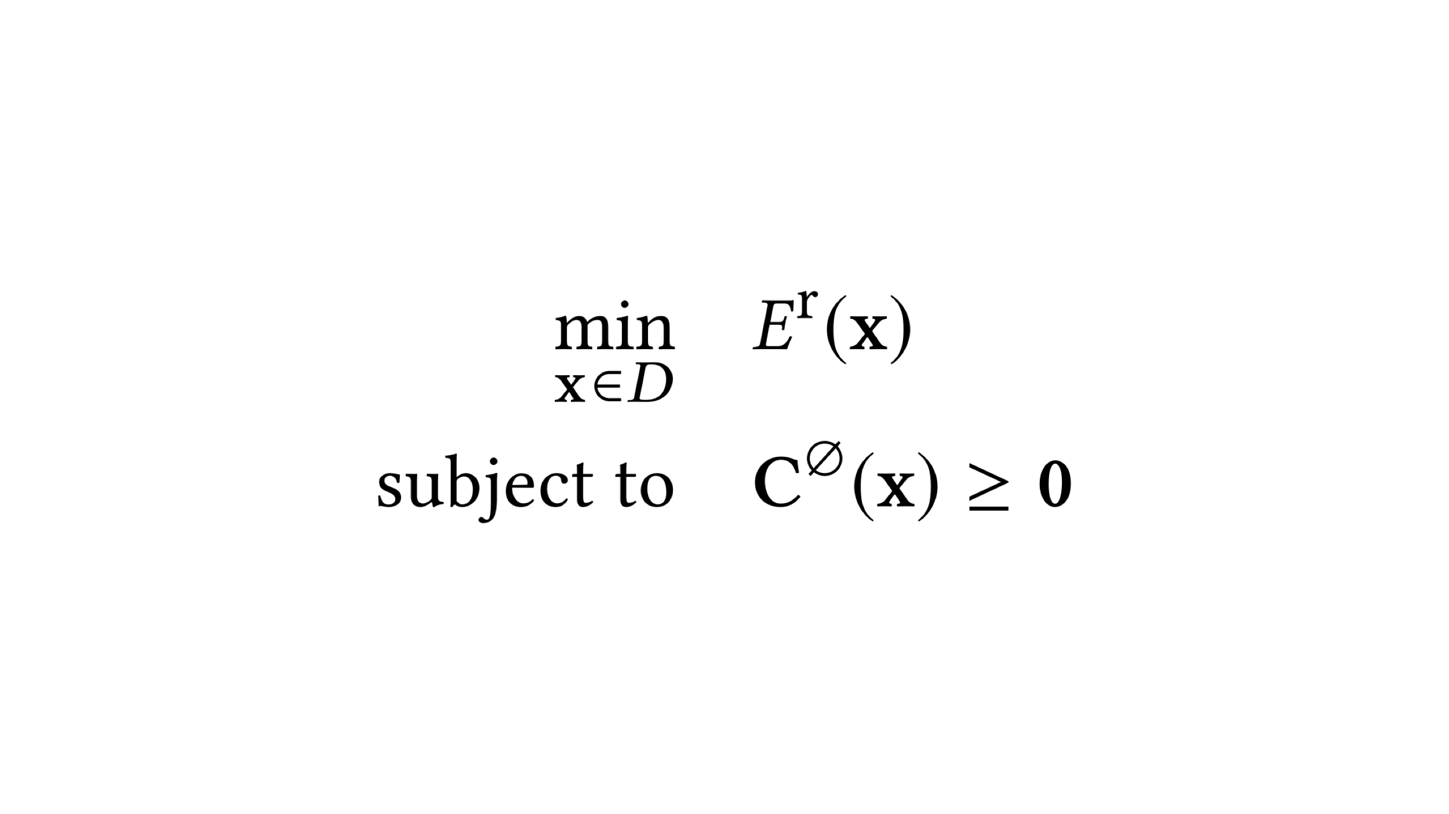
Optimization
Energy based on robustness components
Physical validity constraints

Slide 70
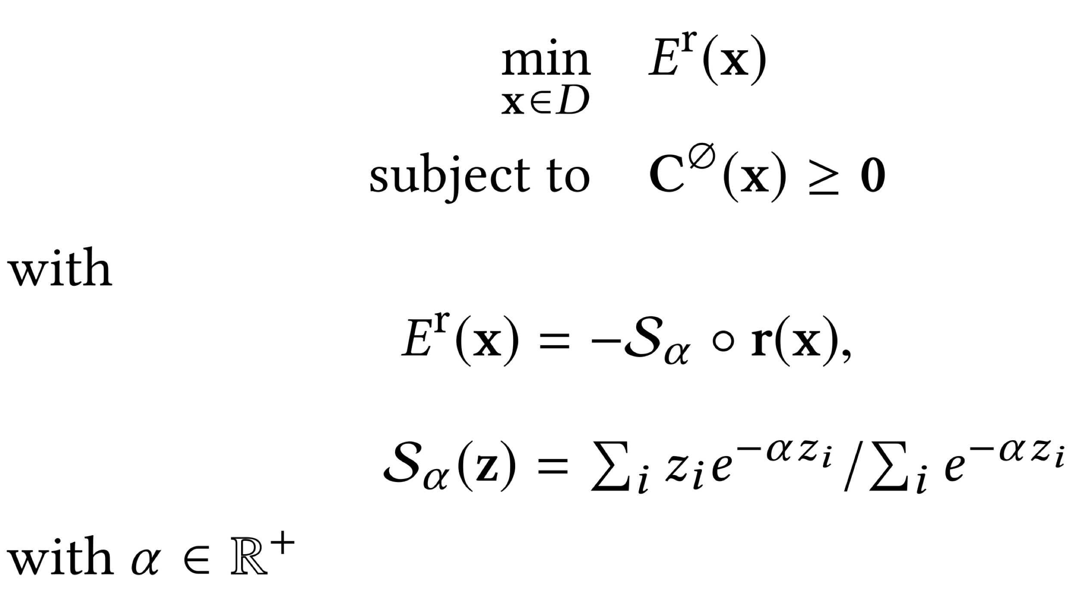
Optimization
Smooth minimum of robustness components

Slide 71
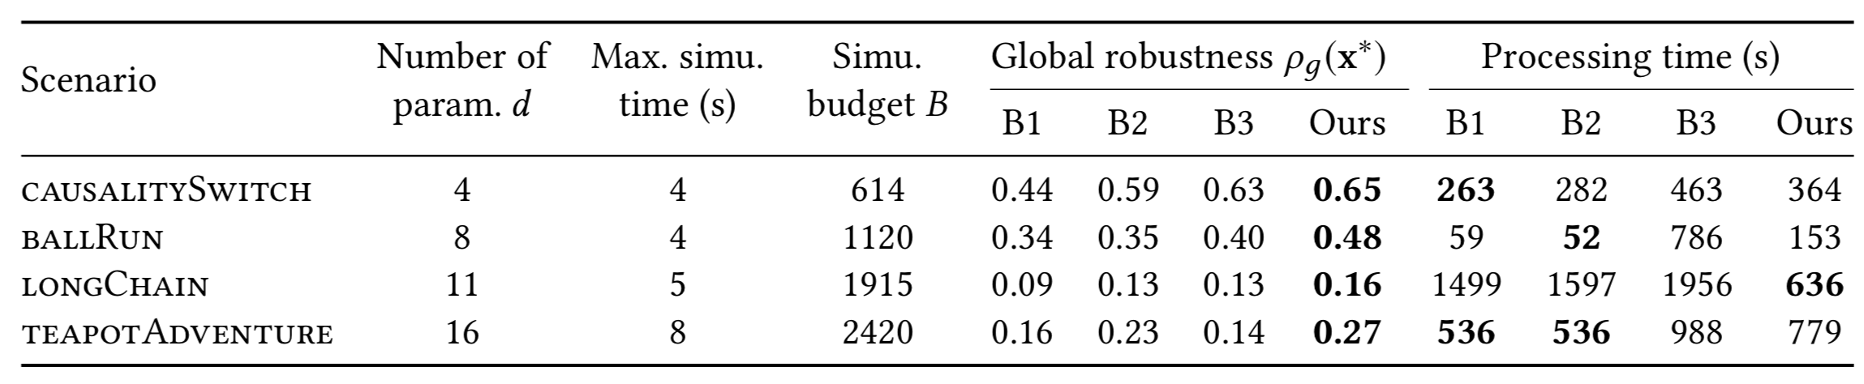
TIMING
CausalitySwitch and BallRun worked in real-life at first try.
LongChain and TeapotAdventur worked after 4-5 trials.

